Slide 1
Specialty Clinic Billing Excellence
Specialty clinics face unique billing challenges with complex procedures and specific documentation requirements. Small errors lead to costly delays or denials.
Let's explore strategies to maximize reimbursement and maintain steady revenue flow.
kW
by Kimberly Wiethoff

Slide 2
The Specialty Billing Challenge
Complex Procedures
Specialty billing involves intricate coding systems unique to each field.
Multiple Modifiers
Claims often require special codes that adjust standard procedure descriptions.
Documentation Requirements
Each payer has specific documentation needs for specialty services.
Revenue Impact
Errors lead to delayed payments, affecting cash flow and operations.

Slide 3
Specialty-Trained Billing Professionals
Specialty Expertise
Certification Matters
Hire billers who understand CPT codes for your specific field. They'll recognize nuanced differences between similar procedures.
Look for certified professionals with credentials like CPC or COC. These certifications prove coding competency in medical specialties.
Reduced Errors
Specialists catch common mistakes before submission. This leads to fewer denials and faster reimbursement.

Slide 4
Documentation Templates & Checklists
Faster Coding
Templates speed up the documentation process
Fewer Omissions
Checklists ensure all required elements are included
Consistent Documentation
Standardized formats create uniformity across all providers
Complete Records
Templates capture duration, symptoms, labs, and medical necessity
Specialty-specific documentation templates dramatically reduce claim delays caused by inconsistent or missing information.

Slide 5
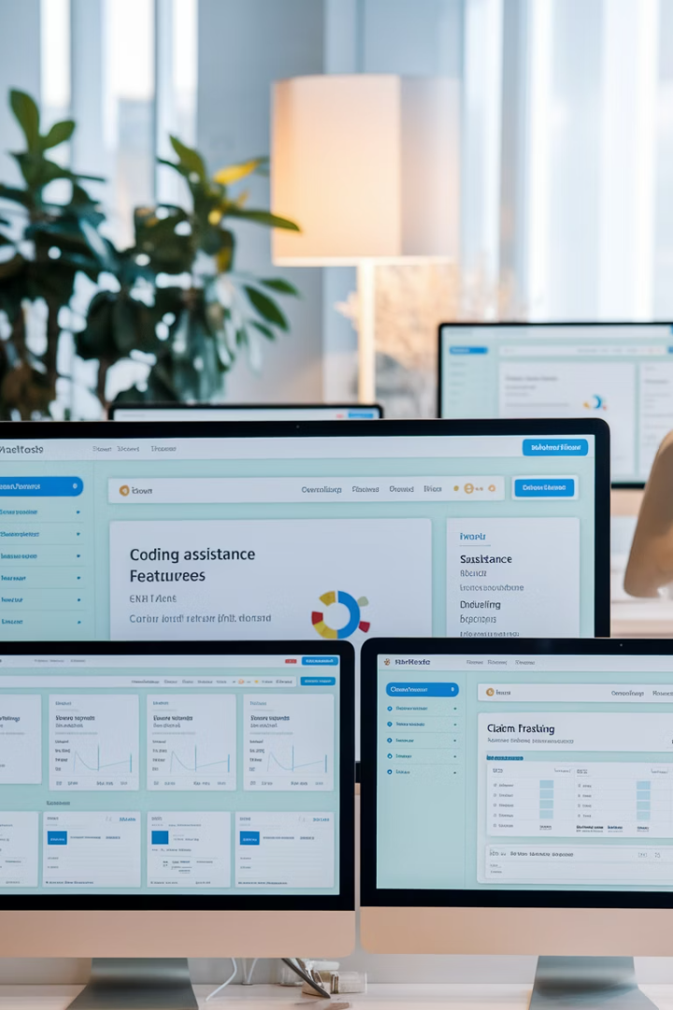
Specialty Billing Software
Modifier Assistance
Smart systems suggest appropriate modifiers based on procedure codes and documentation context.
Automated Code Suggestions
AI-powered tools recommend the most appropriate codes for documented procedures and diagnoses.
Authorization Tracking
Integrated systems monitor prior authorizations and alert staff when they're missing or expiring.
Specialty Templates
Custom claim templates designed for specific specialties streamline the billing process.

Slide 6
Real-Time Eligibility Verification
Pre-Appointment
Verify coverage before patient arrives
Check-In
Confirm benefits and collect patient responsibility
Service Documentation
Note coverage limitations for specific procedures
Claim Submission
Include verified insurance details with claim
Real-time eligibility checks catch inactive coverage or unmet deductibles before they affect reimbursement.

Slide 7
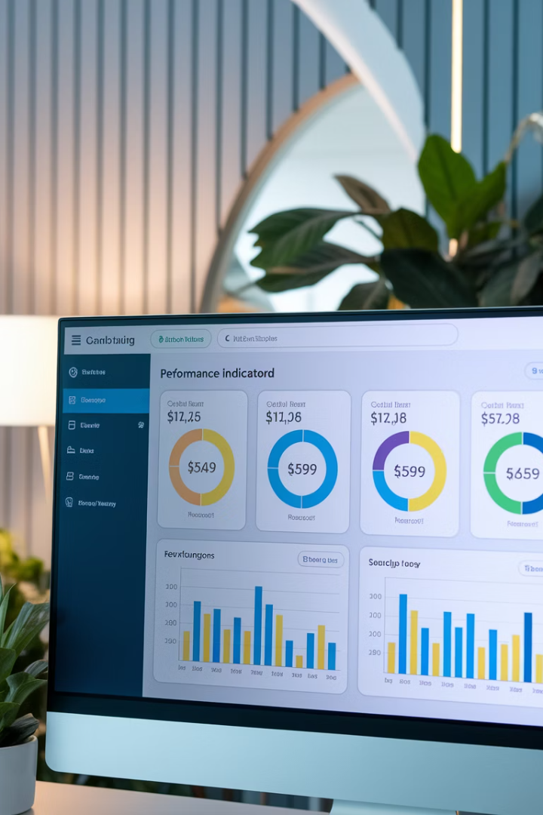
Key Performance Metrics
95%+
Clean Claim Rate
Percentage of claims accepted on first submission without errors
<5%
Denial Rate
Percentage of claims rejected by payers
<30
Days in A/R
Average time from service to payment receipt
90%+
First-Pass Resolution
Claims paid without additional work or appeals
Weekly monitoring of these metrics helps identify whether delays stem from front-end processes, coding errors, or payer issues.

Slide 8
Staff Education & Training
Clinical Staff
Front Office
Procedure documentation and supplies recording
Insurance verification and patient collections
Providers
Billing Team
Documentation requirements and medical necessity criteria
Specialty coding updates and payer requirement changes
Regular training for all staff reduces bottlenecks and significantly boosts claim success rates.

Slide 9
Claim Scrubbing & Validation
Automated Pre-Checks
Use software to verify claims against payer-specific rules before submission. This catches common errors automatically.
Expert Review
Have specialty-trained coders review complex claims. They spot nuanced issues that automated systems might miss.
Batch Analysis
Analyze patterns in claim rejections. This helps identify systemic issues in your documentation or coding practices.

Slide 10
Denial Management Strategy
Root Cause Analysis
Identify why claims are being denied
Correction Process
2
Fix errors and update documentation
Resubmission
Resend corrected claims promptly
Prevention
Implement process changes to prevent recurrence

Slide 11
Payer Communication Strategy
Designated Contacts
Regular Check-ins
Assign staff members as dedicated liaisons for each major payer. This builds relationships and expertise.
Schedule monthly calls with payer representatives. Discuss pending claims and emerging issues proactively.
Documentation Log
Policy Education
Record all communications, including representative names and reference numbers. This creates accountability.
Attend payer-provided training sessions. Stay updated on changing requirements and opportunities.

Slide 12
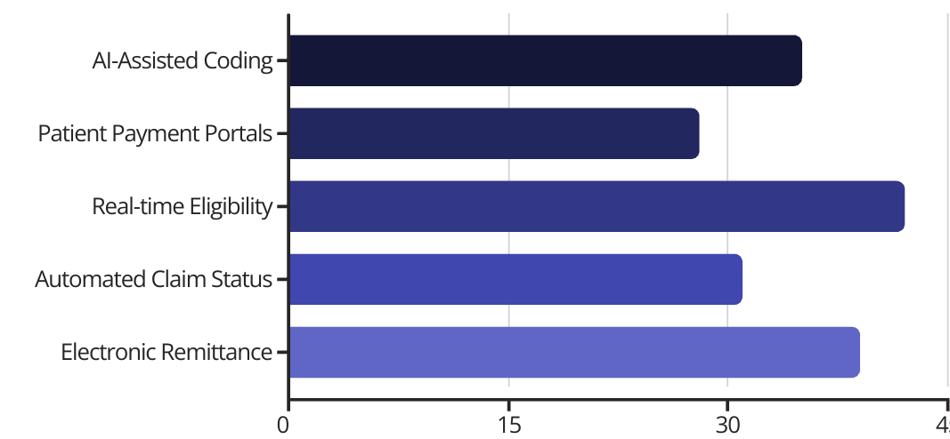
Leveraging Technology
Modern technology solutions dramatically improve billing efficiency. Choose integrated systems that address your specialty's specific requirements.

Slide 13
Your Billing Excellence Roadmap
Expert Team
Standardized Documentation
Hire specialty-trained billing professionals
Implement specialty-specific templates
Performance Monitoring
Advanced Software
Track key metrics and continuously improve
Utilize technology built for your specialty
For specialty clinics, billing isn't one-size-fits-all. By leveraging expertise, modern tools, and smarter processes, you can significantly reduce claim errors.
Enhanced billing efficiency becomes your competitive advantage in today's challenging healthcare environment.

