Slide 1
Certified Business Data Analytics (CBDA) Exam Guide
Boost your career in business analysis with the CBDA credential from the International Institute of Business Analysis (IIBA). This guide covers everything you need to know to prepare and pass on your first attempt.
kW
by Kimberly Wiethoff

Slide 2
What Is the CBDA Certification?
1
Credential Overview
2
Ideal For
Offered by IIBA for professionals who analyze and interpret data to support business decision-making.
Business Analysts working with data, Data Analysts, IT and BI Professionals, Product Managers, and anyone in data analytics.
3
Career Value
Validates expertise and enhances credibility in the growing field of business data analytics.

Slide 3
Exam Cost Breakdown
IIBA Members
$250 for the exam
Non-Members
$400 for the exam
Retake Fee
$195 if you need another attempt
IIBA Membership
$139 per year (optional but recommended)

Slide 4
Taking the Exam
Online Format
Time Limit
Passing Score
Take the exam from anywhere through remote proctoring via PSI Online Exams.
2 hours to complete 75 multiple-choice, scenario-based questions.
Not officially disclosed, but estimated around 70%.

Slide 5
Exam Domain: Identify Research Questions
2
Project Scope
Defining boundaries and objectives for analytics initiatives.
Business Problems
Understanding core business challenges that require data-driven solutions.
1
Research Formulation
Creating targeted questions that address specific business needs.
3
This domain represents 20% of the exam content.

Slide 6
Exam Domain: Source Data
1
Data Source Identification
Finding and evaluating internal and external data sources for analysis.
2
Governance & Security
Understanding data privacy regulations and security protocols.
3
Data Preparation
Extracting and cleaning raw data for analytical processing.
This domain represents 15% of the exam content.

Slide 7
Exam Domain: Analyze Data
Exploratory Analysis
Initial investigation to discover patterns and anomalies in datasets.
Statistical Techniques
Applying appropriate statistical methods to extract meaningful insights.
Pattern Recognition
Identifying trends, correlations, and outliers within the data.
This domain represents 16% of the exam content.

Slide 8
Exam Domain: Interpret and Report Results
Data Visualization
Creating clear, compelling visual representations of analytical findings.
Storytelling
Crafting narratives that explain data insights in business context.
Tool Utilization
Using platforms like Power BI, Tableau, and Excel to communicate results.
This domain represents 20% of the exam content.

Slide 9
Exam Domain: Influence Business Decisions
Strategic Action
1
Implementing data-driven strategies
Business Cases
2
Developing proposals based on analytics
Stakeholder Collaboration
3
Working with decision-makers
Insight Translation
4
Converting data to business value
This domain represents 19% of the exam content.

Slide 10
Exam Domain: Guide Organization Strategy
Digital Transformation
1
Analytics role in business evolution
Strategic Alignment
2
Connecting data to business goals
Data Culture
3
Building data-driven organizations
This domain represents 10% of the exam content.

Slide 11
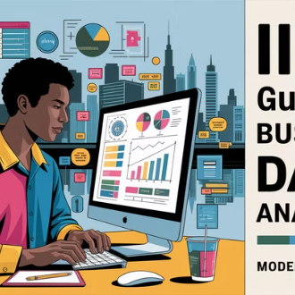
Essential Study Resources
The IIBA Guide to Business Data Analytics is your primary resource. Supplement with the exam blueprint, study groups, practice exams, and recommended books.

Slide 12
Effective Study Strategies
1
2
Training Course
Practice Questions
Take structured CBDA prep courses from Simplilearn, Adaptive US, or Udemy.
Use sample exams from IIBA, Udemy, and BA-Cube to test your knowledge.
3
4
Study Groups
Real-Life Application
Join LinkedIn, Reddit, or IIBA groups to learn from peers.
Practice with Excel, Power BI, or Tableau on actual datasets.

Slide 13
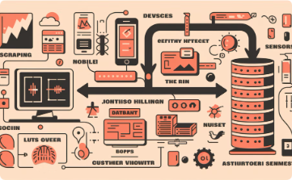
Focus Areas for Success
Identify Research Questions: 20%
Interpret and Report Results: 20%
Influence Business Decisions: 19%
Prioritize this domain as it represents one-fifth of the exam content and focuses on formulating effective analytical questions.
Dedicate equal attention to mastering data visualization and storytelling techniques for this heavily weighted domain.
Focus on understanding how analytics drive strategic actions and business cases in this significant exam aea.
Analyze Data: 16%
Source Data: 15%
Guide Organization Strategy: 10%
Develop proficiency in analytical methods and statistical techniques for this substantial exam component.
Build knowledge of data acquisition and management practices for this foundational exam domain.
While representing the smallest portion, understand how analytics shapes business evolution and strategic alignment.
Allocate your study time proportionally to these percentages for optimal CBDA exam preparation. Focus on domains with higher weights to maximize your preparation effectiveness.

Slide 14
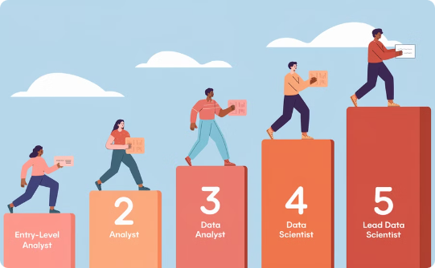
After Certification: Next Steps
Apply Your Skills
Update Credentials
Consider Advanced Certifications
Start leveraging your new knowledge in data-driven projects at work.
Add your certification to your resume and LinkedIn profile.
Explore higher credentials like CAP or Google Data Analytics Certificate.

Slide 15
Final Preparation Checklist
Review All Domains
1
Take Practice Tests
Ensure complete coverage of the six exam areas
2
Simulate exam conditions
4
Rest Before Exam
Focus on Weak Areas
3
Be mentally prepared
Address knowledge gaps
The CBDA certification is your gateway to standing out in business analysis and data analytics. With proper preparation, you'll be well-positioned to pass and advance your career.

