Slide 1
DMAIC: Breaking the Cycle of Recurring Project Problems
A structured approach for Agile project managers to permanently solve delivery challenges
#ManagingProjectsTheAgileWay #DMAIC #LeanSixSigma #ProjectManagement #ProcessImprovement #AgileDelivery
kW
by Kimberly Wiethoff
Managing Projects The Agile Way

Slide 2
The Problem: Project Groundhog Day
Every project manager has experienced it: the same issues surfacing sprint after sprint, despite your best efforts to address them.
Testing delays that push deadlines
Approval bottlenecks holding up progress
Stories consistently rolling over to next sprint
Scope creep that never truly gets contained

Slide 3
Introducing DMAIC: Beyond Agile Problem-Solving
While Agile gives us iterative improvement, it doesn't always provide the structure to solve persistent problems at their root.
Measure
Define
Gather data to understand the current state
Clearly state the problem and desired outcome
Analyze
Identify root causes of the issue
Control
Sustain the gains and prevent regression
Improve
Design and implement solutions

Slide 4
When to Use DMAIC in Agile Environments
DMAIC is your go-to approach when you hear these recurring statements:
Recurring blockers
"We never finish all the stories we commit to."
Quality issues
"Testing is always the bottleneck."
"Stakeholder feedback comes too late."
Communication breakdowns
"We're constantly reworking the same feature."
Hand-off failures
These aren't one-off issues. They're patterns that need systematic resolution.
Resource constraints

Slide 5
Step 1: Define
Key Activities:
Clearly articulate the recurring issue
Identify all relevant stakeholders
Establish project boundaries
Define what success looks like
Example: "Our team consistently carries over 40% of stories into the next sprint, impacting delivery timelines and team morale."
Clarity is key—vague problems yield vague solutions.

Slide 6
Step 2: Measure
Gather Quantitative Data
Collect Qualitative Data
Establish Baseline
Sprint velocity trends
Team surveys
Document current performance
Defect counts
Retrospective themes
Identify patterns and trends
Cycle time metrics
Stakeholder interviews
Create visualization of data
Story point completion rates
Process observations
Set measurable improvement targets
Data removes assumptions and shows whether the issue is systemic or situational.

Slide 7
Step 3: Analyze
Use proven analytical techniques to identify true root causes, not just symptoms:
5 Whys - Ask "why" repeatedly to drill down to fundamental causes
Fishbone (Ishikawa) diagrams - Map potential causes across categories
Pareto charts - Identify the vital few causes creating the majority of issues
Value Stream Mapping - Visualize waste in the process flow
Example: "Why are stories rolling over?" → "They're too big." → "Why?" → "Unclear requirements." → "Why?" → "Insufficient backlog refinement."

Slide 8
Step 4: Improve
1
Brainstorm Solutions
Generate multiple potential improvements based on root cause analysis
2
Prioritize Interventions
Select high-impact, low-effort solutions first
3
Pilot Changes
Test improvements in a controlled environment
4
Evaluate Results
Measure effectiveness against baseline data
5
Refine Approach
Adjust solutions based on feedback and results
Start small and iterate. Improvement doesn't need to be complex—it just needs to stick.

Slide 9
Step 5: Control
Sustain your improvements by:
Creating new process documentation
Adding checklist items to ceremonies
Establishing ongoing monitoring metrics
Updating team training materials
Building verification into retrospectives
Control is about building stability so the issue doesn't resurface when pressure mounts.
Monitor key performance indicators over time to ensure improvements stick.

Slide 10
Real-World Example: Story Rollover Crisis
Define
Analyze
Control
40% of stories carried over every sprint, causing missed deadlines and stakeholder frustration
Root causes: poor backlog refinement and lack of clarity in acceptance criteria
Monitored carryover rates in retrospectives; improved from 40% to under 15% in two sprints
1
2
3
4
5
Measure
Improve
Analyzed 3 months of Jira data, story completion rates, and team survey responses
Introduced weekly refinement meetings and implemented a Definition of Ready checklist

Slide 11
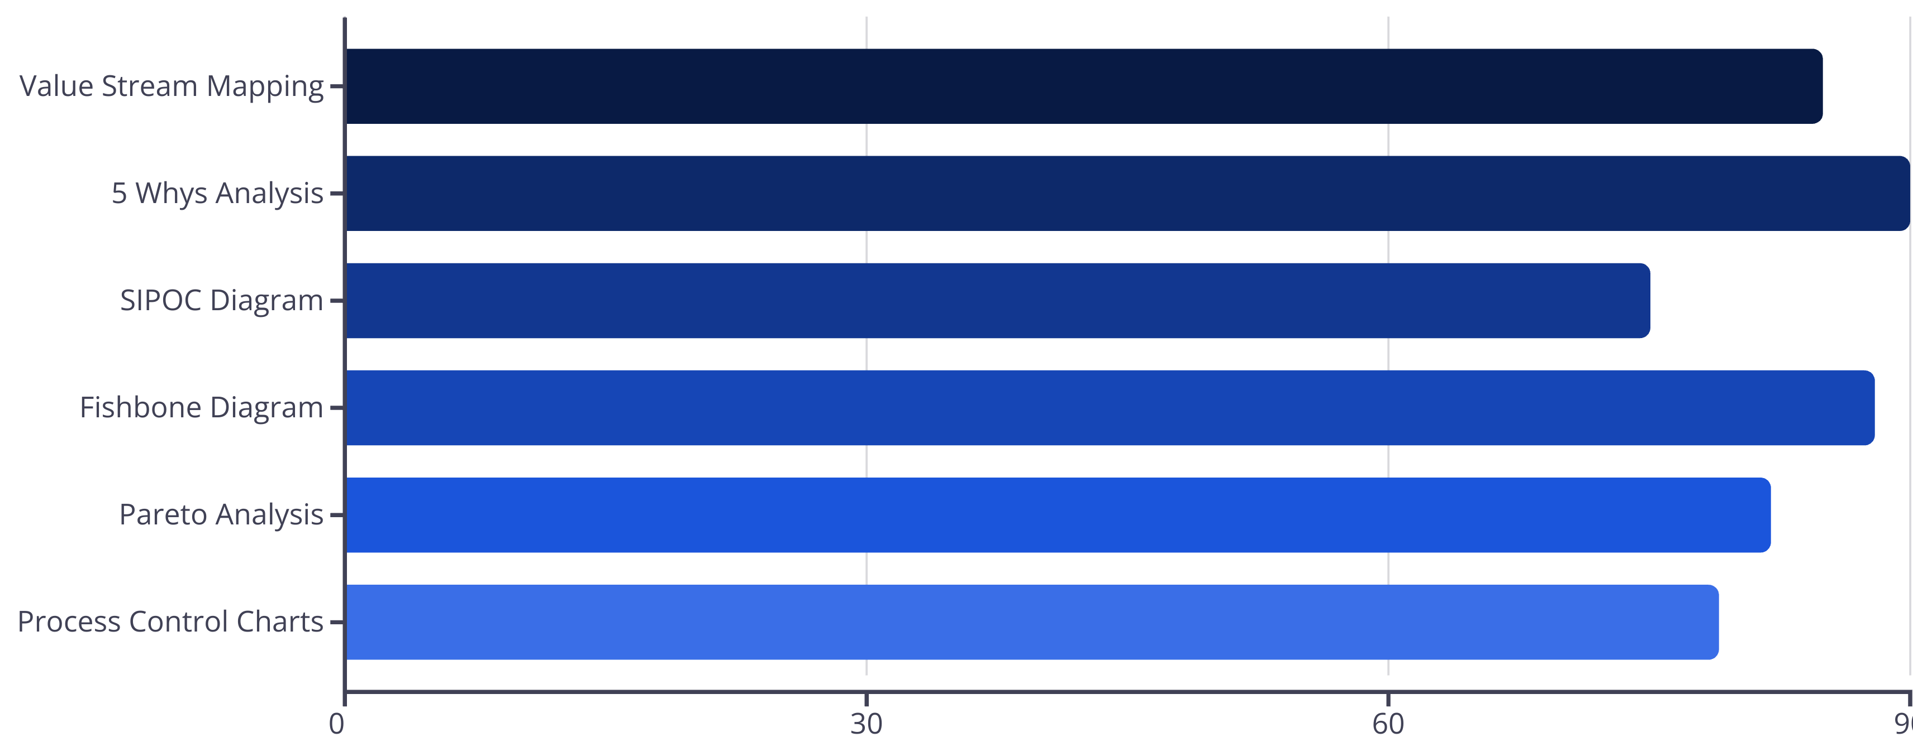
DMAIC Tools for Agile Project Managers
Based on survey of 200 Agile project managers who implemented DMAIC for process improvement

Slide 12
Integrating DMAIC with Agile Ceremonies
Sprint Planning
Daily Standups
Use Define and Measure insights to adjust capacity planning and story prioritization
Track improvement initiatives and identify new data points for the Measure phase
Sprint Review
Retrospective
Demonstrate progress on DMAIC metrics to stakeholders alongside feature demos
Use Analyze techniques to dig deeper into issues and evaluate Control effectiveness
DMAIC doesn't replace Agile—it enhances it by providing structure to solve persistent problems.

Slide 13
Common Pitfalls and How to Avoid Them
Pitfalls:
Best Practices:
Rushing through the Define phase
Take time to get stakeholder alignment
Collecting insufficient data
Set clear metrics before starting
Fixing symptoms instead of root causes
Use multiple analysis techniques
Implementing too many changes at once
Test one solution at a time
Neglecting the Control phase
Build monitoring into existing ceremonies

Slide 14
Key Takeaways
Move from reactive to proactive problem-solving
DMAIC provides the structure to permanently resolve recurring issues, not just patch them temporarily.
Leverage data to drive decisions
Replace assumptions with measurements to identify true causes and validate improvements.
Integrate with existing Agile practices
DMAIC complements Agile frameworks by adding depth to continuous improvement efforts.
Build sustainable solutions
The Control phase ensures improvements stick, even when teams are under pressure.
In Agile environments, we move fast—but fast doesn't always mean smart. DMAIC transforms teams from problem managers to problem solvers.

