Slide 1
Human-Centered Agile: Embedding Values into SAFe and Projects
Agile frameworks like SAFe, Scrum, and Kanban have brought structure to iterative delivery and scaled collaboration—but are we leaving behind the human side of agility?
In today’s digital workplaces, Agile leaders must do more than manage backlogs and velocity. We must create spaces where empathy, equity, and ethics are embedded into how we work.
Beyond frameworks and processes lies the heart of true agility—the human element. This presentation explores how to create Agile environments where empathy, equity, and ethics thrive alongside delivery excellence.
kW
by Kimberly Wiethoff

Slide 2
The Human Dimension of Agility
Process Without Humanity
Frameworks without values become mechanical exercises that miss the purpose of agility.
Values-First Approach
Human-centered agility aligns team behavior with people, not just processes.
Sustainable Outcomes
Balancing delivery speed with team wellbeing creates lasting results.

Slide 3
When Frameworks Overshadow Humanity
Tooling Obsession
Excessive focus on tools rather than team dynamics
Speed Over Health
Prioritizing velocity metrics above sustainable pace
Safety Neglect
Overlooking inclusivity and psychological safety needs

Slide 4
The Value Champion Role
Advocate
Connect
Surface ethical concerns and safety issues during PI events
Bridge gaps between technical delivery and human impact
Nurture
Measure
Foster environments where diverse perspectives thrive
Track team health alongside delivery metrics

Slide 5
Empathetic Team Agreements
Assume Positive Intent
Begin interactions with the belief that others have good intentions.
Encourage All Voices
Create space for quieter team members to contribute their perspectives.
Call Out Burnout
Give permission to identify unsustainable workloads before they cause harm.
Respect Cognitive Diversity
Acknowledge different thinking styles and adapt communication accordingly.

Slide 6
Human-Centered PI Objectives
Traditional Objective
Human-Centered Objective
"Deliver payment gateway integration by end of PI"
"Reduce checkout abandonment by 15% through intuitive payment flow"
Traditional Objective
Human-Centered Objective
"Complete migration to new database architecture"
"Reduce support team load by 20% through system stability improvements"

Slide 7
Story Mapping Through Personas
Create Diverse Personas
Develop realistic user representations across different abilities and backgrounds
Map User Journeys
Trace each persona's path through your product or service
Identify Pain Points
Discover moments of friction or exclusion in the experience
Prioritize Human Impact
Rank backlog items based on meaningful user outcomes

Slide 8
Human-Centered Practice Toolkit
Empathy Maps
Accessibility Audits
Visualize what users think, feel, say, and do during backlog refinement.
Include in Definition of Done to ensure inclusive product design.
Team Health Checks
Equity-Focused Stories
Run recurring assessments to gauge psychological safety and engagement.
Write user stories from diverse perspectives to broaden solution thinking.

Slide 9
Leadership That Models Humanity
Create Safety
Establish environments where vulnerability is valued
Celebrate Inclusivity
Recognize behaviors that support diverse perspectives
Enable Hard Conversations
Make space for discussions about bias and burnout
Bridge Organizational Silos
Partner with HR, DEI teams to align values

Slide 10
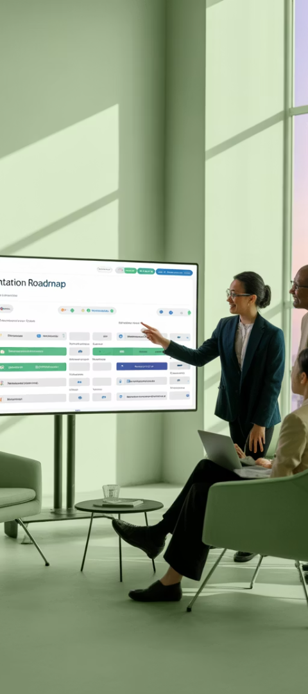
Implementation Roadmap
Assessment Phase
Role Integration
Evaluate current framework implementation for human-centered gaps.
Introduce Values Champion role and train initial champions.
Duration: 2-4 weeks
Duration: 1-2 months
Practice Adoption
Framework Evolution
Implement human-centered tools in selected teams.
Formally adapt ceremonies and artifacts to incorporate human values.
Duration: 3-6 months
Duration: 6-12 months

Slide 11
Measuring Success Beyond Velocity
Traditional agile metrics often overemphasize speed at the expense of human impact. A human-centered approach rebalances our success indicators to value both delivery and wellbeing.
Traditional Weight
Human-Centered Weight
Notice how human-centered metrics shift emphasis from pure output (velocity) toward outcomes that matter to both users and team members. This balanced approach leads to more sustainable delivery, higher quality products, and healthier teams that can innovate over the long term.

Slide 12
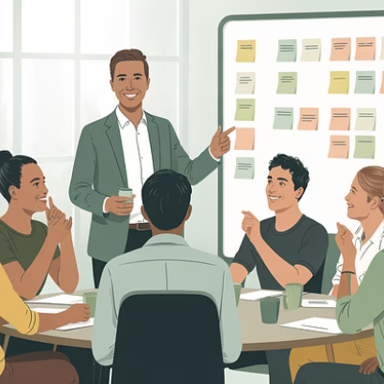
Frameworks Evolve—Values Endure
Human-Centered Agile doesn't compete with SAFe—it completes it. By embedding empathy, inclusivity, and ethical reflection, we create resilient teams and responsible products.
Great Agile isn't just fast—it's fair, thoughtful, and human.

