Slide 1


From Volume to Value: How Healthcare is Redefining Success
Healthcare is undergoing its most significant transformation in decades. As we move from quantity-focused care to outcome-driven excellence, organizations are discovering that true success isn't measured by services delivered—but by lives transformed.
#ValueBasedCare #HealthcareInnovation #PatientOutcomes #HealthcareTransformation #FutureOfHealth #DigitalHealth #ManagingProjectsTheAgileWay

Slide 2

The Traditional Model: Built for Volume
Fee-for-Service Framework
The Numbers Game
For generations, healthcare systems operated on a simple principle: more services equal more revenue. Providers were rewarded for activity—patient visits, diagnostic tests, procedures, and hospital admissions.
Revenue tied to quantity of services
Success measured by patient throughput
Limited focus on prevention and wellness
Fragmented care across specialties
Minimal accountability for outcomes
This model created perverse incentives where success was measured by volume metrics rather than actual patient improvement.

Slide 3
What Is Value-Based Care?
Value-Based Care represents a fundamental shift in healthcare philosophy. Rather than rewarding providers for the quantity of services delivered, VBC links compensation directly to quality outcomes and measurable patient improvements.
Quality Over Quantity
Outcome-Focused
Prevention Priority
Providers are rewarded for delivering better care, not just more care services.
Success measured by actual patient health improvements and wellness metrics.
Emphasis on preventing illness rather than treating symptoms after they occur.

Slide 4

The Core Principles of Value-Based Care
Patient-Centered Outcomes
Coordinated Care Delivery
All care decisions focus on improving patient health, satisfaction, and quality of life rather than maximizing billable services.
Healthcare teams work collaboratively across specialties to ensure seamless, comprehensive patient care without duplication.
Evidence-Based Practices
Continuous Quality Improvement
Treatment protocols are grounded in clinical research and proven methodologies that deliver measurable results.
Systems continuously monitor, analyze, and refine care processes to achieve better outcomes and patient experiences.

Slide 5



Why This Shift Matters Now
The transition to Value-Based Care isn't just a payment model change—it's a response to mounting pressures across the healthcare system. Rising costs, aging populations, and increased chronic disease prevalence demand a more sustainable approach.
Healthcare Cost Crisis
Aging Demographics
Technology Enablement
U.S. healthcare spending reached $4.3 trillion in 2021, representing nearly 20% of GDP. Traditional volume-based models contribute to unsustainable cost growth without proportional health improvements.
By 2030, all baby boomers will be 65 or older, creating unprecedented demand for chronic care management and preventive services that VBC models address effectively.
Advanced analytics, AI-driven insights, and digital health tools now make it possible to accurately measure and improve patient outcomes at scale.

Slide 6

Better Patient Outcomes: The Primary Benefit
When healthcare providers are incentivized to keep patients healthy rather than treat them when sick, the results are transformative. Value-Based Care drives a prevention-first approach that addresses health issues before they become costly complications.
Measurable Improvements
30% reduction in preventable readmissions
Improved chronic disease management
Care teams focus intensively on chronic disease management, wellness programs, and early intervention strategies. This shift has led to measurable improvements in patient satisfaction scores, reduced hospital readmissions, and better management of conditions like diabetes, hypertension, and heart disease.
Higher patient satisfaction scores
Enhanced medication adherence
Coordinated specialty care

Slide 7
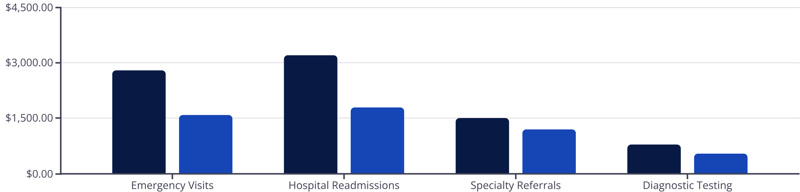
Cost Reduction Through Smart Care
Value-Based Care achieves the healthcare holy grail: better outcomes at lower costs. By preventing expensive emergency interventions and eliminating redundant procedures, VBC models create sustainable financial benefits for all stakeholders.
Traditional Model
Value-Based Care
Organizations implementing VBC report average cost savings of 15-25% while simultaneously improving patient satisfaction and clinical outcomes.

Slide 8




Enhanced Patient Experience
Personalized Care Plans
Each patient receives individualized treatment protocols based on their specific health needs, preferences, and lifestyle factors.
Coordinated Team Approach
Primary care physicians, specialists, nurses, and care coordinators work seamlessly together to provide comprehensive care.
Proactive Communication
Patients receive regular check-ins, preventive care reminders, and ongoing support between visits.
This holistic approach creates deeper patient-provider relationships and builds trust through consistent, coordinated care delivery that feels personal and attentive.

Slide 9








Provider Alignment: Working Toward Common Goals
Value-Based Care transforms healthcare from a collection of individual practitioners into integrated care teams with shared accountability. This alignment creates unprecedented collaboration across specialties.
Primary Care
Specialists
Serves as care quarterback, coordinating all aspects of patient health and wellness.
Focus on specific conditions while maintaining communication with the broader care team.
Support Services
Care Coordinators
Include pharmacists, social workers, and behavioral health specialists as integral team members.
Ensure seamless transitions and follow-up care between different providers and settings.

Slide 10
Implementation Challenges
While the benefits are clear, transitioning to Value-Based Care presents significant operational and cultural challenges that organizations must thoughtfully address.
Payment Model Complexity
Technology Infrastructure
Organizations must navigate multiple payer contracts with varying VBC requirements, quality metrics, and reporting standards. This complexity requires sophisticated revenue cycle management and contract negotiation expertise.
Successful VBC implementation demands robust data systems capable of tracking patient outcomes, analyzing population health trends, and generating actionable insights for care improvement.
Cultural Transformation
Risk Management
Staff must shift mindsets from volume-focused productivity to outcome-oriented care delivery. This requires extensive training, change management, and ongoing support for new care protocols.
Taking on financial responsibility for patient outcomes requires sophisticated risk assessment capabilities and the ability to manage population health across diverse patient populations.

Slide 11

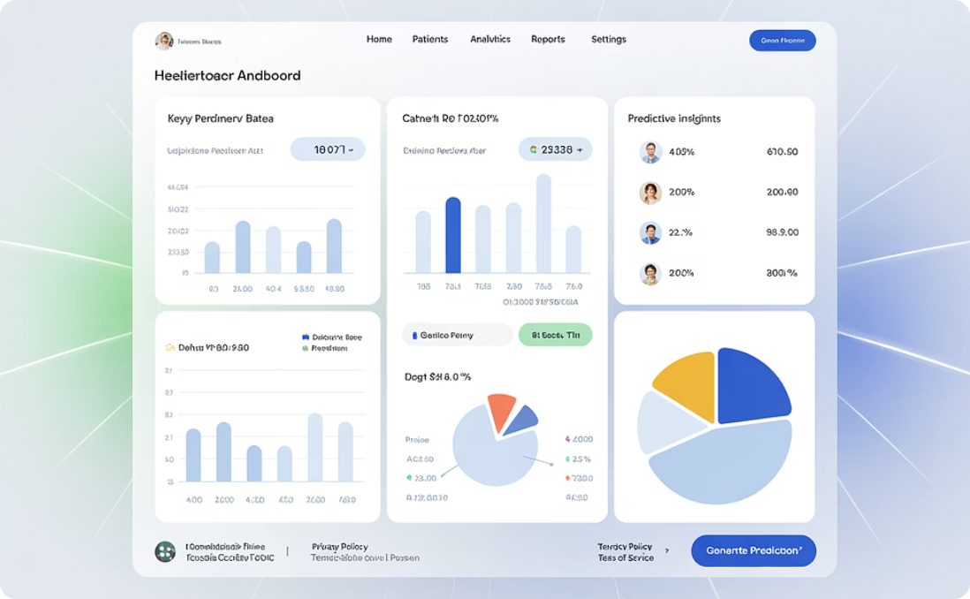

Technology: The VBC Enabler
Modern Value-Based Care is impossible without sophisticated technology infrastructure. Advanced systems enable providers to track, analyze, and improve patient outcomes with precision and scale.
Electronic Health Records
Predictive Analytics
Patient Engagement Tools
Comprehensive patient data enables care coordination and outcome tracking across all touchpoints in the healthcare journey.
AI-driven insights identify high-risk patients before complications occur, enabling proactive interventions and prevention strategies.
Digital platforms connect patients with their care teams, provide health education, and support medication adherence and lifestyle changes.

Slide 12
Measuring Success in Value-Based Care
Success in VBC requires comprehensive measurement across multiple dimensions. Organizations must track both clinical outcomes and operational efficiency to demonstrate value.
85%
30%
15%
92%
Patient Satisfaction
Readmission Reduction
Cost Savings
Quality Metrics
Target satisfaction score for coordinated care delivery and patient experience excellence.
Decrease in preventable hospital readmissions through better discharge planning and follow-up care.
Average reduction in total cost of care through prevention and care coordination initiatives.
Target performance on clinical quality measures including preventive care and chronic disease management.
These metrics demonstrate that Value-Based Care delivers on its promise of better outcomes at lower costs while improving the patient and provider experience.

Slide 13

The Cultural Transformation
The shift to Value-Based Care represents more than operational changes—it's a fundamental transformation in healthcare culture. Organizations are discovering that true success is measured by lives improved, not services billed.
"We've moved from asking 'How many patients did we see today?' to 'How many patients did we help achieve their health goals?' This mindset shift has transformed how our entire organization thinks about success."
This cultural evolution requires strong leadership, continuous education, and unwavering commitment to patient-centered care. When successful, it creates healthcare environments where providers find renewed purpose in their work and patients experience genuinely transformative care.

Slide 14

The Future of Healthcare Success
Value-Based Care represents the future of healthcare—a system where quality trumps quantity, outcomes matter more than outputs, and success is defined by the health and wellness of entire populations.
2020-2025
2030+
Widespread VBC adoption across major health systems and payer organizations
Population health management and preventive care dominate healthcare delivery
1
2
3
2025-2030
Technology integration and AI-driven care optimization become standard practice
As payers, providers, and patients align under this transformative model, healthcare is being redefined—one outcome, one life, one success story at a time. The journey from volume to value isn't just changing how we deliver care; it's revolutionizing what healthcare success truly means.

