Slide 1
From Legacy to Cloud: Transformation Lessons
Moving from legacy systems to cloud platforms isn't just a technical shift. It's a business revolution that requires strategic vision and careful execution.
These lessons from multi-million dollar transformation projects will help you navigate your own cloud journey successfully.
kW
by Kimberly Wiethoff

Slide 2
The Promise vs. Reality
The Promise
The Reality
Greater business agility
Complex migration challenges
Unlimited scalability
Organizational resistance
Accelerated innovation
Hidden costs and dependencies
Enhanced customer experiences
Learning curves for teams

Slide 3
Beyond Lift-and-Shift
Lift-and-Shift Approach
Simply moving existing applications to cloud infrastructure without redesign.
Reimagine Architecture
Redesign applications as modular, service-based systems for true cloud benefits.
Reassess Workflows
Review integrations and dependencies to optimize for cloud environments.
Transform for Agility
Build for scale, flexibility, and future innovation opportunities.

Slide 4
Change Management Is Critical
Communicate Why
Empower Champions
Explain benefits clearly and repeatedly across all levels.
Identify and support early adopters who influence peers.
Measure Adoption
Provide Training
Track usage metrics and gather feedback to improve engagement.
Offer role-specific education on new tools and processes.

Slide 5
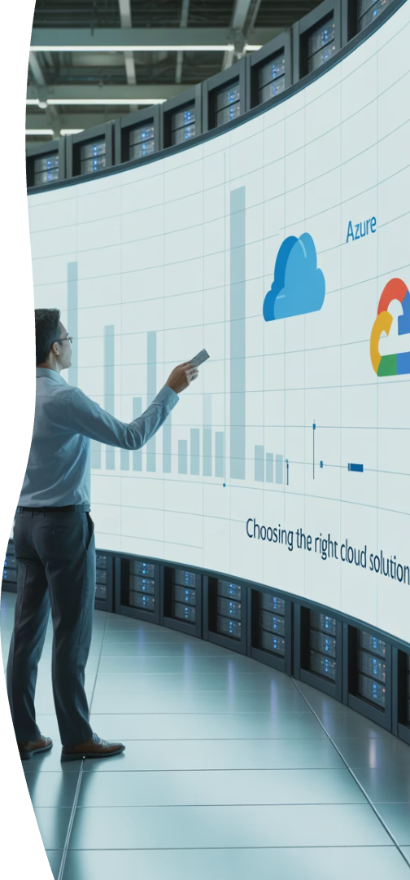
Selecting the Right Cloud Provider
Amazon Web Services (AWS)
Microsoft Azure
Extensive service offerings
Seamless Microsoft integration
Strong infrastructure flexibility
Strong enterprise capabilities
Advanced developer tools
Hybrid cloud excellence
Global reach with many regions
Comprehensive compliance portfolio
Google Cloud Platform (GCP)
Advanced analytics capabilities
Leading machine learning tools
Innovative container solutions
High-performance computing

Slide 6
Security: Build It In, Not Bolt It On
Cloud-Native Security Tools
Invest in specialized security solutions designed for cloud environments.
Identity and Access Management
Implement robust IAM with least-privilege principles and continuous verification.
Continuous Monitoring
Deploy real-time threat detection and automated incident response systems.
Compliance by Design
Align architecture with relevant frameworks: HIPAA, SOC 2, GDPR, etc.

Slide 7
Securing Organizational Support
Executive Sponsorship
Secure C-level advocates who understand risks and ROI
Cross-Functional Leadership
Engage directors who can align departmental priorities
Frontline Champions
Cultivate enthusiastic adopters across business units

Slide 8
Measuring Success: Business Outcomes
32%
47%
Faster Time-to-Market
Cost Reduction
Reduced deployment cycles for new features
Lower operational expenses after migration
63%
28%
Customer Engagement
Innovation Rate
Increased digital interaction metrics
More new initiatives launched annually

Slide 9
Common Transformation Pitfalls
Underestimating Complexity
Legacy systems often have hidden dependencies that complicate migration.
Cloud Cost Overruns
Failing to implement proper governance leads to unexpected expenses.
Skills Gaps
Teams lack cloud expertise, slowing adoption and increasing risks.
Scope Creep
Projects expand beyond original boundaries, delaying completion.

Slide 10
Cloud Migration Strategies
Retire
Eliminate applications that no longer provide business value
Rehost
Lift-and-shift for simple applications with time constraints
Refactor
Modify applications to leverage cloud-native features
Rearchitect
Redesign applications for maximum cloud benefits

Slide 11
Transformation Timeline
A successful cloud transformation follows a structured timeline spanning approximately 23 months from initial assessment to continuous optimization. Each phase builds upon the previous one, with dedicated resources required throughout the journey.
Note: Timeline represents an enterprise-scale transformation. Complexity, existing architecture, and organizational readiness can significantly impact actual durations.

Slide 12
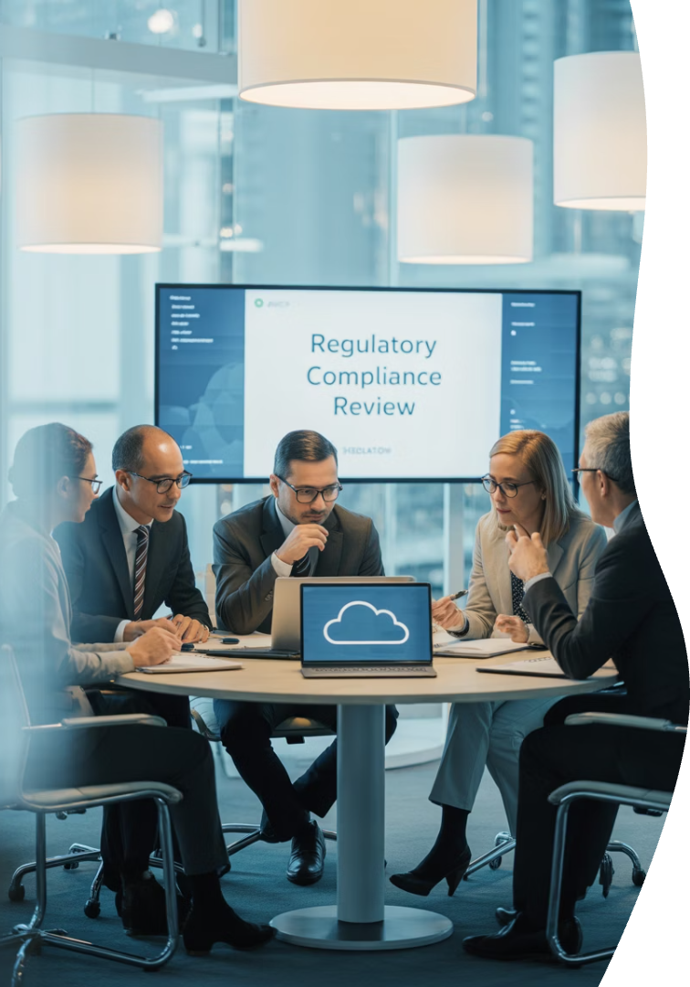
Industry-Specific Considerations
Healthcare
Finance
HIPAA compliance and patient data security require specialized cloud configurations.
Banking regulations demand enhanced security controls and audit capabilities.
Manufacturing
Retail
IoT integration and real-time operations need robust edge computing solutions.
Seasonal demand fluctuations require elastic scaling and advanced analytics.

Slide 13
Key Takeaways
Reimagine, Don't Just Relocate
Use migration as an opportunity to transform architecture for future needs.
Prioritize People and Process
Focus on change management and organizational readiness.
Measure Business Impact
Define success through business outcomes, not just technical metrics.
Build Security from Day One
Integrate compliance and security in your initial architecture.

