Slide 1


AI for Scrum Masters: Transforming Agile Leadership with Intelligent Insights
From Facilitation to Data-Driven Leadership in the Age of AI — how Scrum Masters can leverage artificial intelligence to elevate team performance without losing the human touch that makes Agile successful.
#AIforScrumMasters #AIinAgile #AgileWithAI #ScrumAndAI #ScrumMaster #AgileLeadership #AgileCoach #ArtificialIntelligence #DigitalTransformation #FutureOfWork #ContinuousImprovement #AgileTransformation #DataDrivenLeadership #AgileExcellence #ScrumInnovation

Slide 2
The Shift Is Already Here
Why AI Matters for Scrum Teams Right Now
Artificial Intelligence is no longer a future concept — it's actively reshaping how Agile teams operate today. For Scrum Masters, this shift presents a powerful opportunity: to evolve from process facilitators into strategic, data-driven leaders.
Process Enhancement
Data-Driven Insights
Team Empowerment
Automate burndown charts, sprint metrics, and status reporting — freeing you to focus on coaching, removing impediments, and driving continuous improvement.
Uncover delivery bottlenecks, velocity inconsistencies, and risk indicators before they impact outcomes — enabling proactive, not reactive, leadership.
Provide real-time feedback during sprints, enabling better decision-making at every level without waiting for retrospectives.

Slide 3
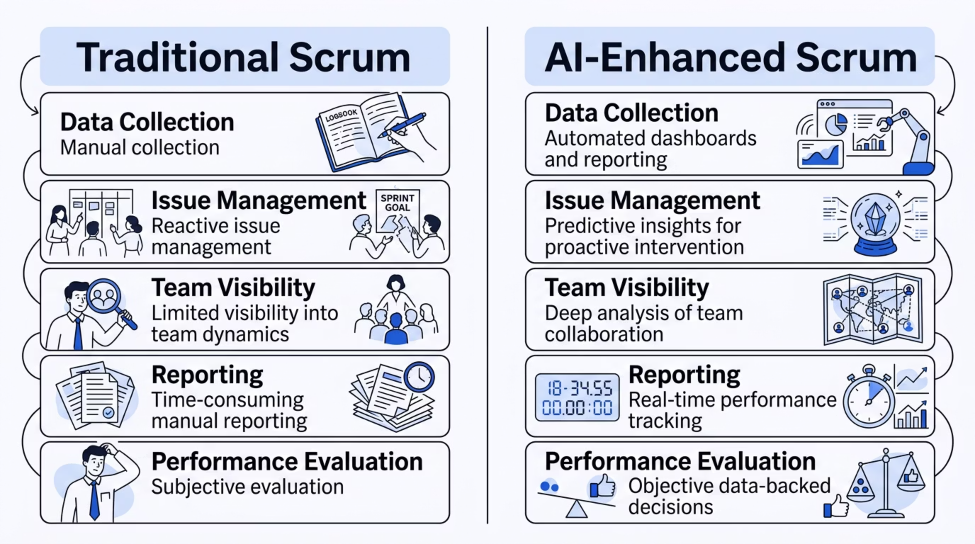

From Traditional to AI-Enhanced Scrum
Traditional Scrum practices work — but they have clear limitations. AI-enhanced Scrum doesn't replace what works; it removes the friction that slows teams down.
The result: Scrum Masters scale their impact without increasing their workload.

Slide 4
Strengthening the Three Pillars of Scrum with AI
AI doesn't replace Scrum — it strengthens its very foundation. Each of Scrum's three core pillars becomes more powerful when paired with intelligent tooling.
Transparency
Inspection
Adaptation
AI-powered dashboards provide real-time visibility into sprint progress, team velocity, and emerging risks. No more waiting for reports — everyone sees the same truth, instantly.
AI identifies hidden performance patterns, quality trends, and communication gaps — surfacing insights that would otherwise go unnoticed in manual reviews.
Predictive adjustments to sprint scope, capacity optimization, and data-driven process improvements replace guesswork with evidence-based decisions.

Slide 5

Core Concepts
Key AI Technologies Every Scrum Master Should Know
You don't need to be a data scientist — but understanding how these three AI capabilities work in your environment will help you lead smarter.
Machine Learning (ML)
Natural Language Processing (NLP)
Predictive Analytics
Learns from historical team data to predict sprint success, forecast velocity, and identify the key drivers behind team performance over time.
Uses historical and real-time data to forecast delivery timelines, identify risks early, and improve planning accuracy across sprints and releases.
Analyzes team communication to detect sentiment in retrospectives, identify recurring issues, and surface recurring themes from standups and written feedback.
Together, these three capabilities form a powerful decision-support system — giving Scrum Masters the intelligence they need to act with confidence.

Slide 6
Myth vs. Reality
Does AI Replace Scrum Masters?
❌ The Myth
✅ The Reality
AI will replace Scrum Masters.
AI amplifies Scrum Masters.
This assumption fundamentally misunderstands Agile. Scrum is human-centered by design — built on trust, conversation, and collaboration that no algorithm can replicate.
AI handles the data — you handle the people
AI provides insights — you provide judgment
AI automates processes — you drive transformation
Your role becomes more strategic, not less relevant.

Slide 7

Practical Application
AI-Powered Sprint Planning
Sprint planning is where AI delivers some of its most immediate value — turning historical performance into forward-looking precision.
Velocity Forecasting
Capacity Planning
ML models analyze past sprint data to predict realistic throughput for the upcoming sprint — reducing over-commitment and under-delivery.
Automatically account for team availability, holidays, and known constraints to calculate true sprint capacity before planning begins.
Risk Prediction
Based on historical patterns, AI flags stories or epics that carry elevated risk — giving teams the chance to de-risk before committing.

Slide 8

Practical Application
AI-Enhanced Retrospectives
Retrospectives are the heartbeat of continuous improvement — but extracting meaningful, actionable signal from team feedback is time-consuming and prone to facilitator bias. AI changes that.
Sentiment Analysis
NLP tools score team responses for mood, energy, and psychological safety — revealing what the numbers alone won't show.
Pattern Recognition
AI identifies themes and recurring issues across multiple sprints, helping teams address root causes rather than symptoms.
AI-Suggested Actions
Based on identified patterns, AI recommends targeted improvement actions — giving the team a structured starting point for discussion.

Slide 9
Practical Application
AI in Daily Scrum & Sprint Execution
Between planning and retrospective, AI keeps teams on track in real time — reducing noise and surfacing the signals that matter most.
Blocker Detection
Intelligent Alerts
AI monitors task aging, dependency delays, and WIP limits to surface blockers before they cascade into sprint risk.
When the team deviates from projected burn-down, AI sends targeted alerts — giving the Scrum Master the data to facilitate focused, purposeful standups.
1
2
3
Automated Tracking
Progress updates are logged and aggregated automatically — eliminating manual status updates and ensuring the board reflects reality.

Slide 10
Practical Application
Reporting & Stakeholder Communication
The Old Way
The AI-Enhanced Way
Manual data pulls, spreadsheet formatting, and hours spent building status reports — only to present information that's already outdated by the time it reaches stakeholders.
Auto-generated executive summaries — distilled from sprint data in seconds
Real-time dashboards — always current, always accessible
Predictive delivery insights — forecast release dates with confidence intervals
Scrum Masters spend less time on reporting and more time on the conversations that stakeholders actually need.

Slide 11
Implementation Strategy: Where to Start
Adopting AI doesn't require a massive transformation. The most successful implementations start small, prove value quickly, and scale deliberately.
Step 2: Introduce AI as an Assistant
Step 1: Identify High-Value Use Cases
Position AI explicitly as a tool that supports the team — not one that evaluates or replaces anyone. Framing matters enormously for adoption.
Begin with areas that have the most immediate ROI — reporting automation, sprint forecasting, and retrospective insights are proven starting points.
Step 4: Measure Success
Step 3: Drive Team Adoption
Track delivery predictability, team efficiency, cycle time, and stakeholder satisfaction. Use the data to demonstrate value and guide the next iteration.
Educate the team on how the tools work, celebrate quick wins visibly, and build trust in AI-generated insights through transparency and explanation.

Slide 12

Strategic Advantage
The Scrum Master's Competitive Edge in the AI Era
Scrum Masters who embrace AI don't just work more efficiently — they fundamentally expand their strategic footprint within the organization.
More Time for Coaching
With administrative and reporting tasks automated, you can invest deeply in team development and servant leadership.
Better Decision-Making
Real data replaces intuition-only decisions, increasing confidence and consistency in how you guide teams and manage impediments.
Stakeholder Credibility
Data-backed insights and predictive delivery forecasts elevate your standing in executive conversations and portfolio discussions.
Business Alignment
AI enables stronger connections between team performance and business outcomes — making the value of Scrum visible at every level.

Slide 13
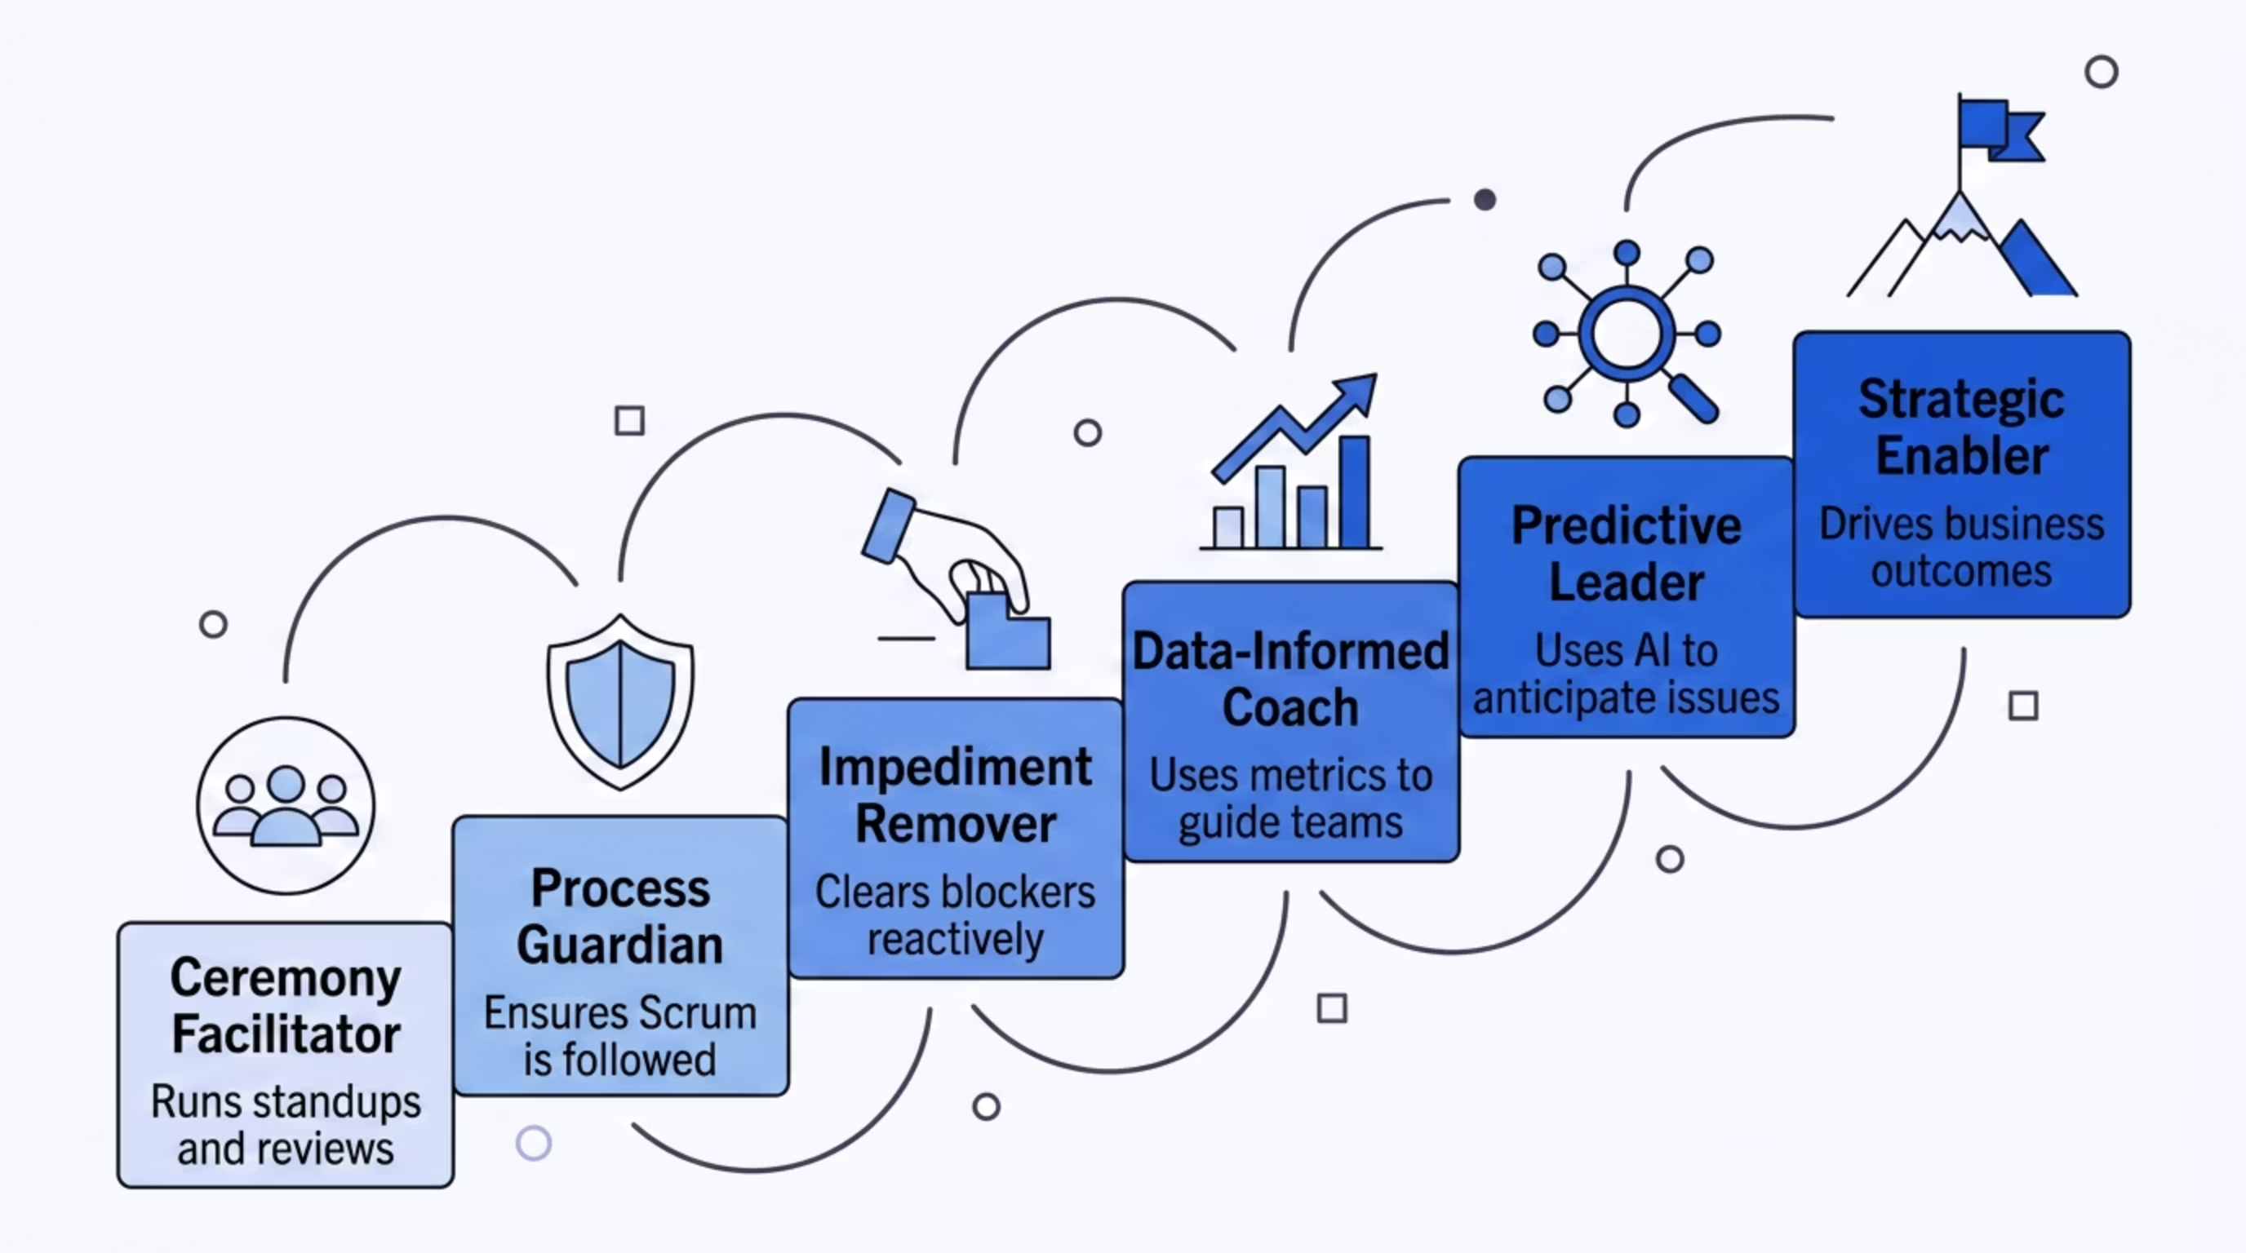

From Facilitator to Strategic Enabler
This is the most important transformation AI unlocks for Scrum Masters — a fundamental shift in how you contribute value to the organization.
Every step up this ladder is made faster and more sustainable when AI provides the data foundation beneath it.

Slide 14

Guiding Principles
The Human-Centered AI Scrum Master
The most effective AI-augmented Scrum Masters share a common philosophy: technology is the tool, but people are always the priority.
Embrace Technology
Stay current with evolving AI tools. Curiosity and continuous learning are now core Scrum Master competencies.
Stay Human-Centered
AI provides the insights. You provide the empathy, context, and judgment that transforms data into meaningful change.
Use Data Responsibly
Be transparent with teams about what data is collected and how it's used. Trust is the foundation of every Agile team.

Slide 15
Final Thoughts
The Future of Agile Is Intelligent — and It Starts With You
AI is not changing the principles of Agile. It's enhancing how we execute them. The Scrum Values — Courage, Focus, Commitment, Respect, and Openness — remain at the core. AI simply removes the friction that stands between those values and their full expression.
Embrace AI as a multiplier
Stay curious and adaptive
Drive outcomes, not outputs
Let it handle the data-intensive work so you can show up as the leader your team needs.
The tools will evolve rapidly. Scrum Masters who invest in AI literacy today will lead the field tomorrow.
Use AI's predictive power to keep the team focused on what delivers real value to customers and the business.
The future isn't about replacing Agile practices. It's about evolving them. And that evolution starts with you.

