Slide 1


Navigating SAFe Roles:
A Guide for Project Managers
Making the leap from traditional project management to Scaled Agile Framework (SAFe) can feel overwhelming. This guide will help you understand where your skills fit in this new ecosystem.
#SAFe #ScaledAgile #AgileTransformation #ReleaseTrainEngineer #RTE #ScrumMaster #ProductOwner #LeanPortfolioManagement #AgileCoach #ProjectManagement #ProgramManagement #PortfolioManagement #Leadership #AgileLeadership #BusinessAgility #DigitalTransformation #PMO #ProjectManager #ContinuousImprovement #AgileMindset #CareerDevelopment #ProfessionalGrowth #PMP #PMIACP #ManagingProjectsTheAgileWay #KimberlyWiethoff

Slide 2





Your Journey into SAFe
Understand the Landscape
Identify key SAFe roles and responsibilities
Assess Your Skills
Match your project management strengths to SAFe roles
Plan Your Path
Choose the role that aligns with your career goals
Grow Your Expertise
Continuously develop your Agile capabilities

Slide 3





Release Train Engineer (RTE)
Program-Level Servant Leader
Facilitates the Agile Release Train (ART) and ensures value delivery.
PI Planning Master
Orchestrates quarterly planning events and manages dependencies.
Impediment Remover
Clears obstacles for teams to maintain continuous flow.
Improvement Driver
Leads retrospectives and implements process enhancements.

Slide 4

Product Owner (PO)
Team-Level Value Champion
Story Expert
Creates clear user stories and acceptance criteria that guide development work.
Represents customer needs and prioritizes the team backlog for maximum value delivery.
Customer Liaison
Maintains regular communication with stakeholders to ensure alignment.

Slide 5








Scrum Master
Team Coach
Ceremony Facilitator
Guides the team in Agile practices and principles.
Leads standups, planning, reviews, and retrospectives.
Cross-Team Coordinator
Blocker Remover
Works with other Scrum Masters to manage dependencies.
Identifies and resolves impediments to team progress.

Slide 6





Agile Team Member
Developer
Tester
Designer
Analyst
Builds features and technical components that deliver value.
Ensures quality through automated and manual testing practices.
Creates intuitive user experiences and visual elements.
Defines requirements and helps translate business needs.

Slide 7






System Architect/Engineer
Technical Vision
Defines the system architecture and long-term direction.
Enabler Definition
Guides creation of architectural runway and foundations.
Non-Functional Requirements
Ensures system performance, security, and reliability.

Slide 8




Business Owner
Investment Authority
Makes funding decisions for value streams and programs.
Outcome Accountability
Responsible for business results from Agile initiatives.
Key Stakeholder
Participates actively in PI Planning and major decisions.

Slide 9



Epic Owner
Initiative Champion
Identifies and defines large-scale business opportunities.
Portfolio Kanban Driver
Shepherds epics through the portfolio management system.
Value Validator
Confirms delivered solutions meet business objectives.

Slide 10
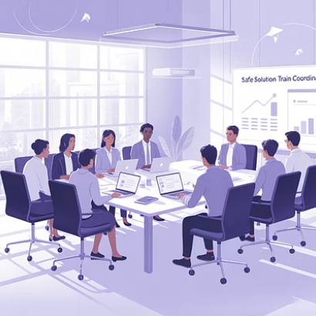
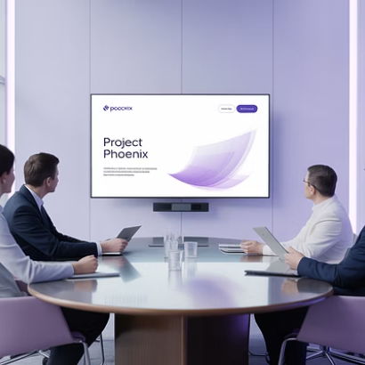

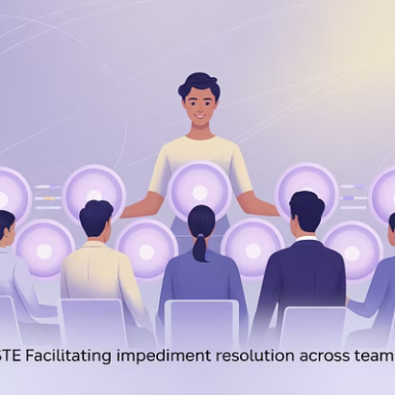
Solution Train Engineer (STE)
The STE orchestrates multiple ARTs working on a single solution. This role suits experienced program managers who excel at large-scale coordination.

Slide 11

Lean Portfolio Manager (LPM)
100%
$$$
Strategic Alignment
Investment Funding
Ensures all work connects to enterprise objectives.
Allocates resources to value streams based on strategy.
25%
Capacity Allocation
Balances innovation, maintenance, and business initiatives.

Slide 12

Agile Coach
Change Agent
Guides organizational transformation to Agile practices and mindset.
Mentor and Trainer
Develops capabilities in teams, RTEs, and leaders.
System Optimizer
Identifies improvement opportunities across the whole organization.

Slide 13
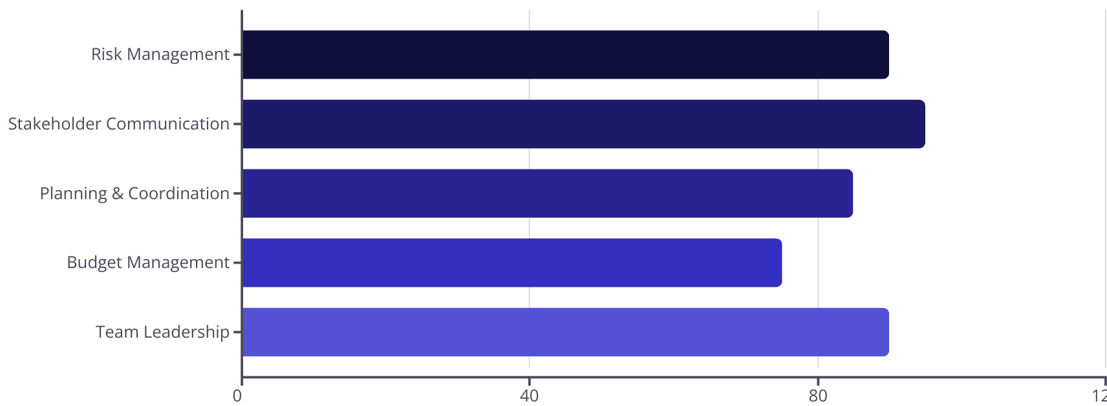
Your PM Skills in SAFe

Slide 14







Finding Your Fit
Team-Focused
Program-Oriented
Consider Scrum Master or Product Owner roles if you thrive in close-knit team environments.
Release Train Engineer or Solution Train Engineer for those who excel at large-scale coordination.
2
Teaching-Inclined
Strategically-Minded
Agile Coach for those who enjoy mentoring and organizational development.
Lean Portfolio Manager or Epic Owner for PMs with business strategy experience.

Slide 15
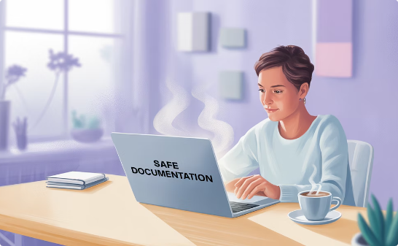


Your Next Steps
Learn SAFe Principles
Shadow SAFe Practitioners
Get Certified
Take a Leading SAFe course to understand the framework fundamentals.
Observe experienced SAFe professionals in action to see roles firsthand.
Pursue relevant certifications for your target role to validate your knowledge.

Slide 16
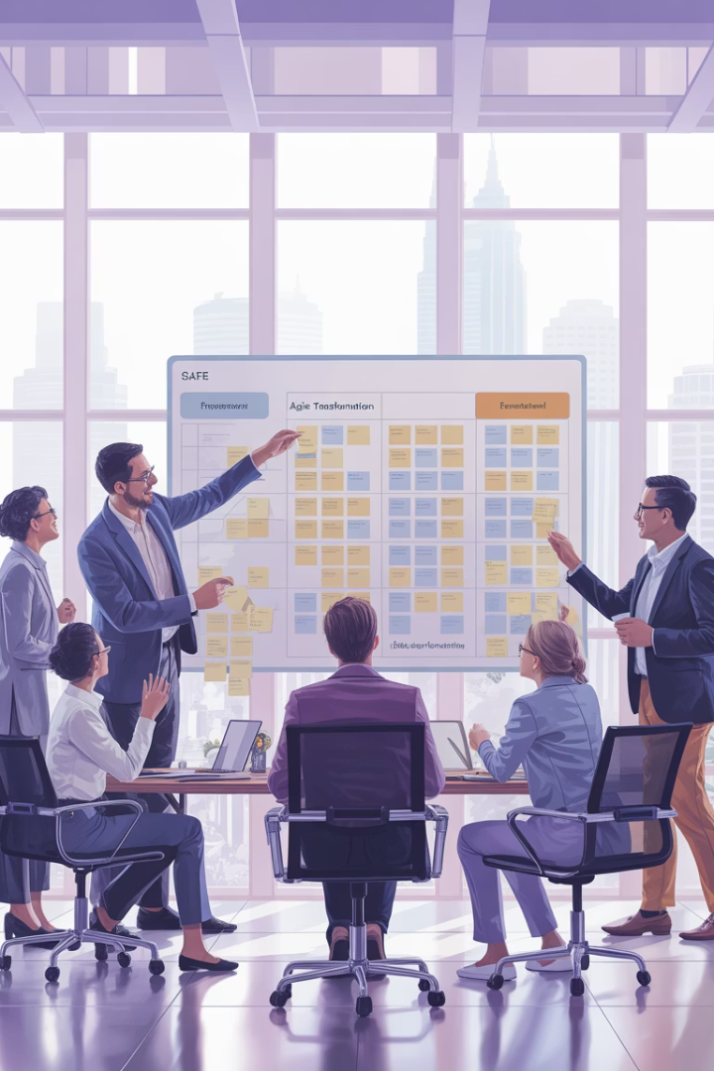
Final Thoughts
The SAFe framework offers project managers a wide range of opportunities to contribute, grow, and lead in Agile at scale. Whether you're transitioning to an RTE, mentoring as a coach, or moving toward Lean Portfolio Management, your foundational skills—coordination, communication, risk management, and stakeholder engagement—remain essential.
The key is to understand each role, align it with your strengths, and continuously develop your Agile mindset.

