Slide 1
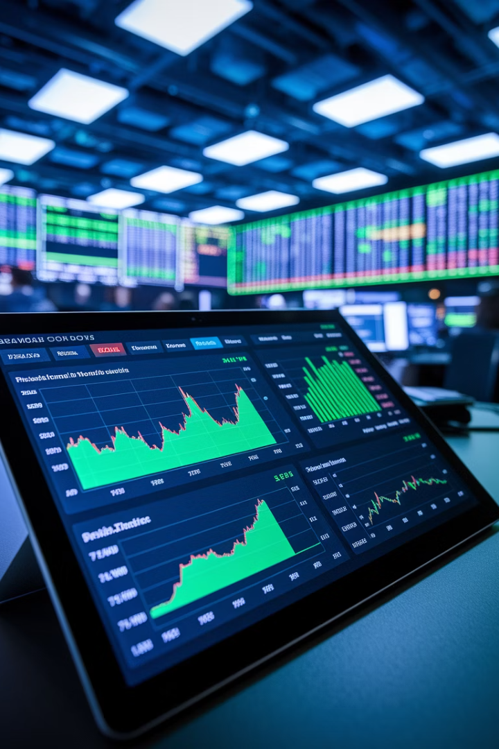
PM Metrics That Matter in Hedge Funds
Every second counts in hedge funds—and so does every decision. Traditional project metrics often miss the mark in fast-paced financial services.
Let's explore the KPIs that truly matter for high-stakes projects.
kW
by Kimberly Wiethoff

Slide 2
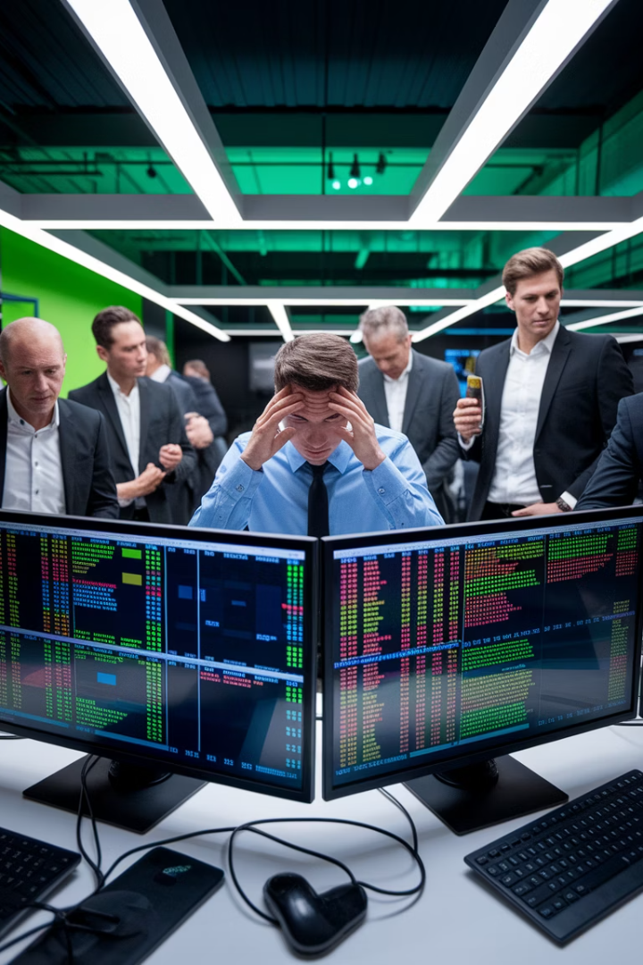
The Challenge for Hedge Fund PMs
Time Sensitivity
Business Impact Focus
In hedge funds, delays directly impact the bottom line. Every minute counts when markets are moving.
Task completion isn't enough. Projects must prove their value in performance, compliance, and ROI terms.
Speaking Finance
Project managers need KPIs that translate technical progress into the language of finance, risk, and results.

Slide 3
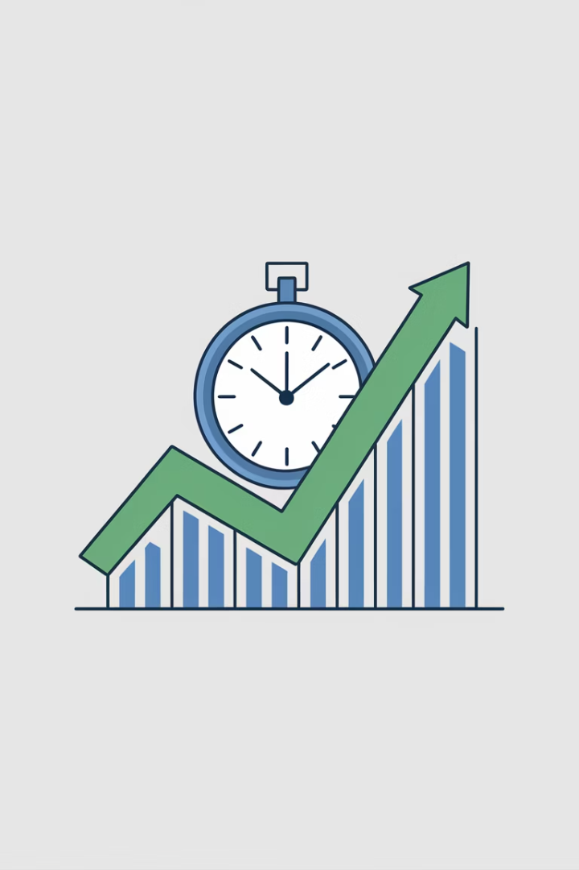



Time-to-Impact (TTI)
Beyond Time-to-Market
Measured in Results
Track improvements like "40% reduction in processing time" rather than just completion percentages.
Hedge funds care about how quickly projects deliver measurable business value, not just go-live dates.
Financial Impact
Quantify early wins in dollar terms whenever possible. Link technical improvements to bottom-line benefits.

Slide 4




Operational Risk Reduction
Automation Gains
Eliminate manual steps in critical processes. Count each handoff automated.
Error Reduction
Measure decreases in trade breaks and reconciliation issues. Track error rate improvements.
System Resilience
Monitor uptime guarantees and successful failover tests. Document recovery time improvements.

Slide 5





Alpha-Enhancing Enablement
Execution Speed
Measure decreased trade latency in milliseconds. Every microsecond matters.
Predictive Power
Track improvements in forecast accuracy from new models or analytics.
Decision Quality
Measure how quickly traders can access and act on new information.
Performance Link
Document correlation between technical improvements and fund performance metrics.

Slide 6








Data Accuracy & Accessibility
Clean Data
Percentage of error-free data available in real-time
Ingestion Speed
Time from market event to data availability
Processing Time
Run time for models and analytical processes
User Access
Time for quants/analysts to retrieve needed information

Slide 7
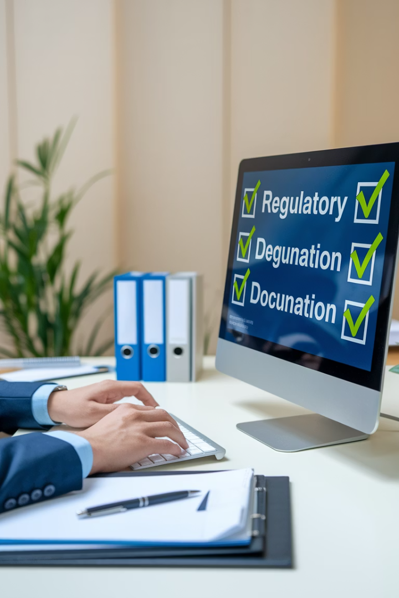
Compliance & Audit Readiness
24h
0
Audit Response
Findings
Time to deliver required artifacts
Target for unresolved compliance issues
100%
Sign-off
Compliance approval rate for new features

Slide 8








Stakeholder Satisfaction & Adoption
Portfolio Managers
Traders
Satisfaction scores from key decision-makers
Daily active usage of new tools
Reduction in manual workarounds
Time saved accessing critical information
Compliance Team
Investor Relations
Ease of generating regulatory reports
Improved client reporting capabilities
Reduction in compliance-related questions
Time saved preparing investor materials

Slide 9
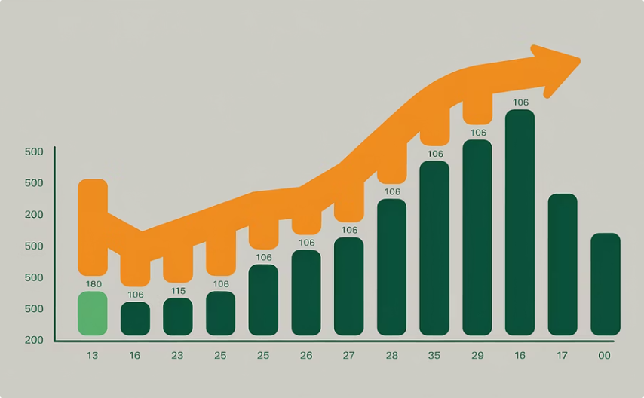
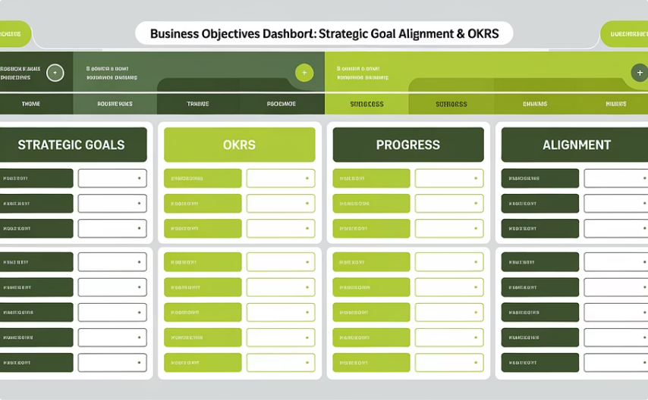
Project Velocity + Value Delivery
Transitioning from traditional project tracking to value-based measurement
Traditional Metrics
Value-Driven Metrics
Story points completed
Features mapped to strategic objectives
Sprint velocities
Progress against OKRs
Burn-down rates
Business capabilities delivered
Backlog size
Measurable objectives achieved

Slide 10
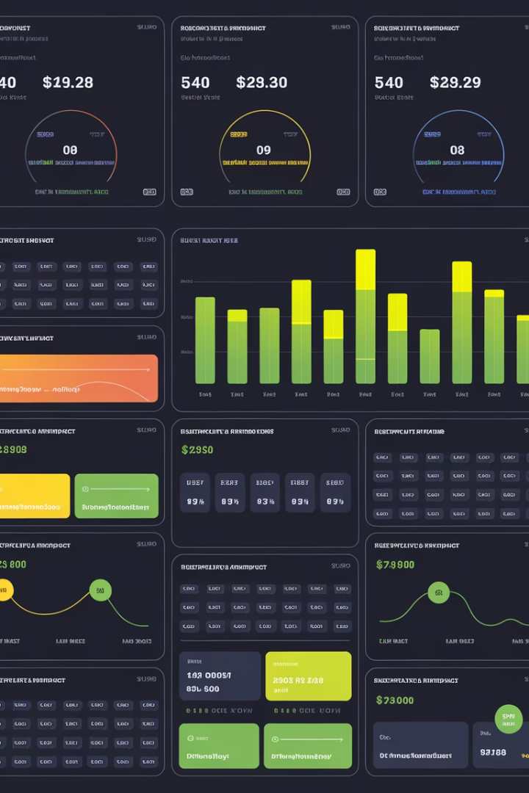
Creating a PM Dashboard
Define Key Metrics
Collaborate with stakeholders to identify the metrics that truly matter for your specific project.
Establish Baselines
Measure current performance to create meaningful comparison points for improvements.
Implement Tracking
Build automated dashboards in tools like Power BI or Excel. Update metrics regularly.
Review & Refine
Adjust your metrics as project goals evolve. Eliminate metrics that don't drive decisions.

Slide 11



Think Like a Strategist
Scheduler
Focuses only on timelines and task completion
Reporter
Tracks and communicates project metrics
Strategist
Links project outcomes to business performance
In hedge funds, successful PMs must evolve beyond schedulers. Your metrics should reflect how projects enable smarter decisions and better fund performance.

Slide 12
KPI Dashboard Template
Metric Category
Sample KPI
Measurement Frequency
Target Threshold (Example)
Time-to-Impact
Days from go-live to measurable business outcome
Weekly/Monthly
< 14 days
Operational Risk Reduction
Reduction in trade breaks / manual interventions
Monthly
≥ 30% reduction
Alpha-Enhancing Enablement
Improvement in model forecast accuracy / latency
Bi-weekly
≥ 10% accuracy increase
Data Accuracy & Accessibility
Percentage of clean real-time data available
Daily/Weekly
≥ 95% clean data available
Compliance & Audit Readiness
Time to audit completion / number of unresolved findings
Quarterly
< 5 unresolved findings
Stakeholder Satisfaction & Adoption
User adoption rate / stakeholder satisfaction score
Monthly
≥ 80% adoption / NPS > 7
Project Velocity + Value Delivery
Story points delivered mapped to strategic objectives
Per Sprint
≥ 90% planned vs delivered

Slide 13
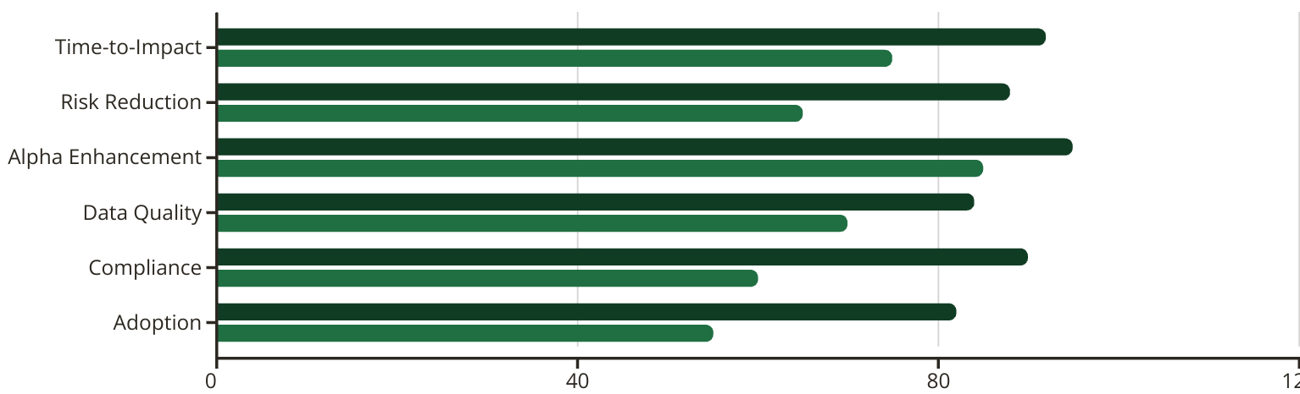
Sample Metrics Dashboard
This dashboard compares importance scores against implementation difficulty across key metric categories. Alpha Enhancement shows highest importance (95) but is most challenging to implement (85), while Compliance offers strong importance (90) with moderate implementation effort (60).
Importance Score
Implementation Difficulty

Slide 14








Final Thought: Value Creation
In hedge funds, PMs must think like strategists—not just schedulers. Your metrics should reflect how your project enables smarter decisions, faster execution, stronger compliance, and ultimately, better fund performance. If your KPIs aren’t speaking the same language as your portfolio manager or CTO, it’s time to realign.
Build
Enable
Technical excellence and quality delivery
Smarter decisions and faster execution
Perform
Protect
Better fund performance and business outcomes
Stronger compliance and reduced risk
It's not just about what you build—it's about the value it creates.

