Slide 1
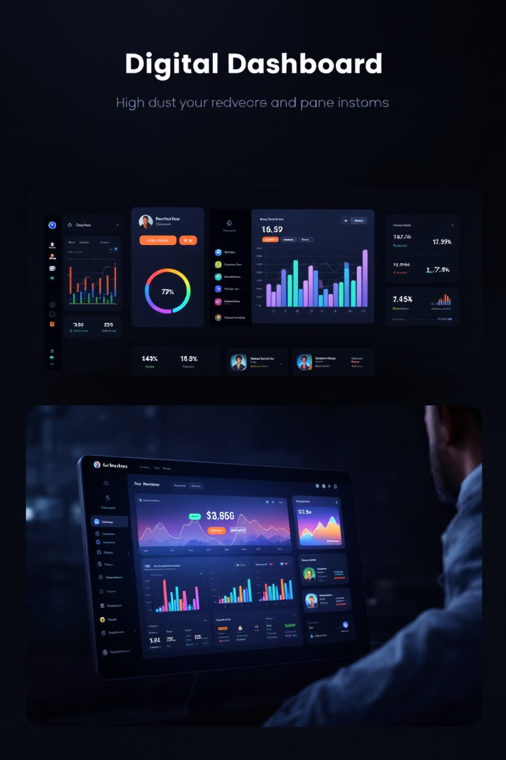
Leveraging Dashboards for Project Performance
In today's fast-paced business environment, effective project management is crucial for success.
kW
by Kimberly Wiethoff

Slide 2
Dashboards: A Centralized Platform for Project Metrics
Real-time Visibility
Data-driven Insights
Track progress and performance at any given moment.
Analyze trends, identify patterns, and make informed decisions.

Slide 3
Boosting Communication and Collaboration
1
Common Point of Reference
2
Quick Access to Information
Foster transparency and improve communication.
Reduce reliance on lengthy reports or email updates.

Slide 4
Uncovering Trends and Optimizing Processes
Trend Identification
Pattern Recognition
Uncover areas of improvement and optimize processes.
Identify correlations and capitalize on opportunities for growth.

Slide 5
Tailoring Dashboards to Your Needs
Customization Options
Flexibility for Different Projects
Tailor the dashboard layout and content to specific needs.
Track financial metrics, team productivity, or customer satisfaction.

Slide 6
Designing Effective Dashboards
Define Key Metrics
Use Visualizations Wisely
Identify the most important metrics and KPIs that align with project objectives.
Choose appropriate chart types and visualizations to communicate your data effectively.
1
2
3
Keep it Simple
Avoid cluttering the dashboard with unnecessary information.

Slide 7
Contextualizing Data for Informed Decisions
Provide Context
Contextualize the data by providing relevant background information, trends, and benchmarks.
Enable Informed Decision-making
Help stakeholders understand the significance of the metrics displayed.

Slide 8
Maintaining Dashboard Accuracy and Relevance
Regular Updates
1
Keep the dashboard up to date with regular updates.
Data Synchronization
2
Ensure that data feeds are synchronized.
Timely Reflections
3
Reflect changes or updates to metrics in the dashboard.

Slide 9
Maximizing the Power of Dashboards
Real-time Visibility
1
Track progress and performance at any given moment.
Data-driven Insights
2
Analyze trends, identify patterns, and make informed decisions.
Improved Communication
3
Foster transparency and improve communication.

Slide 10
Key Takeaways
Leveraging dashboards effectively enables project managers to make informed decisions, improve communication, and drive project success. By following best practices for dashboard design and implementation, teams can harness the full potential of dashboards to optimize project performance and achieve their objectives.

