Slide 1


Strategic Storytelling: Executive Reporting that Moves Transformation Forward
Transform your routine updates into powerful leadership tools that accelerate decision-making and drive transformation success.
#ProjectManagement #ProgramLeadership #ExecutiveCommunication #DigitalTransformation #Leadership #StrategicThinking #BusinessTransformation #MarketingOperations #ChangeLeadership #PMO

Slide 2
The Evolution of Executive Reporting
Traditional Reporting
Strategic Storytelling
Status updates and metrics
Narrative-driven insights
Raw data dumps
Context and clarity
Compliance-focused
Decision-oriented
Reactive communication
Proactive guidance
Information overload
Action-focused messaging
The most effective transformation leaders understand that reporting isn't just about sharing information—it's about crafting a strategic narrative that drives alignment, builds confidence, and accelerates decision-making across the organization.

Slide 3

From Reporter to Strategic Orchestrator
When project leaders adopt a storytelling mindset, reporting transforms from a compliance activity into a powerful leadership opportunity that shapes decisions and drives transformation forward.

Slide 4
What Executives Really Need
Clarity
Context
Confidence
Cut through complexity to deliver clear, actionable insights that busy executives can quickly understand and act upon.
Provide the "why" behind the numbers—help leaders understand what the data means for the business and transformation goals.
Build trust by demonstrating control, acknowledging challenges, and presenting clear paths forward.
Executives don't just need data—they need insights that enable informed decision-making. Strategic storytelling transforms raw metrics into compelling narratives that answer the questions leaders are really asking.

Slide 5

The Three Critical Questions
1
What progress have we made?
Highlight achievements, milestones reached, and tangible value delivered. Focus on outcomes that matter to business objectives.
2
What challenges or risks need attention?
Surface potential issues before they become problems. Present risks with context and potential impact on transformation goals.
3
What decisions or support do we need from leadership?
Be specific about required actions, resources, or strategic decisions that only executive leadership can provide.

Slide 6

The Art of Strategic Framing
Numbers and charts alone won't move executives. Framing is what turns data into a decision.
Strategic framing transforms how executives perceive challenges and opportunities. It's not about spinning negative news—it's about providing context that enables informed decision-making and maintains confidence in program leadership.

Slide 7
Framing in Action: Real Examples
Timeline Adjustment
Engagement Challenge
Instead of: "The timeline slipped by two weeks"
Instead of: "Engagement is down"
Frame as: "To safeguard launch quality, we extended testing by two weeks—minimizing risk to customer experience"
Frame as: "Engagement dropped 8%, signaling the need for an earlier investment in campaign personalization"
Notice how strategic framing positions challenges as thoughtful decisions that protect outcomes, rather than failures. This approach maintains executive confidence while being transparent about program realities.

Slide 8





Building Your Storytelling Structure
Headline
What's the most important message executives need to hear right now?
Progress
What significant achievements have been delivered since the last update?
Risks & Challenges
What's at stake if immediate action isn't taken by leadership?
Next Steps & Needs
What specific support or decisions are required from the executive team?

Slide 9





Creating Rhythm in Executive Communication
A structured approach builds confidence that your transformation program is under control. When executives know what to expect from your updates, they can focus on the content rather than trying to decode the format.
This predictable rhythm helps leaders follow the story across weeks and months, creating a coherent narrative of transformation progress rather than disconnected status reports.
Consistent Messaging
Predictable Flow
Pattern Recognition
Lower Cognitive Load

Slide 10








The Leadership Opportunity
Shape Perspective
Drive Decisions
Guide how executives view challenges and opportunities
Influence strategic choices through compelling narratives
Build Alignment
Accelerate Progress
Create shared understanding across leadership team
Remove barriers by securing executive support and resources
Strategic storytelling transforms reporting from a compliance activity into a powerful leadership tool that shapes organizational direction and accelerates transformation outcomes.

Slide 11
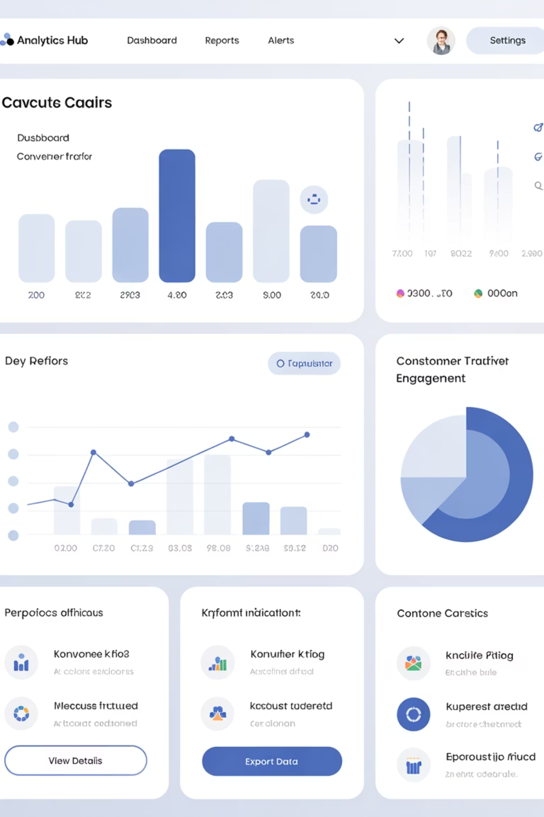
Measuring Your Storytelling Impact
3x
85%
40%
Faster Decisions
Executive Engagement
Resource Approval Rate
Well-framed updates reduce decision time by providing clear context and recommended actions
Strategic storytelling increases leadership participation in transformation discussions
Narrative-driven requests show higher success rates than data-only presentations

Slide 12

Common Pitfalls to Avoid
❌ What Doesn't Work
✅ What Drives Success
Data dumps without context
Insights with clear implications
Focusing only on metrics
Balanced progress and risks
Avoiding difficult conversations
Proactive challenge framing
Inconsistent messaging formats
Consistent narrative structure
Reactive problem reporting
Strategic decision requests
Avoid the trap of overwhelming executives with information. Instead, focus on delivering insights that enable action and build confidence in your program leadership.

Slide 13
Your Path to Strategic Influence
01
02
03
Audit Your Current Reporting
Adopt the Three-Question Framework
Practice Strategic Framing
Evaluate whether your updates inform or inspire executive action
Transform data points into decision-ready insights with proper context
Structure every update around progress, challenges, and leadership needs
04
05
Establish Communication Rhythm
Measure and Refine
Create predictable, consistent formats that build executive confidence
Track decision speed and executive engagement to optimize your approach

Slide 14


Master Strategic Storytelling
Great reporting doesn't just reflect reality—it helps create the reality you want to see by aligning executives around priorities, risks, and opportunities.
In high-visibility transformation programs, the difference between being seen as a reporter versus a strategic orchestrator often comes down to how well you tell your program's story.
When you master the art of strategic storytelling, your updates will not only inform but also inspire action, build stakeholder trust, and accelerate transformation success. Your reporting becomes a powerful leadership tool that shapes decisions and drives meaningful organizational change.
Transform your next executive update using these strategic storytelling principles and experience the difference in leadership engagement and decision-making speed.

