Slide 1
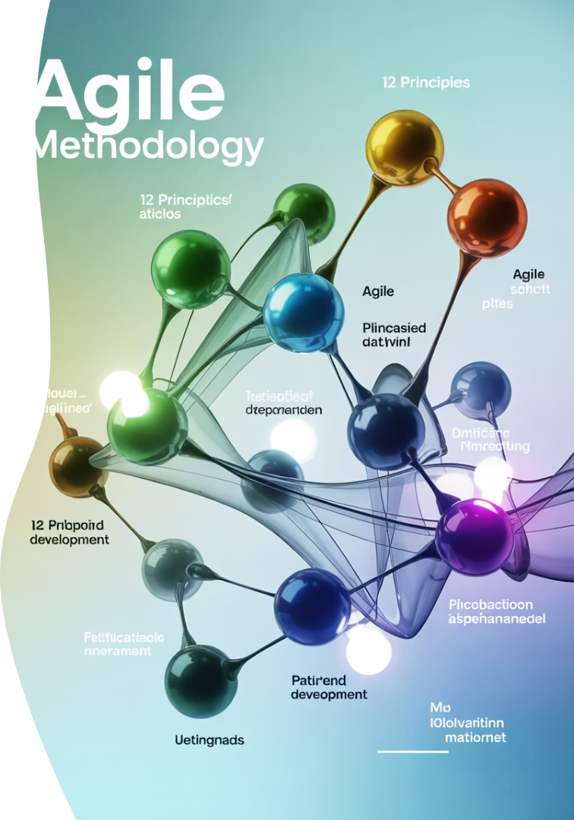
Embracing the Agile Manifesto: A Deep Dive into Its 12 Principles
When the Agile Manifesto was first introduced in 2001 by 17 software thought leaders, it redefined how teams approached software development. While its four core values are widely cited, the true depth of Agile lies in the 12 guiding principles.
These principles provide a framework for delivering high-quality solutions through collaboration, adaptability, and continuous improvement. Join us as we explore each principle and discover how they foster agility across projects and organizations.
kW
by Kimberly Wiethoff

Slide 2





The Agile Journey: An Overview
Origins
Created in 2001 by 17 software development leaders seeking alternatives to documentation-driven processes
The Manifesto
Four values and twelve principles that emphasize individuals, working software, collaboration, and responsiveness
Global Adoption
Widespread implementation across industries beyond software development
Evolution
Continuous refinement with methodologies like Scrum, Kanban, and SAFe adapting the core principles
The Agile journey represents a fundamental shift in how organizations approach complex projects. From its humble beginnings as a reaction to heavyweight methodologies, Agile has grown into a global movement that continues to evolve while staying true to its foundational principles.

Slide 3




Principle 1: Customer Satisfaction
Early Delivery
Continuous Delivery
Valuable Software
Providing working software from the beginning of the project rather than waiting for a final release
Regular releases that incrementally add value and maintain momentum
Focus on features that directly address customer needs and business goals
Delivering working software frequently ensures customers see real progress and gain confidence in the team's ability to meet their needs. This approach creates rapid feedback loops that allow for course correction and validation of ideas before investing too much time in the wrong direction.
When customers can interact with working software early in the process, they're more likely to remain engaged throughout the project lifecycle, leading to higher satisfaction and better outcomes.

Slide 4
Principle 2: Embracing Change
Traditional Approach
Agile Approach
Competitive Advantage
Change is seen as costly and disruptive. Requirements are locked early, and modifications require formal change requests and approvals.
Change is welcomed as an opportunity to deliver more value. Teams build flexibility into their process and adapt continuously based on new information.
Organizations that can pivot quickly in response to market feedback, emerging technologies, or changing business conditions gain significant advantages.
The willingness to embrace changing requirements, even late in development, is perhaps one of the most distinctive aspects of Agile methodologies. Rather than viewing change as a threat to project success, Agile teams see it as an opportunity to better serve the customer's evolving needs.
This principle acknowledges that business environments are dynamic and unpredictable, and the most valuable software is that which can adapt alongside the business it serves.

Slide 5




Principle 3: Frequent Delivery Cycles
Plan
Build
Test
Deploy
Select highest-value features for the current iteration
Develop working features with quality in mind
Validate functionality meets requirements
Release to users for feedback and value delivery
Short delivery cycles, typically ranging from a couple of weeks to a couple of months, enable teams to validate assumptions quickly and ensure development remains aligned with business objectives. Each cycle produces a potentially shippable product increment that delivers real value.
This approach reduces risk by breaking large initiatives into manageable chunks and provides multiple opportunities to course-correct based on feedback. Organizations can respond to market changes more effectively and maintain a competitive edge by continuously delivering valuable software.

Slide 6
Principle 4: Cross-Functional Collaboration
Daily Communication
Shared Understanding
Collaborative Decision-Making
Aligned Execution
Continuous alignment ensures the project delivers maximum business value
Regular interactions bridge the gap between technical and business perspectives
Mutual learning leads to better solutions that address real business needs
Joint problem-solving produces more innovative and effective outcomes
The principle that business people and developers must work together daily throughout the project emphasizes that software development is fundamentally a collaborative endeavor. When technical teams operate in isolation from business stakeholders, the resulting products often miss the mark despite technical excellence.
Daily collaboration ensures that developers understand the business context and objectives, while business representatives gain insight into technical constraints and opportunities. This continuous dialogue helps prevent misalignments and enables faster decision-making.

Slide 7






Principle 5: Motivated Individuals
Trust
Freedom to make decisions and take ownership
Support
Resources, tools, and mentorship needed to succeed
Environment
Physical and psychological safety for optimal performance
Building projects around motivated individuals recognizes that people are the most important factor in software success. When team members are passionate about their work and feel a sense of ownership, they naturally give their best effort and creative energy to solving problems.
Leaders in agile organizations focus on removing obstacles, providing necessary resources, and creating conditions where teams can thrive. Rather than micromanaging, they establish clear goals and boundaries, then step back to let teams determine the best way to achieve objectives.

Slide 8



Principle 6: Face-to-Face Communication
Rich Communication
Efficiency
Team Cohesion
Face-to-face interaction captures tone, body language, and immediate feedback that written communication cannot convey. This richness reduces misunderstandings and accelerates mutual understanding.
A five-minute conversation can often resolve questions that might take hours of back-and-forth emails. Complex topics in particular benefit from real-time dialogue and the ability to sketch ideas visually.
Regular face-to-face interaction, whether physical or virtual, builds stronger relationships and trust among team members. This foundation supports more effective collaboration during challenging situations.
While digital communication tools have their place in modern development environments, Agile emphasizes that the most efficient and effective method of conveying information remains face-to-face conversation. This principle has adapted to include high-quality video calls in distributed teams, maintaining the essence of real-time human connection.

Slide 9
Principle 7: Working Software as Progress Measure
Traditional Metrics
Agile Metrics
Progress measured by completing phases, producing documents, or following processes
Progress measured by delivering functional, valuable software
Working features
Requirements documents
Customer usage
Design specifications
Business value delivered
Status reports
User feedback
Gantt charts
The principle that working software is the primary measure of progress cuts through the illusion of progress that can be created by intermediate artifacts like documentation or partially completed work. At the end of the day, only software that actually works provides value to users and the business.
This focus on tangible results helps teams prioritize what truly matters—delivering functioning software that meets customer needs—over activities that might feel productive but don't directly contribute to the end goal.

Slide 10




Principle 8: Sustainable Development Pace
Team Wellbeing
Consistent Output
Quality Thinking
Team Longevity
Physical and mental health supported
Space for creativity and problem-solving
Reduced turnover and knowledge retention
Reliable, predictable delivery over time
Agile processes promote sustainable development by recognizing that software development is a marathon, not a sprint. While short bursts of increased effort might occasionally be necessary, consistently pushing teams beyond their capacity leads to burnout, technical shortcuts, and ultimately reduced productivity.
Maintaining a sustainable pace ensures that teams can continue to deliver value consistently over time. It acknowledges the human factors in software development and prioritizes long-term effectiveness over short-term gains.

Slide 11

Principle 9: Technical Excellence
42%
65%
3x
Productivity Boost
Defect Reduction
Faster Changes
Teams with strong technical practices show higher productivity
Clean code results in fewer bugs and issues
Well-designed systems enable quicker adaptations
Continuous attention to technical excellence and good design enhances agility by creating a solid foundation that can accommodate change. When code is clean, well-tested, and thoughtfully structured, teams can respond to new requirements without being hampered by a fragile codebase.
This principle reminds us that technical practices like test-driven development, continuous integration, refactoring, and pair programming are not optional luxuries but essential investments in the team's ability to maintain an agile response to change over time.

Slide 12

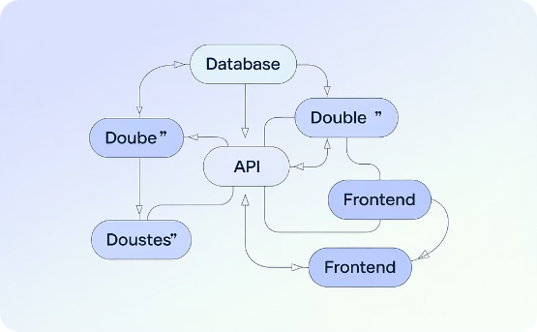

Principle 10: Simplicity
Complexity
Simplicity
Refactoring
When systems grow without attention to simplicity, they become difficult to understand, maintain, and change. Excessive features and over-engineering create cognitive load and technical debt.
The art of maximizing work not done means focusing on what delivers the most value with the least complexity. Simple solutions are easier to adapt, extend, and maintain over time.
Ongoing simplification requires regular refactoring to remove unnecessary code, consolidate duplicate functionality, and improve design as the system evolves.
The principle that simplicity—the art of maximizing the amount of work not done—is essential reminds us that the best feature is often the one we decide not to build. Each line of code, feature, or process step added to a system increases its complexity and maintenance burden.

Slide 13




Principle 11: Self-Organizing Teams
The best architectures, requirements, and designs emerge from self-organizing teams because those closest to the work have the most detailed understanding of the challenges and possible solutions. When teams are empowered to make decisions about how to approach their work, they tap into their collective intelligence and creativity.
Self-organization doesn't mean chaos or absence of leadership. Rather, it's about creating space for team members to exercise their expertise and take ownership of outcomes. Leaders provide context, constraints, and clarity about objectives, then trust the team to determine the best path forward.

Slide 14
Principle 12: Regular Reflection
Iterate
Adjust
The cycle repeats regularly, creating a continuous improvement loop. Each retrospective includes follow-up on previous adjustments to measure their effectiveness.
Analyze
The team commits to specific, actionable changes to their work approach. These adjustments are implemented immediately in the next work period.
Reflect
Through discussion, the team finds patterns and root causes behind challenges. They celebrate successes to reinforce effective practices and prioritize opportunities for improvement.
The team examines recent work periods, identifying what went well and what could be improved. Members share observations about processes, tools, collaboration, and outcomes.
At regular intervals, the team reflects on how to become more effective, then tunes and adjusts its behavior accordingly. This principle embodies the heart of agility: the ability to learn and adapt based on experience.

Slide 15
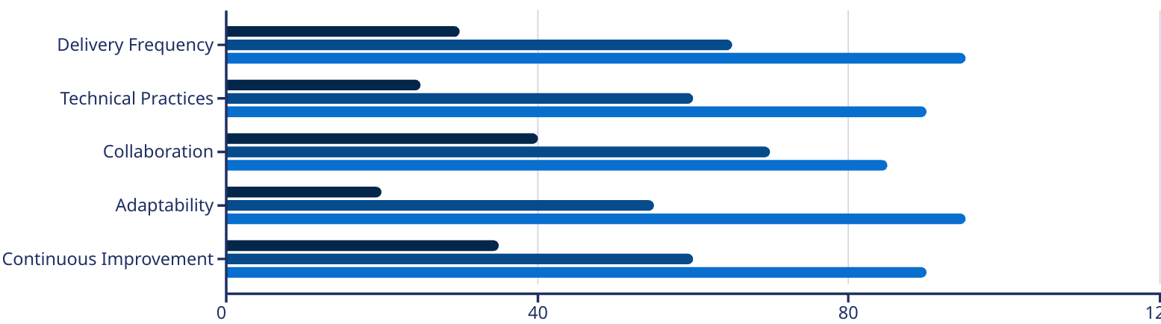
Adopting Agile: A Continuous Journey
Beginners
Practitioners
Masters
The Agile Manifesto's 12 principles represent a mindset shift rather than a methodology. Organizations at different stages of their Agile journey demonstrate varying levels of capability across key dimensions, as shown in the chart above.
Adopting Agile isn't a one-time decision—it's a continuous journey of growth and refinement. True agility comes from deeply internalizing these principles and applying them thoughtfully to your unique context. Start where you are, embrace experimentation, and remember that becoming agile is itself an agile process.

Slide 16

Final Thoughts
The Agile Manifesto's 12 principles are more than just guidelines—they are a mindset. They challenge us to prioritize people over process, results over bureaucracy, and adaptability over rigid planning. Whether you're managing software development, cloud migrations, or enterprise-wide transformations, these principles are timeless.

