Slide 1

Digital Twins in Supply Chain Management
A game-changer for visibility, agility, and resilience in today's complex global operations.
In a world where supply chain disruptions are more frequent and global operations more complex, digital twins have emerged as a powerful tool to improve real-time visibility, predictability, and resilience. Once confined to high-tech sectors like aerospace and manufacturing, digital twin technology is now making waves in supply chain management—and it’s transforming how companies plan, monitor, and optimize every link in the chain.
kW
by Kimberly Wiethoff

Slide 2

What Is a Digital Twin?
Virtual Replica
Data-Driven
Interactive
A real-time digital representation of a physical system, process, or asset.
Pulls live data from sensors, ERP systems, IoT devices, and other sources.
Allows monitoring, analysis, and experimentation with the digital model.

Slide 3





How Digital Twins Work
Data Integration
Pulls structured and unstructured data from across the supply chain.
Modeling
Builds a digital model of the supply chain or sub-system.
Simulation & Prediction
Runs "what-if" scenarios to predict outcomes of decisions or disruptions.
Visualization
Displays real-time operations in a user-friendly interface.

Slide 4

Logistics & Transportation Optimization
Route Planning
Dynamic Adjustments
Simulate alternatives based on real-time conditions.
Automatically update schedules as conditions change.
1
2
3
Risk Assessment
Evaluate weather or geopolitical risks before they impact deliveries.

Slide 5








Inventory Management
Real-Time Stock Data
Flow Modeling
Connect to live inventory levels across locations.
Visualize how inventory moves through your network.
Buffer Optimization
Optimal Reorder Points
Minimize both overstock and stockouts.
Calculate ideal timing and quantities for replenishment.

Slide 6
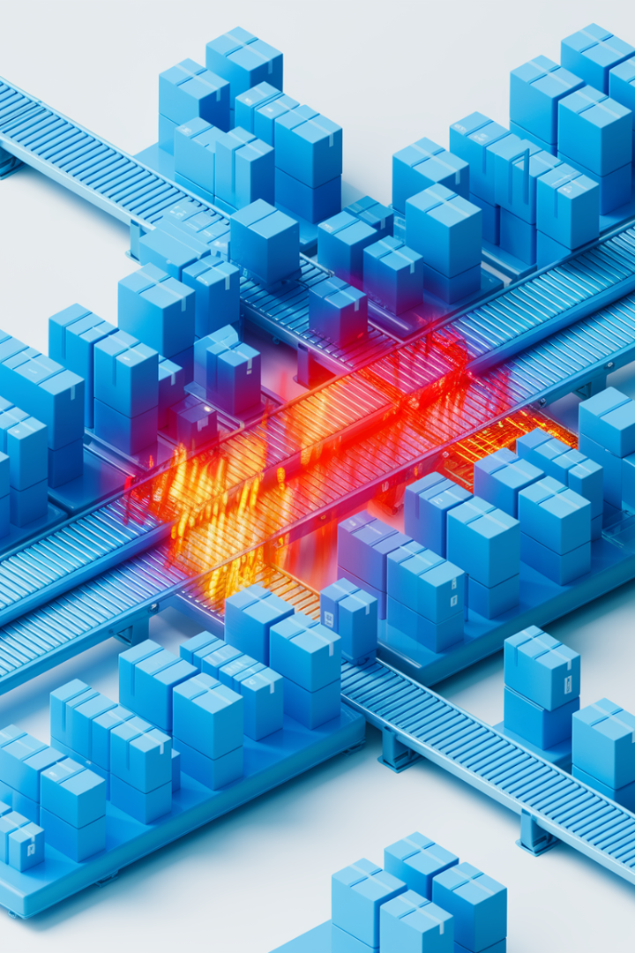




Warehouse Performance Monitoring
Layout Optimization
Test different configurations virtually before implementing changes.
Staffing Simulations
Model optimal worker distribution and scheduling.
Bottleneck Detection
Identify and resolve operational constraints in real-time.
Picking Strategy Analysis
Compare efficiency of different order fulfillment methods.

Slide 7








Supplier Network Risk Assessment
Proactive Mitigation
Implement strategies before disruptions occur.
Alternative Sourcing
Identify backup suppliers and routes.
Disruption Simulation
Model factory shutdowns or supplier bankruptcies.
Network Mapping
Visualize your entire supplier ecosystem.

Slide 8








Sustainability and Carbon Tracking
Packaging Alternatives
Route Optimization
Find the most fuel-efficient transportation options.
Test environmental impact of different materials.
Carbon Footprint
Measure emissions across your supply chain operations.
ESG Alignment
Track progress toward sustainability goals.

Slide 9

Key Benefits of Digital Twins
1
Visibility
Complete view of operations across global nodes.
2
Faster Decisions
Average reduction in response time to disruptions.
3
Cost Savings
Typical reduction in expedited shipping costs.
4
Resilience
Improved ability to withstand supply chain shocks.

Slide 10

Getting Started: Step 1-2
Start Small
Choose a single use case like warehouse or transportation flow. Prove value before scaling to larger operations.
Ensure Data Readiness
Invest in data governance and integration across systems. Clean, accurate data is essential for digital twin success.

Slide 11

Getting Started: Step 3-5
Select the Right Tools
Choose platforms offering real-time modeling, analytics, and simulation capabilities.
Build a Cross-Functional Team
Involve IT, operations, data science, logistics, and business stakeholders.
Define Clear Success Metrics
Measure results through KPIs like cost savings and lead time reduction.

Slide 12
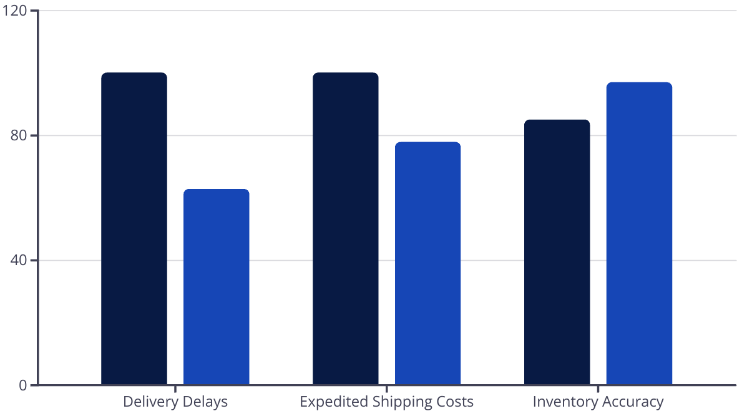
Real-World Success Story
A global retailer implemented digital twins to model its North American distribution network. They now simulate disruptions and reroute goods proactively.
Before Digital Twin
After Digital Twin

Slide 13





The Future of Digital Twins
Autonomous Systems
Blockchain Integration
Augmented Reality
End-to-End Lifecycle
Self-correcting supply chains with minimal human intervention.
Enhanced transparency and traceability across networks.
Immersive visualization for warehouse and logistics operations.
Digital twins that follow products from creation to disposal.

Slide 14



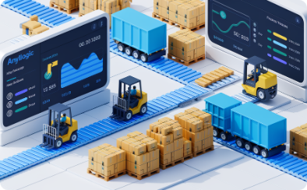
Popular Digital Twin Platforms
Siemens Digital Twin
IBM Sterling
Microsoft Azure Digital Twins
AnyLogic
Comprehensive platform with strong manufacturing integration.
Robust AI-powered supply chain intelligence platform.
Specialized in simulation modeling across industries.
Cloud-based solution with strong IoT capabilities.

Slide 15



Final Thoughts
Present-Day Advantage
Digital twins are no longer futuristic—they're here now.
Strategic Imperative
They offer unprecedented opportunities for smarter decisions.
Competitive Edge
Lead with precision in an increasingly volatile world.

