Slide 1


Integrating AI and Machine Learning into Hedge Fund Operations
Artificial intelligence and machine learning are transforming hedge fund operations, evolving from buzzwords to essential components of competitive strategy. From predicting market movements to enhancing sentiment analysis and optimizing trade execution, AI is revolutionizing how funds operate.
This presentation will guide project managers through the essential considerations when implementing AI initiatives in hedge fund environments, providing practical insights for successful integration and management.
#HedgeFundTech #ProjectManagement #AIinFinance #MachineLearning #QuantPM #FintechProjects #AgileFinance #DataDrivenPM #CapitalMarkets #PMLeadership #InnovationInFinance

Slide 2

Business Objectives First
75%
3X
AI Projects
ROI
Fail due to unclear business objectives
Higher for projects with clearly defined goals
24%
Alpha Gain
Average improvement with targeted AI models
Before diving into technology, project managers must clearly define the "why" behind AI implementation. Are you enhancing alpha generation through predictive models? Automating trade reconciliation? Detecting anomalies in transactions for compliance? Starting with business objectives ensures you select the right data, models, and teams.

Slide 3








Aligning Technical and Business Teams
Partnership Building
Knowledge Translation
Create forums for continuous dialogue between quants and business stakeholders
Convert technical concepts into business impact language
Joint KPI Setting
Synchronized Planning
Develop metrics that satisfy both technical excellence and business value
Align sprint planning with market events and business deadlines
AI projects in hedge funds typically originate from quants or data scientists. Your role as a project manager is to bridge the gap between business requirements and technical execution, facilitating sprint planning, aligning model training with key deadlines, and managing data access with compliance approvals.

Slide 4








Data Infrastructure Requirements
Model Deployment
Scalable compute resources and monitoring
Data Storage & Processing
High-performance databases and compute clusters
Data Transformation
Cleaning, normalization, and feature engineering
Data Acquisition
Market feeds, alternative data, internal systems
AI is only as effective as the data powering it. Project managers must ensure clean, labeled, and timely data from market feeds and internal systems. This requires managing data pipelines, APIs, and security protocols while collaborating with DevOps and data engineering teams to maintain data integrity and accessibility.

Slide 5





System Integration Challenges
API Development
Create standardized interfaces between AI systems and existing platforms
Workflow Redesign
Modify processes to incorporate AI insights at decision points
Latency Optimization
Ensure AI outputs meet time-sensitivity requirements for trading
Security Implementation
Deploy access controls and encryption for sensitive financial data
Model outputs must seamlessly integrate with existing systems like Order Management Systems (OMS), Execution Management Systems (EMS), BI tools such as Power BI or Tableau, and internal dashboards used by traders and compliance teams. This requires careful planning around testing, latency management, and change control procedures.

Slide 6
Risk and Explainability Considerations
Regulatory Requirements
Human Oversight
SEC and other regulatory bodies increasingly demand transparency in algorithmic decision-making. Your models must provide clear audit trails and explanations for their outputs.
Implement human-in-the-loop systems where critical decisions receive human validation before execution. This creates a safety mechanism while building trust in the AI system.
Document model assumptions and limitations
Define escalation thresholds for unusual predictions
Establish confidence intervals for predictions
Create approval workflows for high-value transactions
Create visualization tools for model decisions
Build override capabilities for extraordinary market conditions

Slide 7
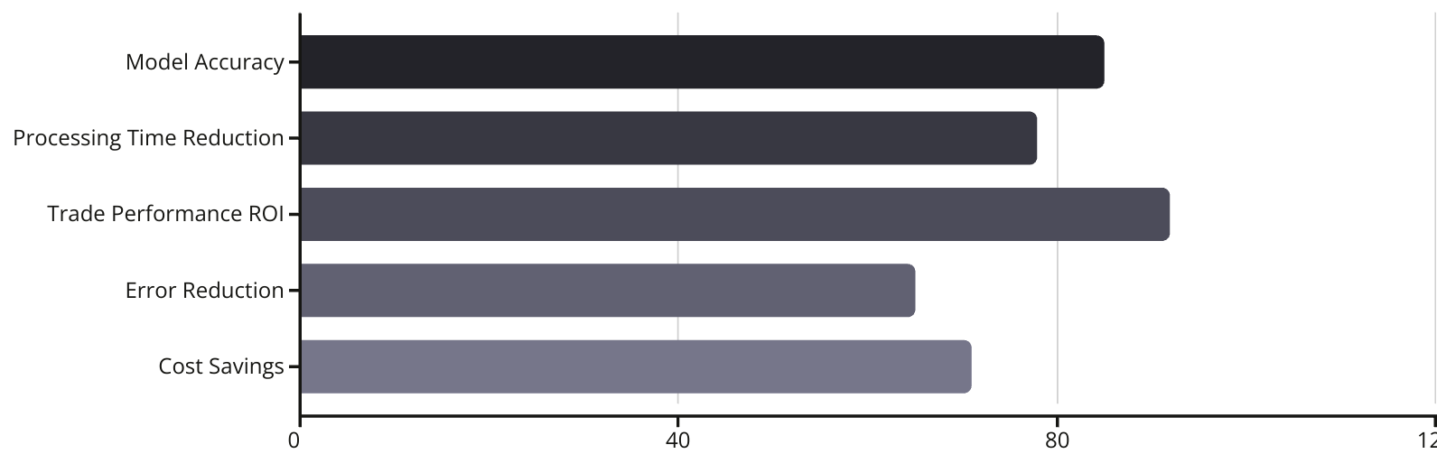
Measuring AI Implementation Success
Measuring impact is critical for demonstrating value and securing ongoing funding. Project managers should track key performance indicators such as model accuracy versus established baselines, processing time reduction, and return on investment in trade performance or operational efficiency.
These metrics provide tangible evidence of AI's contribution to hedge fund operations and help secure executive buy-in for future initiatives.

Slide 8

Change Management Strategies
Stakeholder Education
Conduct workshops and training sessions on AI capabilities and limitations, focusing on how the technology enhances rather than replaces human expertise. Create accessible resources that demystify AI for non-technical team members.
Phased Implementation
Roll out AI capabilities gradually, starting with non-critical functions before moving to core trading operations. This allows teams to build confidence in the technology and adapt workflows incrementally.
Success Celebration
Publicly recognize early wins and showcase how AI tools have improved outcomes or reduced tedious work. Highlight individuals who have effectively incorporated AI into their daily routines.

Slide 9





AI Talent Acquisition and Management
Specialized Recruitment
Partner with HR to develop specific job descriptions that accurately reflect the unique blend of financial knowledge and AI expertise required. Consider candidates from both traditional finance and tech backgrounds.
Competitive Compensation
Develop compensation packages that compete with both tech firms and traditional financial institutions. Consider equity components that align with fund performance enhanced by AI initiatives.
Cross-Functional Teams
Structure teams to include both AI specialists and domain experts from trading, risk, and operations. Facilitate knowledge sharing through regular collaborative sessions and paired programming.
Continuous Learning
Invest in ongoing education through conferences, courses, and research time. Create internal knowledge repositories and communities of practice to share insights across the organization.

Slide 10








Model Monitoring and Maintenance
Retraining Cycles
Anomaly Investigation
Establish regular model refreshes with new market data
Create protocols for examining unexpected model behavior
Performance Tracking
Implement continuous monitoring of model accuracy against market conditions
Scheduled retraining periods
Root cause analysis framework
Version control systems
Market event correlation
Documentation Updates
A/B testing for new versions
Model interpretation tools
Maintain comprehensive records of model changes
Daily accuracy reports
Drift detection algorithms
Compliance-ready audit trails
Automated alerts for degradation
Parameter change history
Performance evolution reports

Slide 11

Cybersecurity for AI Systems
Model Protection
Data Security
Safeguard proprietary algorithms and trained models from intellectual property theft. Implement strict access controls, encryption of model parameters, and monitoring for unauthorized access attempts.
Protect training and production data from breaches. Especially crucial for alternative data sources that may provide competitive advantages in model performance.
Data anonymization protocols
Secure transfer mechanisms
Tokenized access to model APIs
Data lifecycle management
Encrypted model storage
Access logging and review
Adversarial Defense
Build resilience against attempts to manipulate model outputs through adversarial inputs. This is particularly important for models that directly influence trading decisions.
Input validation frameworks
Adversarial training techniques
Anomaly detection systems

Slide 12
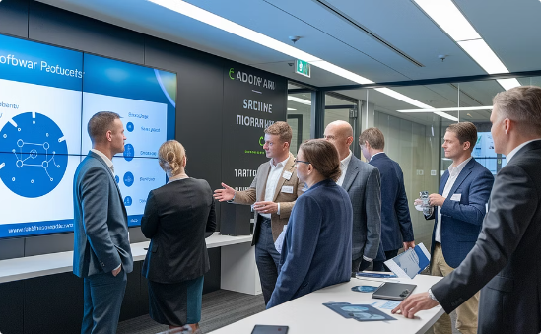


Vendor Selection for AI Tools
Evaluation Criteria
Proof of Concept Testing
Contract Negotiation
Develop a robust framework for assessing AI vendors that looks beyond marketing claims. Evaluate model performance on historical data relevant to your specific use case, not just generic benchmarks. Consider customization capabilities, integration options, and the vendor's financial stability.
Always run a controlled PoC before committing to any vendor solution. Test with a subset of your actual data in a staging environment that mimics production conditions. Set clear success criteria in advance and evaluate both technical performance and user acceptance.
Secure favorable terms that protect your fund's interests. Negotiate for performance guarantees, data ownership clauses, exit strategies, and support SLAs. Ensure contracts address model explainability requirements for regulatory compliance and include provisions for ongoing model updates.

Slide 13




Ethical Considerations in AI Deployment
Fairness & Bias
Ensure models don't perpetuate market inequities
Transparency
Make decision processes explainable to stakeholders
Market Conduct
Prevent manipulation and maintain market integrity
Social Impact
Consider broader implications of AI-driven investing
As AI systems take on greater decision-making responsibilities in hedge funds, project managers must navigate complex ethical considerations. Models must be developed and deployed in ways that maintain market integrity and avoid unintended consequences such as flash crashes or liquidity traps.
Consider establishing an AI ethics committee that includes technologists, traders, compliance officers, and external advisors to review high-impact AI initiatives before deployment.

Slide 14

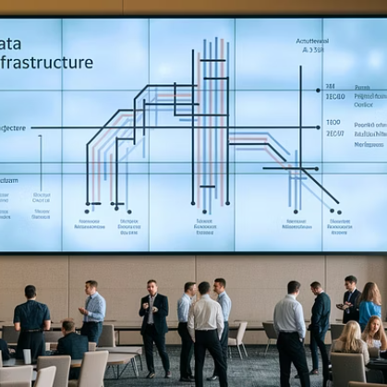


Key Takeaways for Project Managers
Successfully integrating AI into hedge fund operations requires project managers to balance technical expertise with business acumen. Start with clear business objectives before selecting technologies. Bridge the gap between quants and business stakeholders through effective communication and mutual understanding.
Ensure robust data infrastructure and seamless system integration while addressing risk, explainability, and regulatory requirements. Measure success with clear metrics and manage the human side of change through education and gradual implementation.
Remember: in hedge fund AI projects, precision and trust are everything. Your role as translator, facilitator, and strategic partner is crucial to unlocking AI's potential to reshape alpha generation, risk management, and operational efficiency.

