Slide 1

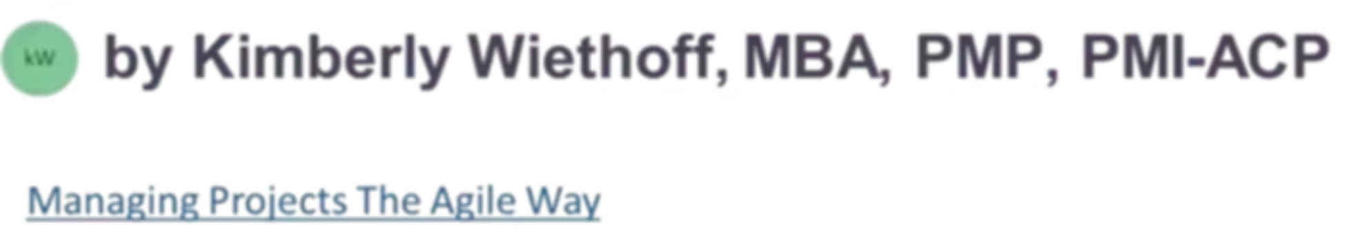
The Program Manager's Guide to AI-Enabled Business Transformation
From pilot projects to enterprise-scale impact — how Program Managers are becoming the essential leaders of AI transformation in the modern organization.
#ArtificialIntelligence #AITransformation #ProgramManagement #DigitalTransformation #Leadership #BusinessTransformation #AgenticAI #GenerativeAI #DataGovernance #ChangeManagement #EnterpriseAI #ProjectManagement #PMO #AgileLeadership #Innovation #BusinessValue #StrategyExecution #FutureOfWork #ManagingProjectsTheAgileWay #TransformationLeadership

Slide 2
The Core Challenge
AI Is Moving from Experimentation to Execution
The Reality
Where Programs Break Down
Organizations across every industry are investing billions in AI to improve customer experiences, automate workflows, enhance decision-making, and unlock new revenue. Yet most struggle to move beyond pilots and proof-of-concepts.
The challenge is rarely the technology itself.
Organizations fail when they underestimate the complexity of integrating AI into business operations, processes, governance structures, and culture. This is precisely where Program Managers become indispensable — connecting strategy to execution, aligning stakeholders, managing dependencies, and guiding organizations through transformational change.

Slide 3


AI Projects Are Different from Traditional Technology Projects
Many organizations approach AI as a standard technology implementation — set a timeline, allocate resources, expect predictable outcomes. AI initiatives require a fundamentally different mindset.
Uncertain Outcomes
Data Complexity
Models improve iteratively; results cannot be fully predicted at project start.
Data quality, access, and governance challenges frequently derail initiatives.
Regulatory & Ethics
Continuous Improvement
Bias monitoring, compliance, and responsible AI require ongoing attention.
AI programs never truly "finish" — models require continuous refinement and monitoring.
Success means creating measurable business outcomes while adapting to rapidly changing conditions — not simply delivering a system on schedule.

Slide 4
Foundational Principle
Start with Business Problems, Not Technology
The Wrong Question
The Right Question
"How can we use AI?"
"What business problem are we trying to solve?"
This framing leads teams to chase technology capabilities before understanding whether those capabilities solve a real business need. The result is AI initiatives that impress technically but fail to deliver value.
When AI becomes the solution to a clearly defined challenge — reducing costs, improving retention, accelerating decisions — organizations are far more likely to achieve meaningful and measurable results.
Program Managers must continuously guide stakeholder discussions back to outcomes, benefits, and value realization. Every AI conversation should be anchored to a specific business objective.

Slide 5

Build a Cross-Functional Coalition
AI transformation is not owned by a single department. Many initiatives fail because teams work in silos rather than in collaboration. Program Managers must establish governance structures that encourage alignment, transparency, and shared ownership.
Business & Product
Executive leadership and product teams define priorities, own outcomes, and provide strategic direction for AI investments.
Technology & Data
Engineering, data science, and architecture teams build and deploy the capabilities that power AI solutions.
Risk & Legal
Compliance, security, and legal teams ensure AI initiatives meet regulatory requirements and manage organizational exposure.
Operations & CX
Operations and customer experience teams ground AI in real-world workflows and ensure adoption at the front line.

Slide 6

Chapter 2 — Foundations
Focus on Data as a Strategic Asset
Organizations frequently discover that data — not AI — is their biggest challenge. AI systems rely on accurate, accessible, and trustworthy data. Without addressing foundational data issues, even the most advanced models will fail to produce meaningful results.
Program Managers should ensure data readiness is incorporated into program planning, risk management, and governance from day one. In many cases, data modernization becomes the first phase of AI transformation.
Common Data Obstacles
Poor Data Quality
Inaccurate or outdated records undermine model reliability.
Data Silos
Fragmented systems prevent unified, accessible data assets.
Never treat data preparation as a downstream concern — it is the critical path of every AI program.
Governance Gaps
Undefined ownership and inconsistent definitions create risk.

Slide 7

Establish AI Governance Early
As AI capabilities expand, governance becomes critical infrastructure — not an afterthought. Without it, organizations expose themselves to operational, legal, reputational, and compliance risks.
1
2
Decision Authority
Risk & Compliance
Define who is accountable for AI-driven decisions and outcomes across the organization.
Document regulatory requirements and establish controls for bias monitoring and data privacy.
3
4
Model Monitoring
AI Content Controls
Define performance thresholds, drift detection processes, and model refresh cadences.
Establish guardrails for AI-generated content, including review workflows and approval standards.
Strong governance creates organizational confidence and enables responsible, sustainable AI scaling.

Slide 8

Scaling AI
Move Beyond Pilots to Enterprise Scale
Why Pilots Stall
What Scaling Requires
Many organizations successfully launch AI pilots but struggle to achieve enterprise adoption. A pilot demonstrates technical feasibility — but scaling requires an entirely different level of coordination across technology, operations, people, and culture.
The transition from pilot to production is where the greatest transformation challenges emerge.
Technology Integration
Process Redesign
Connect AI capabilities to enterprise systems and workflows.
Remap operational processes to take full advantage of AI capabilities.
Training & Adoption
Continuous Improvement
Equip employees with skills and drive behavioral change organization-wide.
Monitor performance, gather feedback, and iterate after go-live.
Organizations that successfully scale AI treat implementation as an enterprise change initiative — not a technology deployment.

Slide 9
Value Realization
Measure What Matters
One of the most important responsibilities of a Program Manager is defining — and communicating — success. AI teams and executives often speak different languages when it comes to measurement.
What AI Teams Track
What Executives Care About
Model Accuracy
System Performance
Business Impact
Customer Outcomes
Prediction precision and error rates
Response times and processing speed
Revenue growth, cost savings, and productivity gains
Satisfaction scores, retention rates, and experience improvements
Program Managers must establish measurement frameworks that connect AI capabilities directly to business results. This alignment sustains executive support and ensures investment decisions remain focused on value creation rather than technical milestones.

Slide 10



Change Management Is the Real Transformation
Technology implementation is often the easiest part of an AI initiative. The harder challenge is helping people adapt. Unaddressed concerns create resistance that quietly undermines even well-designed programs.
Employee Concerns
Manager Skepticism
Customer Hesitation
Fear of job displacement and uncertainty about new roles must be addressed proactively through transparent communication and reskilling programs.
Leaders who question AI-generated recommendations need structured trust-building — including explainability, pilot evidence, and peer validation.
Customers may distrust automated interactions. Gradual rollouts with human oversight and clear feedback channels help build confidence over time.

Slide 11
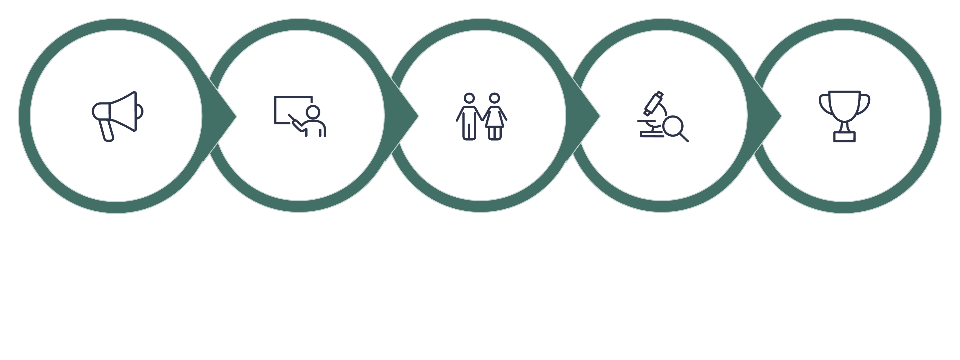
Change Management Framework
A Program Manager's People Strategy
Communicate
Train
Engage
Measure
Sustain
The organizations that achieve the greatest success with AI are those that invest as much in people strategy as they do in technology. A structured change management approach is not optional — it is a core program deliverable.

Slide 12

The Next Frontier
The Rise of Agentic AI
The next phase of AI transformation is already emerging. Traditional AI systems provide recommendations and insights. Agentic AI goes further — it takes action.
What AI Agents Can Do
New Governance Demands
Execute multi-step workflows, coordinate tasks across systems, interact with enterprise platforms, resolve customer issues autonomously, and perform routine business processes end-to-end.
As organizations deploy AI agents, Program Managers will face heightened questions around accountability, human oversight, security boundaries, and real-time performance monitoring.
Why Prepare Now
Organizations that build governance, risk, and operational frameworks today will be significantly better positioned to scale agentic AI capabilities as they mature.

Slide 13
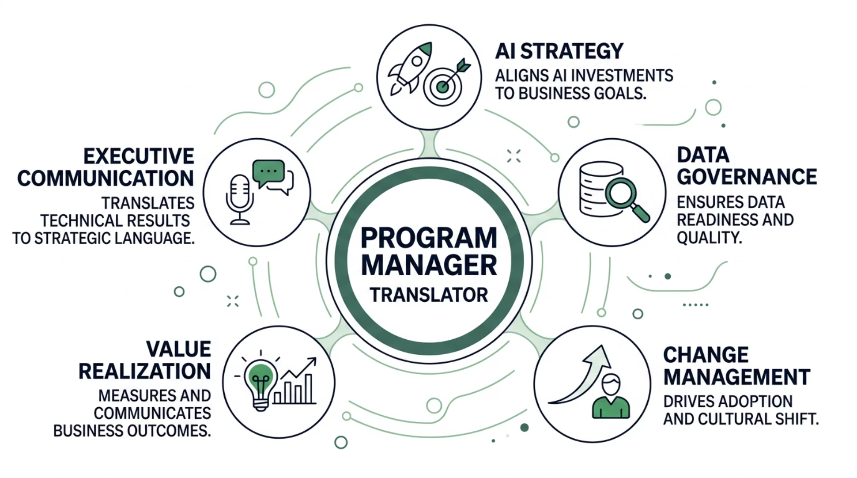

Looking Ahead
The Evolving Role of the Program Manager
AI is reshaping how organizations operate, compete, and innovate. As a result, the Program Manager's role is expanding well beyond traditional project delivery.
Tomorrow's Program Managers will serve as translators between business leaders, technical experts, and operational teams — ensuring AI investments generate real, lasting business outcomes rather than isolated technical achievements.

Slide 14

Final Thoughts
Leadership Is the Future of AI Transformation
The Core Truth
Your Strategic Mandate
Artificial Intelligence is not simply another technology trend. It represents a fundamental shift in how organizations make decisions, engage customers, and operate at scale.
The organizations that succeed will not necessarily be those with the most advanced algorithms. They will be the ones that effectively align strategy, governance, people, processes, and technology.
01
02
Anchor to Business Outcomes
Build Governance Early
Keep every AI initiative tied to measurable value.
Establish frameworks before risk becomes crisis.
03
04
Lead the People Agenda
Measure and Communicate
Champion change management as a core program workstream.
Connect AI performance to the metrics executives care about.
Program Managers are uniquely positioned to lead AI transformation — from experimentation to enterprise-scale impact.

