Slide 1

How to Manage AWS Costs in Your Projects: A PM's Guide to Cloud Budgeting
One of the biggest cloud adoption myths is that moving to AWS will automatically reduce IT costs. While AWS can provide scalability, flexibility, and efficiency, the pay-as-you-go model means that costs can quickly spiral out of control if not managed properly.
As a Project Manager (PM) leading an AWS initiative, you're not just responsible for timelines and deliverables—you also need to keep cloud costs under control and align budgets with business goals.
kW
by Kimberly Wiethoff

Slide 2
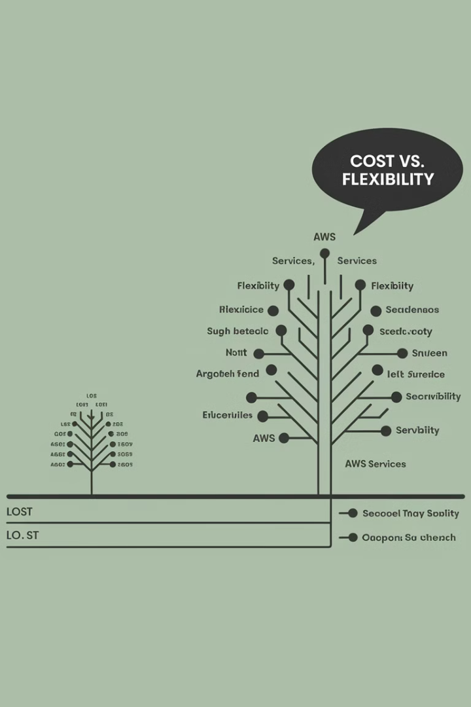
Understanding AWS Pricing Models
1
On-Demand Instances
Pay per hour/second for compute resources. Best for short-term, unpredictable workloads (but expensive).
2
Reserved Instances (RIs)
Commit to 1-3 years upfront for major discounts (up to 72% savings). Ideal for long-term workloads.
3
Savings Plans
Flexible pricing model offering discounts in exchange for long-term usage commitment.
4
Spot Instances
Unused AWS capacity sold at steep discounts (up to 90%). Best for non-critical, batch jobs, or test environments.

Slide 3

Building a Cloud Cost Management Strategy
Define Budget Expectations Early
Work with finance teams to estimate AWS costs upfront before project kickoff.
Set Up AWS Cost Alerts
Use AWS Budgets to create alerts when spending exceeds predefined limits.
Use Cost Allocation Tags
Track costs by project, department, or environment to see where money is going.
Monitor Data Transfer Costs
Moving data between AWS regions and services can be unexpectedly expensive.

Slide 4





Essential AWS Cost Management Tools
AWS Cost Explorer
AWS Budgets
AWS Trusted Advisor
Provides visuals and reports on AWS spending trends, allowing you to analyze costs by service, account, or custom tags.
Sends alerts if usage or costs exceed preset thresholds, helping you stay within financial guardrails.
Recommends cost-saving opportunities by identifying underutilized resources and inefficient configurations.
AWS Compute Optimizer
Suggests better instance types to optimize performance vs. cost based on actual usage patterns.

Slide 5
Optimizing Compute Costs
Right-size EC2 Instances
Implement Auto-Scaling
Leverage Serverless
Scale resources to match actual usage rather than overprovisioning. Many organizations waste money on instances that are too large for their workloads.
Automatically add/remove instances based on demand patterns. This ensures you're only paying for compute resources when they're actually needed.
Use AWS Lambda to eliminate idle costs by running code only when triggered. This pay-per-execution model can significantly reduce costs for intermittent workloads.
Regularly review utilization metrics and downsize instances that consistently show low CPU or memory usage.
Set up scaling policies based on metrics like CPU utilization, network traffic, or application-specific indicators.

Slide 6
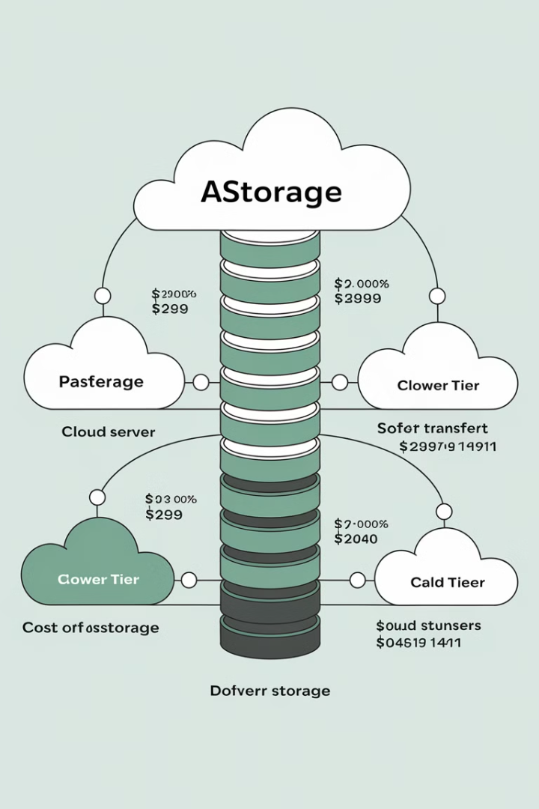
Optimizing Storage Costs
1
Implement S3 Lifecycle Policies
Automatically move infrequently accessed data to cheaper storage tiers like S3 Standard-IA or S3 Glacier after predefined periods.
2
Use Amazon S3 Glacier
Store archival data at 90% lower cost when immediate access isn't required. Perfect for compliance data, backups, and historical records.
3
Delete Unused Snapshots & Volumes
Regularly audit and remove unnecessary EBS storage to avoid paying for resources that aren't providing value.
4
Compress Data Where Possible
Implement compression for databases and file storage to reduce the overall storage footprint and associated costs.

Slide 7
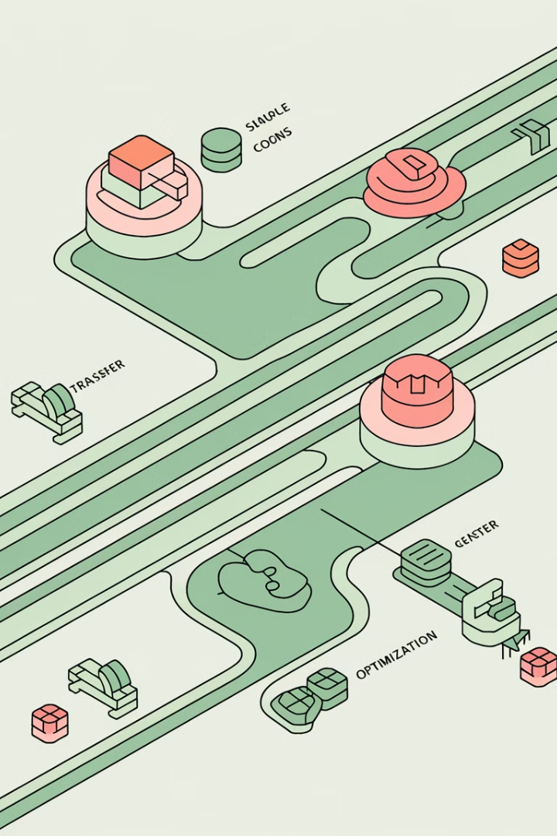
Reducing Networking & Data Transfer Costs
Use AWS PrivateLink
Reduces traffic between AWS services by keeping it inside AWS network, avoiding expensive public internet data transfer fees.
Optimize Cross-Region Traffic
Avoid unnecessary cross-region replication as data transfer between AWS regions incurs significant charges. Consolidate workloads where possible.
Implement Amazon CloudFront
Use this CDN to reduce bandwidth costs by caching content closer to users, minimizing repeated transfers from origin servers.
Remove Unused Network Resources
Regularly audit and eliminate unused Elastic IPs, Load Balancers, and NAT Gateways that continue to generate charges.

Slide 8





Monthly Cost Review Process
Identify Optimization Opportunities
Analyze Cost Reports
Pinpoint resources that are underutilized or could be moved to more cost-effective options.
Review AWS Cost Explorer data to identify spending trends and anomalies.
2
1
Implement Cost-Saving Measures
3
Apply recommended changes to reduce waste and improve efficiency.
5
Report to Stakeholders
4
Track Results
Share cost performance metrics with leadership and project teams.
Measure the impact of optimization efforts and document savings achieved.

Slide 9





Building a Cost-Conscious Culture
Make Cost Reviews a Regular Practice
Include finance, engineering, and PMO teams in recurring AWS cost review meetings. Create a shared responsibility model for cloud spending.
Set Clear Cost KPIs
Track metrics like cost per user, cost per API request, or cost per compute hour to measure efficiency and identify opportunities.
Educate Teams on Cost Awareness
Encourage engineers to choose cost-efficient AWS services and understand the financial impact of their technical decisions.
Enable Self-Service Cost Dashboards
Give teams visibility into how their work impacts cloud costs through accessible reporting tools.

Slide 10
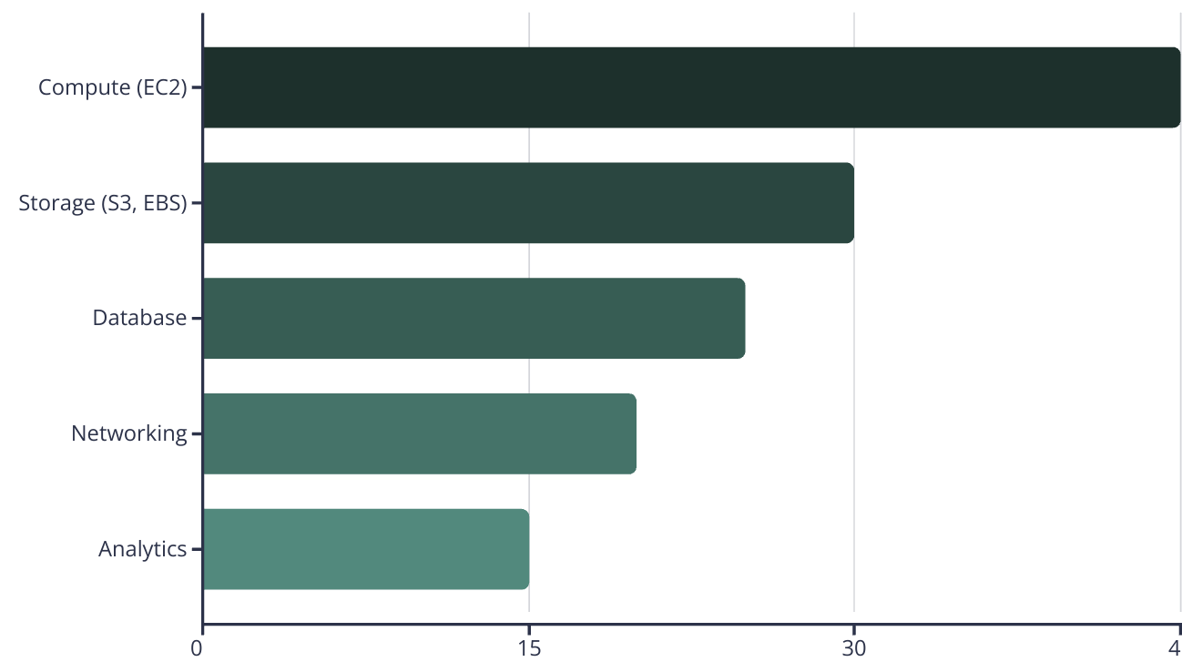
AWS Cost Optimization by Service Type
The chart illustrates typical potential savings percentages across major AWS service categories. Compute services like EC2 often present the greatest optimization opportunities, followed by storage services. This is why right-sizing instances and implementing lifecycle policies should be prioritized in cost management efforts.

Slide 11

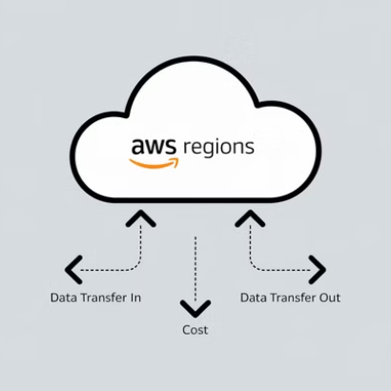

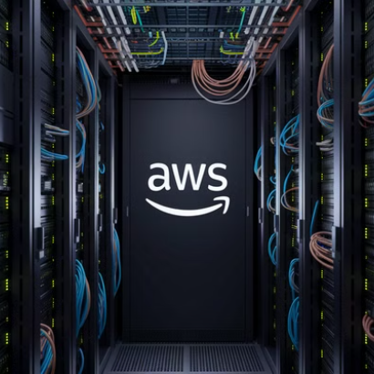
Common AWS Cost Pitfalls to Avoid
Project managers should be vigilant about these common cost traps: forgotten test environments that continue to run and generate charges, expensive cross-region data transfers that could be avoided, oversized instances with consistently low utilization, and untagged resources that make cost allocation impossible.
Implementing regular audits and automated policies can help identify and eliminate these unnecessary expenses before they impact your project budget.

Slide 12

Case Study: AWS Cost Optimization Success
72%
Cost Reduction
By implementing Reserved Instances for predictable workloads
$45K
Monthly Savings
Through right-sizing and removing unused resources
30%
Storage Savings
Using S3 lifecycle policies and Glacier for archival
3x
ROI
Return on investment for cost optimization efforts
A financial services company implemented a comprehensive AWS cost optimization strategy led by their project management office. By focusing on the right pricing models, eliminating waste, and building a cost-conscious culture, they achieved significant savings while maintaining performance and reliability.

Slide 13





Key Takeaways: Managing AWS Costs as a PM
Drive Cultural Change
1
Make cost optimization everyone's responsibility
Implement Regular Reviews
2
Schedule monthly cost analysis meetings
Use AWS Cost Tools
3
Leverage Cost Explorer, Budgets, and Trusted Advisor
Understand AWS Pricing
4
Know the pricing models and their best applications
Plan Before Migration
5
Set clear budget expectations from the start
Keeping AWS projects within budget is just as important as meeting deadlines and deliverables. As a Project Manager, you play a crucial role in balancing technical requirements with financial constraints. By implementing these strategies, you can deliver successful cloud projects while avoiding unexpected costs.

Slide 14

Final Thoughts
Keeping AWS projects within budget is just as important as meeting deadlines and deliverables. As a Project Manager, you can:
1
Understand AWS pricing models to avoid surprises.
2
Leverage AWS cost tracking tools to monitor cloud spend.
3
Implement cost optimization strategies for compute, storage, and networking.
4
Build a cost-conscious project culture to sustain long-term savings.

