Slide 1
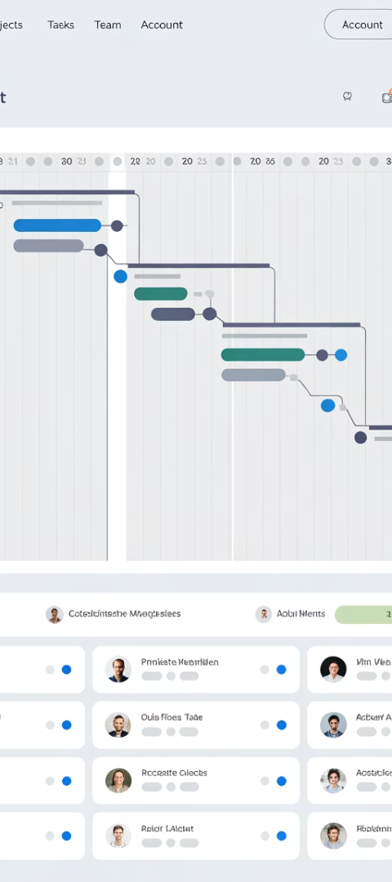
Microsoft Dynamics 365 or Microsoft Project: Which One Is Right For You?
Choosing the right project management software is critical for organizations seeking to streamline operations and ensure project success. Microsoft offers two powerful solutions - Dynamics 365 Project Operations and Project for the Web - each designed to serve different organizational needs and project complexities.
This presentation will guide project managers and PMO leaders through the key differences between these platforms, helping you determine which solution aligns best with your organization's specific requirements.
kW
by Kimberly Wiethoff

Slide 2
Understanding Project for the Web
Project for the Web is Microsoft's modern, cloud-based project management solution built on the Power Platform. It offers an intuitive interface with grid, board, and timeline views that simplifies project planning and execution for teams of various sizes.
This lightweight tool integrates seamlessly with Microsoft Teams and the broader Office 365 ecosystem, enabling real-time collaboration and enhanced productivity without overwhelming users with complex features they may not need.
Simple Scheduling
Team Collaboration
Drag-and-drop interface for timeline management and resource assignment
Native integration with Microsoft Teams for seamless communication
Workflow Automation
Cloud-Based Access
Power Automate support for creating custom workflow processes
Work from anywhere with consistent access across devices

Slide 3
Exploring Dynamics 365 Project Operations
Dynamics 365 Project Operations delivers comprehensive enterprise-grade project management capabilities by combining robust project scheduling with financial management, resource optimization, and customer relationship management.
This full-featured solution addresses the complex needs of professional services organizations managing billable projects, with deep integration across the Microsoft ecosystem for end-to-end business process management.
Analytics & BI
Advanced reporting and business intelligence
Financial Management
Billing, revenue recognition, and cost tracking
Resource Management
Capacity planning and skills-based allocation
Project Management
Scheduling, task management, and collaboration

Slide 4
Key Feature Comparison
Understanding the specific capabilities of each platform is essential for making an informed decision that aligns with your organization's project management maturity and business requirements.
While both solutions share Microsoft's commitment to user experience and integration, they differ significantly in depth, complexity, and specialized features designed for different use cases.
Feature
Project for the Web
D365 Project Operations
Complexity
Low to Moderate
High
Target Audience
Individuals, Small Teams
Enterprises, PMOs, Consultants
Financial Management
Not Included
Full project accounting + billing
Resource Management
Basic
Advanced with skill-matching
Customization
Yes (Power Platform)
Yes (More extensive)
Integration with CRM/ERP
Limited
Deep integration with D365 apps
Reporting
Basic
Advanced with Power BI
Licensing/Cost
Lower
Higher (broader capabilities)

Slide 5
Project for the Web: Ideal Use Cases
Project for the Web excels in environments where simplicity, quick adoption, and core project management functionality are the primary requirements. Its intuitive interface makes it accessible to users with varying levels of project management experience.
Organizations with straightforward project structures and those deeply invested in the Microsoft 365 ecosystem can achieve significant productivity gains without the learning curve of more complex systems.
Departmental Initiatives
Small to Medium Teams
Perfect for managing internal projects within individual departments that don't require complex financial tracking or enterprise-wide resource optimization.
Ideal for teams of under 25 members looking for straightforward task assignment, timeline visualization, and basic collaboration tools.
Microsoft 365 Organizations
Cost-Sensitive Deployments
Maximizes value for businesses already using Teams, SharePoint, and other Microsoft 365 apps through seamless integration and familiar interface patterns.
Delivers essential project management capabilities at a lower price point, making it accessible for organizations with limited budget allocation for PM tools.

Slide 6
Dynamics 365 Project Operations: Ideal Use Cases
Dynamics 365 Project Operations addresses the multifaceted needs of organizations managing complex, often billable project portfolios where financial management and resource optimization are critical success factors.
The platform's comprehensive capabilities make it particularly valuable for professional services organizations and enterprise PMOs that require deep integration between project management, financials, and customer relationship management.
Professional Services Firms
Enterprise PMOs
Complete solution for consulting firms managing billable client engagements
Supports organization-wide project governance and resource management
Dynamics 365 Customers
Multi-Entity Organizations
Maximizes value through integration with existing D365 applications
Handles complex global projects spanning multiple business units

Slide 7
Resource Management Comparison
How each platform handles resource management represents one of the most significant differences between these solutions. Organizations with complex resourcing needs should carefully assess these capabilities against their specific requirements.
Project for the Web offers straightforward resource assignment functionality, while Dynamics 365 Project Operations provides sophisticated capacity planning, utilization tracking, and skills-based matching essential for optimizing professional services delivery.
Project for the Web
Dynamics 365 Project Operations
Basic resource assignment to tasks
Detailed resource requirements planning
Simple views of assigned vs. unassigned work
Skills-based matching and recommendations
Microsoft Teams integration for collaboration
Capacity planning across multiple projects
Limited visibility into resource capacity
Resource utilization tracking and forecasting
No skills-based matching capabilities
Integration with HR for skills and certifications

Slide 8
Financial Management Capabilities
Financial management represents another critical distinction between these platforms. Project for the Web lacks native financial capabilities, while Dynamics 365 Project Operations excels in this area with comprehensive project accounting functionality.
Organizations managing billable work or needing to track project financials in detail should carefully consider these differences when evaluating which solution best meets their requirements.
Project Budgeting
D365 enables detailed budget creation and tracking against actuals, while Project for the Web offers no native budgeting capabilities.
Time & Expense
D365 provides comprehensive timesheet and expense management with approval workflows; Project for the Web has no built-in time tracking.
Billing & Invoicing
D365 supports multiple billing methods (fixed price, T&M) with invoice generation; Project for the Web lacks billing functionality.
Revenue Recognition
D365 handles compliant revenue recognition for project accounting; Project for the Web has no financial tracking capabilities.

Slide 9
Integration Capabilities
Both solutions leverage Microsoft's ecosystem, but with different degrees of depth and breadth. Understanding these integration differences is crucial when evaluating how each platform would fit within your existing technology landscape.
While Project for the Web offers essential connections to Microsoft 365, Dynamics 365 Project Operations provides deeper enterprise integrations that enable comprehensive business process management across departments.
Microsoft 365
Finance & Accounting
Both solutions integrate with Teams, SharePoint, and Office apps, with Project for the Web offering a more lightweight, embedded experience.
Project Operations offers native integration with Dynamics 365 Finance; Project for the Web has no built-in financial system connections.
Power Platform
CRM & Sales
Both leverage Power Platform capabilities, with customization options through Power Apps, automation via Power Automate, and reporting with Power BI.
Project Operations integrates deeply with Dynamics 365 Sales for opportunity-to-project conversion; Project for the Web has limited CRM connectivity.

Slide 10
Making the Right Choice for Your Organization
Selecting between Project for the Web and Dynamics 365 Project Operations requires a thorough assessment of your organization's project management maturity, complexity of work, and specific business requirements.
Plan Implementation Approach
Evaluate Total Cost
Consider Growth Trajectory
Compare licensing costs against capability benefits, considering both immediate expenses and long-term value delivery.
Map out adoption strategy, considering that Project for the Web offers faster implementation while D365 Project Operations typically requires more planning.
Assess Your Requirements
Factor in not just current needs but anticipated future requirements as your project management practices mature and business grows.
Evaluate project complexity, team size, financial tracking needs, and existing Microsoft investments to establish baseline requirements.
For many organizations, the ideal approach may involve using both solutions strategically - Project for the Web for departmental teams managing simpler projects, and Dynamics 365 Project Operations for complex client engagements requiring financial management capabilities.

