Slide 1

Mastering Project Management: Key Metrics for Success
In the dynamic landscape of project management, success hinges on more than just careful planning and execution. It requires a keen understanding of project performance through the lens of key metrics. These metrics serve as navigational beacons, guiding project managers toward informed decisions and strategic adjustments that drive success.
kW
by Kimberly Wiethoff

Slide 2
Budget Variance
Budget Variance
Example
Keeping a close eye on budget variance is paramount for project success. This metric compares actual expenditures with the budgeted amount, revealing financial health and highlighting potential overspending or cost savings opportunities.
A project manager tracks spending against the allocated budget. If the actual cost is higher than the planned budget, it indicates a budget variance that needs attention. Analyzing the variance can help identify areas for cost optimization.

Slide 3

Schedule Variance
1
Schedule variance measures the deviation between planned timelines and actual progress. It provides insights into whether the project is on track or falling behind schedule, empowering project managers to make necessary adjustments to ensure timely delivery.
2
If a project milestone is delayed, the schedule variance will indicate the difference between the planned completion date and the actual completion date.
3
By monitoring schedule variance, project managers can identify potential delays early on and take corrective actions to keep the project on track.

Slide 4

Resource Utilization
Efficient Allocation
Example
Efficient allocation of resources is critical for maximizing productivity and minimizing waste. Resource utilization metrics track the usage of personnel, equipment, and materials, ensuring optimal allocation throughout the project lifecycle.
By analyzing resource utilization, a project manager can identify underutilized resources and reallocate them to areas where they're needed most. This ensures optimal resource allocation and prevents unnecessary expenses.

Slide 5




Quality Metrics
Defects
Cycle Time
Quality metrics track the number of defects found in deliverables, helping project managers identify areas for improvement and ensure product quality meets standards.
Metrics that track the duration of specific tasks, revealing bottlenecks and areas for process optimization.
Customer Feedback
Gathering customer feedback through surveys and reviews provides valuable insights into product quality and areas for improvement.

Slide 6




Earned Value Management (EVM)
1
Integrated View
Cost
2
Track actual costs versus planned costs.
Schedule
3
Monitor progress against planned timelines.
Scope
4
Assess the completion of project deliverables.

Slide 7
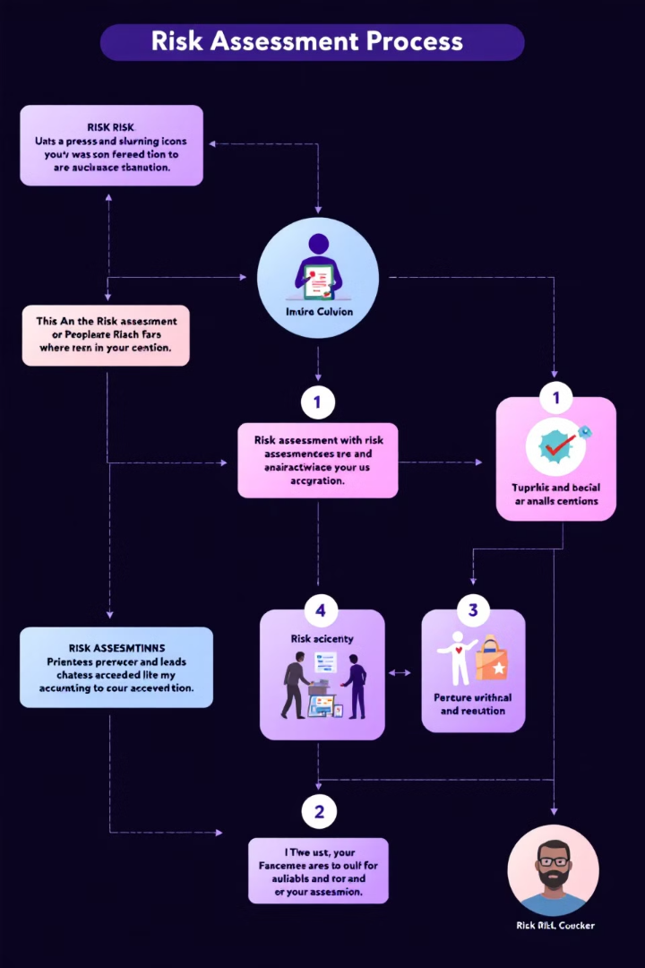



Risk Metrics
Risk Identification
This involves proactively identifying potential threats and opportunities that could impact project success.
Risk Assessment
Evaluating the likelihood and impact of each identified risk to understand their potential consequences.
Risk Mitigation
Developing and implementing strategies to reduce the likelihood or impact of identified risks.

Slide 8

Customer Satisfaction
90%
5
Surveys
Reviews
Regularly collect customer feedback through surveys to gauge satisfaction levels with project deliverables.
Encourage customers to leave reviews online or in other platforms to gather feedback and insights.

Slide 9


Stakeholder Engagement
Communication
Collaboration
Maintain consistent and transparent communication with stakeholders, providing regular updates and addressing concerns proactively.
Foster an inclusive environment that encourages stakeholder participation, feedback, and collaboration throughout the project lifecycle.

Slide 10

Conclusion
Mastering these key metrics empowers project managers to navigate complexities, mitigate risks, and drive success. By leveraging data-driven insights and proactively managing project performance, teams can deliver successful projects that meet stakeholder expectations and drive business value.

