Slide 1

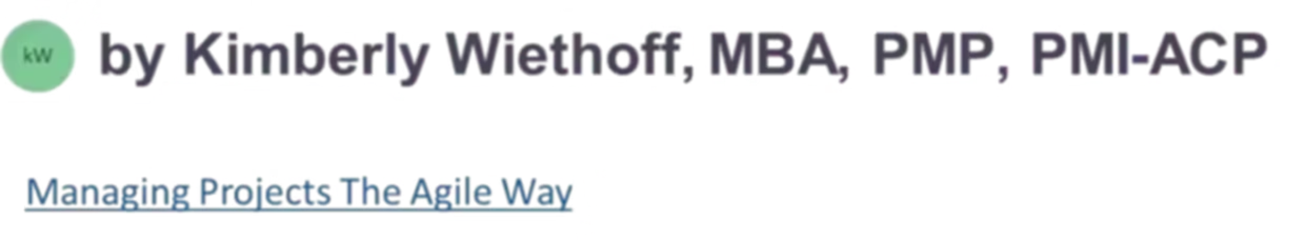
Understanding ServiceNow: ITSM, CSM, FSM, and Modern Integration Patterns
ServiceNow is often described as an IT tool, but that framing dramatically understates its value. At scale, ServiceNow is an enterprise workflow orchestration platform—one that connects people, processes, and systems across IT, customer operations, and field services. This presentation explores the strategic capabilities that make ServiceNow essential for modern enterprise operations.
#ServiceNow #ITSM #CSM #FSM #ServiceManagement #WorkflowAutomation #ProgramManagement #DigitalTransformation #EnterpriseArchitecture #PMOLeadership #DeliveryExcellence #SystemsIntegration #APIDesign #AIOps #CloudTransformation #Automation #AgileLeadership #ManagingProjectsTheAgileWay #ContinuousImprovement

Slide 2

ServiceNow at a Glance: More Than a Ticketing System
At its core, ServiceNow provides a unified foundation for enterprise work management that transforms how organizations operate at scale.
Single System of Record
Centralized repository for all work across the enterprise
Workflow Engine
Intelligent automation that orchestrates how work moves
Governed Integration Layer
Secure connections to execution systems across the organization
The platform shines when it is treated not as a siloed tool, but as the orchestration layer across the enterprise—connecting disparate systems, teams, and processes into a cohesive operational framework.

Slide 3
ITSM: Keeping Internal IT Services Stable and Governed
IT Service Management (ITSM) focuses on internal technology services and operational stability. It transforms IT from a reactive cost center into a proactive service delivery organization.
What ITSM Covers
Incident Management
Problem Management
Rapidly restoring service with minimal business impact
Identifying and eliminating root causes to prevent recurrence
Change Management
Request Management
Risk-aware governance for production changes
Standardized handling of employee service requests
Knowledge Management
CMDB
Reusable solutions that accelerate resolution
Configuration items and service relationships mapped
Why ITSM Matters
For delivery leaders, ITSM provides predictable operational outcomes, risk-aware change governance, and measurable service performance. When implemented well, ITSM moves organizations from reactive firefighting to proactive service management—reducing downtime, improving employee satisfaction, and enabling strategic initiatives.

Slide 4

CSM: Delivering Consistent Customer Experiences at Scale
Customer Service Management (CSM) extends ServiceNow beyond internal IT to serve external customers and partners. It creates a unified platform for customer engagement that eliminates silos and ensures consistency.
Key CSM Capabilities
Omnichannel Case Management
SLA and Entitlement Enforcement
Unified handling across email, portal, chat, and phone
Automated compliance with service agreements
Customer Self-Service Portals
AI-Driven Routing
Empowering customers to resolve issues independently
Intelligent assignment and deflection capabilities
End-to-End Visibility
Why CSM Matters
Transparency for customers and account teams
CSM bridges the gap between front-line customer experience and back-end operational execution. Instead of disconnected CRMs and ticketing tools, CSM creates a single, end-to-end customer service lifecycle—from intake through resolution—ensuring consistent experiences and enabling data-driven service improvements.

Slide 5




FSM: Managing Physical Work in the Real World
Field Service Management (FSM) handles work that must happen outside the data center—on-site, hands-on, and asset-driven. It connects digital workflows to physical execution.
Work Order Creation
Intelligent Scheduling
Automated dispatch and assignment based on skills, location, and availability
Optimized technician routing that minimizes travel time and maximizes productivity
Asset Tracking
Mobile Enablement
Complete visibility into assets, parts, and inventory across locations
Empowering field workers with real-time information and tools
Why FSM Matters
FSM closes the loop when a customer issue requires physical repair, assets must be maintained or replaced, or operational uptime depends on field execution. Without FSM, organizations often struggle to connect digital service workflows to real-world outcomes, resulting in disconnected processes, inefficient dispatching, and poor visibility into field operations.

Slide 6
The Power Is in the Connection: ITSM + CSM + FSM Together
Individually, each module provides value. Together, they deliver transformation. The true power of ServiceNow emerges when these modules work as an integrated platform.
Example End-to-End Flow
Customer Issue Submitted
Field Dispatch
Customer reports a problem through CSM portal or support channel
FSM assigns qualified technician with right parts and tools
1
2
3
4
Technical Analysis
Automated Updates
ITSM correlates with known issues and identifies root cause
Assets, SLAs, and knowledge base updated across all modules
This seamless orchestration eliminates handoff delays, reduces errors, and provides complete visibility across the service lifecycle. This is where ServiceNow becomes a platform, not just a tool—enabling organizations to deliver superior service outcomes while reducing operational complexity.

Slide 7
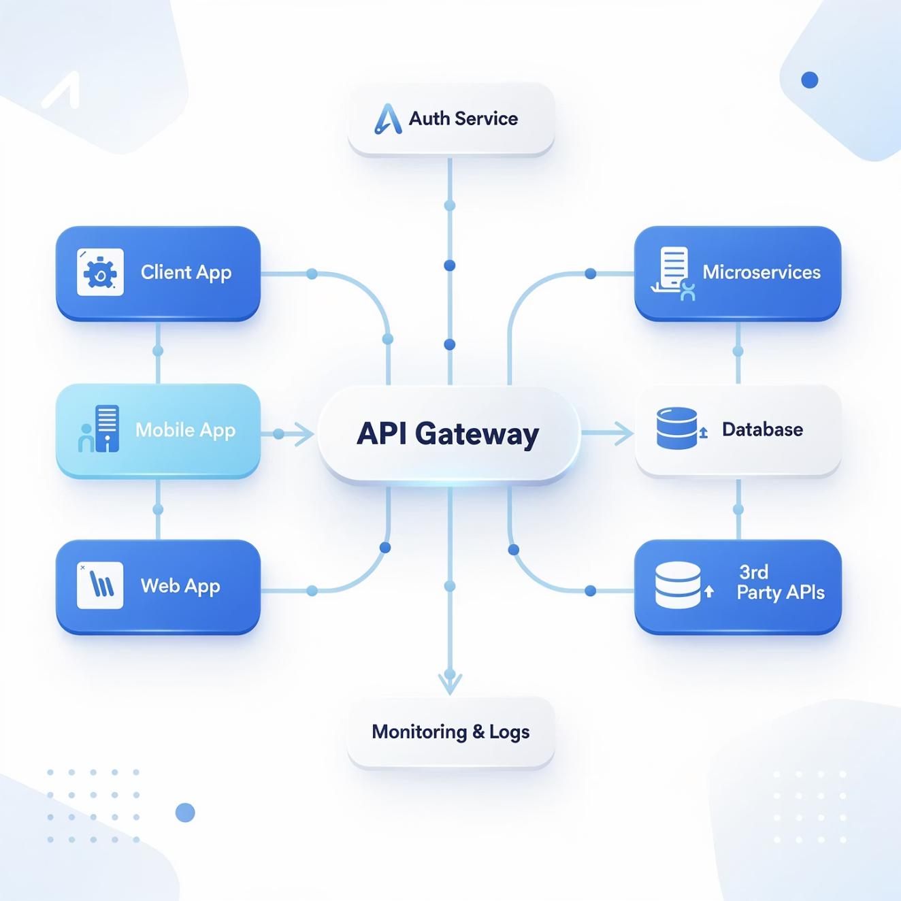
Integration Patterns: Where ServiceNow Really Succeeds (or Fails)
ServiceNow is rarely the system that executes work. It is the system that coordinates it. Understanding integration patterns is critical for success.
1. API-Based Integrations (Real-Time)
Used when immediate interaction is required for time-sensitive workflows and user-facing operations.
REST / SOAP APIs
Standard protocols for system-to-system communication
OAuth Authentication
Secure, token-based access control
Webhooks
Event-driven callbacks for instant notifications
Common integrations: Azure AD for identity management, Salesforce for CRM sync, Jira for development tracking, Azure DevOps for CI/CD pipelines, and ERP systems for financial workflows.

Slide 8

Event-Driven Integrations
2. Event-Driven Integrations
Used for monitoring and alert-based workflows where observability tools detect issues and ServiceNow orchestrates the response.
Event Collection
Intelligent Correlation
Automated Response
Observability tools continuously monitor systems and send events when thresholds are breached
ServiceNow correlates related events to reduce noise and identify true incidents
Triggers incidents, assigns teams, and initiates remediation workflows
Common sources: Splunk for log analytics, Datadog for infrastructure monitoring, AppDynamics for application performance, and Azure Monitor for cloud resources. This pattern is essential for modern AIOps initiatives that reduce alert fatigue and accelerate incident response.

Slide 9
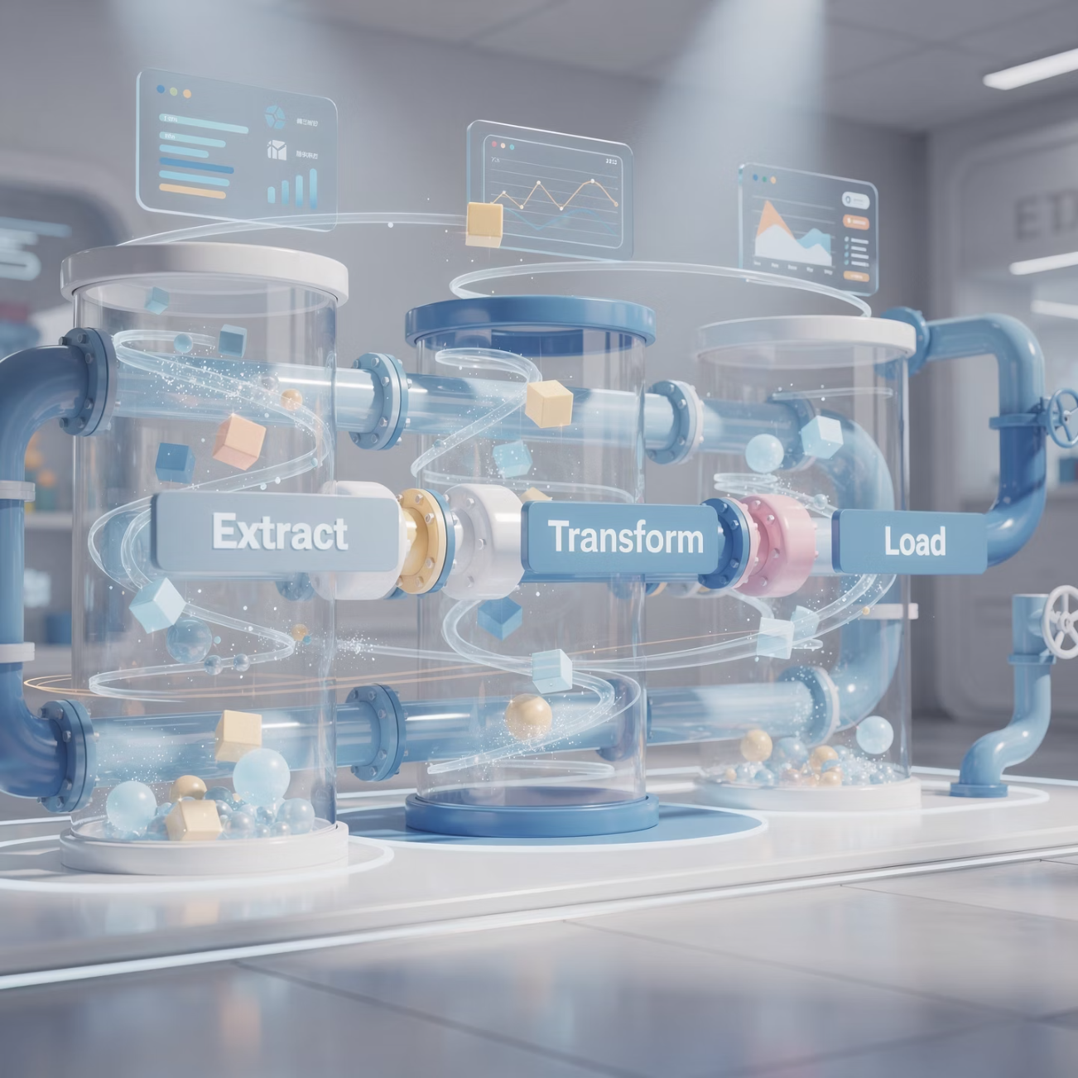
Batch and ETL Integrations
3. Batch / ETL Integrations
Used for high-volume, non-real-time data synchronization where stability and data quality matter more than speed.
01
02
CMDB Population
Asset Reconciliation
Scheduled imports of configuration items from discovery tools and asset management systems
Periodic synchronization to ensure accurate inventory and ownership records
03
Reporting Pipelines
Data warehouse feeds for analytics, compliance, and executive dashboards
These integrations typically run nightly or weekly, with robust error handling and data validation. Success depends on strong data governance, clear ownership, and well-defined reconciliation rules.

Slide 10




IntegrationHub: Low-Code Governance
4. IntegrationHub (Low-Code Governance)
ServiceNow's IntegrationHub provides a governed, low-code approach to building and maintaining integrations at scale.
Pre-Built Connectors
Flow Designer Automations
Centralized Error Handling
Hundreds of certified "spokes" for common enterprise systems, reducing development time from weeks to hours
Visual workflow builder that enables business analysts to create integrations without coding
Built-in logging, retry logic, and alerting that ensures reliability
This pattern balances speed, governance, and maintainability. For program leaders, IntegrationHub reduces dependency on specialized developers while maintaining enterprise-grade reliability and security. It's particularly effective for medium-complexity integrations that need to be deployed quickly without sacrificing quality.

Slide 11

Middleware-Orchestrated Integrations
For complex ecosystems with multiple systems, intricate transformation logic, or legacy protocols, middleware handles transformation and choreography.
5. Middleware Integration Layer
Enterprise integration platforms act as the transformation and routing engine:
MuleSoft – API-led connectivity with reusable assets
Boomi – Cloud-native iPaaS for rapid integration
Azure Logic Apps – Serverless workflows in Azure
n8n – Open-source automation for custom needs
In this model, ServiceNow remains the orchestration brain, not the transformation engine. Middleware handles complex mappings, protocol translations, and multi-step choreography, while ServiceNow coordinates the overall business process. This separation of concerns improves maintainability and allows each platform to focus on its strengths.

Slide 12









CMDB: The Backbone That Everything Depends On
The Configuration Management Database (CMDB) is the foundation that enables intelligent automation and informed decision-making across ServiceNow.
Impact Analysis
Change Risk Assessment
Understanding downstream effects before making changes
Automated evaluation based on service criticality
Service Visibility
Incident Correlation
Clear mapping of applications to business services
Connecting related issues across infrastructure
Without a healthy CMDB: Automation breaks because relationships are unknown, reporting loses credibility due to inaccurate data, and change governance weakens without proper impact visibility.
Best practice: Model services and relationships, not every possible asset. Focus on business-critical services and their dependencies rather than attempting to document every configuration item. A lean, accurate CMDB is far more valuable than a bloated, outdated one.

Slide 13
AI and Automation: The Modern ServiceNow Advantage
Modern ServiceNow implementations increasingly leverage artificial intelligence and automation to deliver exponential improvements in efficiency and service quality.
Virtual Agents
Predictive Intelligence
AIOps Capabilities
Flow Designer Automation
Conversational AI for self-service that handles common requests 24/7, deflecting up to 40% of routine incidents
Machine learning models for intelligent routing, categorization, and proactive issue detection
Event correlation and noise reduction that transforms thousands of alerts into actionable incidents
Low-code workflow creation that eliminates manual handoffs and accelerates resolution
Impact for Delivery Leaders
Reduced Manual Effort
Faster Decision-Making
Earlier Risk Detection
Automation handles repetitive tasks, freeing teams for strategic work
AI-powered insights enable rapid, data-driven responses
Predictive models identify issues before they impact users

Slide 14
Final Takeaway for Program and Delivery Leaders
ServiceNow's true value is not in tickets—it's in orchestrating outcomes.
1
2
3
4
Unified Platform
Balanced Governance
Modern Integration
AI-Augmented Service
Aligns IT, customer service, and field operations under a single orchestration layer
Standardizes delivery without slowing innovation or creating bureaucratic overhead
Integrates seamlessly into cloud and DevOps ecosystems with flexible patterns
Enables intelligent service management at enterprise scale with continuous improvement
The organizations that succeed with ServiceNow treat it as a strategic workflow platform, not just an operational tool. They invest in integration architecture, maintain a healthy CMDB, leverage AI capabilities, and continuously optimize their service delivery models.
When positioned correctly, ServiceNow becomes the connective tissue that transforms disconnected systems into a coordinated enterprise—delivering measurable improvements in efficiency, customer satisfaction, and operational resilience.

