Slide 1
Security and Compliance in AWS Projects: A PM's Responsibility
In today's digital landscape, security and compliance are no longer just IT concerns—they are business-critical priorities. As organizations migrate to AWS, project managers must embed security best practices from day one.
kW
by Kimberly Wiethoff

Slide 2
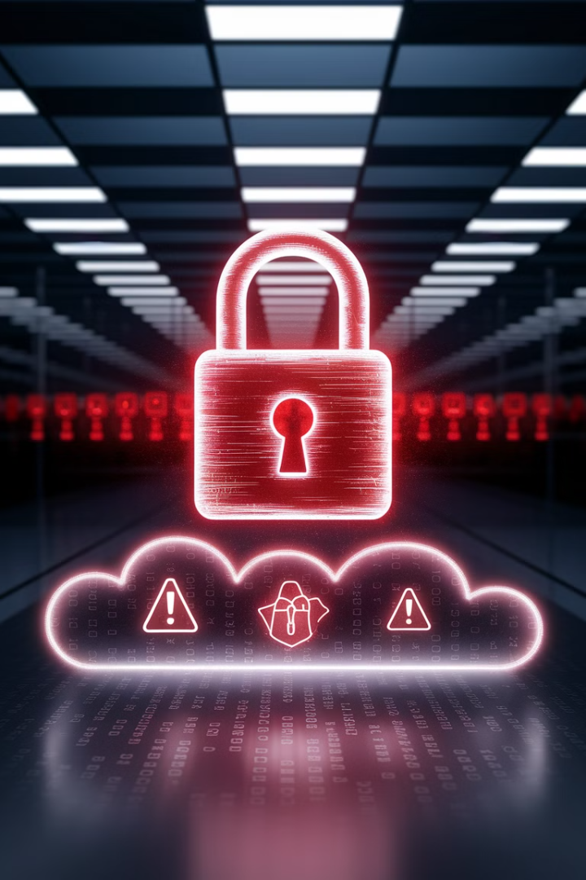
Why Security Matters
1
Data Breach Costs
2
Configuration Risks
Breaches can cost millions in fines and damage your reputation.
Poorly configured AWS environments can expose sensitive information.
3
Compliance Penalties
Non-compliance can result in legal penalties and loss of customer trust.

Slide 3
The PM's Security Role
Not a Security Expert
Strategic Integration
You don't need to be a cybersecurity expert.
You must ensure security is part of planning and execution.
Risk Management
Security must be included in your risk management strategy.

Slide 4
AWS's Shared Responsibility Model
AWS Responsibilities
Your Organization's Responsibilities
AWS secures physical infrastructure including data centers, servers, and networks.
You must secure applications, data, and access controls.
Your team implements encryption, IAM policies, and monitoring.
They ensure compliance with global security standards like ISO 27001 and SOC 2.
You ensure regulatory compliance based on industry needs (HIPAA, GDPR).

Slide 5
Identity and Access Management
Least Privilege Access
Multi-Factor Authentication
IAM Roles
Use IAM roles instead of long-term access keys.
Only give users the permissions they absolutely need.
Enable MFA for all AWS accounts.

Slide 6
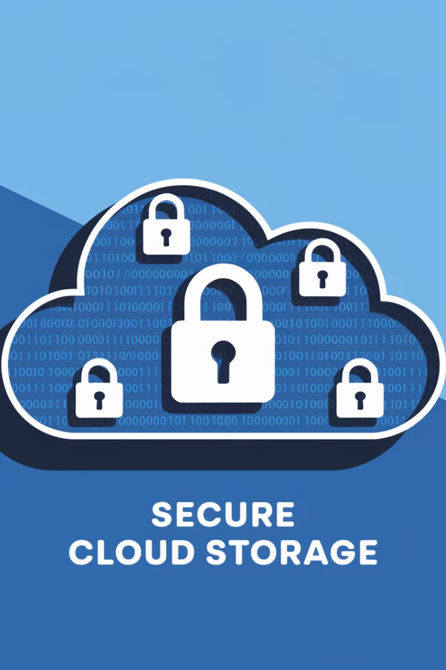
Data Protection & Encryption
1
Data at Rest
Encrypt stored data using AWS KMS and S3 encryption.
2
Data in Transit
Secure data movement with TLS/SSL protocols.
3
Data Backup
Regularly back up critical data using AWS Backup.
4
Sensitive Data Detection
Set up Amazon Macie to detect PII and financial records.

Slide 7
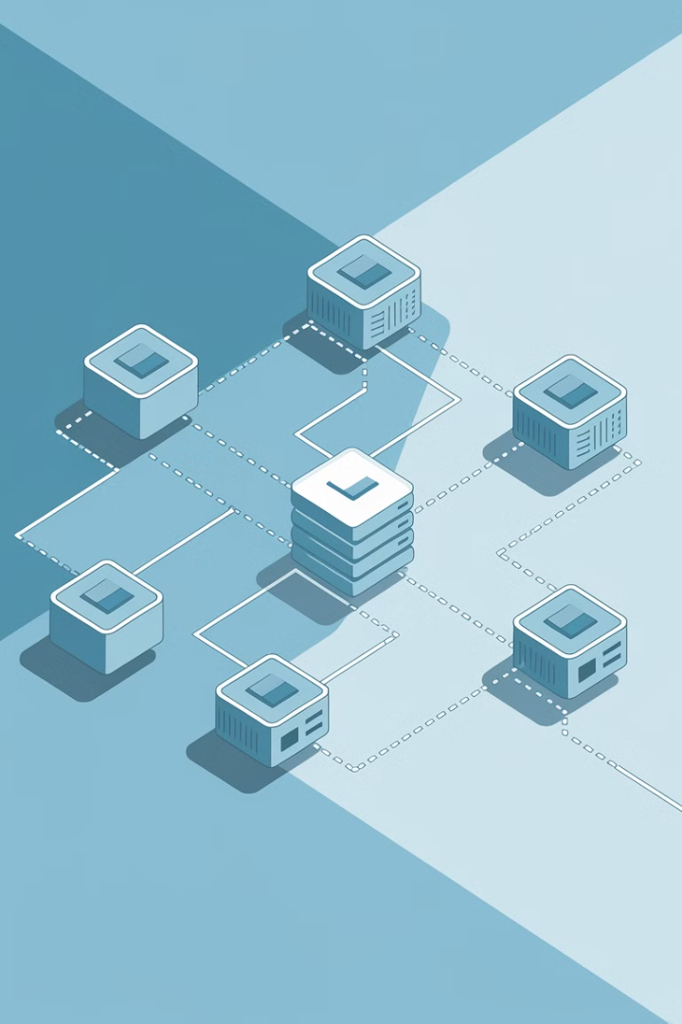
Network Security
Isolation
Use AWS VPC to isolate environments.
DDoS Protection
Enable AWS Shield for attack protection.
Traffic Control
Implement security groups and network ACLs.

Slide 8
Monitoring & Threat Detection
Security Dashboard
2
Use AWS Security Hub for centralized monitoring.
Activity Logging
1
Enable AWS CloudTrail for API activity.
Threat Detection
Set up Amazon GuardDuty for anomaly monitoring.
3
Include security tasks in your project schedule to avoid last-minute risks.

Slide 9
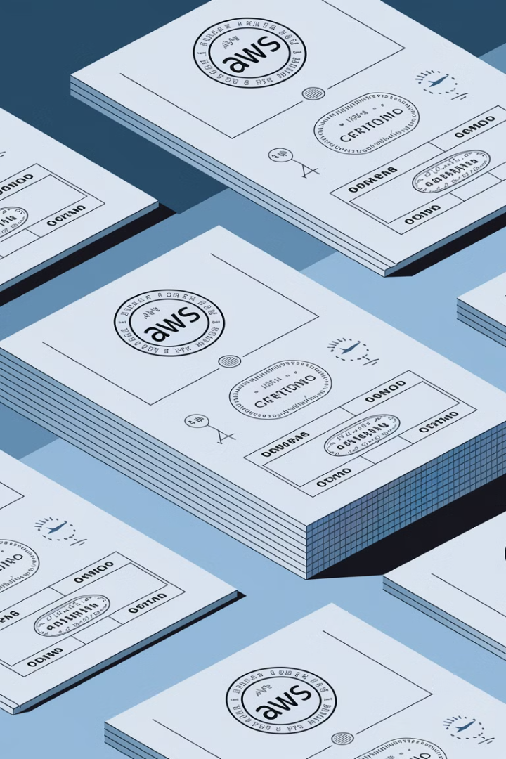
Compliance Standards & AWS Solutions
Standard
Industry
AWS Solutions
HIPAA
Healthcare
AWS HealthLake, AWS Config
SOC 2, ISO 27001
Security Frameworks
AWS Audit Manager
GDPR
EU Data Privacy
AWS KMS, AWS Access Analyzer
PCI DSS
Payment Processing
AWS Key Management Service

Slide 10
Security & Compliance Risk Management
Train Teams
Automate Monitoring
Prevent misconfigured resources that can lead to data leaks.
Conduct Regular Audits
Set up alerts using AWS Config & Security Hub.
Identify Requirements Early
Use AWS Audit Manager to track security risks.
Align security policies before deployment.

Slide 11
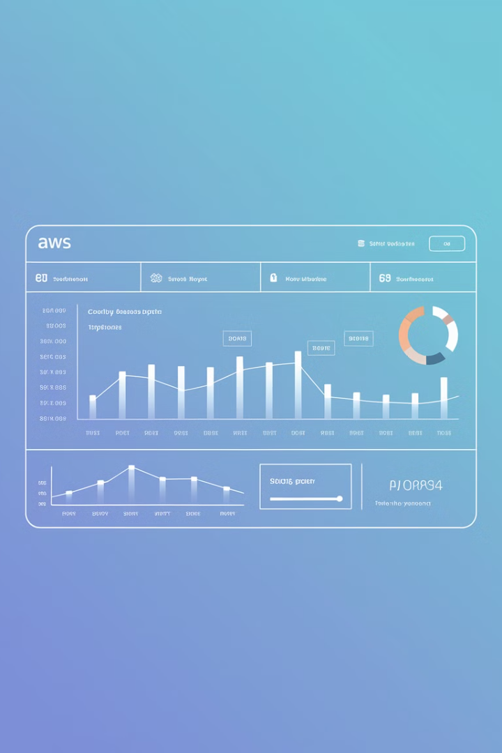
Security & Compliance Metrics
0
Security Incidents
Target zero GuardDuty alerts.
100%
Encrypted Resources
All S3 buckets and databases must be encrypted.
90+
Compliance Score
Maintain high compliance score in AWS Security Hub.
0
IAM Violations
Eliminate overly permissive roles.

Slide 12
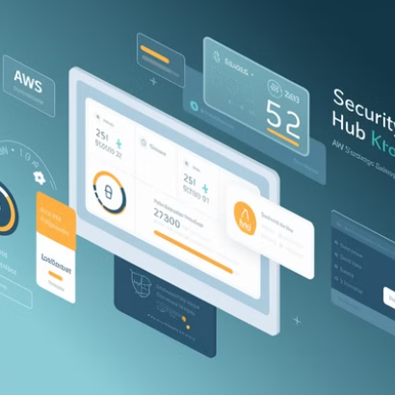
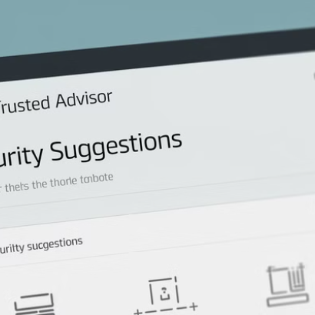
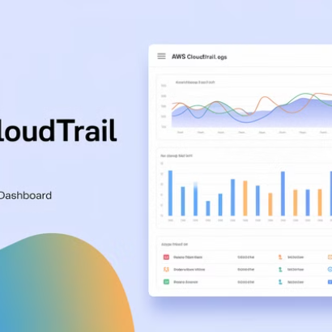
AWS Tools for Security Reporting
Use Security Hub for consolidated security scores and compliance status, Trusted Advisor for cost/performance/security optimization, AWS Config for compliance auditing and resource tracking, and CloudTrail for detailed API activity monitoring. Schedule monthly security reviews with cross-functional teams (IT, compliance, dev) using these reports to identify gaps, track incident trends, and document compliance for stakeholders.

Slide 13
The PM's Security & Compliance Checklist
Continuous Monitoring
1
Risks are continuously monitored
Clear Requirements
2
Compliance defined before execution
Best Practices
3
AWS security implemented from start
Team Alignment
4
Everyone knows their responsibilities
Security and compliance should never be an afterthought in AWS projects. Integrate them from day one for project success.

