Slide 1
Guide to Passing the PMI-ACP Exam
Are you ready to take your Agile career to the next level? Becoming a PMI Agile Certified Practitioner (PMI-ACP) is an excellent way to validate your expertise in Agile methodologies and demonstrate your commitment to professional development in the field of project management.
This comprehensive guide will walk you through everything you need to know to prepare for the PMI-ACP exam and succeed with flying colors. From understanding the exam structure to effective study strategies, we've got you covered on your certification journey.
kW
by kimberly Wiethoff

Slide 2
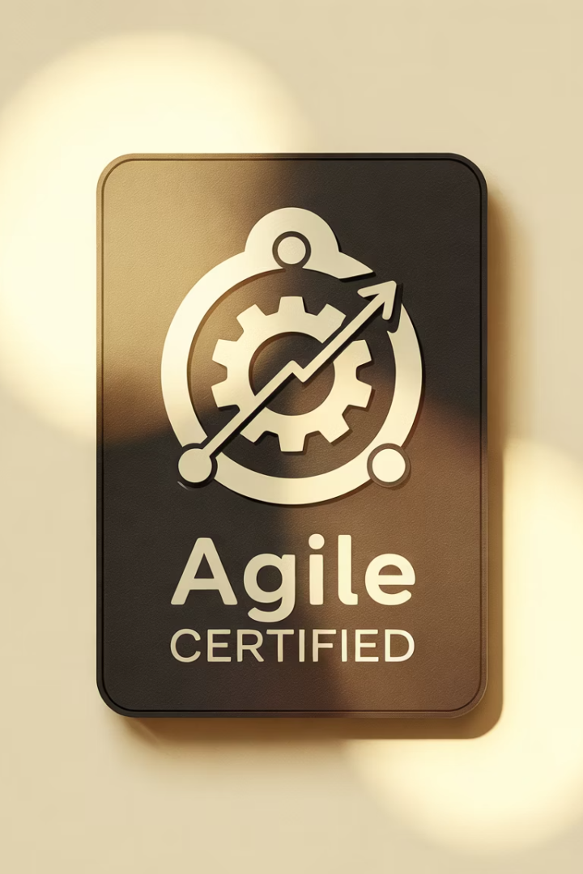
What is the PMI-ACP Certification?
Credential Value
Career Impact
Validates expertise in Agile methodologies and demonstrates professional commitment to project management excellence
Opens doors to exciting career opportunities in Agile project management
Industry Recognition
Respected certification from the Project Management Institute (PMI), a global leader in project management standards

Slide 3
Exam Structure Overview
120
3
65%
Questions
Hours
Passing Score
Multiple-choice format testing knowledge across all domains
Total time allowed to complete the examination
Minimum percentage required to successfully pass the exam

Slide 4
Agile Principles and Mindset
Agile Mindset
Embracing change and continuous improvement
Agile Manifesto
Four values that guide agile approaches
12 Principles
Fundamental guidelines for agile implementation
The first exam domain focuses on understanding the fundamental principles that guide all agile methodologies. You'll need to demonstrate knowledge of the Agile Manifesto's four values and twelve principles, plus how they translate into practical application in project environments.

Slide 5
Value-Driven Delivery
Prioritization
Stakeholder Engagement
Techniques for determining highest value work
Involving key parties throughout development
Customer Feedback
Incremental Delivery
Gathering and implementing user input
Releasing working features frequently
This domain examines how agile practitioners ensure they're delivering maximum value to customers. The exam will test your knowledge of techniques for prioritizing work, engaging stakeholders effectively, gathering customer feedback, and implementing incremental delivery approaches.

Slide 6
Stakeholder Engagement
Identify Stakeholders
Mapping all parties affected by or influencing the project
Analyze Needs
Understanding stakeholder requirements and expectations
Communicate Effectively
Establishing transparent, regular communication channels
Collaborate Continuously
Working together throughout the project lifecycle

Slide 7
Team Performance
Team Roles
Team Building
Understanding responsibilities within agile teams
Creating high-performing, self-organizing teams
Conflict Resolution
Motivation
Addressing and resolving team disagreements
Techniques for inspiring team members
This domain focuses on how agile teams function and how to optimize their performance. The exam will test your knowledge of team dynamics, including roles and responsibilities, team building techniques, motivation strategies, and approaches to resolving conflicts effectively.

Slide 8
Adaptive Planning
Iterative Planning
Planning in short cycles rather than upfront for the entire project
Allows for adaptation based on new information and changing requirements
Estimation Techniques
Using relative sizing, story points, and team-based estimation approaches
Focuses on comparative complexity rather than exact time predictions
Risk Management
Continuously identifying, assessing, and mitigating risks throughout the project
Incorporates risk responses into regular planning activities

Slide 9
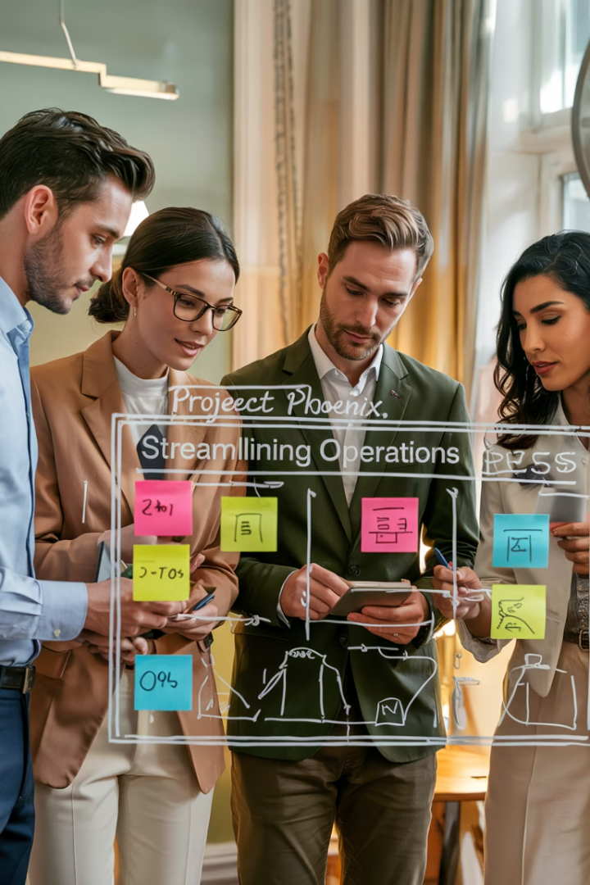
Problem Detection and Resolution
Early Problem Detection
Using metrics, visual management, and daily standups to identify issues before they become critical. Agile emphasizes making problems visible as early as possible.
Problem-Solving Techniques
Applying root cause analysis, five whys, fishbone diagrams, and other analytical methods to understand the true source of problems rather than just addressing symptoms.
Impediment Removal
Systematically addressing obstacles that block team progress, often through dedicated roles like the Scrum Master who helps remove barriers to productivity.
Collaborative Solutions
Engaging the entire team in problem-solving rather than relying on individuals, leveraging collective intelligence to find effective solutions.

Slide 10
Continuous Improvement
Inspect
Regularly examine processes, practices, and outcomes to identify areas for improvement
Adapt
Make adjustments based on inspection findings to enhance effectiveness
Implement
Put changes into practice and monitor their impact
Measure
Evaluate results and gather data to inform the next improvement cycle

Slide 11
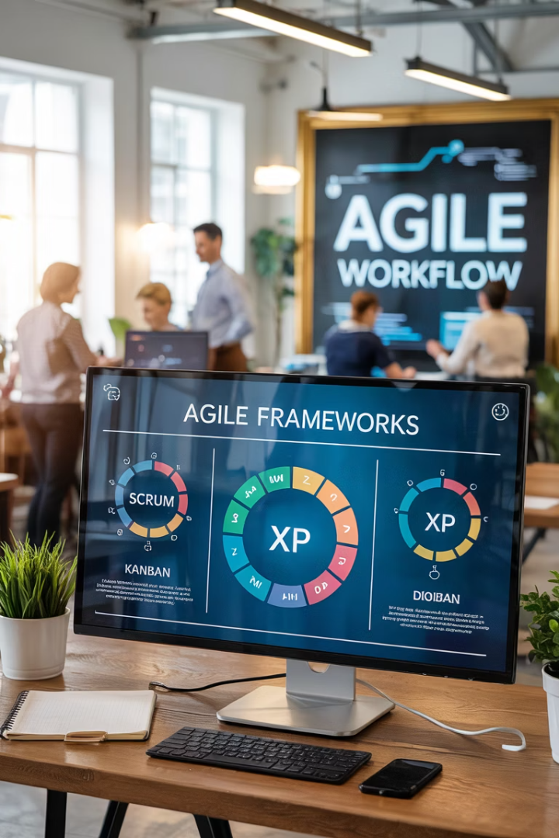
Agile Frameworks and Methodologies
Scrum
Kanban
Framework with defined roles, events, and artifacts focused on delivering product increments in sprints
Visual workflow management system emphasizing flow, limiting work in progress, and continuous delivery
Lean
XP
Approach focused on maximizing value while minimizing waste in development processes
Engineering-focused methodology emphasizing technical excellence and specific practices like pair programming
The PMI-ACP exam covers multiple agile approaches rather than focusing on a single framework. You'll need to understand the principles, practices, and unique aspects of each methodology, including how they can be combined or tailored to different project contexts.

Slide 12
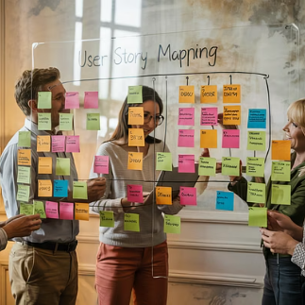
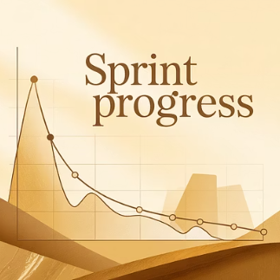
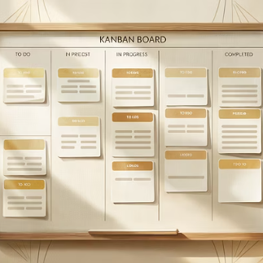
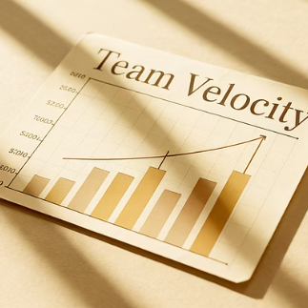
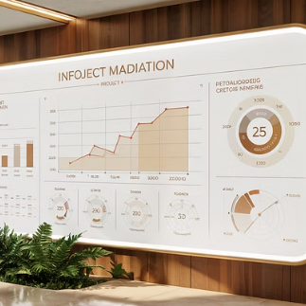
Agile Tools and Techniques
The exam will test your knowledge of various agile tools and techniques used in project management. These include user stories for requirements, burndown charts for tracking progress, Kanban boards for visualizing workflow, velocity charts for measuring team performance, and information radiators for transparent communication.

Slide 13
Effective Study Strategies
Understand the Content Outline
Review PMI's official exam content guide
Master Agile Concepts
Study frameworks, tools, and techniques
Join Study Groups
Collaborate with other candidates
Take Practice Exams
Test your knowledge and identify gaps
Preparing for the PMI-ACP exam requires a comprehensive study plan and dedication to mastering Agile principles and practices. Start by reviewing the official PMI-ACP Examination Content Outline, then systematically study each domain while practicing with sample questions to assess your readiness.

Slide 14
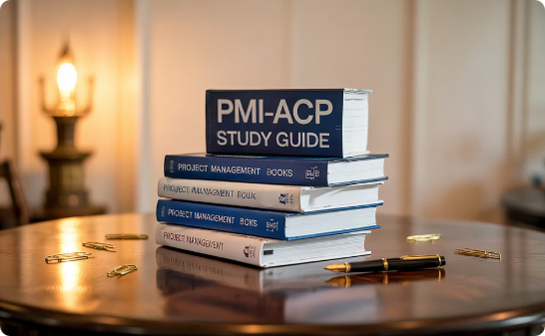
Recommended Study Resources
Official Study Materials
Practice Exams
Study Groups
PMI's official exam content outline provides the foundation for your studies. Supplement with recommended books like "PMI-ACP Exam Prep" by Mike Griffiths and "Agile Practice Guide" published by PMI.
Take multiple practice exams to familiarize yourself with the question format and identify knowledge gaps. Look for reputable providers that offer explanations for correct and incorrect answers.
Join online forums, local PMI chapters, or virtual study groups to collaborate with other candidates. Explaining concepts to others and discussing challenging topics enhances understanding and retention.

Slide 15
Your Path to Certification Success
The PMI-ACP certification is a valuable credential that can open doors to exciting career opportunities in Agile project management. With thorough preparation and a solid understanding of Agile principles and practices, you can confidently tackle the exam and take your career to new heights.
Start your preparation journey today by creating a structured study plan, gathering quality resources, and committing to regular practice. Your investment in becoming a certified Agile professional will pay dividends throughout your project management career.

