Slide 1

The 12 Principles of Agile: A Blueprint for Modern Development
In today's fast-paced software development world, Agile methodology has transformed from a mere concept to a guiding philosophy that empowers teams to adapt, innovate, and thrive amid constant change. At its core are 12 fundamental principles that shape how teams collaborate, communicate, and deliver value to customers.
This presentation explores these powerful principles and demonstrates how they can revolutionize your development process, enhance team dynamics, and ultimately lead to greater customer satisfaction and business success.
kW
by Kimberly Wiethoff

Slide 2








Customer Satisfaction Through Early and Continuous Delivery
Build
Deliver
Create working software in small increments
Release frequently to customers
Adapt
Feedback
Refine based on real user needs
Gather user insights
Agile prioritizes customer satisfaction by delivering working software in short, iterative cycles rather than waiting months for a complete product. By releasing functional increments early and often, teams can collect valuable feedback that guides subsequent development.
This continuous delivery approach ensures the final product truly meets customer needs, reducing the risk of building features that miss the mark. Teams can pivot quickly when requirements change, creating a responsive development ecosystem that consistently delivers value.

Slide 3






Embracing Change as Opportunity
Innovation
New ideas improve the product
Adaptation
Adjust plans based on feedback
Flexibility
Welcome changes even late in development
In traditional development, late-stage changes are often viewed as disruptions. Agile takes the opposite approach, recognizing that change represents new insights and opportunities for improvement. By designing flexible processes and architecture, teams can pivot when business priorities shift.
This principle acknowledges market realities: customer needs evolve, competitive landscapes transform, and new technologies emerge. Embracing change allows teams to deliver products that remain relevant even in dynamic environments, ultimately creating more value for users and stakeholders.

Slide 4




Frequent Delivery of Working Software
Sprint Planning
Development
Testing
Deployment
Define deliverables for the iteration
Build working features
Validate functionality
Release to production
Agile teams focus on delivering working software in short timeframes—typically two to four weeks. This regular cadence of releases creates a rhythm of progress that keeps stakeholders engaged and provides frequent opportunities to course-correct if necessary.
Each iteration produces tangible, working features that can be tested and validated. This approach reduces risk by identifying integration issues early, prevents scope creep by maintaining focus on current priorities, and builds confidence with stakeholders through visible progress. Most importantly, it accelerates the delivery of business value instead of delaying benefits until a distant future release.

Slide 5



Business and Development Collaboration
Daily Collaboration
Shared Vision
Quick Decision Making
Regular interactions between business stakeholders and developers create shared understanding and alignment on priorities. This continuous engagement ensures the team builds the right features in the right way.
When business experts and technical teams work closely together, they develop a common language and shared goals. This bridges the traditional gap between "what the business wants" and "what developers build."
Direct access to business expertise allows technical questions to be resolved immediately rather than through lengthy documentation processes, accelerating development and reducing misalignment.
This principle revolutionizes the traditional handoff model where business stakeholders define requirements and then disappear until delivery. Instead, Agile fosters an environment of continuous collaboration and shared ownership of outcomes.

Slide 6



Building Projects Around Motivated Individuals
Trust
Confidence in team capabilities
Support
Provide necessary resources
Empowerment
Allow autonomy in decision-making
Agile recognizes that motivated individuals form the backbone of successful projects. When teams have autonomy, purpose, and mastery, they demonstrate higher levels of creativity, problem-solving, and commitment to quality outcomes.
This principle emphasizes creating an environment where team members can thrive: providing the right tools and resources, removing impediments, minimizing unnecessary bureaucracy, and trusting teams to make appropriate technical decisions. Organizations that embrace this approach find their teams more engaged, innovative, and capable of delivering exceptional results.

Slide 7




Face-to-Face Communication
Information Exchange
Non-verbal Cues
Real-time Feedback
Relationship Building
Conveying core concepts
Reading body language and expressions
Immediate clarification of misunderstandings
Developing team trust and cohesion
While comprehensive documentation has its place, Agile recognizes that direct conversation is often the most efficient way to share complex ideas. Face-to-face communication—whether in person or through video conferencing—reduces misunderstandings and accelerates problem-solving.
This principle emphasizes creating opportunities for rich, multi-dimensional communication through practices like daily stand-ups, planning sessions, and pair programming. These interactions build stronger team relationships, facilitate knowledge sharing, and create a shared understanding that written documents alone cannot achieve.

Slide 8
Working Software as Primary Progress Measure
Traditional Metrics
Agile Metrics
Benefits
Hours logged
Working features delivered
Concrete evidence of progress
Documents produced
User stories completed
Early identification of issues
Tasks completed
Customer value created
Alignment with business goals
Phase milestones reached
Production deployments
Enhanced stakeholder confidence
Agile shifts focus from intermediate artifacts to the only measure that truly matters: working software that delivers value. This principle challenges teams to demonstrate tangible progress through functional features rather than status reports or partial work.
By emphasizing working software, teams maintain focus on outcomes rather than outputs. This creates transparency about actual progress, prevents the illusion of advancement through documentation, and ensures stakeholders can evaluate real business value throughout the development process.

Slide 9
Sustainable Development Pace
40
20%
85%
Hours Per Week
Improvement Time
Utilization Target
Optimal work time for sustained productivity
Dedicated to learning and refactoring
Allowing buffer for unexpected work
Agile rejects the unsustainable "hero culture" of frequent overtime and crisis management. Instead, it advocates for a measured, consistent pace that teams can maintain indefinitely. This approach recognizes that software development is a marathon, not a sprint, and that team burnout ultimately reduces productivity and quality.
By establishing realistic expectations, implementing predictable iterations, balancing feature work with technical debt reduction, and respecting work-life boundaries, organizations create environments where teams can deliver high-quality work consistently over the long term. This sustainable pace benefits not only team health but also product quality and business outcomes.

Slide 10








Technical Excellence and Good Design
Thoughtful Architecture
Automated Testing
Well-structured systems that can evolve over time
Comprehensive test coverage for confidence in changes
Clean Code
Readable, maintainable software that follows best practices
Continuous Refactoring
Regular improvement of existing code
Technical excellence isn't just about professional pride—it's a business necessity. Well-designed systems with clean code are easier to modify, extend, and maintain, enabling teams to respond quickly to changing requirements without accumulating technical debt.
This principle emphasizes practices like test-driven development, continuous integration, pair programming, and regular refactoring. Teams that invest in technical excellence may appear to move more deliberately initially, but they ultimately deliver more value by avoiding the compounding slowdown that comes from poor technical foundations.

Slide 11



Simplicity: Maximizing Work Not Done
Eliminate Unnecessary Features
Minimize Process Overhead
Reduce Technical Complexity
Focus only on capabilities that deliver tangible business value, avoiding "nice-to-have" features that increase complexity without proportional benefits.
Create just enough documentation, meetings, and ceremonies to support the team without creating bureaucratic burdens that slow delivery.
Choose the simplest viable solution rather than overengineering. Solve today's problems without attempting to predict all future scenarios.
In software development, complexity is the enemy of agility. This principle emphasizes the strategic importance of simplicity in all aspects of the development process. By focusing on essential work and eliminating waste, teams can deliver more value with less effort.
The discipline of simplicity requires ongoing vigilance. Teams must continuously question whether features, processes, or technical approaches add sufficient value to justify their complexity cost. This lean mindset accelerates delivery, improves quality, and enhances the team's ability to adapt to changing requirements.

Slide 12
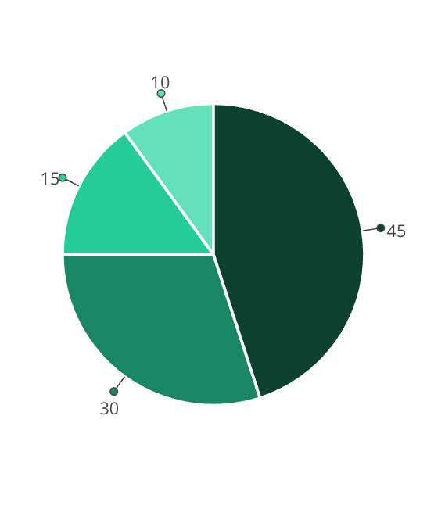
Self-Organizing Teams
Self-organization doesn't mean chaos—it means empowering teams to make appropriate decisions about how they'll achieve their goals. In self-organizing teams, members collectively determine who does what, how they'll approach problems, and how they'll improve their processes.
Technical Approach
Task Assignment
This principle recognizes that those closest to the work often have the best insights about how to perform it effectively. When teams are trusted to self-organize, they develop ownership of outcomes, leverage diverse perspectives to find optimal solutions, and adapt more quickly to changing circumstances than hierarchically managed teams.
Process Adaptation
Tooling Choices

Slide 13
Regular Reflection and Adaptation
Implement Changes
Plan Adjustments
Apply improvements immediately and measure their impact in subsequent iterations.
Analyze Patterns
Develop specific, actionable changes to processes, practices, or tooling based on insights.
Gather Data
Identify what's working well and what could be improved, looking for root causes rather than symptoms.
Collect metrics, team feedback, and stakeholder input about the current process effectiveness and outcomes.
Continuous improvement is the engine that powers agile teams. Through regular retrospectives—typically held at the end of each iteration—teams reflect on their performance, identify obstacles, and implement changes to their processes and practices.
This principle embodies the empirical nature of Agile: rather than following a fixed, prescribed process, teams continuously experiment, learn, and adapt based on real-world experience. Over time, these incremental improvements compound to create highly optimized, context-specific ways of working that maximize team effectiveness.

Slide 14




Bringing It All Together: The Agile Mindset
The 12 Agile Principles aren't just practices to follow—they represent a fundamental shift in thinking about software development. When embraced fully, they create a culture of collaboration, adaptability, and continuous improvement that enables teams to deliver extraordinary results.
Implementing these principles requires commitment at all levels of the organization. Leaders must provide support and remove impediments. Teams must embrace autonomy and accountability. And everyone must maintain a relentless focus on delivering customer value through working software. The journey to agility is challenging but transformative, leading to more engaged teams, satisfied customers, and successful products.

