Slide 1

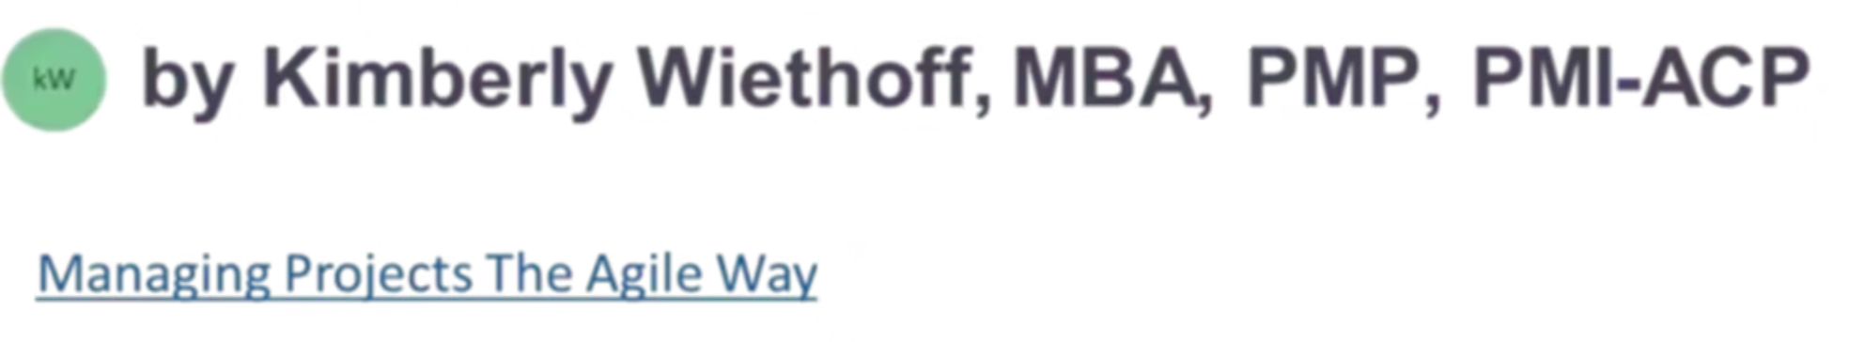
The Hybrid Advantage: Making Waterfall Projects More Agile
Delivering faster results without compromising compliance in regulated industries
#ManagingProjectsTheAgileWay #HybridProjectManagement #AgileLeadership #WaterfallToAgile #ProjectDelivery #PMO #DigitalTransformation #ChangeLeadership #ContinuousImprovement #ProjectManagementCommunity

Slide 2
Two Worlds, One Challenge
The Waterfall World
The Agile World
Governed by structure, documentation, and sequential planning. Required for regulatory compliance and risk management in healthcare, finance, and manufacturing.
Driven by adaptability, collaboration, and continuous feedback. Demanded by today's fast-paced business environment and competitive pressures.
Stage gates and approvals
Iterative development cycles
Fixed budgets and timelines
Rapid response to change
Comprehensive documentation
Early value delivery
Linear progression through phases
Continuous stakeholder engagement
Project managers today must navigate both worlds simultaneously. The pressure to move faster while maintaining compliance creates a seemingly impossible tension — but Hybrid methodology offers a practical solution.

Slide 3

Why Hybrid Works in Regulated Environments
A Hybrid model respects the structure your stakeholders expect while introducing agility where it matters most. It's not about abandoning Waterfall — it's about making it smarter, faster, and more human-centered.
Maintain Compliance
Iterate Within Phases
Keep stage gates, budgets, and documentation intact for regulatory requirements and risk controls
Build flexibility into deliverables while staying within approved project boundaries
Gather Early Insights
Increase Visibility
Collect user feedback throughout the project instead of waiting until final delivery
Use Agile tools for real-time collaboration and transparency across teams

Slide 4

Start with Value, Not Methodology
Too often, organizations jump into frameworks instead of outcomes. The key question isn't "Are we Agile or Waterfall?" — it's "How can we deliver value faster and with fewer surprises?"

Slide 5
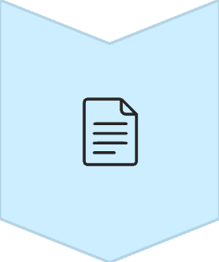
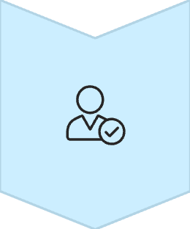
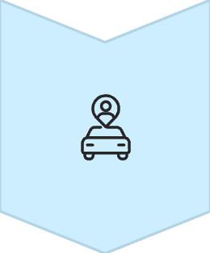
Shift Your Focus from Process to Purpose
Requirements Evolve
Allow new insights to refine requirements as the project progresses, rather than locking everything down upfront
Testing Happens Continuously
Integrate testing throughout each phase instead of saving it all for the end, catching issues early when they're cheaper to fix
Stakeholders Stay Engaged
Keep leadership and end-users involved throughout the journey, not just during formal sign-offs and milestone reviews
When teams align on the "why" behind their work, they become more invested in outcomes and better equipped to make smart decisions under pressure.

Slide 6

Bring Agile Cadence into Waterfall Rhythm
You can keep your high-level Waterfall schedule while introducing Agile cadences to improve collaboration and control. These rhythms help your team stay connected, focused, and responsive — without changing the overall governance structure.
1
Weekly Standups
15-minute sync meetings to increase visibility and accountability across the team
2
Biweekly Demos
Show progress early and often, gathering feedback before work is finalized
3
Phase Retrospectives
Capture lessons learned at the end of each phase to continuously improve

Slide 7
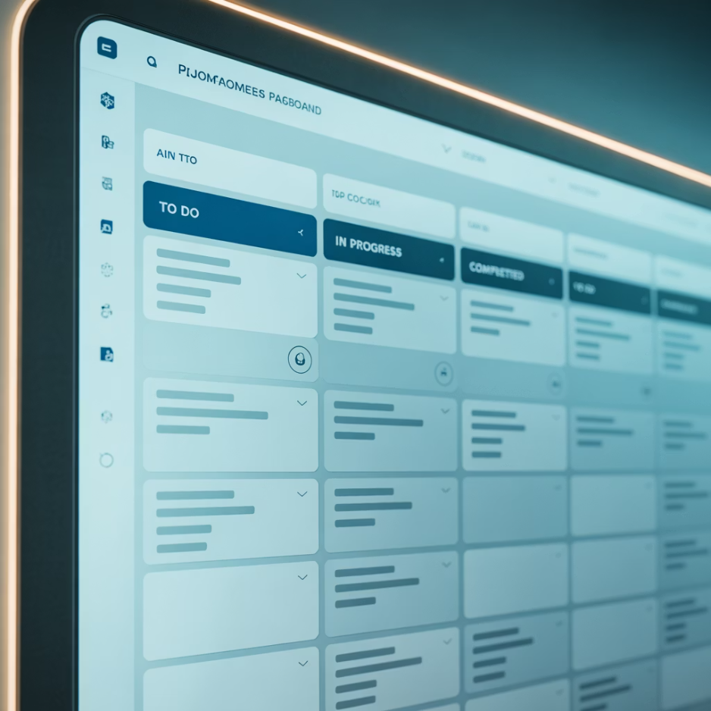
Use Agile Tools for Transparency
Agile tools like Kanban boards, backlogs, and burndown charts aren't limited to Agile teams. Even in a traditional project, they provide instant clarity on who's doing what, what's blocked, and how the work aligns to milestones.
Hybrid project managers leverage these tools to turn static project plans into living dashboards — empowering better decisions through visibility. Stakeholders appreciate seeing progress in real-time rather than waiting for status reports.
Visual task boards show work in progress
Backlogs prioritize what matters most
Burndown charts track velocity and predict completion
Digital collaboration tools keep distributed teams aligned

Slide 8

Empower Teams to Adapt Within Boundaries
Define Fixed Elements
Identify Flexible Areas
Trust Your Teams
Once boundaries are clear, empower teams to make decisions and adapt within those guardrails without constant approvals
Clearly identify what cannot change: regulatory deliverables, compliance requirements, key milestone dates, and budget constraints
Determine where teams have room to innovate solution details, implementation approaches, requirements refinement, and delivery sequencing
Agility thrives when people understand what they can change and what they can't. This clarity reduces anxiety, speeds decision-making, and increases ownership across the project team.

Slide 9

Communicate the "Why" Behind Hybrid
Stakeholders may resist change if they don't understand it. Frame your Hybrid approach as a way to reduce risk, improve predictability, and deliver faster feedback — not as an Agile experiment.
Position as Business Improvement
Emphasize how Hybrid methods address real pain points: delayed feedback, late-stage surprises, and missed opportunities to course-correct
Use Their Language
Speak in terms of risk mitigation, cost control, and quality assurance rather than Agile jargon that may feel foreign
Show, Don't Tell
Run small pilots to demonstrate value before rolling out broadly, building confidence through proven results

Slide 10

Real-World Hybrid Success Metrics
Organizations that successfully implement Hybrid approaches see measurable improvements across key performance indicators. These results demonstrate the tangible value of combining Waterfall structure with Agile flexibility.
35%
48%
Faster Time-to-Market
Fewer Late Changes
Earlier feedback cycles and parallel workstreams accelerate overall delivery
Continuous stakeholder engagement catches misalignments early
52%
40%
Higher Team Satisfaction
Reduced Rework
Empowered teams with clear boundaries report greater engagement
Testing throughout phases prevents costly fixes at the end

Slide 11
Getting Started with Hybrid: A Practical Roadmap
Assess Your Current State
Start Small and Focused
Identify pain points in your existing Waterfall process and determine where flexibility would add the most value
Choose one project or phase to pilot Hybrid practices before scaling across the organization
Build Capability
Measure and Adjust
Train teams on both methodologies and help them understand when to apply each approach
Track results, gather feedback, and refine your Hybrid approach based on real-world learnings
Remember: Hybrid isn't a one-size-fits-all solution. Adapt these principles to fit your organization's unique culture, constraints, and goals.

Slide 12

The Path Forward: Predictable Flexibility
The Hybrid Advantage isn't about blending buzzwords — it's about bridging philosophies. By combining Waterfall's structure with Agile's adaptability, you can achieve the holy grail of project delivery: predictable flexibility.
What You Keep
What You Gain
Regulatory compliance and documentation
Faster feedback and course correction
Stage gates and governance
Early value delivery to users
Budget and timeline accountability
Improved team collaboration and morale
Stakeholder confidence through structure
Reduced risk through continuous validation
In today's fast-paced environment, project leaders who master Hybrid methods will lead the way toward smarter, faster, and more sustainable outcomes.

Slide 13

Key Takeaways
Hybrid Respects Reality
It acknowledges that regulated industries need structure while recognizing the competitive advantage of agility
Focus on Outcomes
Start with the value you want to deliver, then choose practices that support those outcomes
Boundaries Enable Agility
Clear constraints actually increase team empowerment by defining where adaptation is welcome
Communication is Critical
Frame Hybrid as business improvement, not methodology change, to gain stakeholder buy-in
The future of project management isn't Waterfall versus Agile — it's learning to leverage the strengths of both. Start your Hybrid journey today and discover what's possible when structure meets adaptability.

