Slide 1
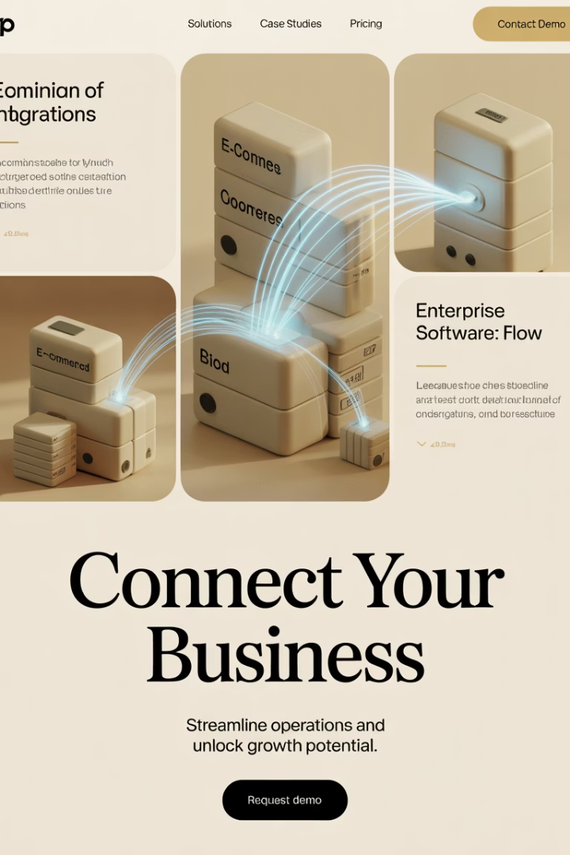
Integrating ERP and E-Commerce Platforms: What PMs Need to Know
As online businesses scale, one of the most critical and complex projects a company will undertake is integrating its e-commerce platform with an ERP system. This integration ensures data flows smoothly across sales, inventory, finance, fulfillment, and customer service—empowering real-time decisions and delivering a seamless customer experience.
For project managers, successfully navigating these integration challenges requires bridging business strategy with technical execution. This presentation will guide you through the essentials of ERP-eCommerce integration to ensure your projects deliver maximum ROI with minimal disruption.
kW
by Kimberly Wiethoff

Slide 2
Why ERP Integration Matters
Real-time Inventory Synchronization
Maintain accurate stock levels across all sales channels, preventing overselling and stockouts that damage customer trust.
Automated Order Processing
Eliminate manual data entry, reducing human error and accelerating fulfillment times from days to minutes.
Enhanced Financial Visibility
Gain accurate, real-time reporting on sales, revenue, and profitability across all channels and markets.
Unified Customer Experience
Provide consistent information and service quality regardless of how customers interact with your brand.

Slide 3
The Cost of Disconnected Systems
Before Integration
After Integration
Manual data entry causing 4-6 hour delays
Automated real-time data flows
10-15% error rate in order processing
Error rates below 1%
Inventory discrepancies leading to stockouts
Accurate inventory across all channels
Duplicate customer records
Single customer view
Weekend overtime for reconciliation
Streamlined accounting processes
Limited visibility into true profitability
Detailed product and channel profitability
Disconnected systems create operational chaos that affects both internal efficiency and customer satisfaction. By eliminating these gaps, companies typically see 15-30% improvements in operational efficiency.

Slide 4
Key Integration Touchpoints
Product Catalog
Orders & Fulfillment
Customer Data
SKUs, descriptions, pricing, variants, images, inventory levels, and product attributes
Sales orders, shipping status, tracking information, returns processing, and delivery notifications
Profiles, purchase history, contact information, B2B account structures, and communication preferences
Finance
Promotions
Tax rules, payment status, refunds, reconciliations, and revenue recognition
Coupon codes, loyalty points, campaign tracking, and discount rules
Each touchpoint requires careful consideration of data ownership, synchronization frequency, and exception handling. Project managers should facilitate detailed discussions with stakeholders from each functional area.

Slide 5
Common Integration Methods
Pre-Built Connectors
Middleware Platforms
Custom API Integration
Vendor-supplied integration apps that connect specific platforms with minimal configuration.
Integration-as-a-Service platforms that connect multiple systems through a central hub.
Tailor-made connections built by developers using platform APIs.
Fully customizable
Faster deployment (2-6 weeks)
Flexible connection options
Specific to business needs
Lower technical complexity
Visual workflow builders
Higher development cost
Vendor-managed updates
Monitoring and alerts
Requires ongoing maintenance
Limited customization options
Additional subscription costs
Best for: Highly customized platforms or unique workflows
Examples: Celigo for NetSuite + Shopify, Microsoft Dataverse + D365
Examples: Boomi, MuleSoft, Jitterbit, Zapier (for SMBs)

Slide 6
Choosing the Right Integration Approach
Strategic Fit
Does it align with long-term technical strategy?
Technical Requirements
Customization needs, data volumes, real-time needs
Resource Availability
Developer expertise, maintenance capacity
Budget Constraints
Upfront vs. ongoing costs, ROI timeline
The most successful integration projects begin with a thorough evaluation of your organization's specific needs, capabilities, and constraints. While pre-built connectors offer speed, they may not accommodate complex business rules. Custom solutions provide flexibility but require significant development resources.
Consider conducting a formal evaluation process with input from IT, operations, and finance stakeholders.

Slide 7
Data Mapping Workshop Essentials
Gather the right stakeholders
IT, Finance, Operations, Sales, Customer Service
Identify data elements
List all fields that need to sync between systems
Define data flow direction
One-way, bidirectional, or conditional flows
Establish sources of truth
Which system is authoritative for each data element
A comprehensive data mapping workshop is the foundation of successful integration. This collaborative session should document exactly how data will move between systems and establish clear ownership for each data element. The resulting data mapping document becomes your blueprint for configuration and testing.

Slide 8
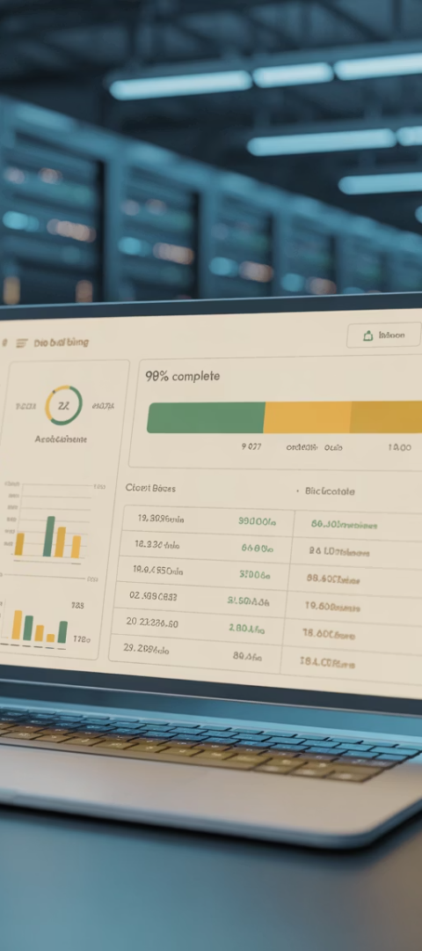
Sync Frequency Considerations
Real-Time (Immediate)
Near Real-Time (Minutes)
Scheduled Batch (Hours/Daily)
Inventory availability
Product information updates
Financial reconciliation
Order status updates
Reporting data
Customer account changes
Shipping confirmations
Customer analytics
Price changes
Bulk catalog updates
Payment confirmations
Balance between timeliness and system load
Efficient for high-volume, low-urgency data
Critical for customer-facing operations
Misaligned synchronization timing can lead to serious operational issues. Balance system performance with business needs when determining sync frequency. Document your decisions and review them regularly as business volumes grow.

Slide 9
Testing Strategy for Integration Projects
Unit Testing
Integration Testing
End-to-End Process Testing
User Acceptance Testing
Verify individual API calls and data mappings work correctly in isolation. Focus on proper data transformation and field mapping accuracy.
Test connections between systems with controlled data sets. Ensure data flows correctly in both directions and triggers appropriate actions.
Validate complete business workflows across all connected systems. Test order-to-cash, returns, inventory adjustments, and customer updates.
Have business users verify the integration supports their daily operations. Document and address any gaps in business requirements.
Comprehensive testing is essential for integration success. Create detailed test plans that cover both technical functionality and business processes. Include edge cases and high-volume scenarios to ensure performance under real-world conditions.

Slide 10
Error Handling and Recovery Planning
Error Detection
Documentation
Recovery Procedures
Failover Systems
Implement monitoring systems that can quickly identify failed synchronizations or data discrepancies. Set up alerts for critical integration points with notification escalation procedures.
Maintain detailed logs of all integration activities, including timestamps, affected records, and error codes. Store error details for troubleshooting and auditing purposes.
Create redundant pathways for business-critical data flows. Implement queue systems that can temporarily store transactions if primary integration channels fail.
Develop standard operating procedures for common failure scenarios. Include both automated recovery processes and manual intervention steps for complex issues.
Even the best-designed integrations will occasionally fail. A robust error handling strategy minimizes business disruption and prevents data corruption. Document your approach clearly and ensure support teams are trained on troubleshooting procedures.

Slide 11
Stakeholder Communication Plan
70%
4x
6+
Integration Success Rate
Weekly Updates
Key Departments
Projects with comprehensive communication plans vs. 30% for those without
Minimum recommended frequency for stakeholder communications during active phases
Number of functional areas typically impacted by ERP-eCommerce integrations
Effective communication is essential for integration success. Create a stakeholder communication matrix identifying who needs what information and when. Include technical teams, business users, leadership, and external vendors in your plan.
Proactively communicate milestone achievements, upcoming changes, and potential risks. Establish regular check-ins with key stakeholders to gather feedback and address concerns early.

Slide 12
Common Integration Pitfalls
Most integration projects face significant challenges, with inadequate requirements gathering and poor source data quality topping the list. As a project manager, you can mitigate these risks through thorough documentation, comprehensive data cleansing, and rigorous testing protocols.
Remember that technical integration is only part of the equation—change management for affected teams is equally important for project success.

Slide 13
Case Study: RetailCorp's Integration Success
Results
Solution
Achieved 99.8% inventory accuracy, reduced order processing time from 6 hours to 4 minutes, decreased manual data entry by 87%, and improved financial reporting accuracy while enabling same-day shipping for 95% of online orders.
Challenge
Implemented a phased integration approach using middleware with real-time syncing for inventory and orders, and scheduled batches for financial data. Created a centralized data governance team to maintain data quality across platforms.
RetailCorp, a multi-channel retailer with 50+ locations and a growing e-commerce presence, struggled with inventory discrepancies, delayed order processing, and incomplete financial reporting due to siloed Shopify Plus and NetSuite ERP systems.
RetailCorp's success demonstrates the transformative impact of well-executed integration. By prioritizing cross-functional collaboration and focusing on business outcomes rather than just technical connections, they achieved significant operational improvements within six months of implementation.

Slide 14
Key Takeaways for Project Success
Collaborate Widely
Plan Thoroughly
2
Involve stakeholders from all impacted business functions
Invest time in requirements gathering and detailed data mapping
Test Rigorously
Validate both technical connections and business processes
Measure Outcomes
Track KPIs that demonstrate business value and ROI
Prepare for Failures
Develop comprehensive error handling and recovery plans
ERP-eCommerce integration projects are among the most strategically important—and technically complex—initiatives a digital business can pursue. Done right, they unify operations, improve customer experience, and scale your business with confidence.
As a project manager, your ability to bridge business and technical teams while maintaining focus on key outcomes will determine your integration success.

Slide 15
Final Thoughts
ERP-eCommerce integration projects are among the most strategically important—and technically complex—initiatives a digital business can pursue. Done right, they unify operations, improve customer experience, and scale your business with confidence. Done poorly, they introduce costly errors and fragmented workflows.
As a project manager, your role is to bridge business strategy and technical execution, ensuring that systems don't just connect—but work together seamlessly.
Seamless e-commerce operations start with strong integrations. If you're planning a system sync between Shopify, NetSuite, Dynamics, or Adobe Commerce, here's what project managers should know.

