Slide 1
Certified Lean Management Professional Exam Guide
Earning the Certified Lean Management Professional (CLMP) credential can be a game-changer for your career in process improvement, efficiency, and operational excellence. This certification validates your expertise in Lean principles and continuous improvement methodologies, making you a valuable asset in any industry.
This presentation covers everything you need to know about preparing for and passing the CLMP exam, including costs, testing locations, key study topics, and strategies for success.
kW
by Kimberly Wiethoff

Slide 2
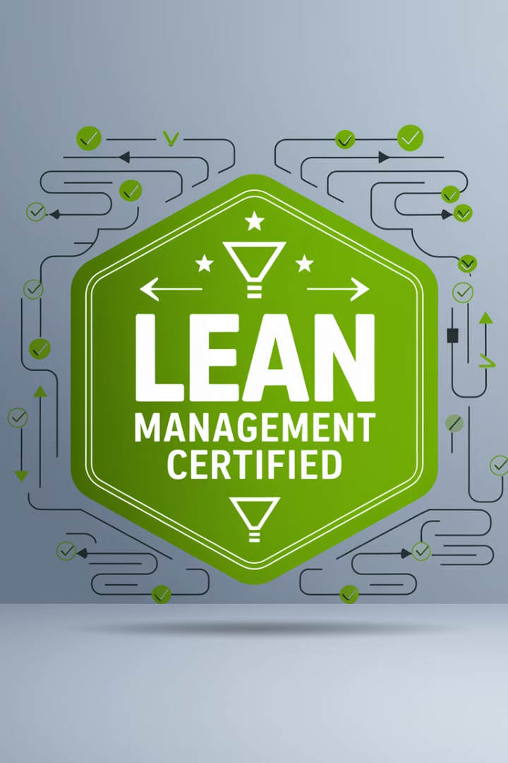
What Is the CLMP Certification?
Certification Purpose
Core Focus Areas
The Certified Lean Management Professional (CLMP) certification is designed for professionals who want to master Lean principles, identify waste, and drive efficiency in business processes.
It covers essential methodologies including Lean tools, Kaizen practices, value stream mapping, and other critical approaches to process improvement and waste elimination.
Career Impact
This credential demonstrates your ability to implement continuous improvement strategies and optimize operations across various business environments.

Slide 3
Who Should Pursue CLMP Certification?
Project Managers
Operations Managers
Manufacturing Specialists
Process Improvement Consultants
Professionals who lead projects and need to optimize resources, timelines, and deliverables using Lean methodologies.
Leaders responsible for day-to-day operations who want to eliminate waste and improve efficiency in their processes.
Professionals in production environments looking to implement Just-in-Time systems and reduce waste in manufacturing processes.
Advisors who help organizations identify inefficiencies and implement Lean solutions across various industries.

Slide 4
CLMP Exam Cost Breakdown
$200-500
$50-300
$300-1.5K
Exam Fee
Study Materials
Optional Training
The base cost for taking the certification exam, which varies by provider and location.
Investment in books, online resources, and practice tests to prepare for the exam.
Cost for instructor-led courses or comprehensive training programs if self-study isn't preferred.
Many organizations offer discounts for members or group enrollments. Check if your employer will cover these costs as part of professional development programs.

Slide 5
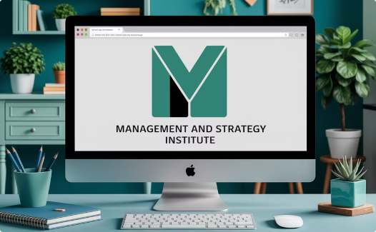
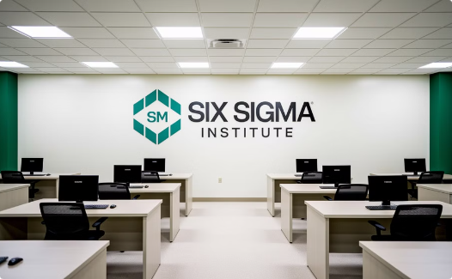
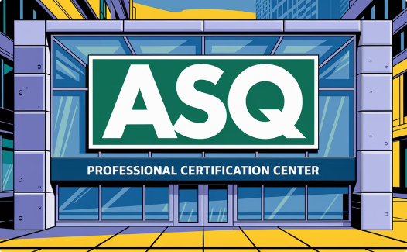
Where to Take the CLMP Exam
Management and Strategy Institute (MSI)
Six Sigma Institute (SSI)
American Society for Quality (ASQ)
Provides comprehensive Lean certification programs with both online and in-person testing options at partner locations.
Offers an online exam format with self-paced training options, allowing candidates to prepare and test on their own schedule.
While primarily focused on Six Sigma, ASQ also offers Lean certifications with respected industry recognition.
Most providers now offer online proctored exams, allowing you to take the test from home with proper verification procedures.

Slide 6
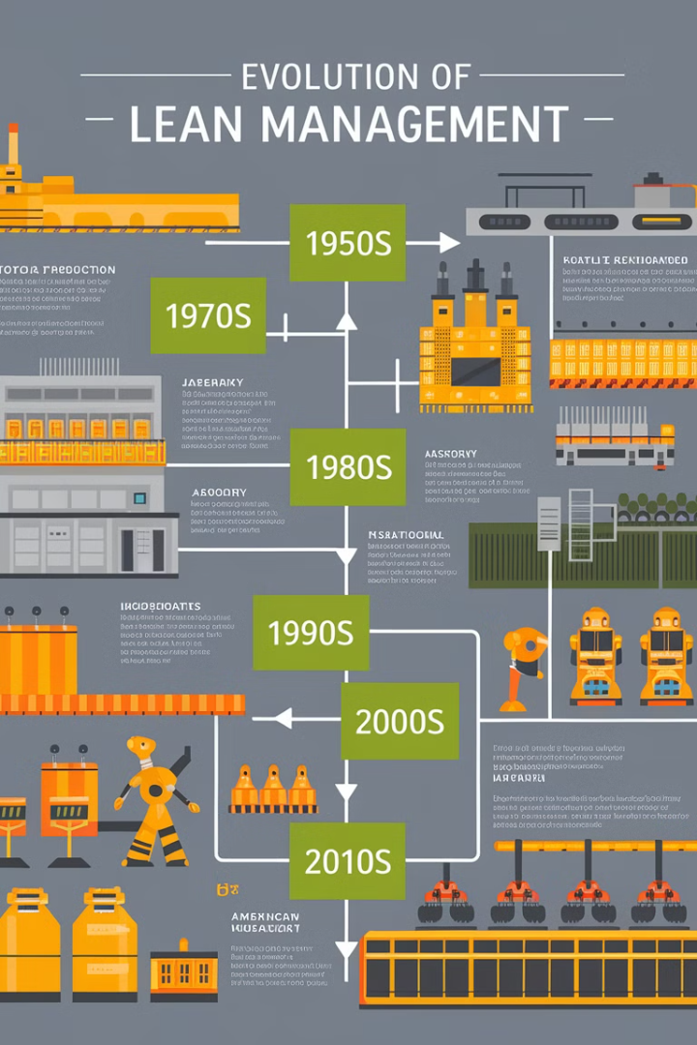
Introduction to Lean Management
1
History of Lean
Originated from Toyota Production System in post-WWII Japan, developed by Taiichi Ohno and Shigeo Shingo as a methodology to eliminate waste and improve efficiency.
2
Core Lean Principles
Five fundamental principles: identifying Value, mapping the Value Stream, creating Flow, establishing Pull systems, and pursuing Perfection through continuous improvement.
3
Lean vs. Six Sigma
While Lean focuses on eliminating waste and improving flow, Six Sigma targets reducing variation and defects. Together they form a powerful improvement methodology.

Slide 7
Types of Waste (Muda, Mura, Muri)
Defects
Overproduction
Products or services that don't meet specifications, requiring rework or scrapping.
Producing more than needed or before it's needed, creating excess inventory.
Extra Processing
1
2
Waiting
Doing more work than required by the customer or specification.
Idle time when materials, information, people, or equipment aren't ready.
8
3
Motion
7
4
Non-utilized Talent
Unnecessary movement by people (reaching, walking, searching).
Failing to leverage employees' skills, knowledge, and creativity.
6
5
Inventory
Transportation
Excess materials, work-in-progress, or finished goods not being processed.
Unnecessary movement of materials, products, or information between processes.
These eight wastes (DOWNTIME) represent the core focus of waste elimination strategies in Lean management. Identifying and addressing these wastes is a key component of the CLMP exam.

Slide 8
Kaizen & Continuous Improvement
Plan
1
Do
Identify opportunities and develop action plans
2
Implement changes on small scale
Act
4
Check
3
Standardize successful changes
Measure results against expectations
Kaizen, meaning "change for better" in Japanese, is a philosophy of continuous improvement through small, incremental changes. The PDCA (Plan-Do-Check-Act) cycle is the foundation of Kaizen implementation.
Leadership plays a crucial role in fostering a culture of continuous improvement by encouraging employee involvement, providing necessary resources, and removing barriers to change.

Slide 9
Essential Lean Tools and Techniques
Standard Work
Just-in-Time & Kanban
Documented procedures that establish the best practices for performing processes. Standard work ensures consistency, quality, and efficiency while providing a baseline for future improvements.
Value Stream Mapping
5S Methodology
JIT focuses on producing only what is needed, when needed, in the amount needed. Kanban is a visual signaling system that supports JIT by controlling the flow of resources through visual cues.
A visual tool that documents, analyzes, and improves the flow of information or materials required to produce a product or service. VSM helps identify bottlenecks and opportunities for improvement.
Sort (remove unnecessary items), Set in Order (organize remaining items), Shine (clean the area), Standardize (create consistent procedures), and Sustain (maintain the system). 5S creates an efficient, safe workplace that eliminates waste.

Slide 10
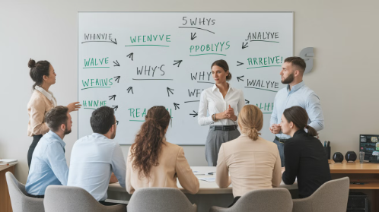
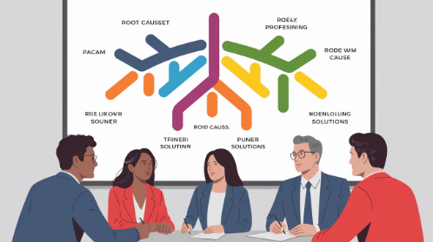
Problem Solving and Root Cause Analysis
The 5 Whys Technique
Fishbone (Ishikawa) Diagram
Failure Mode and Effects Analysis
An iterative questioning method that explores cause-and-effect relationships underlying a problem. By asking "why" five times, you can peel away layers of symptoms to reveal the root cause of an issue.
A visual tool that helps categorize potential causes of a problem into distinct groups (typically: People, Methods, Machines, Materials, Measurements, and Environment). This comprehensive approach ensures all possible causes are considered.
A systematic, proactive method for evaluating a process to identify where and how it might fail, and assessing the relative impact of different failures to prioritize improvement actions.

Slide 11
Lean Metrics and Performance Measurement
Metric
Definition
Importance
Cycle Time
Time to complete one unit from start to finish
Measures process efficiency
Lead Time
Total time from customer order to delivery
Measures responsiveness to customer
Takt Time
Available production time divided by customer demand
Sets the pace of production to match demand
Overall Equipment Effectiveness (OEE)
Availability × Performance × Quality
Measures productive manufacturing time
First Pass Yield
Percentage of units produced correctly the first time
Measures process quality
Understanding these key performance indicators is essential for measuring the success of Lean implementations and identifying areas for improvement. The CLMP exam tests your ability to calculate and interpret these metrics in various scenarios.

Slide 12
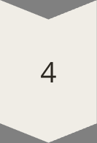
Effective Study Strategies
Take an Online Course
Enroll in structured courses from training providers like Coursera, Udemy, or LinkedIn Learning that cover all exam topics systematically. These platforms offer affordable Lean Management courses with expert instruction.
Use Official Study Materials
Prioritize official study guides from your exam provider as your primary resource. Supplement with respected texts like "Lean Thinking" by James Womack and "The Toyota Way" by Jeffrey Liker for deeper understanding.
Practice with Sample Questions
Test your knowledge with sample exams and practice questions from certification providers. Websites like Six Sigma Study Guide and GoLeanSixSigma.com offer practice tests to assess your exam readiness.
Join a Lean Community
Engage in Lean forums, LinkedIn groups, or local networking events to discuss concepts with professionals who have taken the exam. Peer learning can provide valuable insights and clarify difficult concepts.

Slide 13
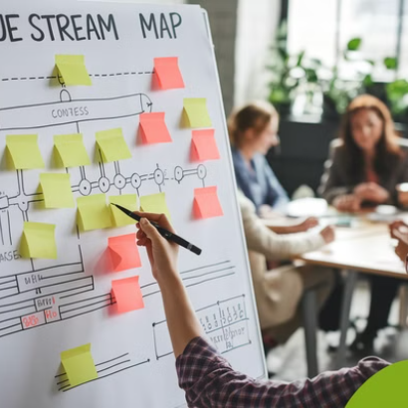
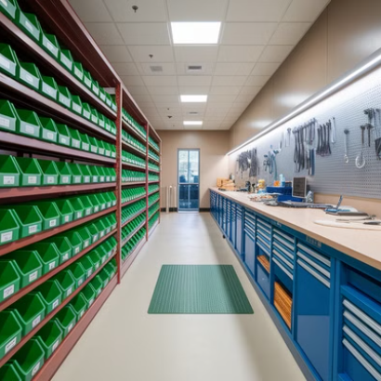
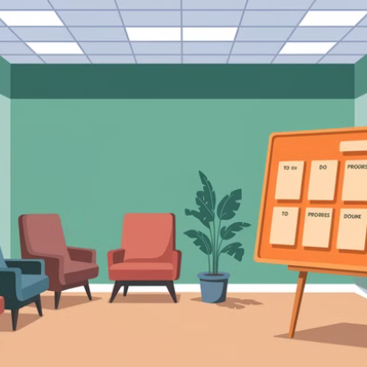
Apply Lean in Real Life
Practical application is one of the most effective ways to reinforce your learning. Identify waste in your current processes, create a value stream map of your workflow, or implement 5S in your workspace. These hands-on experiences will deepen your understanding of Lean concepts and prepare you for real-world scenarios on the exam.
Document your improvements and results to build a portfolio of Lean implementations that can benefit both your exam preparation and future career opportunities.

Slide 14
What's Next After Passing the CLMP Exam?
Advanced Certifications
1
Pursue Lean Six Sigma Green/Black Belt
Lead Improvement Projects
2
Apply knowledge to organizational challenges
Implement Lean Principles
3
Use techniques to improve workflows
Once you earn your Certified Lean Management Professional credential, you can immediately begin applying your knowledge to improve workflows and efficiency in your organization. Look for opportunities to lead process improvement initiatives that demonstrate the value of your new skills.
Consider pursuing advanced certifications like Lean Six Sigma Green Belt or Black Belt to deepen your expertise. These additional credentials can open doors to more specialized roles and higher-level positions in process improvement.

Slide 15
Final Thoughts on CLMP Certification
Career Advancement
1
Open doors to new opportunities
Practical Application
2
Transform organizations with Lean
Knowledge Foundation
3
Master essential Lean principles
Earning the Certified Lean Management Professional (CLMP) certification gives you a competitive edge in project management, operations, and process improvement. The knowledge and skills you gain through this certification process will enable you to identify waste, streamline processes, and drive meaningful improvements in any organization.
With the right study approach and practical experience applying Lean methodologies, you'll be well-prepared to pass the exam and leverage your expertise throughout your career. The journey to becoming a Lean professional doesn't end with certification—it's just the beginning of a continuous improvement path.

