Slide 1

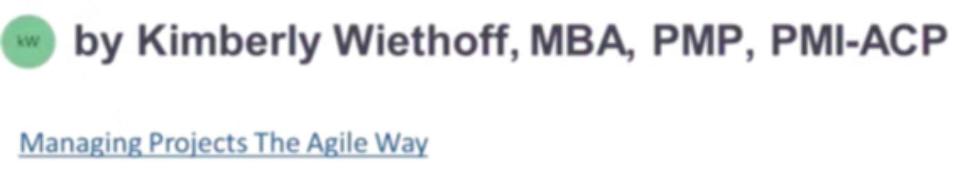
Leading Through Influence: The Most Important Skill for Agile Coaches
The most effective Agile Coaches don't rely on authority—they rely on influence. By building trust, asking powerful questions, coaching leaders, and fostering collaboration, they create environments where teams embrace change, solve problems together, and continuously improve.
#AgileCoaching #AgileLeadership #ServantLeadership #Leadership #Influence #ChangeManagement #EnterpriseAgility #ContinuousImprovement #Scrum #ScrumMaster #BusinessTransformation #DigitalTransformation #LeadershipDevelopment #TeamPerformance #EmotionalIntelligence #ArtificialIntelligence #FutureOfWork #ProjectManagement #OrganizationalChange #HighPerformingTeams

Slide 2

The Core Premise: Influence Over Authority
The Misconception
The Reality
Many believe an Agile Coach's success depends primarily on how well they understand frameworks like Scrum, Kanban, Lean, and scaled Agile practices. While that knowledge is essential, technical expertise alone is rarely enough to drive meaningful organizational change.
Unlike traditional managers, Agile Coaches typically have little or no formal authority. They cannot assign work, conduct performance reviews, or direct teams to follow a specific process. Instead, they lead by building trust, fostering collaboration, asking thoughtful questions, and helping others recognize opportunities for improvement.
Influence—not authority—is the foundation of successful Agile coaching.

Slide 3
Why Influence Matters in Agile Transformations
Agile transformations introduce significant change. Teams adopt new ways of working, leaders shift from directing to empowering, and organizations rethink how they deliver value. Change creates uncertainty—and uncertainty almost always generates resistance.
The Root of Resistance
The Role of the Coach
Inspire, Don't Force
People rarely resist Agile itself. More often, they resist the discomfort that accompanies change—fear of the unfamiliar, loss of control, or unclear expectations.
Influential coaches help people understand the purpose behind change, align teams around shared goals, and build confidence that new approaches will lead to better outcomes.
Rather than mandating change through positional power, effective Agile Coaches inspire it—creating willing participants who own the transformation rather than comply with it.

Slide 4
Building Trust Before Driving Change
Influence begins with trust. Teams are far more willing to embrace new ideas when they believe their coach genuinely understands their challenges and is committed to helping them succeed. Trust cannot be established through a certification or job title—it is earned through consistent behavior over time.
Listen First
Follow Through
Offer solutions only after deeply understanding the team's context, concerns, and constraints.
Demonstrate reliability by honoring every commitment, no matter how small.
Stay Transparent
Celebrate Wins
Be honest about decisions, tradeoffs, and limitations—even when the message is difficult.
Recognize and celebrate team successes publicly, reinforcing a culture of progress and momentum.
When trust is present, difficult conversations become productive conversations.

Slide 5
Asking Powerful Questions
Experienced Agile Coaches understand that providing answers is not always the best way to develop teams. When teams discover solutions themselves, they are far more likely to embrace and sustain those changes. Asking the right questions encourages ownership and builds stronger problem-solving capabilities.
What problem are we trying to solve?
What assumptions are we making?
Refocuses the conversation on the actual challenge rather than symptoms or assumptions.
Surfaces hidden beliefs that may be blocking creative or effective solutions.
What is preventing us from delivering value?
What can we learn from this experience?
Identifies impediments and invites the team to take ownership of removing them.
Cultivates a continuous improvement mindset by treating every outcome as a learning opportunity.

Slide 6
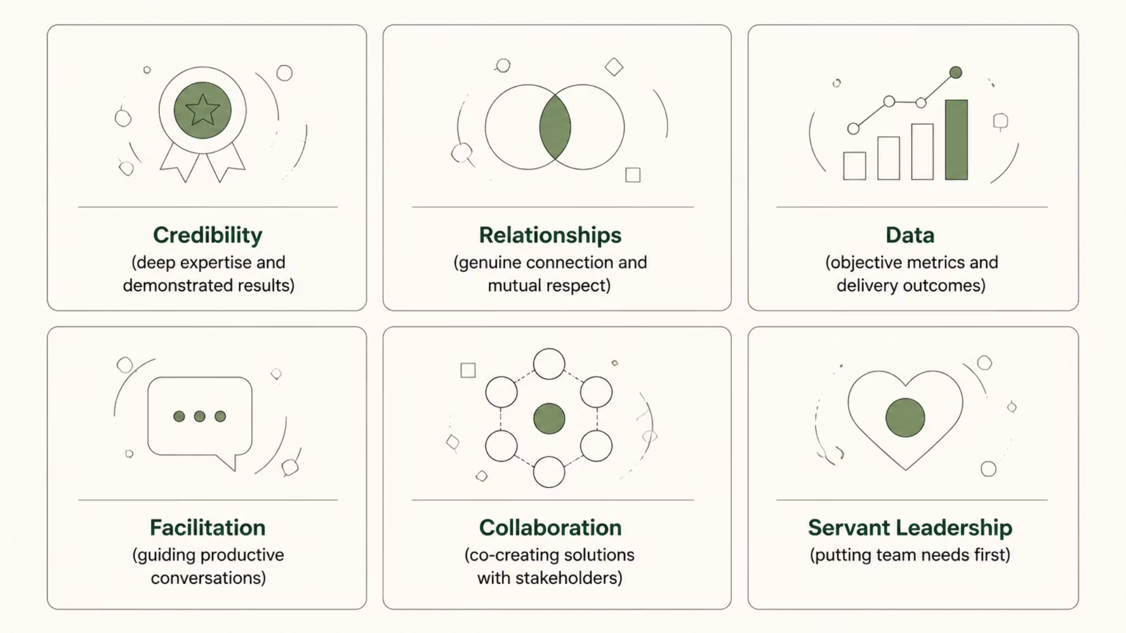
Influencing Without Formal Authority
Perhaps the greatest challenge for Agile Coaches is leading people who do not report to them. Product Owners, Scrum Masters, developers, business leaders, and executives often have competing priorities and different definitions of success. Rather than relying on positional authority, effective coaches build their influence through six core levers.
By focusing conversations on customer value and organizational outcomes rather than individual preferences, Agile Coaches help stakeholders find common ground. Influence creates alignment where authority often creates compliance.

Slide 7

LEADERSHIP COACHING
Coaching Leaders as Well as Teams
Agile transformations succeed when leaders change alongside their teams. Executives and managers play a critical role in shaping organizational culture, allocating resources, and removing systemic barriers. Influencing senior leaders often has a greater organizational impact than coaching individual teams.
Empower Decisions
Encourage Experimentation
Push decision-making to the people closest to the work.
Create safety for leaders to try new approaches without fear of failure.
Foster Transparency
Enable Outcomes
Build visibility into progress, impediments, and outcomes at every level.
Shift leaders from managing tasks to supporting and enabling team results.

Slide 8
Using Data to Strengthen Influence
Facts strengthen influence. Rather than relying solely on opinions, Agile Coaches use delivery metrics and business outcomes to guide meaningful conversations with leaders and stakeholders. Presenting objective data helps leaders understand where improvements are needed and encourages evidence-based decisions rather than assumptions.
Sprint Predictability
Cycle & Lead Time
Customer Satisfaction
Data informs the conversation, but people still drive the change.
Defect Trends
Team Engagement
Delivery Forecasting

Slide 9

Managing Resistance with Empathy
Resistance is a natural part of every transformation. Some employees fear losing control; others worry about new expectations or unfamiliar ways of working. Effective Agile Coaches recognize that resistance often reflects uncertainty rather than unwillingness—and respond accordingly.
01
02
Listen Carefully
Acknowledge Concerns
Give resistors space to voice their concerns without judgment or defensiveness.
Validate feelings and demonstrate genuine understanding of the underlying fears.
03
04
Involve Stakeholders
Build Momentum
Co-create solutions with those who are resistant, transforming skeptics into engaged advocates.
Celebrate small wins to reinforce that the new direction is working and sustainable.

Slide 10
AI & THE FUTURE OF COACHING
Leveraging AI to Enhance Coaching
What AI Can Do
What AI Cannot Replace
Analyze delivery trends and surface patterns invisible to the naked eye
Building trust, resolving conflict, inspiring change, and influencing leaders all require emotional intelligence, active listening, and authentic human relationships. AI enhances influence by providing better insights—but people remain at the center of Agile transformation.
Detect organizational bottlenecks and recurring impediments automatically
Summarize sprint outcomes and monitor team sentiment at scale
Forecast delivery risks before they become critical blockers

Slide 11




Developing Influence as an Agile Coach
Influence is not an innate talent—it is a skill that can be deliberately developed over time. Every interaction is an opportunity to build credibility. Consistent actions, repeated across many conversations and relationships, create the lasting influence that drives real organizational transformation.
Continuously Learn
Seek Feedback
Build Relationships
Communicate Effectively
Expand knowledge of business, technology, and human behavior to stay relevant and credible.
Actively request honest input from teams and leaders to identify blind spots and growth areas.
Invest in strong connections across all levels of the organization to expand your sphere of influence.
Sharpen verbal, written, and facilitation skills to convey ideas with clarity and conviction.

Slide 12





The Influence Flywheel
Influence in Agile coaching is not a single action—it is a self-reinforcing cycle. Each element builds on the previous one, creating a flywheel of compounding credibility and impact that grows stronger over time.
Ask Questions
Build Trust
Encourage ownership through powerful inquiry
Earn credibility through consistency and empathy
Use Data
Guide evidence-based conversations and decisions
Drive Change
Foster Collaboration
Inspire lasting transformation at every level
Align diverse stakeholders around shared outcomes

Slide 13

Frameworks provide structure.
Influence creates lasting change.
The most successful Agile Coaches are remembered not for the ceremonies they facilitated, but for the people they helped develop and the organizations they helped transform.

Slide 14
Key Takeaways: Leading Through Influence
As organizations navigate rapid technological change, distributed teams, and the growing role of artificial intelligence, the ability to lead through influence will become even more essential. Agile coaching is not about directing people toward a solution—it is about empowering them to discover it, embrace it, and sustain it together.
1
2
3
Trust is the Foundation
Questions Beat Answers
Lead Leaders Too
Earned through consistent behavior, empathy, and transparency—not titles or credentials.
Powerful inquiry builds team ownership and sustains change far better than prescriptive advice.
Coaching executives and managers often delivers greater organizational impact than coaching teams alone.
4
5
Data + Empathy = Impact
AI Augments, Humans Transform
Objective metrics guide conversations; emotional intelligence drives the decisions that follow.
Use AI for insights and pattern detection, but relationships and influence remain irreplaceably human.

