Slide 1
Program Management 30-60-90 Day Plan
Welcome to Innovantage Technologies, LLC. This presentation outlines a strategic approach for the first 90 days of program management.
kW
by Kimberly Wiethoff

Slide 2
30-60-90 Day Overview
1
2
3
First 30 Days
Next 30 Days (31-60)
Final 30 Days (61-90)
Learning and Integration: Understand company, team, and projects.
Contribution and Optimization: Identify areas for improvement and contribute actively.
Leadership and Strategic Planning: Lead initiatives and plan for long-term success.

Slide 3
First 30 Days: Company, Team, and Projects
Company
Team
Projects
Study company's mission, values, products, and services. Understand industry, competitors, and market trends.
Meet key stakeholders. Understand team structure, roles, and responsibilities. Schedule one-on-one meetings.
Review current projects, timelines, milestones, budgets, and deliverables. Analyze project management tools and methodologies.

Slide 4
First 30 Days: Training and PMO Requirements
Training & Systems Familiarization
Understanding PMO Requirements
Complete mandatory training sessions. Familiarize with internal systems and tools.
Review PMO guidelines from parent company. Meet PMO representatives. Assess project alignment with PMO standards.

Slide 5
Next 30 Days: Contribute and Identify Improvements
Project Management and Execution
Process Evaluation and Improvement
Team Development and Support
Take active role in projects. Review progress and adjust plans. Address immediate risks.
Analyze current processes. Identify areas for improvement in workflows and resource allocation.
Provide support to team members. Implement changes to improve performance and morale.

Slide 6
Days 31-60: Stakeholder Communication and PMO Alignment
Establish Communication Channels
Set up regular updates with key stakeholders on project statuses and improvements.
Develop PMO Alignment Plan
Create strategy to align practices with parent company's PMO requirements.
Implement Changes
Make immediate adjustments to meet PMO standards. Communicate changes to the team.

Slide 7
Final 30 Days: Lead Initiatives and Plan for Success
Strategic Planning
1
Develop 6-12 month plan aligned with business goals.
Implement Improvements
2
Start approved process improvements. Monitor and adjust as needed.
Leadership and Mentorship
3
Mentor team members. Foster culture of continuous improvement.

Slide 8
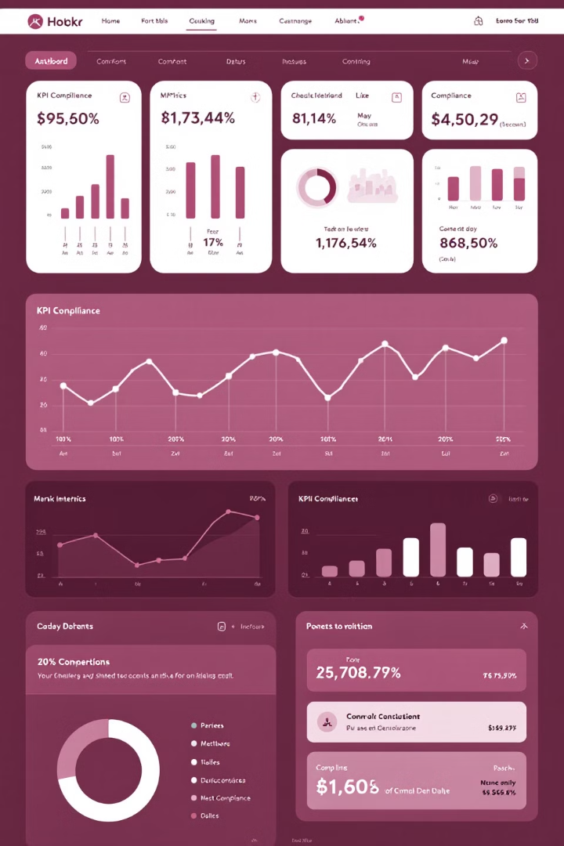
Final 30 Days: KPIs and PMO Compliance
Establish KPIs
Develop Reporting Framework
Create metrics to measure project success and team performance.
Create system to track and communicate progress to stakeholders.
Ensure PMO Compliance
Report Compliance Status
Conduct reviews to maintain adherence to PMO standards.
Communicate PMO compliance to senior management and stakeholders.

Slide 9
Deliverables Overview
1
First 30 Days
Project portfolio summary, team dynamics observations, PMO requirement summary.
2
Next 30 Days
Process improvement plan, project status reports, PMO alignment plan.
3
Final 30 Days
Strategic plan, documented improvements, KPI framework, PMO compliance report.

Slide 10
Thank You
Presented by Kimberly Wiethoff - 2024
This concludes our 30-60-90 day plan for Program Management at Innovantage Technologies, LLC.

