Slide 1

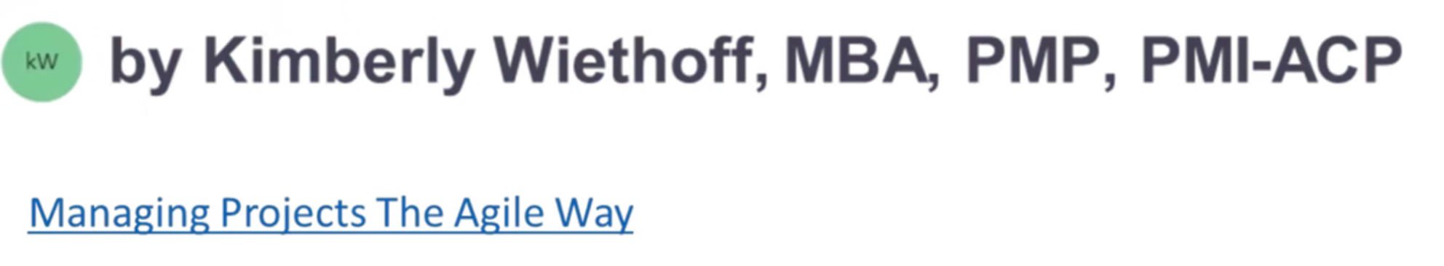
Bridging the Agile-Executive Divide: Speaking ROI
Translate your team's agile achievements into business outcomes that executives care about.
Executives don’t want to hear how many user stories were completed—they want to know how those stories moved the business forward. If you want your Agile initiatives to be supported, funded, and celebrated, you need to speak their language: the language of ROI.
#AgileLeadership #ExecutiveCommunication #BusinessValue #ROI #ProjectManagement #PMO #StrategicLeadership #DigitalTransformation #DataDrivenLeadership #AgileTransformation #LeadershipCommunication #KPIs #BusinessAlignment #ValueDelivery #ManagingProjectsTheAgileWay

Slide 2
The Communication Challenge
What Agile Teams Discuss
What Executives Care About
The Gap Result
Story points
Funding challenges
Sprint velocity
Business outcomes
Limited executive support
Burndown charts
Market impact
Strategic misalignment
Daily stand-ups
Revenue growth
Missed opportunities
Customer retention

Slide 3

Transform Your Messaging
Instead of:
Say This:
"We increased velocity by 25% over the last 3 sprints."
"We accelerated delivery of features reducing customer churn by 10%."
"The team completed 15 user stories this sprint."
"We launched capabilities that increase average order value by $27."
"Our burndown chart shows we're on track."
"We're on pace to beat competitors to market by 6 weeks."

Slide 4





Translate Agile to Business Outcomes
Agile Output
Technical capabilities delivered by the team
Translation
Link to strategic objectives and customer value
Business Outcome
Impact on growth, efficiency, or market position
Executive Buy-in
Support, resources, and strategic alignment

Slide 5




Executive-Friendly Metrics
Feature Cycle Time
Customer Adoption Rates
Measure how quickly ideas transform into market-ready features.
Track how rapidly users embrace new capabilities.
Cost of Delay
Net Promoter Score
Quantify the financial impact of postponing feature releases.
Monitor how features influence customer satisfaction and loyalty.

Slide 6




Effective Executive Updates
What we accomplished
Focus on completed deliverables with business impact
Why it matters
Connect to strategic objectives and financial outcomes
What's next
Preview upcoming value without technical details
Help needed
Specific requests for executive support or decisions

Slide 7

Example: Translating Team Updates
Technical Update
Executive Translation
Implemented user authentication microservice
Enhanced security infrastructure, reducing risk exposure by 40%
Refactored legacy code base
Reduced maintenance costs by $250K annually
Automated regression testing
Accelerated time to market by 3 weeks per release
Completed API integration
Enabled new $2M revenue stream through partner connectivity

Slide 8








Align Agile with Strategic Timelines
Sprint Cadence
Release Milestones
2-4 week delivery cycles focused on incremental value
Feature completions that deliver measurable customer value
Annual Planning
Quarterly Reviews
Strategic roadmaps connecting agile delivery to company goals
Business impact assessments aligned to financial reporting

Slide 9






Quarterly Executive Syncs
Strategic Alignment
Ensure agile priorities match evolving business needs
Showcase Impact
Demonstrate cumulative business value of delivered features
Roadmap Adjustments
Adapt plans based on market changes and new priorities

Slide 10

Educating Leaders on Agile Value
68%
24%
71%
Higher ROI
Faster Delivery
Better Alignment
Average ROI increase from agile vs. traditional approaches
Average reduction in time-to-market for new products
Organizations citing improved business/IT alignment

Slide 11

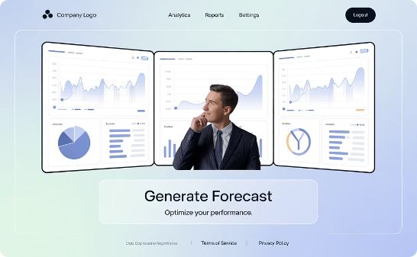

Executive Agile Education Approaches
Hands-On Workshops
Impact Showcases
Leadership Retrospectives
Invite executives to participate in simplified agile ceremonies. Focus on business decisions, not technical details.
Create visual displays connecting agile practices to business results. Highlight metrics executives care about.
Hold casual reviews examining how agile is improving strategic execution. Gather feedback on what matters most.

Slide 12
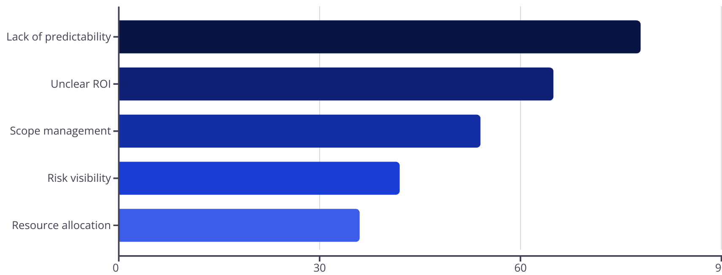
Common Executive Concerns

Slide 13





Addressing Executive Concerns
Predictability
ROI Clarity
Show how empirical data improves forecasting. Demonstrate consistent velocity trends and feature completion rates.
Create value-tracking dashboards. Quantify business impact for each feature and tie to strategic objectives.
Scope Management
Risk Mitigation
Demonstrate how agile enables rapid pivots. Show examples of avoiding waste by adapting to market feedback.
Highlight how early detection reduces costs. Present specific examples of issues caught before production.

Slide 14

Next Steps: Building Your Executive Communication Plan
Audit Current Reporting
Review existing communications for technical jargon. Identify metrics that matter to your specific executives.
Create Value Translation Matrix
Map technical deliverables to business outcomes. Develop templates for consistent messaging.
Establish Regular Touchpoints
Schedule quarterly syncs with leadership. Create concise, business-focused dashboard for monthly updates.
Develop Executive Allies
Identify champions who understand both worlds. Partner to refine your approach based on feedback.

Slide 15

Final Thoughts
Bridging the Agile-executive gap isn't about simplifying Agile—it's about amplifying its value in terms leadership understands. When you connect the dots between sprint activities and business impact, you unlock stronger support, smarter decisions, and greater influence in your organization.
Start small, speak clearly, and always lead with the "why."
🔗 Related Reads from ManagingProjectsTheAgileWay.com:
Top 12 KPIs Every Project Manager Should Track for Project Success
Agile KPIs vs. Traditional Project KPIs: What You Need to Know
Embracing the Agile Manifesto: A Deep Dive into Its 12 Principles

