Slide 1

Navigating the PMO: A Guide for New Project Managers
Starting as a project manager in a new organization can be both exciting and overwhelming. This guide will help you understand and navigate the Project Management Office (PMO), helping you succeed in your new role.
kW
by Kimberly Wiethoff

Slide 2
Understanding PMO Structures
Supportive
Controlling
Directive
Provides templates, best practices, and guidance. Minimal control over project execution.
Sets governance standards, enforces compliance, and ensures project managers follow predefined methodologies.
Directly manages projects, assigning resources and overseeing execution.

Slide 3

Familiarize Yourself with PMO Processes
Project Initiation
Project Planning
How projects are approved, assigned, and kicked off.
Required documentation, templates, and methodologies (Agile, Waterfall, or hybrid approaches).
Project Execution
Project Closure
Monitoring and reporting mechanisms, stakeholder engagement practices, and change management procedures.
Documentation, lessons learned, and final reporting requirements.

Slide 4




Engage with PMO Leadership
Networking
Seeking Insights
Community Involvement
Build relationships with PMO leaders and other project managers.
Schedule one-on-one meetings to understand key PMO expectations and best practices.
Join internal project management communities or attend PMO-led training sessions.

Slide 5
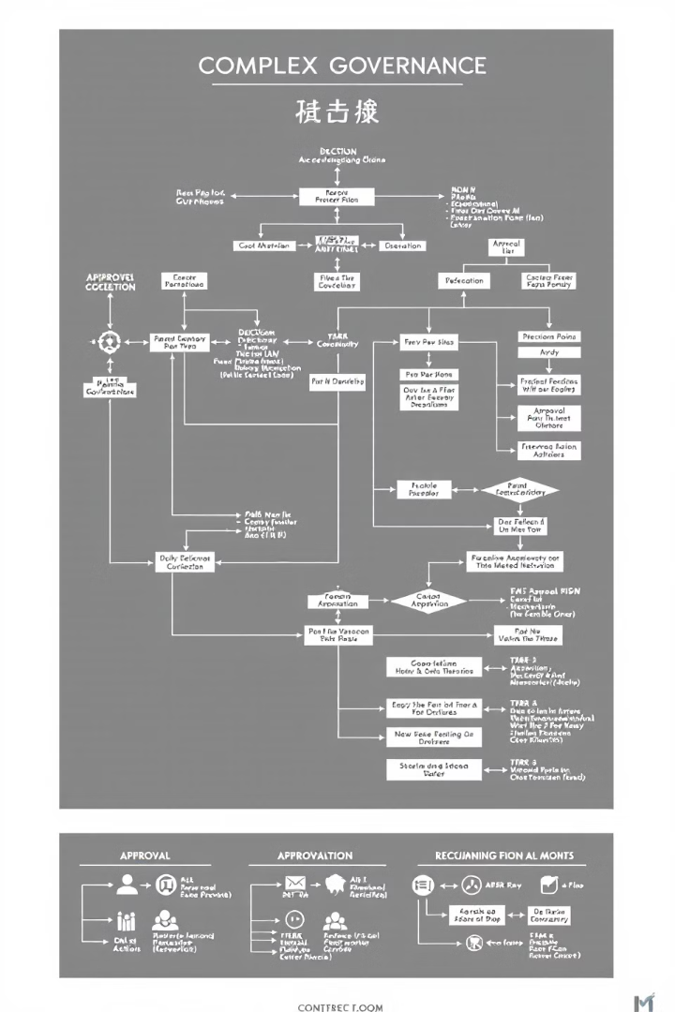
Understand Governance and Compliance
1
Approval Gates
Key milestones where leadership reviews and approves project progress.
2
Risk Management
Protocols for identifying, logging, and mitigating risks.
3
Financial Oversight
Budget tracking and financial reporting expectations.
4
Quality Assurance
Deliverable review processes and compliance with regulatory standards.

Slide 6
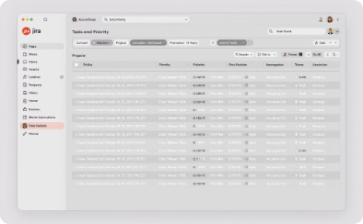
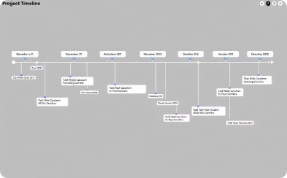
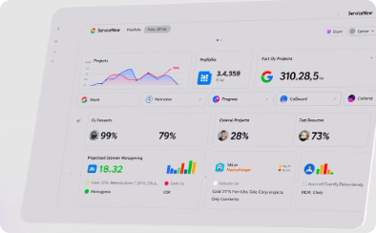
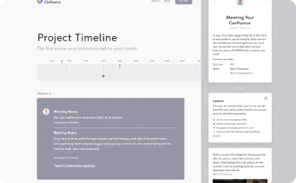
Master Project Management Tools
Agile Project Management
Scheduling
Portfolio Tracking
Documentation
Microsoft Project or Primavera.
ServiceNow or Monday.com.
Confluence or SharePoint.
Jira or Azure DevOps.

Slide 7
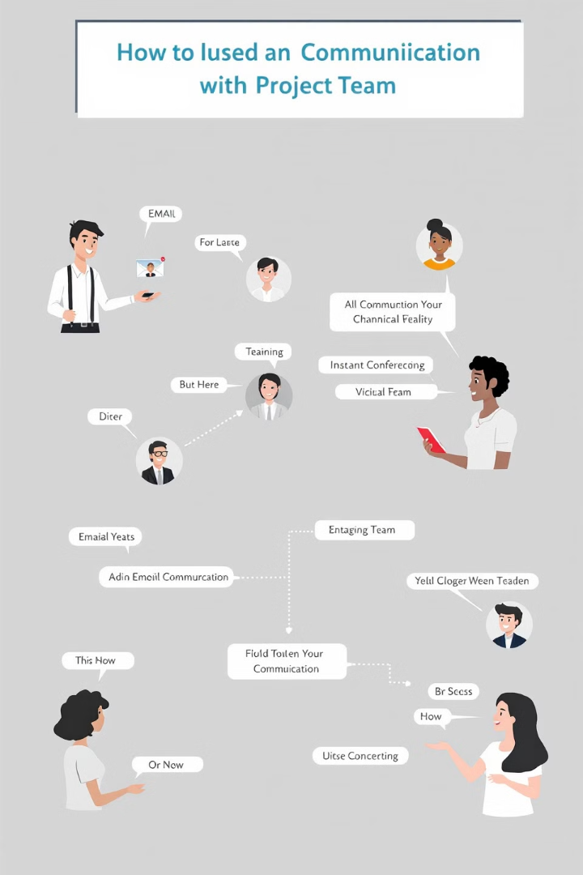



Communicate Effectively with Stakeholders
Clarify Expectations
Early communication avoids misunderstandings.
Provide Concise Updates
Status updates align with PMO reporting requirements.
Seek Feedback
Refine your approach based on stakeholder feedback.

Slide 8

Stay Flexible and Continuously Improve
Stay Updated
Keep up with PMO process updates.
Attend Training
Participate in training sessions or webinars.
Suggest Improvements
Streamline workflows and enhance efficiency.

Slide 9
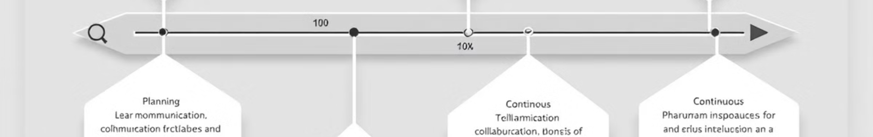
PMO Best Practices: Lessons Learned
Understanding the PMO structure is essential for success.
1
2
Early engagement with PMO leadership is crucial.
Communicate effectively with stakeholders to avoid misunderstandings.
3
4
Embrace continuous improvement by staying up-to-date on PMO processes.

Slide 10



PMO: Case Studies and Real-World Examples
Governance
1
A company enforces strict risk management protocols to ensure project success.
Communication
2
A project manager uses a detailed communication plan to keep stakeholders informed.
Flexibility
3
A team adapts to changing PMO processes and embraces continuous improvement.

Slide 11

Key Takeaways for New Project Managers
1
Know Your PMO
Understand the PMO's structure, processes, and governance requirements.
2
Engage and Collaborate
Build relationships with PMO leaders and other project managers.
3
Master Tools and Techniques
Become proficient in PMO-approved project management tools and methodologies.
4
Communicate Effectively
Clearly communicate expectations, provide updates, and seek feedback from stakeholders.

Slide 12


Next Steps: Embrace the PMO Journey
Embracing the PMO journey will help you navigate complex projects, collaborate effectively, and drive successful outcomes. Remember, the PMO is there to guide you and support you in achieving organizational goals.

