Slide 1

How to Build Your First AI PMO
Artificial intelligence is moving from experimentation to enterprise transformation. Organizations are deploying AI copilots, generative platforms, predictive analytics, and intelligent automation at scale. But there is a fundamental difference between using AI tools and building an enterprise capability around AI.
KIMBERLY WIETHOFF, MBA, PMP, PMI-ACP
MANAGING PROJECTS THE AGILE WAY
#AIPMO #ArtificialIntelligence #PMO #ProgramManagement #ProjectManagement #DigitalTransformation #AIGovernance #EnterpriseAI #AILeadership #BusinessTransformation #Innovation #FutureOfWork #ManagingProjectsTheAgileWay

Slide 2

The Case for an AI PMO
Without a coordinated operating model, AI adoption becomes fragmented — creating security exposure, misaligned investment, and unmeasured value. The questions that matter most have shifted:
Where should we use AI? How do we govern it? Which initiatives deserve investment? How do we measure their value — and scale what works without creating unnecessary risk?
This is where the AI Project Management Office — the AI PMO — becomes a critical enterprise capability: providing the governance, portfolio discipline, delivery standards, and organizational capacity to move AI from scattered experimentation to sustainable business transformation.

Slide 3
What Is an AI PMO?
A traditional PMO improves project and program delivery through governance, standards, and oversight. An AI PMO expands that mission considerably — connecting strategy, technology, data, and risk functions into a unified operating model for AI-enabled transformation.
The AI PMO Mission
What a Successful AI PMO Ensures
Help the organization identify, prioritize, govern, deliver, measure, and scale AI-enabled initiatives — ensuring they remain aligned with enterprise strategy and accountable to measurable outcomes.
AI investments are aligned to measurable business objectives
Initiatives are prioritized by enterprise value — not novelty
Governance, compliance, and security requirements are met
Data readiness and quality are assessed before deployment
Benefits are measured against expected outcomes post-launch
Successful capabilities are scaled across teams and functions
The AI PMO serves as a bridge across groups that have traditionally operated in silos: business leaders who understand the problems, technology teams who understand the platforms, data teams who understand the information, and risk functions who understand the controls. Together — coordinated through the AI PMO — they form a repeatable operating model.

Slide 4

Step 1: Start With Business Outcomes, Not AI Technology
One of the most common mistakes in AI transformation is beginning with the technology. A new platform captures executive attention, and teams scramble to find use cases. That approach reverses the equation entirely.
The first question should never be "Where can we deploy this AI tool?" — it should be "Which business problems are important enough to solve, and could AI help us solve them better?"
The AI PMO can facilitate structured discovery sessions with business leaders to surface high-value opportunities. Guiding questions include:
Process Inefficiency
Decision Complexity
Customer Friction
Competitive Opportunity
Which processes consume significant employee time or experience frequent delays and errors?
Where do employees search through large volumes of data to support manual analysis or judgment?
Where do customers experience unnecessary friction or delays that technology could reduce?
Which business capabilities could create competitive advantage if significantly improved?
A mature AI PMO should also be willing to conclude that AI is not the right solution — when a simpler process improvement would deliver better value. Strategy must begin with the business problem, not the novelty of the technology.

Slide 5
Step 2: Establish AI Governance Before Scaling
Organizations often view governance as a brake on innovation. For AI, the opposite is true. Clear governance gives employees boundaries within which they can experiment confidently — without exposing the organization to unnecessary risk.
Governance Framework Areas
Risk-Tiered Governance
Responsible AI principles and ethics
Data privacy, classification, and protection
Approved AI platforms and third-party vendors
Intellectual property and AI-generated content
Model validation, bias, and fairness
Explainability, human oversight, and auditability
Regulatory requirements and incident management
AI agent and model monitoring
Not every AI initiative requires the same level of review. The AI PMO should establish proportional risk tiers:
Low Risk: Internal productivity tools with limited sensitive data access — accelerated approval path
Moderate Risk: Systems that influence operational workflows or analyze internal business data
High Risk: AI affecting customers, financial decisions, regulated processes, or sensitive data — full review required
The goal is not bureaucracy. The goal is governance proportional to risk — enabling fast-moving teams while ensuring appropriate oversight where it matters most.

Slide 6
Step 3: Create an AI Use Case Portfolio
Once employees understand what AI can do, ideas will emerge quickly. The challenge becomes deciding which ideas deserve investment. This is where portfolio management discipline becomes essential — replacing ad hoc experimentation with structured prioritization.
Business Value
Data Readiness
Risk & Compliance
What measurable outcome could improve? Does this support enterprise strategic priorities?
Is the required data available, trustworthy, and accessible for AI model use?
What security, privacy, regulatory, or ethical concerns must be addressed?
Feasibility & Cost
Time to Value
Can the solution realistically be implemented within acceptable cost and complexity?
How quickly could benefits be realized? Could the capability scale to other functions?
Map use cases across business value and implementation complexity. High-value, low-complexity opportunities become quick wins. High-value, high-complexity initiatives require strategic investment and sponsorship. Low-value, high-complexity ideas are typically eliminated. The AI PMO should be comfortable saying no — portfolio management is about directing limited investment toward the opportunities most likely to create enterprise value.

Slide 7
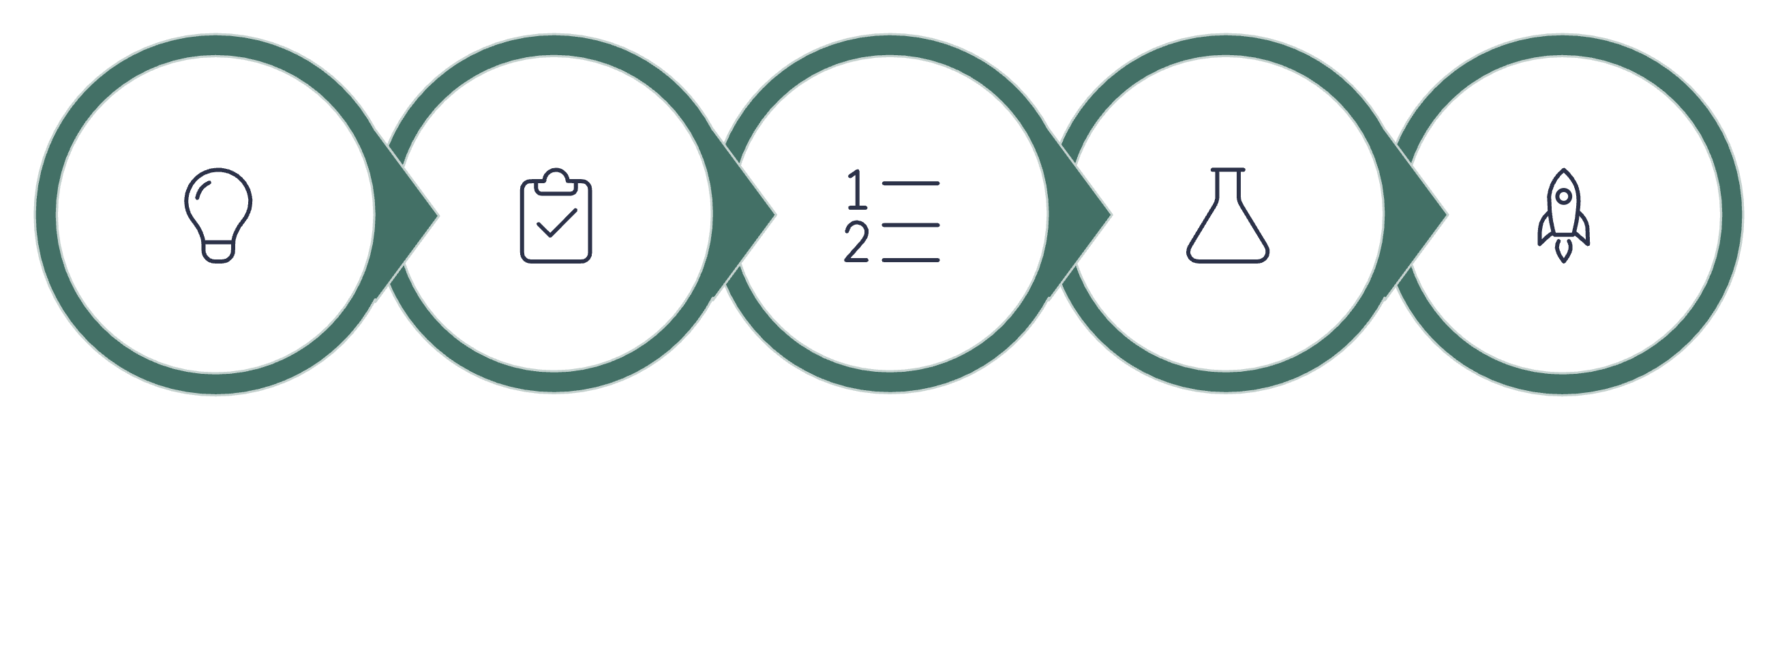
Step 4: Build a Standard AI Delivery Lifecycle
AI initiatives do not behave like traditional software projects. Teams must determine whether sufficient data exists, whether a model performs accurately enough, whether users trust the results, and whether the economics justify production deployment. A standard lifecycle acknowledges this uncertainty while creating repeatable structure.
Intake
Assess
Prioritize
PoC
Pilot
This lifecycle creates repeatable delivery discipline without forcing every AI initiative into an identical model. Critically, it extends well beyond deployment — requiring ongoing monitoring of performance, cost, risk, adoption, model behavior, and changing business conditions. The AI PMO owns not simply project completion, but benefits realization over time.

Slide 8
Step 5: Build an AI-Ready Workforce
Technology alone does not create transformation. People do. Employees need to understand how AI changes their work, what they are permitted to use, when human judgment is required, and how to recognize unreliable outputs. The AI PMO can partner with HR, Learning & Development, and business leaders to design a structured enterprise AI learning program.
Executive & Leadership
Program Managers
AI strategy, investment decisions, governance frameworks, and risk management at the enterprise level.
AI delivery lifecycles, value measurement, data dependencies, model uncertainty, and portfolio governance.
Employees & End Users
Technical Teams
Practical guidance on approved AI tools, responsible use, prompt engineering, and human-AI collaboration.
Deep skills in model development, AI architecture, agent design, security, automation, and data engineering.
The objective is not to turn everyone into a machine-learning engineer. It is to build an organization in which employees understand how to work effectively and responsibly alongside AI.

Slide 9
Step 6: Measure Value, Not AI Activity
Organizations frequently confuse AI activity with AI value. Tracking pilots launched, models deployed, and licenses purchased provides operational visibility — but does not answer the question executives care most about: Did AI improve the business?
Productivity
Financial Value
Quality & Risk
Hours eliminated from manual work, cycle-time reduction, increased throughput, and faster analysis and decision-making.
Cost reduction, cost avoidance, revenue growth, improved margins, and reduced vendor or operational spending.
Lower error rates, reduced rework, improved compliance, earlier risk identification, fraud reduction, and fewer operational incidents.
Customer Experience
Adoption
Faster response times, higher satisfaction scores, better personalization, and reduced customer effort across interactions.
Active users, frequency of use, workflow penetration, employee satisfaction, and percentage of targeted processes using the capability.
A strong AI business case establishes the baseline before implementation. If an invoice process currently takes 15 minutes and AI reduces it to five, the organization can quantify the difference — and continue tracking it as employee behaviors evolve. The AI PMO owns benefits realization not just at launch, but over the full lifecycle.

Slide 10


Step 7: Treat Change Management as Part of the AI Product
AI transformation creates understandable concern. When employees ask difficult questions, ignoring them creates resistance that derails even technically successful deployments.
"Will AI eliminate my job or replace my role entirely?"
"Can I trust the output — and what happens when it's wrong?"
"Which information can I safely share with an AI system?"
"Am I responsible for reviewing AI decisions that affect others?"
Successful AI adoption requires transparency. Leaders should clearly explain what the AI is designed to do, where humans remain accountable, and how roles may evolve over time. Program managers should also involve employees early in design — the people performing the work often understand exceptions, risks, and practical requirements better than anyone else.
Instead of designing AI for employees, organizations should increasingly design AI with employees. Participation drives trust. Trust drives adoption.

Slide 11
Step 8: Scale Responsibly
A successful pilot creates a new challenge: How do we scale it? Scaling does not mean purchasing more licenses or deploying the same tool everywhere. The AI PMO should systematically identify and build reusable capabilities that accelerate future initiatives — rather than requiring each team to rebuild governance, security controls, and integrations from scratch.
Shared Platforms
Reusable Controls
Approved AI platforms, model catalogs, common APIs, and enterprise data services available to all teams.
Standard security controls, governance templates, compliance checklists, and monitoring frameworks applied consistently.
Common Integrations
Standard Evaluation
Reusable prompts, agents, and integrations that enable new initiatives to build on what already exists.
Shared evaluation frameworks so teams can assess performance, risk, and value consistently across the portfolio.
The more reusable infrastructure the organization develops, the faster future AI initiatives can move. This is where the AI PMO transcends individual project delivery and becomes an enterprise accelerator — compounding the value of every investment made.

Slide 12
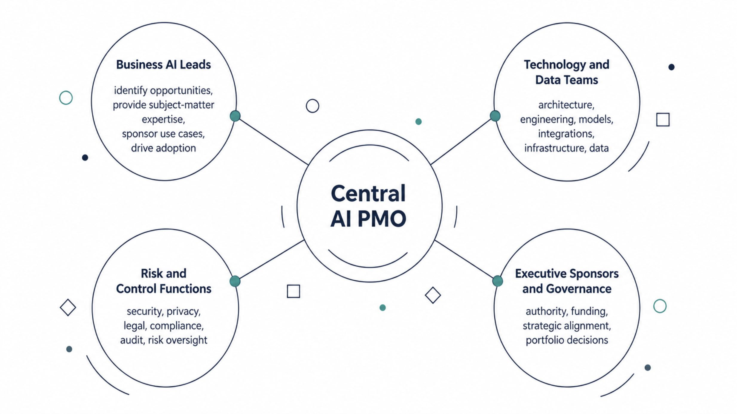
What Should the AI PMO Operating Model Look Like?
There is no single structure that fits every organization. However, most can begin with a hub-and-spoke model that balances central consistency with distributed innovation.

Slide 13

The Hub-and-Spoke AI PMO Model
Central AI PMO / CoE Owns
Why This Model Works
Governance and risk management
Portfolio management and reporting
Delivery standards and templates
Benefits realization tracking
Reusable capabilities and training frameworks
It creates central consistency in governance, standards, and measurement — without preventing innovation within individual business units. Business AI Leads embedded in functions ensure that priorities stay grounded in real operational needs, while risk and technology teams provide the guardrails that keep adoption responsible and scalable.

Slide 14
Building Your First AI PMO Team
You do not need dozens of people to launch an AI PMO. Many organizations can begin with a small, cross-functional virtual team — then expand as AI maturity grows. Core roles to prioritize from day one:
Executive Sponsor
AI PMO Director
Provides authority, funding, organizational alignment, and sustained executive commitment.
Owns the portfolio, operating model, governance processes, delivery standards, and executive reporting.
AI Governance Lead
Data & Analytics Lead
Coordinates responsible AI, risk classification, policy development, and cross-functional oversight.
Assesses data readiness, quality, analytics infrastructure, and model requirements for each initiative.
Change Management Lead
Business Relationship Manager
Supports communication strategy, training programs, adoption tracking, and workforce transformation.
Connects business problems with AI solutions and ensures use cases reflect operational reality.
As AI maturity increases, organizations may add ML engineers, AI architects, agent developers, model-risk specialists, prompt engineers, and AI product managers. Start lean, demonstrate value, then scale the team alongside the portfolio.

Slide 15



A Practical 90-Day AI PMO Roadmap
Organizations do not need to build the entire operating model before getting started. A focused 90-day approach can establish the foundation needed to deliver early value and build lasting enterprise capability.
Days 1–30: Discover & Assess
Days 31–60: Design the Operating Model
Days 61–90: Launch & Learn
Inventory existing AI tools and initiatives
Identify executive sponsors
Meet with business leaders; document pain points
Assess existing AI policies and data concerns
Establish an AI governance working group
Begin collecting potential AI use cases
Launch selected pilots
Establish portfolio reporting and risk monitoring
Collect adoption data and measure pilot outcomes
Capture lessons learned
Refine governance processes
Develop the next wave of use cases
Define AI PMO roles and responsibilities
Create intake process and evaluation criteria
Establish AI risk categories and approval process
Create standard business-case templates
Define pilot success criteria and value metrics
Select high-value pilot opportunities
Deliverable: Current-state AI assessment and initial opportunity inventory
Deliverable: AI PMO operating model and prioritized pilot portfolio
Deliverable: AI portfolio dashboard, pilot results, and scaling roadmap
After 90 days, the organization should have more than a collection of AI experiments. It should have the beginnings of a repeatable enterprise capability.

Slide 16
How AI PMOs Mature Over Time
An AI PMO should evolve as organizational capability grows — progressing from fragmented experimentation toward an intelligent, portfolio-driven enterprise operating model.
Stage 1: Experimentation
Stage 2: Coordination
Stage 3: Standardization
Teams independently explore AI tools. Governance is limited and measurement is inconsistent.
The organization begins cataloging initiatives, defining approved tools, and introducing governance structures.
Common intake, prioritization, risk management, delivery, and measurement processes emerge across the enterprise.
Stage 4: Enterprise Scaling
Stage 5: Intelligent Portfolio Management
Reusable platforms, shared services, AI agents, and enterprise data capabilities accelerate cross-functional adoption.
AI itself supports portfolio decisions — analyzing performance, risk signals, strategic priorities, and resource capacity continuously. The AI PMO helps orchestrate an AI-enabled enterprise.

Slide 17
Common Pitfalls to Avoid
Even organizations with strong technical capabilities can struggle with AI transformation. These mistakes appear repeatedly — and each one is avoidable with the right operating model in place.
Starting With Technology
Scaling Before Establishing Governance
Buying AI tools without identifying business problems creates expensive solutions searching for problems. Strategy must lead technology.
Rapid adoption without clear policies creates security, privacy, regulatory, and reputational risk that is difficult to remediate after the fact.
Ignoring Data Readiness
Underestimating Change Management
AI performance depends heavily on the quality, accessibility, relevance, and governance of underlying data. Poor data produces poor AI.
Employees will not automatically adopt AI because it is available. Adoption requires communication, training, and meaningful involvement.
Measuring Activity Instead of Outcomes
Treating AI as an IT Initiative
More AI does not mean more value. Portfolio discipline must connect every initiative to measurable business impact.
AI transformation affects business processes, workforce capabilities, operating models, and strategy. It must be governed as an enterprise transformation.

Slide 18
The Future AI PMO
The most significant evolution of the AI PMO may occur when AI itself becomes part of the PMO workforce — continuously monitoring portfolio health and supporting program leaders with intelligence that no human team could generate at the same speed or scale.
What AI Agents Could Do Inside the PMO
How the Program Manager's Role Evolves
Monitor project health 24/7 and identify emerging schedule risks
Analyze dependencies and predict resource shortages across programs
Draft status reports and steering committee materials
Monitor benefits realization and financial variances continuously
Identify duplicate initiatives and summarize portfolio-level risks
Recommend portfolio reprioritization when business conditions shift
The program manager's role does not disappear — it changes fundamentally. Instead of collecting updates, formatting reports, and consolidating spreadsheets, program leaders spend more time evaluating tradeoffs, managing stakeholders, solving complex problems, and connecting execution with strategy.
Program managers become strategic orchestrators of work performed by both humans and intelligent systems — a shift that may represent one of the most significant transformations AI brings to the project management profession.

Slide 19
Final Thoughts
Artificial intelligence isn't replacing the PMO. It is creating an opportunity to redefine what the PMO can become.
For years, PMOs have worked to move beyond the perception of being primarily administrative organizations. AI creates the opportunity to become something far more strategic — connecting strategy, governance, portfolio management, technology, data, risk, workforce transformation, and measurable business outcomes into a unified operating model.
Start with a business problem
Establish basic governance
Anchor every AI initiative in a real, measurable challenge — not the novelty of a technology.
Define the policies, risk tiers, and approval processes that enable confident experimentation.
Create an AI use-case portfolio
Measure value — then scale what works
Prioritize a small number of meaningful opportunities using consistent, objective evaluation criteria.
Track outcomes against the original business case. Learn from pilots. Expand reusable capabilities.
The organizations that develop this capability today will be better positioned to move beyond isolated experiments and build sustainable enterprise AI capabilities. The future of project management is not simply digital — it is intelligent, measurable, governed, and strategically aligned. The AI PMO can help lead the way.

Slide 20
