Slide 1
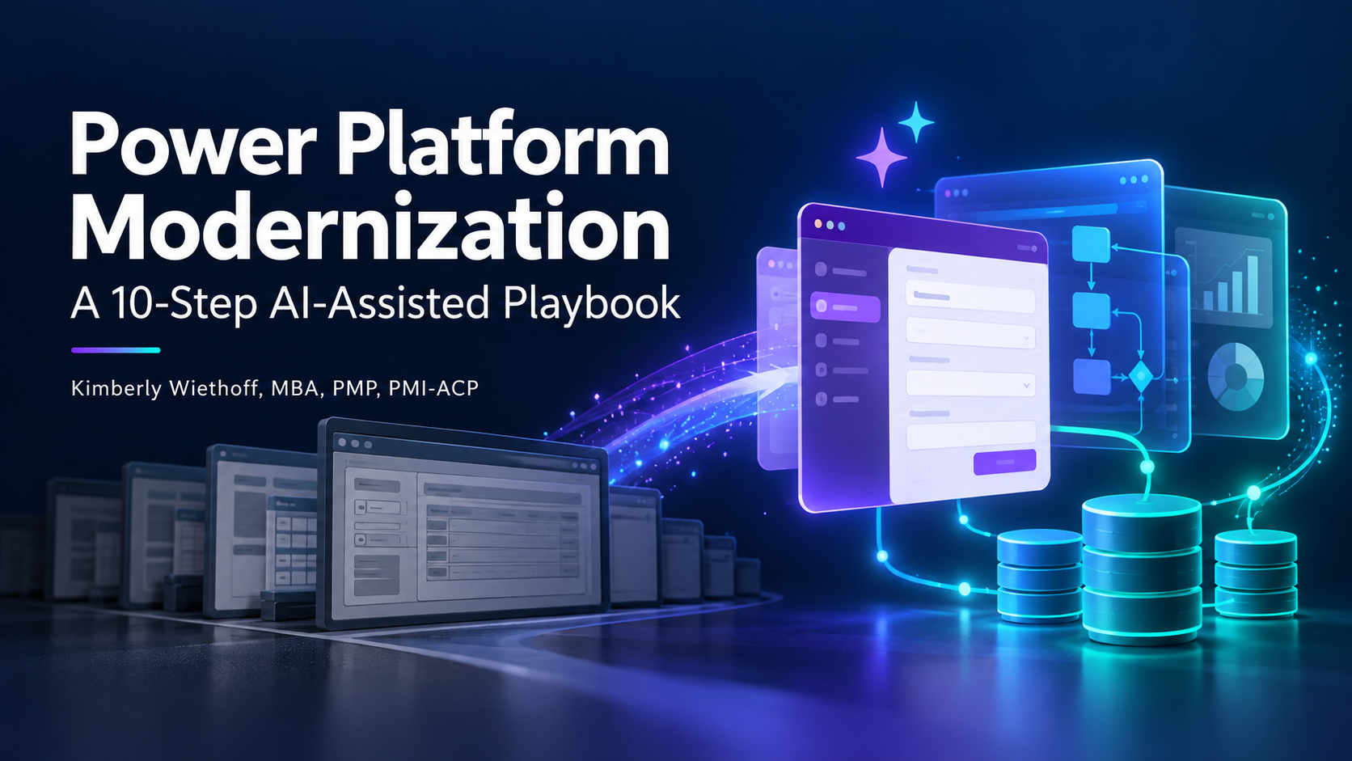
Power Platform Modernization: A 10-Step AI-Assisted Playbook
A structured, end-to-end guide for enterprise teams migrating legacy applications to Microsoft Power Platform — with clear deliverables, acceptance criteria, and practical AI integration points at every phase.
By Kimberly Wiethoff, MBA, PMP, PMI-ACP
ENTERPRISE IT PLAYBOOK
AI-ASSISTED DELIVERY

Slide 2
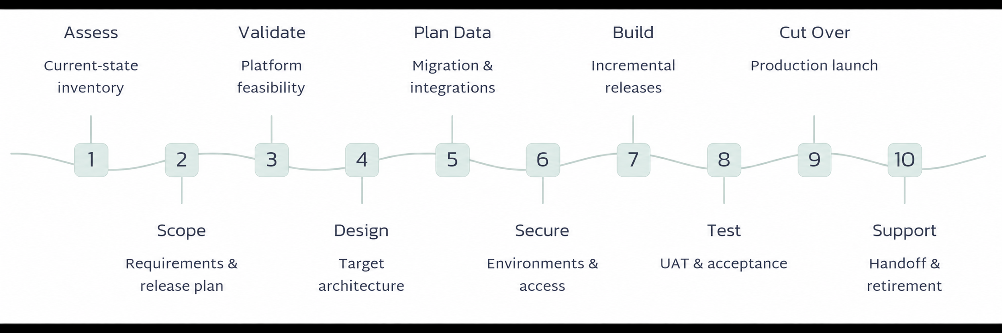
The Modernization Journey at a Glance
Ten structured phases carry your team from initial discovery through production launch and legacy retirement. Each phase produces a concrete deliverable and carries measurable acceptance criteria — so progress is always visible and handoffs are unambiguous.

Slide 3
PHASE 1
Assess the Current Application
What Needs to Happen
Where AI Can Help
Inventory every screen, workflow, business rule, report, integration, data source, and user role. Identify known pain points, technical debt, and the business and technical owners accountable for each area.
Summarize existing documentation and legacy code at speed
Draft process maps from narrative descriptions
Extract embedded business rules from screen logic or specs
Surface gaps and generate targeted stakeholder questions
Key Deliverable
Acceptance Criteria
Current-state assessment document, validated by business and technical owners.
All in-scope screens, workflows, rules, reports, integrations, and data sources documented
User roles and application dependencies identified
Business and technical owners have validated the assessment

Slide 4

PHASE 2
Define Scope and Success Measures
What Needs to Happen
Key Deliverable
Decide which capabilities to retain, improve, or retire. Define the first release scope and agree on measurable outcomes with baselines and targets so success is objectively verifiable at go-live.
Approved requirements backlog and first-release scope document.
Acceptance Criteria
Where AI Can Help
Every in-scope requirement has a unique ID, priority, owner, and testable acceptance criterion
First-release scope and exclusions are approved by stakeholders
Success measures have documented baselines and quantified targets
Convert stakeholder notes into structured user stories and acceptance criteria
Flag duplicate, conflicting, or ambiguous requirements before they cause rework
Identify out-of-scope items and suggest explicit exclusions
Use the Given / When / Then format for individual requirements — it forces precision and makes test-case generation straightforward.

Slide 5
PHASE 2 · DEEP DIVE
Writing Requirements in Given / When / Then
A consistent requirement format eliminates ambiguity, speeds review cycles, and makes AI-assisted test-case generation far more reliable. Every testable condition is explicit from the start.
Given an authorized approver has a request awaiting review,
When they approve the request,
Then its status changes to "Approved," the approver and timestamp are recorded, and the requester receives a notification within [X minutes].
Given
When
Then
Establishes the precondition — who is involved and what state the system is in before the action.
Describes the specific action or event that the user or system performs.
Defines the expected, verifiable outcomes — including data changes, notifications, and timestamps.

Slide 6

PHASE 3
Confirm Power Apps Suitability
Before committing to Power Platform, validate it against your real-world constraints. Surface risks early — when they are cheap to resolve — rather than mid-build, when rework is costly.
Performance & Volume
Security & Licensing
Confirm that expected data volumes, concurrent users, and response-time targets are achievable within platform limits.
Validate connector policies, data-loss prevention rules, and per-user licensing costs against current Microsoft guidance.
Integrations & Offline
Proof of Concept
Assess connectivity requirements, offline scenarios, and API availability for all required external systems.
Build a targeted prototype covering the highest-risk business scenarios using representative data volumes.

Slide 7
PHASE 4
Select the Application Architecture
What Needs to Happen
Acceptance Criteria
Choose canvas app, model-driven app, or a hybrid combination. Determine whether Power Pages is needed for external users and define the Power Automate automation strategy for approvals, notifications, and scheduled processes.
Application type, data platform, integrations, and automation approach are documented and approved
Design addresses required user journeys and access needs
Error handling and supportability considerations are covered
Key Deliverable
Target solution design — documenting application type, data platform, integrations, and automation approach, all reviewed and approved by the solution architect and technical lead.
Where AI Can Help
Draft architecture options with tradeoff comparisons
Propose initial Dataverse data models and table relationships
Generate workflow design drafts for technical review

Slide 8

PHASE 5
Plan the Data and Integrations
Data migration is consistently one of the highest-risk phases of any modernization project. Resolve mapping, quality, and reconciliation questions before a single record moves to production.
1
Map Fields and Relationships
Document every in-scope table, field, relationship, attachment, and history record. Define how legacy identifiers translate to the new data model.
2
Define Transformation and Reconciliation Rules
AI can suggest field mappings, flag data-quality issues, draft transformation logic, and generate reconciliation queries for trial migration runs.
3
Validate Integration Interfaces
Each integration must pass normal, failure, and recovery scenarios without unexplained data loss or duplication before production cutover.

Slide 9
PHASE 6
Establish Environments and Security
What Needs to Happen
Acceptance Criteria
Provision development, test, and production environments with consistent configuration. Set up security roles, data-loss prevention connector policies, and automated deployment controls before any build work begins.
Development, test, and production environments are fully configured
Tests confirm users can perform authorized actions and cannot access restricted data
Connector policies are reviewed and approved
A deployment rehearsal succeeds end-to-end using environment-specific configuration
Where AI Can Help
Draft role-access matrices from requirements and user-role inventory
Generate environment configuration checklists
Flag potential permission gaps for security review before deployment
Draft deployment pipeline documentation and runbooks
Never share production credentials or sensitive personal data with AI tools during environment setup. Use synthetic or anonymized data throughout.

Slide 10
PHASE 7
Build the Application Incrementally
Deliver working software in short, demonstrable increments. Regular reviews with product owners catch misalignments early and keep the backlog aligned with real business needs.
AI Accelerates Development
Errors Become Learning Moments
Traceability Is Non-Negotiable
AI can assist with Power Fx formulas, workflow logic, screen layout suggestions, and technical documentation — reducing time on boilerplate and freeing developers for complex logic.
Developers can paste error messages into AI tools for plain-language explanations and candidate fixes — but every suggested fix must be tested and understood before it is committed.
Every implemented requirement must trace to working, accepted functionality. Business rules, approvals, notifications, and reports must behave exactly as specified in acceptance criteria.

Slide 11
PHASE 8
Test and Obtain Business Acceptance
Scope of Testing
Where AI Can Help
Functional correctness across all business scenarios
Permission and access-control verification
Integration data accuracy and error recovery
Performance under representative load
Accessibility to agreed standards
User Acceptance Testing conducted by business representatives
Generate test cases directly from approved requirements
Suggest edge cases and negative scenarios teams often miss
Create synthetic test data sets at scale
Summarize defect reports and coverage gaps for stakeholder reviews
Acceptance Criteria
All critical business scenarios pass
No open critical or high-severity defects — exceptions require written authorization
Performance and accessibility targets met
Business representatives complete UAT and sign off on release readiness

Slide 12

PHASE 9
Prepare and Execute Cutover
1
Train Users
Deliver role-based training using AI-drafted materials. Confirm support coverage is in place before go-live.
2
Rehearse Migration
Run a full cutover rehearsal. AI analyzes rehearsal results to surface missed dependencies and timing risks.
3
Final Data Load
Load final changes, run reconciliation checks, and validate production data before releasing access to users.
4
Go Live & Smoke Test
Execute production smoke tests. Rollback triggers, owners, and procedures must be documented and rehearsed.

Slide 13
PHASE 10
Transition to Support and Retire the Legacy System
What Needs to Happen
Acceptance Criteria
Assign a named support owner, transfer documentation and runbooks, monitor adoption metrics and error rates through hypercare, and retire the legacy application only after all archival and acceptance conditions are satisfied.
Support owner accepts runbook, access, monitoring, and escalation responsibilities
Support team demonstrates independent resolution of representative incidents
Application meets agreed stability targets for [X days]
Required legacy records are archived and retrievable before retirement approval
Where AI Can Help
Draft support guides, FAQs, and escalation procedures
Summarize recurring incidents into actionable patterns
Analyze adoption feedback and suggest backlog improvements

Slide 14
Strongest Starting Opportunities for AI Assistance
Not all phases benefit equally from AI involvement. These four areas deliver tangible, reviewable outputs immediately — making them the ideal entry points for teams new to AI-assisted delivery.
Requirements Drafting
Documentation Analysis
Convert raw stakeholder notes into structured user stories with Given/When/Then acceptance criteria. Reviewable within hours rather than days.
Summarize legacy specs, extract business rules, and identify gaps — dramatically reducing the time spent reading and interpreting existing material.
Development Assistance
Test-Case Generation
Accelerate Power Fx, workflow logic, and screen design. AI explains errors in plain language and proposes candidate fixes for developers to evaluate.
Generate comprehensive test cases from approved requirements, including edge cases and negative paths that manual review often misses.

Slide 15
AI Governance: Acceptance Criteria Across All Phases
AI accelerates delivery — but accountability remains with named human owners. Apply these criteria consistently across every phase to maintain quality, security, and audit readiness.
Area | Acceptance Criteria
Requirements & Documentation | A designated owner reviews AI-generated content against source material. Unsupported assumptions are resolved or explicitly recorded before approval.
Formulas, Code & Workflows | AI-generated components pass the same review, security checks, and functional tests as all other components. No untested generated logic is deployed.
Migration & Data Mapping | Proposed mappings and transformations are validated using representative records and reconciliation results before any production use.
Testing | Test cases trace to approved requirements. Expected results are independently verified, and actual execution evidence supports every pass/fail decision.
Data Handling | Information supplied to AI tools complies with the organization's approved data-handling rules. No sensitive production data is shared without authorization.
Approval & Accountability | Named business or technical owners approve all deliverables and release decisions — including those prepared with AI assistance.

