Slide 1
From Chaos to Control: Mastering Data Migrations in Applied Epic Projects
Data migration is one of the most critical—and often most underestimated—components of any Applied Epic project. Whether you're moving from a legacy system like TAM or migrating from another platform entirely, mishandling the transition can lead to lost records, operational downtime, and compliance risks.
Transform your Applied Epic implementation with our battle-tested six-step migration methodology that eliminates risk and ensures seamless transition of your critical business data.
kW
by Kimberly Wiethoff

Slide 2
Understanding Data Discovery
Audit Legacy Data
Examine policies, client records, notes, attachments, and accounting entries.
Assess Data Quality
Identify duplicates, outdated records, and inconsistencies.
Determine Data Ownership
Assign responsibility for each dataset to specific team members.

Slide 3
Mapping Your Data Journey
Field Mapping Documents
Data Transformations
Business Rules for Exceptions
Create detailed documentation showing how each field transfers from legacy systems to Applied Epic.
Define code value conversions, date format changes, and other necessary transformations.
Establish clear rules for handling incomplete or non-standard data during migration.

Slide 4
The Art of Data Cleansing
Improved User Adoption
Clean data leads to better experiences
De-duplication Routines
Remove redundant client and policy records
Data Standardization
Uniform formats for phone numbers, states, dates
Archiving Strategy
Identify and exclude outdated information

Slide 5
Testing: The Path to Confidence
Partial Data Dry Runs
Validate mappings and transformations with sample data sets. Identify issues early in the process.
Full Test Loads
Conduct complete data migrations in test environments. Enable stakeholder review and UAT testing.
Reconciliation Validation
Compare record counts and validate accounting balances. Ensure data integrity across systems.

Slide 6
Precision Cutover Planning
1
Establish Cutover Date
2
Create Backup Plans
Set clear timeline with data freeze period. Communicate to all stakeholders.
Develop detailed rollback procedures. Test recovery processes before go-live.
3
Define Extraction Windows
4
Organize Support Team
Schedule final data pulls. Include validation routines after extraction.
Assign specialized resources for Day 1. Focus on accounting and client service.

Slide 7
Post-Migration Support Framework
Track Defects
Address Training Gaps
Monitor and prioritize data gaps and migration issues
Provide targeted education on newly imported data
Implement Solutions
Gather User Feedback
Deploy fixes and improvements based on findings
Collect insights on missing or misaligned data

Slide 8
Key Migration Challenges
Timeline Pressure
Data Complexity
Migrations often face compressed schedules while requiring extensive preparation.
Legacy systems may contain decades of unstructured or inconsistent information.
Resource Gaps
Business Continuity
Teams frequently lack specific Applied Epic technical expertise.
Operations must continue with minimal disruption during transition.

Slide 9
Migration Team Structure
Data Analyst
Technical Lead
Creates mapping specifications and validation reports
Manages extraction, transformation, and loading processes
Project Manager
Business SMEs
Oversees timeline, resources, and deliverables
Provides operational context and validates results

Slide 10
Migration Performance Metrics
Setting clear performance targets ensures measurable migration success. These key metrics represent our minimum acceptable thresholds for a successful implementation.
While technical metrics demand near-perfect results, we recognize that user satisfaction targets are more conservative as adaptation to new systems naturally requires adjustment time. Post-migration remediation efforts will prioritize addressing any gaps in these performance areas.

Slide 11
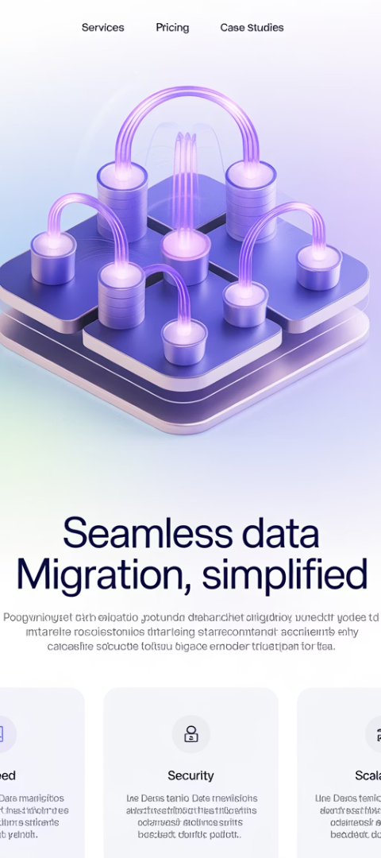
Technology Enablers
ETL Tools
Validation Software
Applied Epic APIs
Extract, transform, and load utilities specifically designed for insurance data.
Tools that verify data integrity before, during, and after migration.
Integration points that enable programmatic data loading and validation.
Automated reconciliation
Client/Policy APIs
Talend
Accounting interfaces
Informatica
Data profiling utilities
Document management
Custom SQL scripts
Exception reporting

Slide 12
Your Path to Migration Success
Start with thorough discovery
Know your data landscape completely
Cleanse early and thoroughly
Don't migrate problems to your new system
Test, test, and test again
Validate every aspect of your migration
Support beyond go-live
Your migration journey continues after launch

Slide 13
Final Thoughts
Managing an Applied Epic data migration isn't just a technical exercise—it's a business-critical project that requires collaboration, attention to detail, and proactive leadership. By investing time in planning, cleansing, testing, and post-go-live support, you'll pave the way for a smooth transition and long-term success.

