Slide 1


How AI Is Changing Agile Coaching
From Facilitation to Intelligent Team Insights
Artificial Intelligence is transforming Agile coaching from a role focused primarily on facilitation to one powered by intelligent, data-driven insights. By leveraging AI, Agile Coaches can identify delivery risks earlier, uncover team performance trends, enhance retrospectives, improve sprint planning, and spend more time developing people rather than compiling reports. The future belongs to Agile leaders who can combine human-centered coaching with AI-powered decision support to help teams deliver greater value faster and more predictably.
STRATEGIC INSIGHT FOR AGILE LEADERS
#AgileCoaching #AgileTransformation #ArtificialIntelligence #GenerativeAI #AgileLeadership #ScrumMaster #Scrum #AzureDevOps #PowerBI #AgileMetrics #ContinuousImprovement #DigitalTransformation #Leadership #Productivity #TeamPerformance #LeanAgile #EnterpriseAgility #AgileTeams #FutureOfWork #ProjectManagement

Slide 2

The Evolving Role of the Agile Coach
For years, Agile Coaches have centered their work on helping teams adopt Agile practices, facilitate collaboration, remove impediments, and foster continuous improvement. These responsibilities remain foundational — but AI is fundamentally reshaping how coaches deliver value.
Traditional Focus
The AI-Augmented Coach
Facilitating planning sessions and retrospectives
Tracking metrics and sprint performance manually
Identifying impediments through observation
Coaching Scrum Masters and Product Owners
Today's Agile environments generate massive amounts of data through tools like Azure DevOps, Jira, GitHub, and Microsoft Teams. AI analyzes this information continuously — surfacing patterns and risks that manual methods miss.
The modern Agile Coach is becoming a strategic advisor who combines human expertise with AI-powered intelligence.

Slide 3
AI-Powered Delivery Insights
One of AI's most significant contributions is transforming raw delivery data into actionable intelligence — enabling coaches to move from reactive problem-solving to proactive performance improvement.
Velocity & Predictability
Risk Indicators
Detect inconsistent velocity trends across sprints before they become release failures, enabling earlier intervention.
Surface growing technical debt, increasing defect rates, and workflow bottlenecks across multiple teams simultaneously.
Capacity Concerns
Root Cause Analysis
Monitor team capacity trends and flag overloaded members before burnout affects delivery quality.
Analyze months of sprint data to identify systemic patterns that isolated sprint reviews would never reveal.

Slide 4

SPRINT PLANNING
Smarter Planning, Better Commitments
Sprint planning requires balancing capacity, priorities, dependencies, and delivery risk — often under time pressure. AI-powered tools bring objective data to planning conversations that were once driven entirely by intuition.
Forecast sprint capacity based on historical availability and velocity
Identify patterns from past sprints to improve estimation accuracy
Highlight overloaded team members before commitments are made
Predict delivery risks and recommend realistic sprint scope
Agile Coaches can then redirect their energy toward facilitating strategic discussions — not gathering data manually.

Slide 5

Transforming Retrospectives with AI
Retrospectives are among the most powerful Agile practices — yet many teams fall into repetitive discussions with limited follow-through. AI can elevate retrospective quality dramatically by bringing organizational memory into the room.
Historical Pattern Recognition
AI reviews months of retrospective notes and action items, identifying recurring themes such as environment instability, unclear requirements, or stakeholder delays that teams may have normalized.
Sentiment & Engagement Trends
Detect shifts in team sentiment over time — early signals of disengagement or frustration that are difficult to spot in a single retrospective session.
Systemic vs. Isolated Issues
Coaches gain a broader organizational perspective, shifting discussions from one-off incidents to systemic improvements with lasting impact.

Slide 6
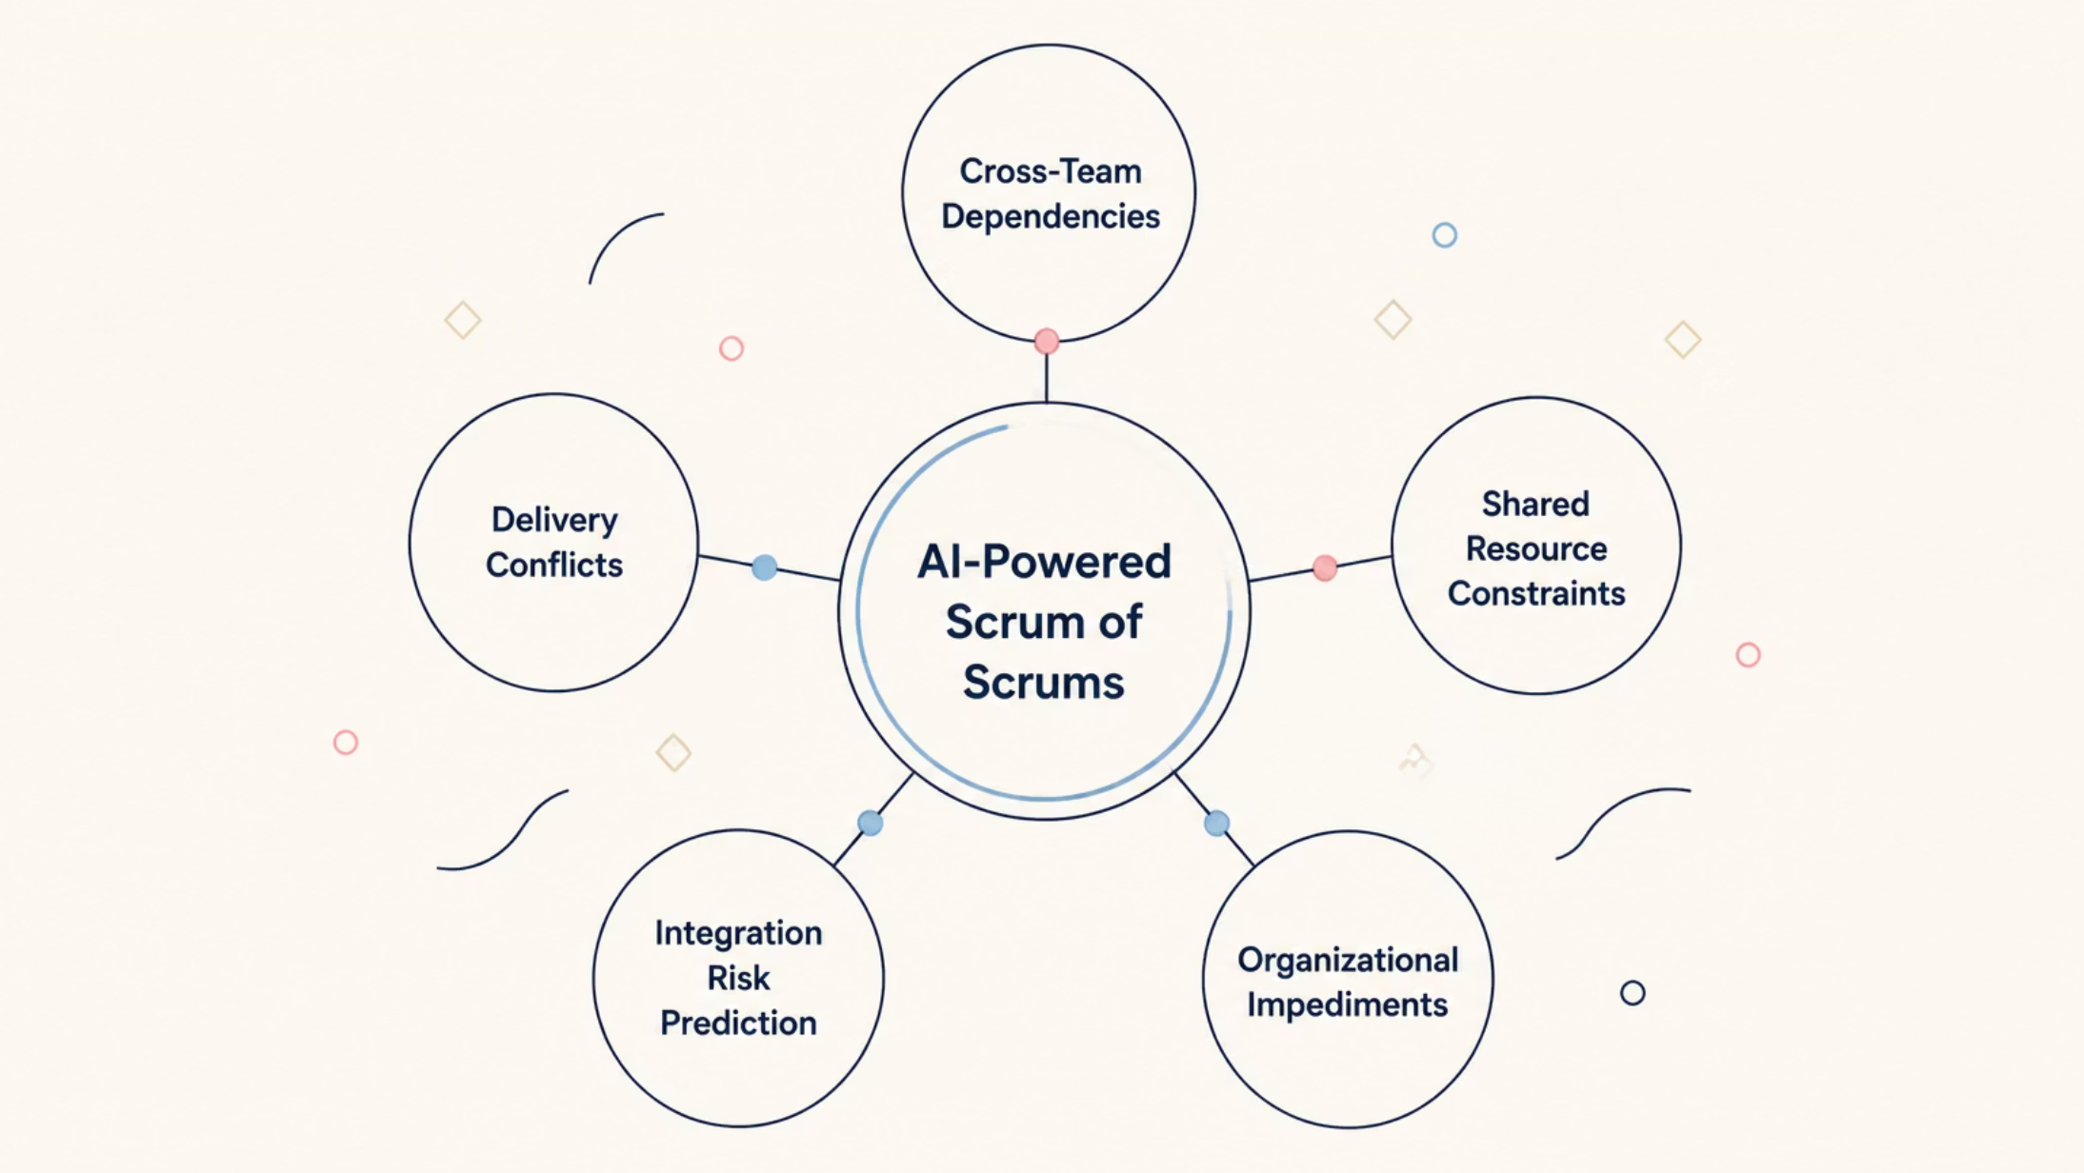
Intelligent Scrum of Scrums at Scale
As organizations scale Agile practices, coordinating dozens of teams across shared business outcomes becomes increasingly complex. AI transforms the Scrum of Scrums from a status-reporting ceremony into a strategic risk management forum.
Rather than relying entirely on verbal status updates, coaches leverage AI-generated insights to focus every conversation on the highest-priority risks and opportunities — particularly valuable in large-scale Agile environments with dozens of contributing teams.

Slide 7

SCRUM MASTER DEVELOPMENT
AI-Enhanced Coaching for Scrum Masters
Mentoring Scrum Masters is one of the most critical — and most time-consuming — responsibilities for Agile Coaches. AI makes this coaching sharper, more targeted, and measurably effective.
By analyzing team health indicators continuously, AI provides objective evidence to support coaching conversations across key dimensions:
Facilitation Effectiveness
Sprint Completion Rates
Team Engagement
Escalation Patterns
Process Adherence
Improvement Outcomes
Rather than offering generic guidance, Agile Coaches can address specific challenges supported by measurable evidence — making every coaching conversation count.

Slide 8

Generative AI in Everyday Agile Workflows
Tools like Microsoft Copilot and ChatGPT are becoming practical productivity multipliers within Agile organizations — reducing administrative overhead so teams can focus on delivering customer value.
What Teams Can Automate
What Coaches Can Accelerate
Draft user stories and acceptance criteria
Generate test scenarios from requirements
Summarize meetings and standups
Prepare sprint review presentations
Document retrospective outcomes
Develop stakeholder communications
Training materials and workshop facilitation guides
Personalized coaching plans for Scrum Masters
Team health assessment summaries
Executive briefings on delivery performance
Agile maturity roadmaps and transformation playbooks

Slide 9



The Human Skills AI Cannot Replace
Despite its growing capabilities, AI cannot replicate the human side of Agile coaching. Successful Agile transformations are built on relationships, trust, and behavioral change — none of which an algorithm can inspire.
Trust Building & Emotional Intelligence
Change Leadership & Stakeholder Influence
Team Motivation & Coaching Presence
AI can identify patterns, but it cannot create psychological safety, navigate interpersonal conflict, or build the trust that enables teams to be vulnerable and grow.
Organizational transformation requires executive coaching, political navigation, and the ability to inspire leaders to model the behaviors Agile demands.
The most effective Agile Coaches combine data-driven insights with strong leadership — knowing when to challenge, when to support, and when to simply listen.

Slide 10
Building Your AI-Enabled Coaching Strategy
Organizations ready to embrace AI in Agile coaching should invest in three interconnected capabilities. Those who do will gain a significant and lasting competitive advantage.
3. Develop AI Literacy Across Roles
2. Start with Decision Support
1. Integrate Your Data Sources
Use AI to surface recommendations and insights rather than automating decisions outright. Human judgment must remain central to Agile leadership.
Train Agile Coaches, Scrum Masters, Product Owners, and leaders to understand how AI works, where it adds value, and where its limitations lie.
Connect Azure DevOps, Jira, GitHub, ServiceNow, and Power BI to create a unified, real-time view of team performance across the organization.

Slide 11

The Future of Agile Coaching
AI is not changing the purpose of Agile coaching — it is expanding its potential.
The future Agile Coach will be more strategic, data-driven, and organizationally influential than ever before. Rather than spending hours compiling sprint reports, coaches will leverage AI to surface meaningful insights automatically — freeing their focus for leadership development, organizational transformation, and continuous improvement at scale.
Deliver Value Faster
Lead with Intelligence
AI-enabled teams respond to change with greater speed and predictability.
Coaches become transformation leaders armed with objective, real-time insight.
Scale High Performance
Organizations build teams that thrive in an increasingly complex digital landscape.

