Slide 1

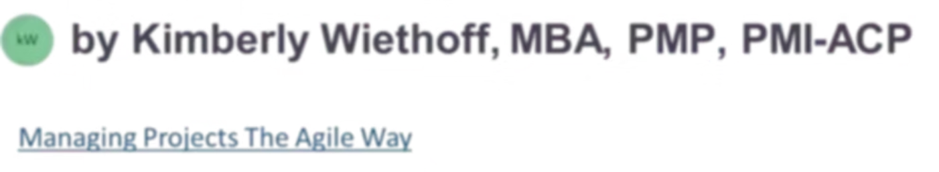
How RAG Transforms the PMO: The Future of AI-Powered Project Delivery
Project Management Offices have always faced a common challenge: turning vast amounts of project data into actionable insights. Most PMOs sit on a goldmine of information — from project charters and risk registers to lessons learned and financial forecasts — yet project managers still struggle to find the right information when they need it most. Retrieval-Augmented Generation (RAG) has the potential to fundamentally change that, transforming the PMO from an administrative function into a strategic intelligence engine.
#PMO #ProjectManagement #ProgramManagement #AI #GenerativeAI #RAG #RetrievalAugmentedGeneration #EnterpriseAI #AITransformation #DigitalTransformation #PortfolioManagement #Agile #Scrum #Leadership #TechnologyLeadership #ProjectDelivery #PMI #PMP #PMOLeadership #KnowledgeManagement #OperationalExcellence #Innovation #FutureOfWork #BusinessTransformation #AIGovernance

Slide 2





The PMO Knowledge Problem
Most organizations do not suffer from a lack of project information. They suffer from a lack of accessible project intelligence. Information accumulates across hundreds of projects — yet it is rarely leveraged effectively.
Initiation
Business cases, project charters, stakeholder analyses
Planning
Requirements, WBS, resource plans, risk assessments
Execution
Status reports, sprint metrics, issue logs, change requests
Closeout
Lessons learned, benefits realization reports, retrospectives
Over time, this information accumulates across dozens, hundreds, or even thousands of projects — creating an enormous repository of organizational knowledge that is rarely leveraged effectively. Most PMOs spend significant effort collecting information but relatively little time extracting value from it.

Slide 3
What Is RAG?
For PMOs, RAG-powered AI can access:
Retrieval-Augmented Generation (RAG) is an AI architecture that retrieves relevant information from trusted organizational sources before generating a response. Rather than relying solely on what an AI model learned during training, RAG enables AI systems to search enterprise knowledge repositories in real time — delivering contextual, grounded, and relevant insights.
Historical project data and portfolio reports
Governance frameworks and compliance standards
Risk registers, issue logs, and lessons learned
Agile artifacts, sprint metrics, and retrospectives
Resource management and financial forecast data
Instead of searching manually, project teams simply ask questions.

Slide 4



From Project Data to Project Intelligence
Traditional PMO tools are excellent at storing information. RAG-powered systems are designed to help teams use it. The shift is profound — from passive data repositories to active intelligence engines that answer questions in natural language.
"What risks caused delays in our last three ERP implementations?"
"Show me lessons learned from cloud migration projects completed in the last two years."
"What dependencies have historically impacted go-live readiness?"
Instead of digging through SharePoint sites, Confluence pages, Jira tickets, and email archives, the AI retrieves relevant information and synthesizes a precise, actionable response — transforming raw project data into genuine project intelligence.

Slide 5


USE CASE 1
Unlocking Lessons Learned
Many organizations conduct lessons learned sessions at project closeout. Unfortunately, those insights often disappear into document repositories and are rarely revisited by future teams. The institutional experience exists — but it remains invisible.
RAG changes this dynamic entirely. Project teams can proactively query the knowledge base at the start of a new initiative, surfacing relevant experience before mistakes are repeated.
"What lessons learned exist for large-scale CRM implementations?"
"What challenges did previous teams encounter during user acceptance testing?"
The AI retrieves relevant lessons learned across multiple projects and presents actionable recommendations — so teams can leverage institutional experience from day one instead of rediscovering known pitfalls.

Slide 6
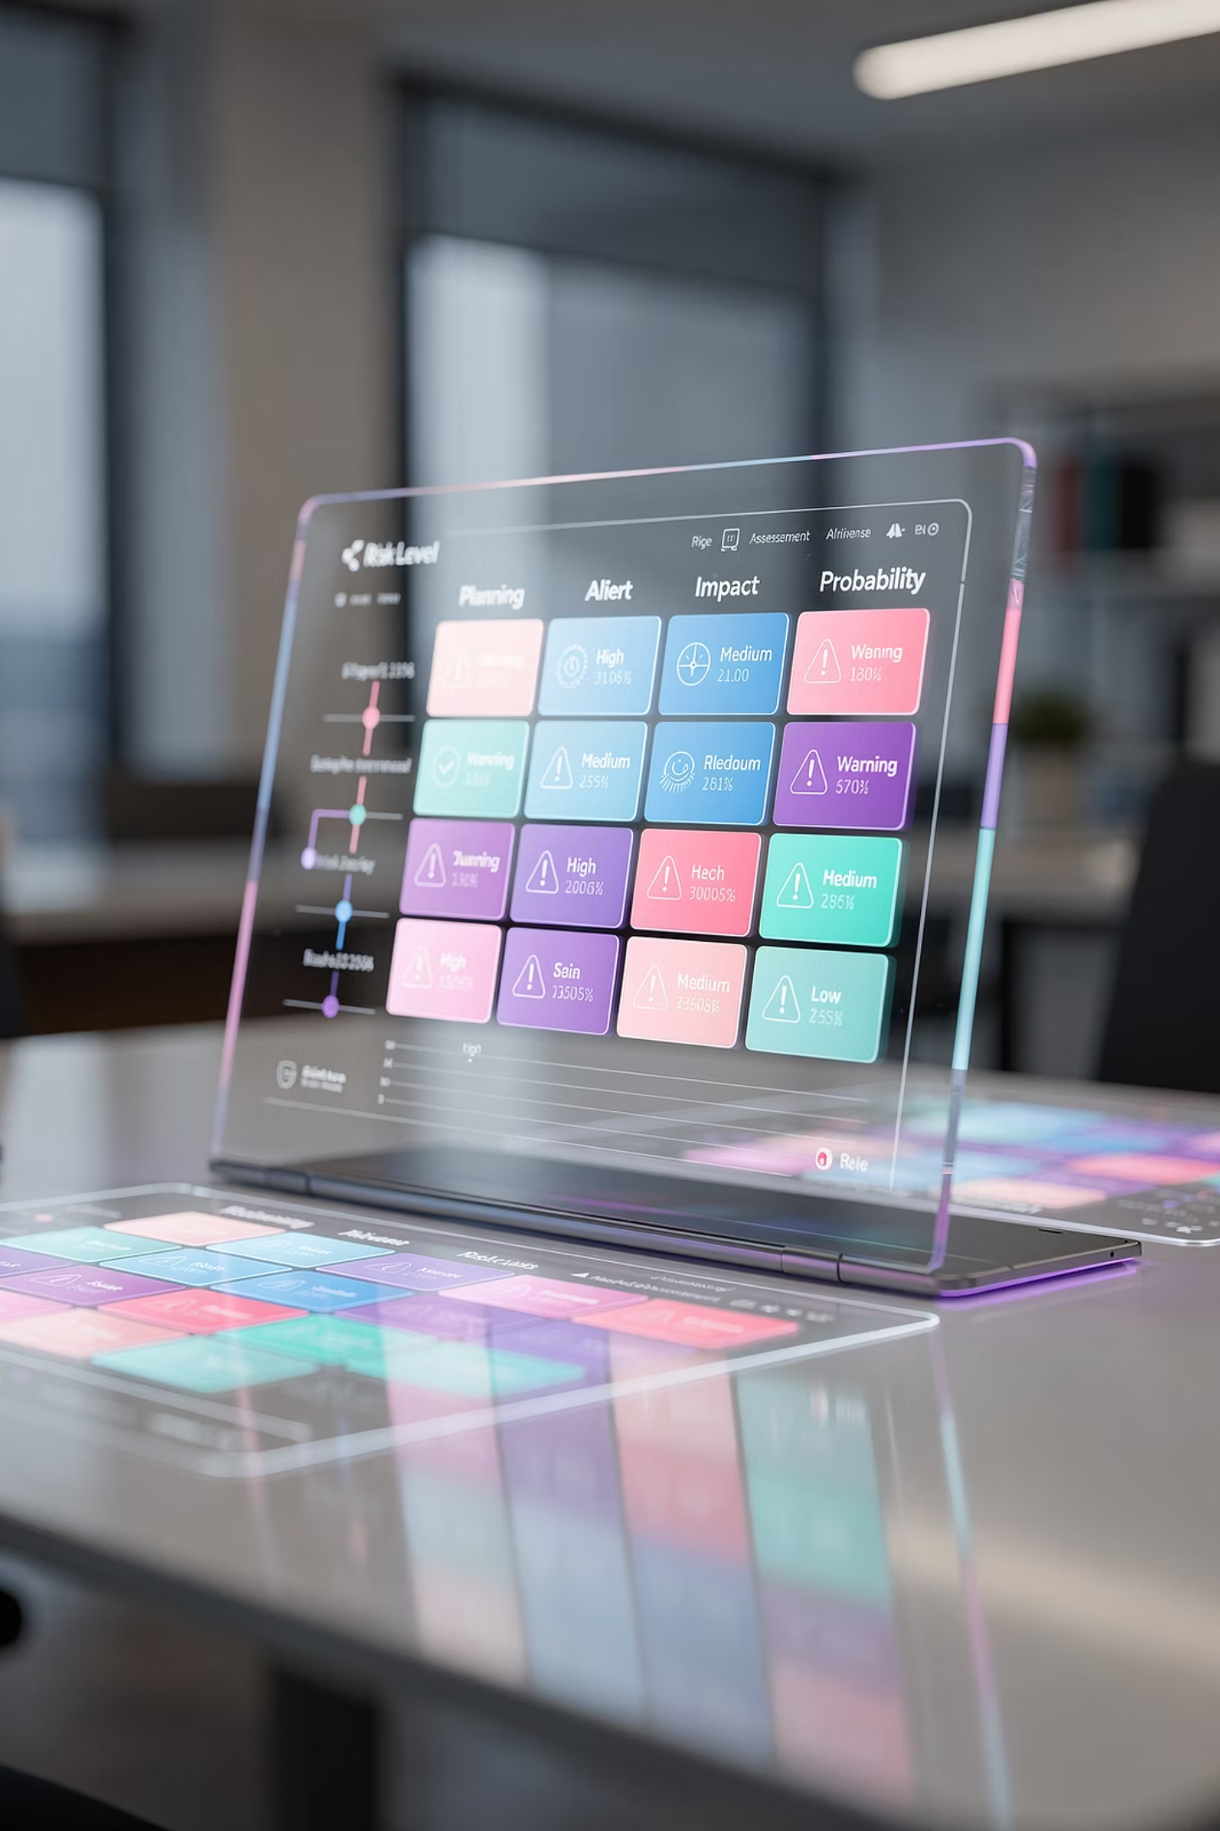
USE CASE 2
Improving Risk Management
One of the most powerful applications of RAG within a PMO is risk intelligence. Most organizations maintain risk registers, issue logs, escalation records, and audit findings — repositories that contain valuable historical patterns waiting to be discovered.
Pattern Recognition
"What risks are most commonly associated with ERP implementations?" — The AI surfaces recurring risk themes across your portfolio history.
Vendor Risk Insights
"Which vendor-related risks have historically impacted schedule performance?" — Proactively identify third-party risk patterns before contract execution.
Early Warning Signals
By detecting risk patterns earlier, project teams can make more informed decisions and take preventive action — rather than responding reactively to issues that have surfaced before.

Slide 7

USE CASE 3
Accelerating Project Planning
Project managers often spend significant time creating plans, governance documents, communication strategies, and stakeholder analyses — frequently starting from scratch even when comparable work has already been done elsewhere in the organization.
RAG accelerates planning by retrieving similar project artifacts and proven best practices on demand:
Stakeholder Engagement
Resource Planning
Retrieve engagement approaches used in previous enterprise transformation programs
Identify resource constraints that impacted comparable projects
Governance Templates
Surface approved governance frameworks aligned to project type and complexity
This allows project managers to start with organizational knowledge — not a blank page.

Slide 8
USE CASE 4
Enhancing Portfolio Visibility
PMO leaders often struggle to identify trends across large portfolios. Information may exist across dozens of projects but remains difficult to analyze collectively — buried in individual status reports and siloed systems.
Schedule Variance Patterns
Budget Overrun Analysis
Dependency Risk Detection
"What are the most common causes of schedule variance across the portfolio?" — Identify systemic delivery issues before they escalate.
"Which project types consistently exceed budget estimates?" — Improve estimation accuracy with evidence from historical performance data.
"What dependencies are creating the highest levels of delivery risk?" — Surface cross-project interdependencies that threaten the portfolio.
Instead of reviewing hundreds of reports, leadership can interact with portfolio intelligence conversationally — enabling faster, better-informed strategic decisions.

Slide 9
USE CASE 5
Supporting Executive Reporting
Project leaders spend considerable time preparing executive updates. Information must be collected from multiple systems, validated, summarized, and communicated clearly — a process that is both time-consuming and prone to inconsistency.
A RAG-powered PMO assistant can retrieve and synthesize executive-ready summaries across:
The Result
PMO leaders reclaim hours previously spent on manual data aggregation — redirecting that energy toward strategic analysis and decision support.
Status
Risks
Current health across projects and programs
Escalated issues requiring leadership attention
Milestones
Financials
Key delivery dates and upcoming decision gates
Budget performance and resource utilization trends
This reduces administrative effort while improving consistency, speed, and visibility for senior stakeholders.

Slide 10
RAG and Agile Project Delivery
Agile teams generate large volumes of information — user stories, sprint reviews, retrospectives, backlogs, velocity metrics, and defect reports. Over time, these artifacts become a valuable source of organizational knowledge that is rarely tapped systematically.
1
2
3
Impediment Intelligence
Scope Creep Patterns
Retrospective Mining
"What recurring impediments have impacted sprint velocity?" — Identify systemic blockers that persist across teams and release cycles.
"Which user story patterns resulted in scope expansion?" — Learn from historical backlog behavior to improve refinement and estimation.
"What recommendations emerged from previous retrospectives?" — Surface actionable team insights that would otherwise be forgotten after a sprint closes.
RAG creates opportunities for continuous improvement at scale — turning every sprint into a building block of organizational learning.

Slide 11




Building the PMO Copilot
One of the most exciting applications of RAG is the emergence of the PMO Copilot — an AI-powered assistant that retrieves information from project repositories, Jira, Azure DevOps, SharePoint, Confluence, governance frameworks, and lessons learned databases. Project managers interact with organizational knowledge using natural language.
Governance Support
Resource Planning
Risk Management
Executive Reporting
"What approvals are required before entering the testing phase?" — Instant access to stage-gate criteria and compliance requirements.
"Which skill sets created bottlenecks in previous cloud migrations?" — Anticipate capacity constraints before they derail delivery.
"Show me similar risks from previous infrastructure modernization efforts." — Ground risk responses in proven historical context.
"Summarize portfolio risks requiring steering committee attention." — Generate leadership-ready briefings in seconds.
The PMO Copilot becomes a force multiplier for project teams and leadership alike.

Slide 12
Benefits Beyond Productivity
While productivity gains are significant, the true value of RAG extends well beyond efficiency. RAG fundamentally changes how PMOs create and preserve organizational value.
Improve Decision Quality
Reduce Memory Loss
Standardize Best Practices
Leverage historical knowledge and institutional patterns when making high-stakes project decisions.
Preserve lessons learned and critical context even as experienced team members move on or transition roles.
Promote consistent delivery approaches and proven frameworks across all programs and portfolios.
Increase Governance Compliance
Strengthen Strategic Alignment
Provide project teams with easy, on-demand access to policies, standards, and procedures.
Connect portfolio decisions to enterprise knowledge, ensuring delivery remains anchored to organizational priorities.

Slide 13


CHALLENGE TO ADDRESS
Knowledge Quality
Successful RAG implementation requires more than deploying AI technology. The most foundational challenge PMOs must address is knowledge quality. AI systems can only retrieve information that exists — and only generate reliable insights from information that is accurate, complete, and consistently structured.
Poor documentation leads to poor insights. Garbage in, garbage out applies at enterprise scale.
PMOs should invest in documentation standards and data hygiene before implementing RAG. This means establishing clear templates for lessons learned, risk registers, and status reports — and enforcing consistent project closeout procedures that ensure institutional knowledge is captured at every engagement.

Slide 14
CHALLENGE TO ADDRESS
Governance & AI Controls
Organizations must establish clear controls before deploying RAG systems across the PMO. Without proper governance, AI-powered knowledge retrieval can create unintended risk — particularly around sensitive project data, proprietary business information, and regulatory obligations.
Data Access Controls
Security & Compliance
Responsible AI Usage
Define role-based permissions to ensure AI systems only retrieve information that a user is authorized to view — preserving confidentiality across programs and business units.
Ensure that enterprise knowledge repositories used by RAG systems comply with data security policies, privacy regulations, and industry-specific compliance standards.
Establish organizational guidelines for how AI-generated insights are reviewed, validated, and acted upon — keeping human accountability at the center of all project decisions.

Slide 15


CHALLENGE TO ADDRESS
Change Management
Technology is only part of the equation. For RAG to deliver lasting value, project teams must understand how to work alongside AI — and recognize both its strengths and its limitations. Without deliberate change management, adoption will stall and value will be lost.
1
Understand AI's Role in Decision-Making
2
Recognize When Human Judgment Is Essential
Help project managers understand how RAG retrieves and synthesizes information — so they can use it confidently as a decision-support tool.
Not every situation can be resolved by retrieving historical data. Teams must remain critically engaged, especially in novel or high-stakes scenarios.
3
Validate AI-Generated Insights
Establish habits of verification — treating AI outputs as a starting point for analysis, not a final answer.
RAG should augment project managers — not replace them.

Slide 16




The Future PMO: From Reporting to Intelligence
For decades, PMOs have focused heavily on reporting, governance, compliance, and process management. These functions remain critically important. However, the next evolution of the PMO is centered on intelligence — not just tracking what is happening, but understanding why and predicting what comes next.
Historical Knowledge
Portfolio Trends
Instant access to lessons, artifacts, and decisions across all past projects
Identify patterns across programs to improve forecast accuracy and delivery performance
Governance Guidance
Risk Intelligence
Deliver real-time policy and standards support through conversational AI
Surface emerging risks earlier with evidence from historical delivery data
This is no longer a future-state vision. Organizations are already beginning to explore these capabilities today — and the PMOs that move early will establish a lasting competitive advantage.

Slide 17
Final Thoughts
In the age of AI, the future of the PMO may not be defined by the reports it produces — but by the intelligence it delivers.
The PMO has always been responsible for managing project information. RAG creates the opportunity to transform that information into organizational intelligence — a living, queryable asset that grows more valuable with every project completed.
Smarter Decisions
Reduced Risk
Accelerated Planning
Ground every project decision in historical knowledge and portfolio context
Identify and mitigate risks earlier using evidence-based pattern recognition
Start every project with organizational experience, not a blank page
Preserved Knowledge
Greater Strategic Value
Retain institutional memory even as teams and leadership evolve over time
Evolve the PMO from a reporting function into a strategic intelligence partner
The organizations that successfully embrace RAG will move beyond simply managing projects — they will build PMOs that actively drive smarter outcomes, stronger governance, and greater enterprise value.

