Slide 1
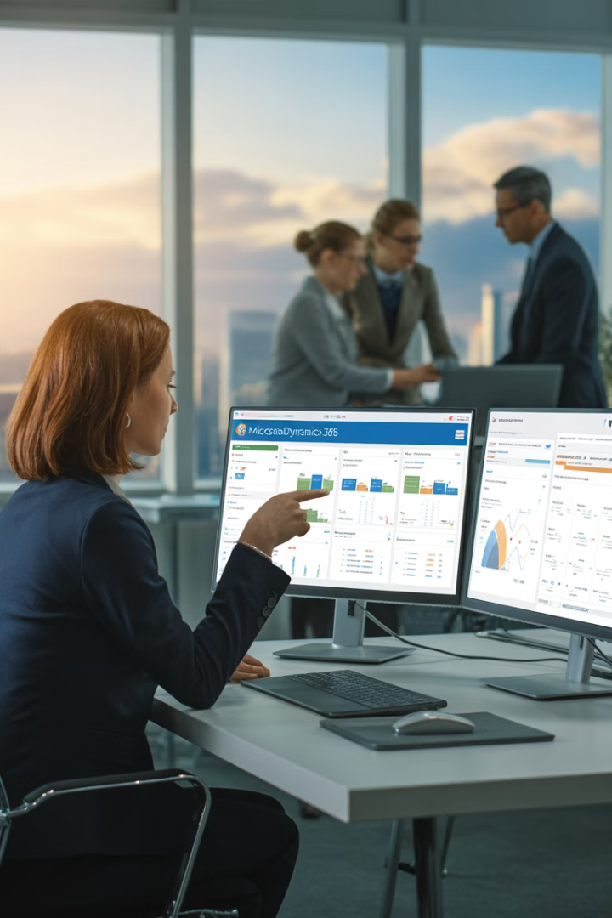
Microsoft Dynamics 365 for End-to-End Project Lifecycle Management
Transform your project management approach with Microsoft Dynamics 365, the unified platform that connects teams, automates workflows, and provides complete visibility across every project phase.
kW
by Kimberly Wiethoff

Slide 2
The Project Management Challenge
Current Challenges
Dynamics 365 Solution
Siloed information across departments
Unified platform for all project data
Real-time dashboards and reports
Limited visibility into project health
Automated workflows and notifications
Manual coordination between teams
Scattered documentation and resources
Centralized document management

Slide 3
End-to-End Project Lifecycle
Planning
Initiation
Create detailed roadmap and resource plan
Define scope and build business case
Execution
Coordinate work and deliver value
Closure
Complete deliverables and capture learnings
Monitoring
Track progress and control changes

Slide 4
Project Initiation Phase
Business Justification
Stakeholder Identification
Capture strategic goals and expected ROI in Dynamics 365 Sales to align projects with business objectives.
Map key stakeholders directly in the system to ensure proper communication throughout the project lifecycle.
Preliminary Scoping
Resource Estimation
Draft initial scope parameters and connect them to customer needs using the Project Operations module.
Create high-level resource forecasts and cost estimates to support project approval decisions.

Slide 5
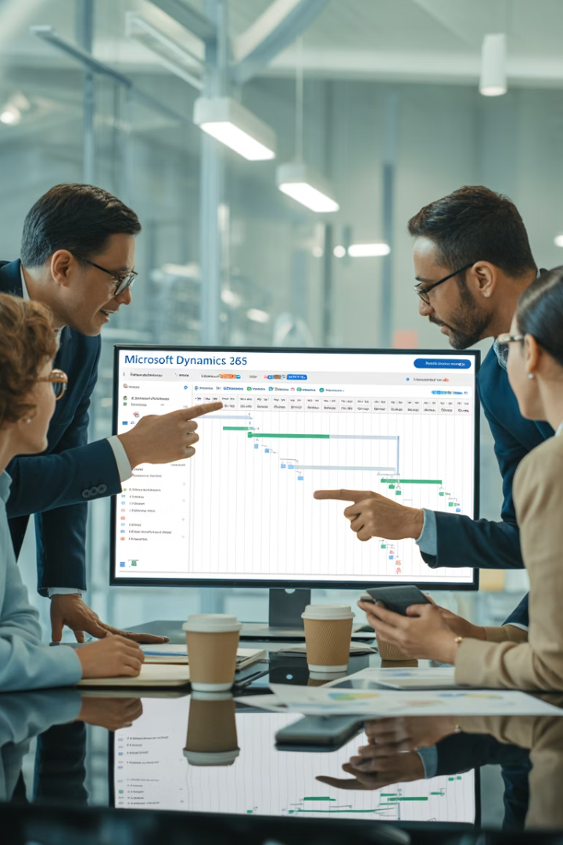
Planning Phase in Dynamics 365
Work Breakdown Structure
Build comprehensive WBS with tasks, subtasks, and dependencies for clear project structure.
Project Schedule
Develop timelines with interactive Gantt views to visualize critical path and milestones.
Resource Assignment
Match tasks to team members based on skills, availability, and capacity planning tools.
Budget Forecasting
Create detailed financial projections to set baselines for cost tracking and billing.

Slide 6
Execution Phase Tools
Time & Expense Tracking
Capture work hours and project expenses through mobile-friendly forms for accurate billing.
Task Management
Coordinate assignments through Microsoft Teams integration for seamless collaboration.
Workflow Automation
Implement Power Automate flows for approvals, notifications, and process standardization.
Document Management
Store and version-control project files through SharePoint integration.

Slide 7
Monitoring Project Health
KPI Dashboards
Monitor critical metrics through Power BI visuals integrated with real-time project data.
Financial Analysis
Compare budgeted costs against actuals to identify and address variances early.
1
2
3
4
Risk Management
Automated Alerts
Track potential issues with severity ratings and assign mitigation plans to team members.
Receive notifications for approaching deadlines, budget concerns, or scope changes.

Slide 8
Project Closure Process
Team Reassignment
Knowledge Transfer
Release resources and update availability for new project assignments.
Financial Closeout
Document lessons learned and archive project artifacts for future reference.
Finalize Deliverables
Process final invoices, reconcile costs, and close financial records for the project.
Complete all project outputs and obtain formal acceptance from stakeholders.

Slide 9
Resource Management Excellence
Optimal Utilization
Maximize productivity without overloading teams
Skills Matching
Assign resources based on capabilities and requirements
Capacity Planning
Forecast resource needs across multiple projects
Utilization Tracking
Monitor billable hours and team productivity

Slide 10
Financial Management Capabilities
100%
24/7
Invoice Accuracy
Financial Visibility
Automated time and material billing based on actual project activities
Real-time access to budget performance metrics
15%
60%
Cost Reduction
Faster Billing
Average improved margin through better financial controls
Reduction in invoice processing time with automation

Slide 11
Cross-Department Integration
Sales to Delivery
Seamless handoff from opportunity to project execution
Operations to Finance
Automatic flow of time entries to billing
Delivery to Support
Knowledge transfer for ongoing customer success

Slide 12
Microsoft Teams Integration
Document Collaboration
Task Tracking
Co-author files and share updates within project channels.
View and update assignments directly in Teams conversations.
Unified Communication
Quick Approvals
Streamline decisions within the team communication flow.
Chat, call, and meet without leaving the project context.

Slide 13
Power BI Analytics
Time Saved (%)
Cost Efficiency (%)

Slide 14
Implementation Best Practices
Process First
Connected Systems
Define your project lifecycle methodology before system configuration. Match the technology to your way of working.
Integrate with existing tools where needed. Balance consolidation with practical workflow considerations.
User Adoption
Continuous Improvement
Invest in proper training and change management. Success depends on team engagement and system use.
Start with core functionality and expand. Add complexity as teams master the basics.

Slide 15
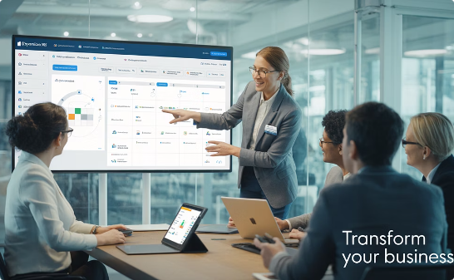
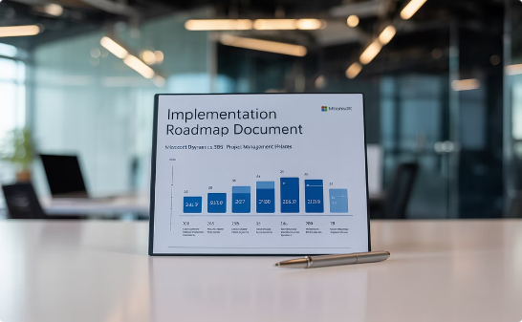
Next Steps for Success
Request a Demo
Build Your Roadmap
Start a Pilot
See how Dynamics 365 supports your specific project management needs with a personalized demonstration.
Create a phased implementation plan to transform your project management practices step by step.
Begin with a single project to demonstrate value and refine your approach before full deployment.

Slide 16
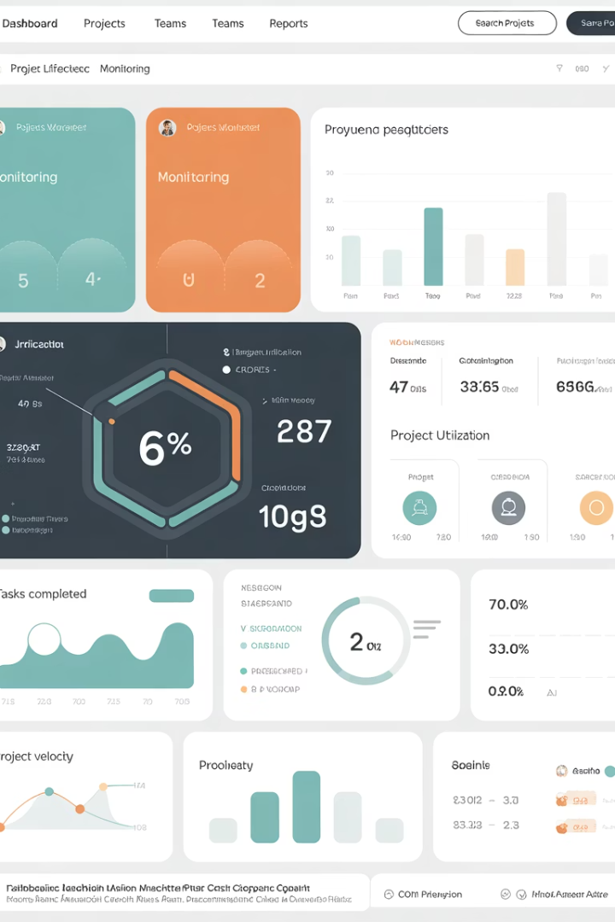
Final Thoughts
Microsoft Dynamics 365 is a powerful ecosystem that supports end-to-end project lifecycle management—from ideation and planning to delivery and closure. By leveraging its integrated modules and automation features, project managers can gain full visibility, improve accountability, and deliver projects that drive measurable business value.
Whether you're running internal IT initiatives, client-facing engagements, or global programs, Dynamics 365 equips you to lead with agility and control—all from a single platform.

