Slide 1
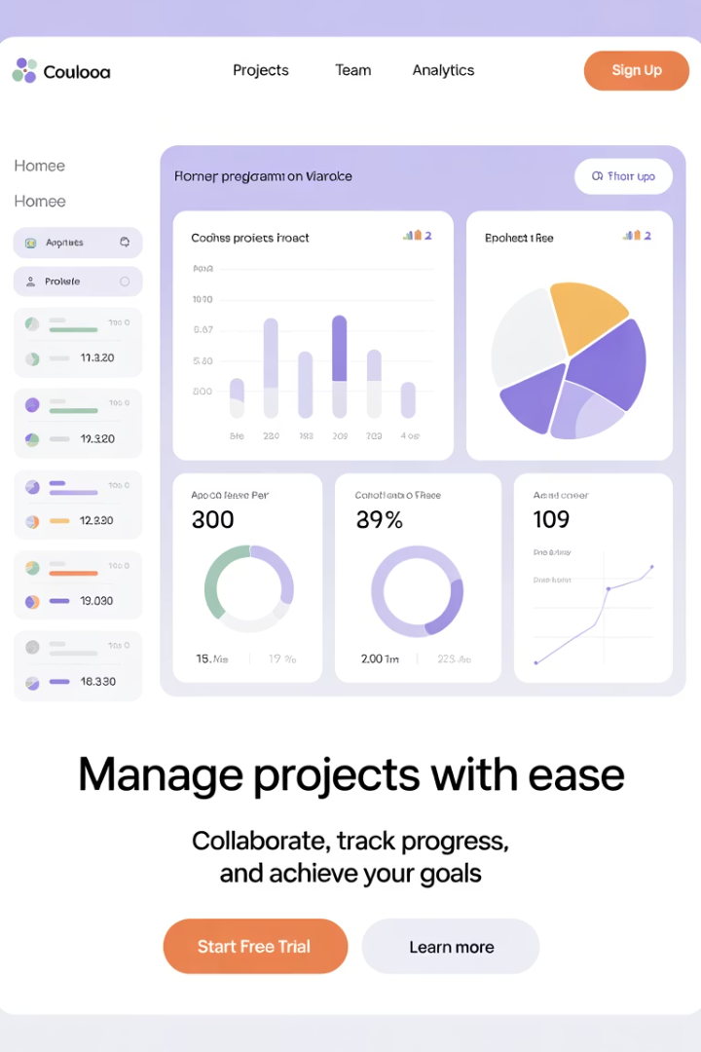
Agile KPIs vs Traditional Project KPIs
This presentation explores the key differences between Agile and Traditional project measurement approaches, helping you select the right metrics for your context.
kW
by Kimberly Wiethoff

Slide 2
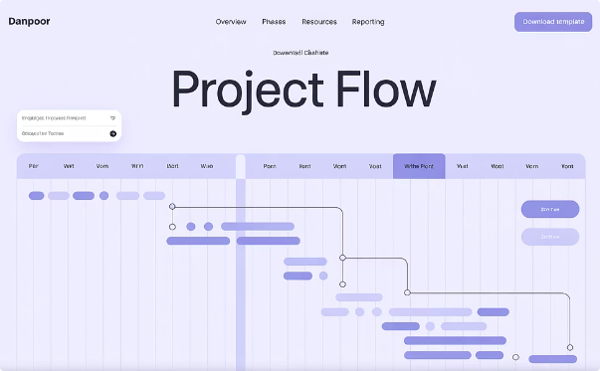

Understanding KPI Philosophies
Traditional Approach
Agile Approach
Linear, phase-driven planning with defined scope and fixed timelines.
Adaptability, customer feedback, and incremental delivery.
Measures team performance, product quality, and continuous value delivery.
Focus on plan adherence: budget, schedule, and scope control.

Slide 3




Traditional Project KPIs
Schedule Variance (SV)
Cost Performance Index (CPI)
Budget Variance
Measures how far ahead or behind schedule the project is.
Compares actual spend versus forecasted budget.
Evaluates cost efficiency of work completed.
Formula: SV = Earned Value - Planned Value
Formula: CPI = Earned Value / Actual Cost

Slide 4

More Traditional KPIs
Milestone Completion Rate
Risk Exposure
Tracks the impact and likelihood of potential project risks.
Percentage of major deliverables completed on schedule.
Requirements Stability Index
Measures the number of requirement changes over time.
Lower score signals higher volatility in requirements.

Slide 5




Agile Project KPIs
Team Velocity
Sprint Burndown
Epic/Release Burndown
Amount of work completed per sprint. Used to forecast future delivery capacity.
Tracks how quickly the team completes work in a sprint.
Longer-term views of progress across features and releases.

Slide 6








More Agile KPIs
Lead & Cycle Time
Escaped Defects
Lead Time: From request to delivery.
Number of defects found after release.
Cycle Time: From work start to completion.
Key quality metric for development teams.
Team Happiness
CSAT Score
Measures team morale and psychological safety.
Captures stakeholder feedback at each release.

Slide 7
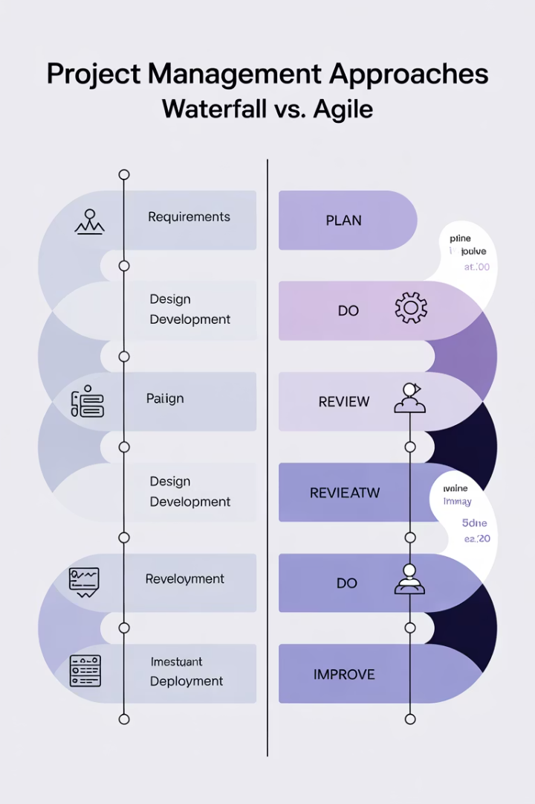
Visual Comparison of Approach
1
Traditional
Long-term planning with fixed scope
2
Hybrid
Mix of fixed milestones with iterative execution
3
Agile
Short sprints with regular reassessment

Slide 8




Cultural Differences
Control
Traditional KPIs emphasize adherence to plans.
Adaptability
Agile KPIs promote flexibility and iteration.
Validation
Both methods require appropriate success metrics.

Slide 9






When to Use Each Approach
Complex & Uncertain
Use Agile KPIs
Mixed Environments
Hybrid measurement approach
Predictable Projects
Traditional KPIs work well

Slide 10



Real-World Success Patterns
Align KPIs with business goals
Metrics should connect to organizational objectives
Balance leading and lagging indicators
Track both predictive and outcome-based metrics
Adjust metrics as projects evolve
Regularly review and update your measurement approach

Slide 11








Implementation Roadmap
An implementation roadmap is a set of deliverables, accelerators, role descriptions and additional guides that outline the activities involved in implementing, upgrading, or enhancing solutions. It is a one-page visual summary of how a program of work will move towards a desired future state, launch or release date.
Assess
Configure
Determine project type and appropriate measurement model
Set up dashboards and data collection processes
Adapt
Monitor
Refine your metrics based on project evolution
Track KPIs and gather insights from the data

Slide 12
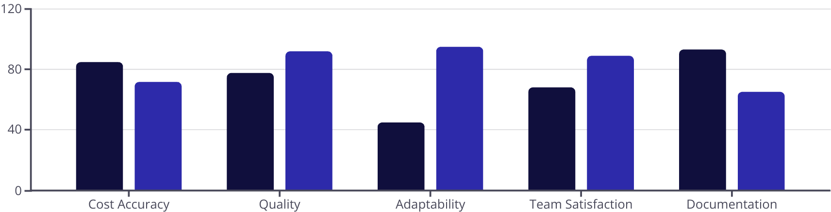
Performance Data Comparison
Traditional Projects
Agile Projects

Slide 13

Key Takeaways
Foster Measurement Culture
Balance Metric Types
Use KPIs to improve, not just report.
Choose Context-Appropriate KPIs
Include both delivery efficiency and value creation metrics.
Create psychological safety around metrics to drive honest reporting.
Select metrics that match your project methodology and goals.
Consider team health alongside technical performance.
There's no one-size-fits-all approach to project measurement.

Slide 14
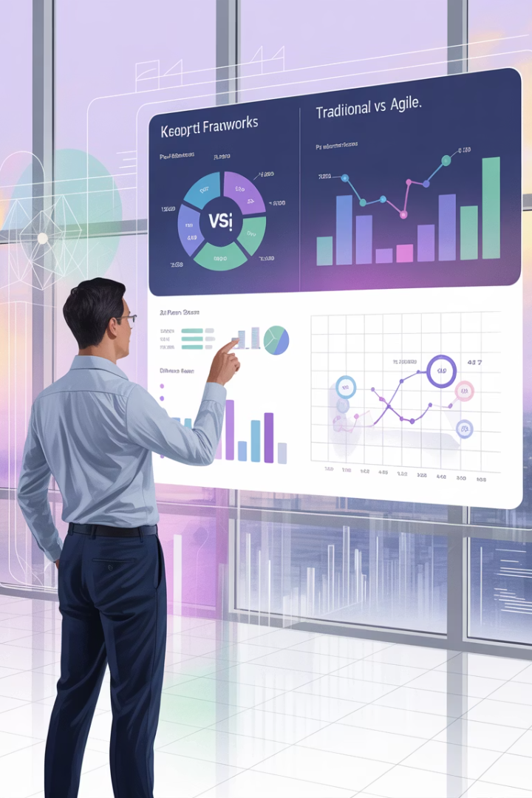
Final Thoughts
There's no one-size-fits-all KPI framework. The best project managers understand both worlds and tailor their performance tracking accordingly. Whether you're forecasting milestones in a Waterfall ERP deployment or tracking team velocity on a mobile app sprint, choosing the right KPIs is key to project transparency, stakeholder confidence, and business success.

