Slide 1
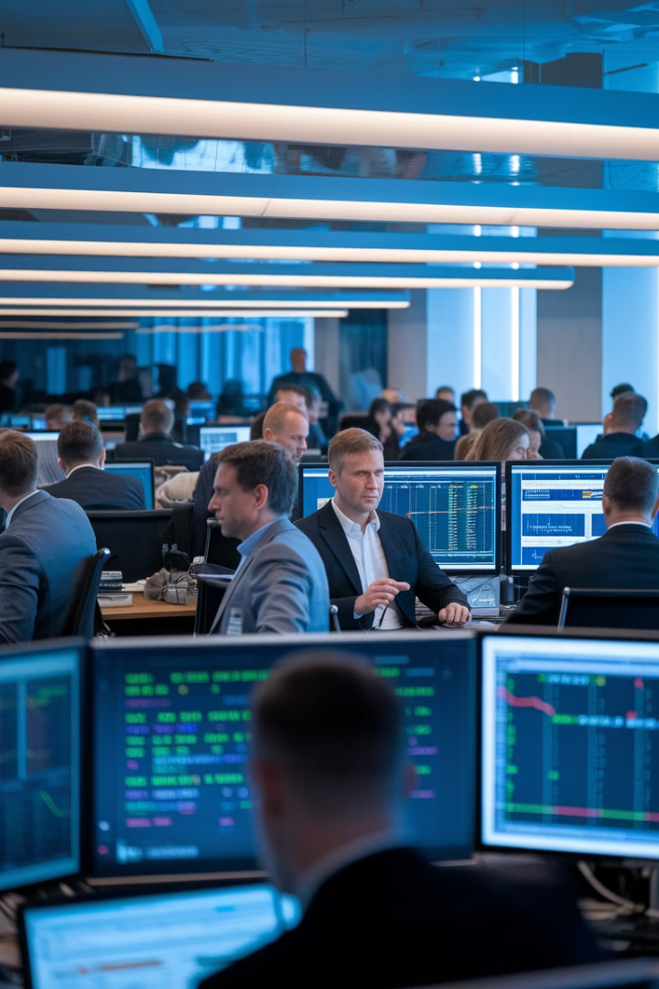

Stakeholder Management in Hedge Funds: Communicating with the C-Suite and Front Office
In the high-stakes world of hedge funds, effective communication can be the difference between project success and failure. Project managers serve as the critical bridge between executive leadership, front office staff, and technical teams.
This presentation explores strategies for navigating stakeholder relationships in the uniquely demanding hedge fund environment, where pressure is high, timelines are tight, and millions of dollars can depend on clear, effective communication.
#HedgeFundProjects #ProjectManagement #StakeholderManagement #FrontOfficeTech #FintechLeadership #PMTips #CapitalMarkets #AgileFinance #DataDrivenPM #CLevelCommunication #FinancialServicesPM

Slide 2





Understanding Your Stakeholder Landscape
Portfolio Managers
Traders
Focused primarily on investment strategy and maximizing returns. They need concise updates that directly relate to performance metrics.
Require real-time tools with minimal latency. They value efficiency and have little tolerance for system disruptions during market hours.
Compliance Officers
CTO/CIO
Prioritize regulatory alignment and risk management. They need detailed documentation and verification of control implementation.
Concerned with technical architecture, scalability, and security. They evaluate projects against long-term technology strategy.

Slide 3
Tailoring Your Communication Approach
Executive Leadership
Front Office
Middle/Back Office
Focus on business outcomes, ROI, and strategic alignment. Keep communications brief, highlighting risks that require their attention or decisions.
Emphasize how projects impact daily operations and performance. Highlight improvements to trading capabilities, data accessibility, and automation.
Address process efficiency, error reduction, and compliance enhancements. Demonstrate understanding of their operational challenges.
Prepare executive summaries that can be digested in under two minutes, with options to drill deeper if needed.
Schedule updates during non-market hours and be prepared to answer detailed questions about functionality and timeline.
Involve these teams early in requirements gathering to ensure solutions address real-world workflows.

Slide 4
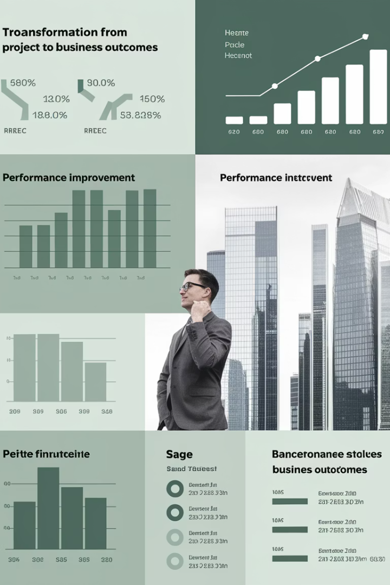



Communicating in Outcomes, Not Tasks
Task-Based
"Sprint 5 is 80% complete with 15 user stories delivered"
Transition
Convert technical progress into business value
Outcome-Based
"We're on track to launch the automated reporting tool 2 weeks early, reducing trade reconciliation time by 30%"
Hedge fund stakeholders rarely care about technical details unless they directly impact business operations. Always translate your project metrics into language that resonates with financial professionals.
This approach demonstrates that you understand not just how to deliver a project, but why the project matters to the organization's competitive edge and bottom line.

Slide 5
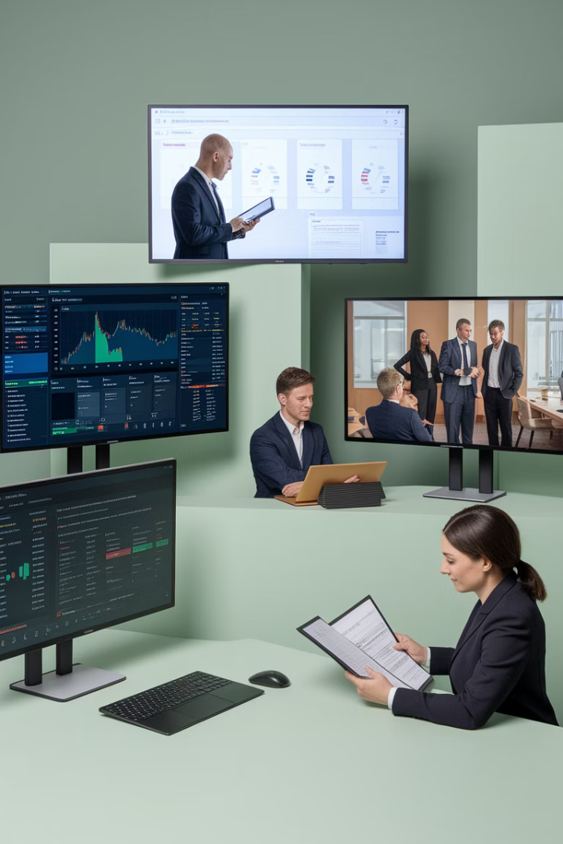
Selecting the Right Communication Tools
Executive Dashboards
Trading Floor Updates
Leverage data visualization tools like Power BI or Tableau to create high-level KPI dashboards that executives can access anytime.
Brief, in-person syncs with traders and portfolio managers during non-critical market hours.
Keep to under 15 minutes
Focus on progress vs. targets
Focus on immediate impacts
Highlight critical risks
Address performance concerns
Show resource allocation
Formal Documentation
Detailed reports for compliance, audit, and governance stakeholders with comprehensive traceability.
Maintain regulatory alignment
Document decision history
Include validation evidence

Slide 6



Proactive Risk Management Communication
Identify
Early detection of potential issues
Mitigate
Develop actionable response strategies
Communicate
Share impact and resolution plan
In hedge funds, surprises are unwelcome—especially ones that delay trades, impact performance, or create compliance issues. A proactive approach to risk communication demonstrates foresight and builds credibility with stakeholders.
When communicating risks, always quantify the potential business impact in terms stakeholders care about: trading downtime, performance degradation, regulatory exposure, or operational inefficiency. Present multiple mitigation options with clear tradeoffs to empower stakeholder decision-making.

Slide 7








Building Credibility Through Consistency
Establish Cadence
Document Decisions
Create predictable communication schedules
Maintain clear records of all stakeholder decisions
Adapt Approach
Track Follow-ups
Refine based on stakeholder feedback
Ensure accountability for action items
Consistency builds trust. When hedge fund stakeholders know they can rely on regular, accurate updates, they're less likely to micromanage your projects. This predictable communication pattern reduces their uncertainty and positions you as a dependable strategic partner.
Use a stakeholder management plan to document preferred communication methods, frequency, and content for each key stakeholder. Review and refine this plan quarterly as stakeholder needs evolve.

Slide 8






Speaking the Language of Finance
Performance Metrics
Sharpe ratios, alpha generation, VaR
Regulatory Framework
MiFID II, Dodd-Frank, SEC requirements
Trading Terminology
Order management, execution, settlement
Project managers who learn the language of hedge funds position themselves as trusted insiders rather than outsiders. This specialized vocabulary demonstrates your understanding of what truly matters in the financial world and helps bridge the gap between technical teams and business stakeholders.
Invest time to understand key financial concepts relevant to your projects. When presenting to senior stakeholders, seamlessly incorporate industry terminology to demonstrate your grasp of the business context and enhance your credibility as a strategic partner.

Slide 9
Demonstrating Project Value to Stakeholders
Stakeholder Group
Key Value Metrics
Communication Focus
Portfolio Managers
Alpha generation, faster analysis
Performance enhancement
Traders
Execution speed, system uptime
Operational efficiency
Compliance
Regulatory adherence, audit trails
Risk reduction
Technology Executives
System integration, scalability
Technical architecture
Investor Relations
Reporting accuracy, transparency
Client confidence
Different stakeholders evaluate project success through different lenses. By mapping your communication to these specific value metrics, you ensure that each stakeholder understands how your project delivers value in their particular area of concern.
Remember that hedge fund stakeholders are constantly evaluating where to allocate their attention and resources. Projects that clearly demonstrate value aligned with business priorities receive more support and encounter fewer obstacles.

Slide 10

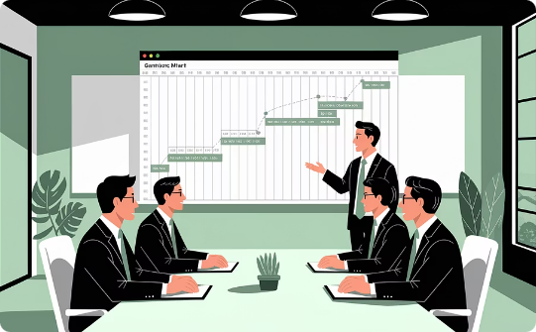

Managing Stakeholder Expectations
Clear Scope Definition
Realistic Timelines
Progressive Elaboration
Establish precise boundaries around project deliverables at kickoff. Document what is explicitly excluded to prevent scope creep, which is common in hedge fund environments where stakeholders often request "one more feature."
Build buffers into schedules to account for market volatility and regulatory shifts. In hedge funds, external factors often necessitate reprioritization. Communicate timeline ranges rather than specific dates whenever possible.
Set expectations that project details will evolve. Hedge fund projects often start with high-level concepts that become more defined over time as market conditions and requirements mature.

Slide 11
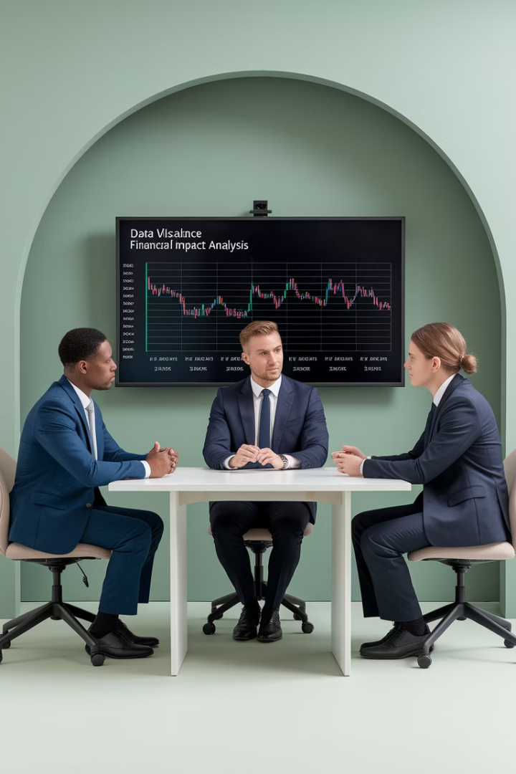
Navigating Stakeholder Conflicts
Identify Competing Priorities
Hedge funds often have inherent tensions between speed, compliance, and performance optimization. Map stakeholder priorities to understand where conflicts might emerge. For example, trading teams may prioritize execution speed while compliance focuses on regulatory controls.
Facilitate Data-Driven Discussions
When stakeholders disagree, shift from opinion-based to fact-based conversations. Present objective data on tradeoffs, costs, benefits, and risks. Use financial metrics whenever possible to ground discussions in business impact rather than personal preferences.
Escalate Strategically
When conflicts persist, have a clear escalation path to the appropriate decision-maker. Document the options presented, stakeholder positions, and final decision rationale to maintain transparency and facilitate future reference.

Slide 12
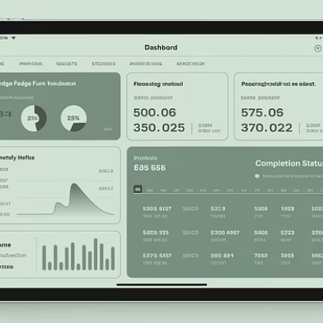
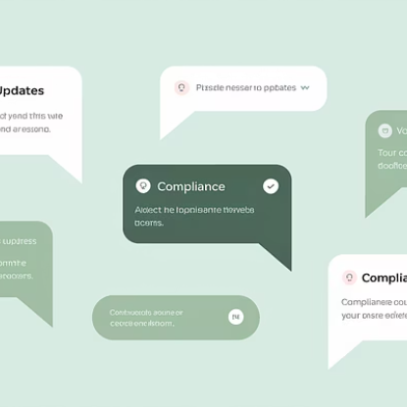

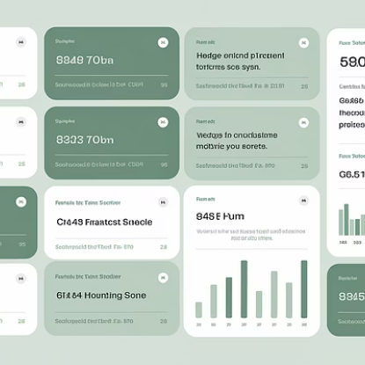
Leveraging Technology for Stakeholder Communication
Modern technology enables more efficient and secure stakeholder communication in the hedge fund environment. Project management platforms with real-time dashboards allow stakeholders to access information on demand, reducing the need for status meetings.
When selecting communication technology, prioritize security and compliance. Hedge funds operate under strict regulations regarding data protection and information sharing. Ensure all tools meet organizational security standards and facilitate appropriate audit trails of key decisions and approvals.

Slide 13
RACI Chart
Responsible, Accountable, Consulted, Informed
Project Task
Project Manager
Portfolio Manager
Quant/Data Science
Comp Officer
CTO/IT Lead
Define project scope and business goals
A
C
C
I
C
Approve budget and resources
C
A
C
C
R
Develop AI models
C
C
A
I
R
Validate data quality and access
R
C
C
I
A
Ensure regulatory compliance
C
C
I
A
C
Integrate model with OMS/EMS
R
C
C
C
A
Test and deploy solution
A
I
R
C
R
Monitor and retrain models
C
I
A
C
R
Communicate project status and impact
A
C
I
C
I

Slide 14
Becoming a Strategic Communication Partner
78%
3.5X
68%
Project Success Rate
ROI Improvement
Reduced Scope Changes
When PMs align communication with stakeholder priorities
For projects with effective stakeholder management
Through proactive stakeholder engagement
Project managers in hedge funds must evolve beyond being mere taskmasters to become strategic communication partners. This requires understanding the business context, speaking the language of finance, and consistently demonstrating how projects deliver value aligned with organizational objectives.
By mastering stakeholder communication, you position yourself as an invaluable asset in the hedge fund environment. Remember that the C-suite and front office don't just want to know what's happening—they need to understand why it matters and what comes next. This strategic perspective transforms your role from project executor to trusted advisor.

Slide 15
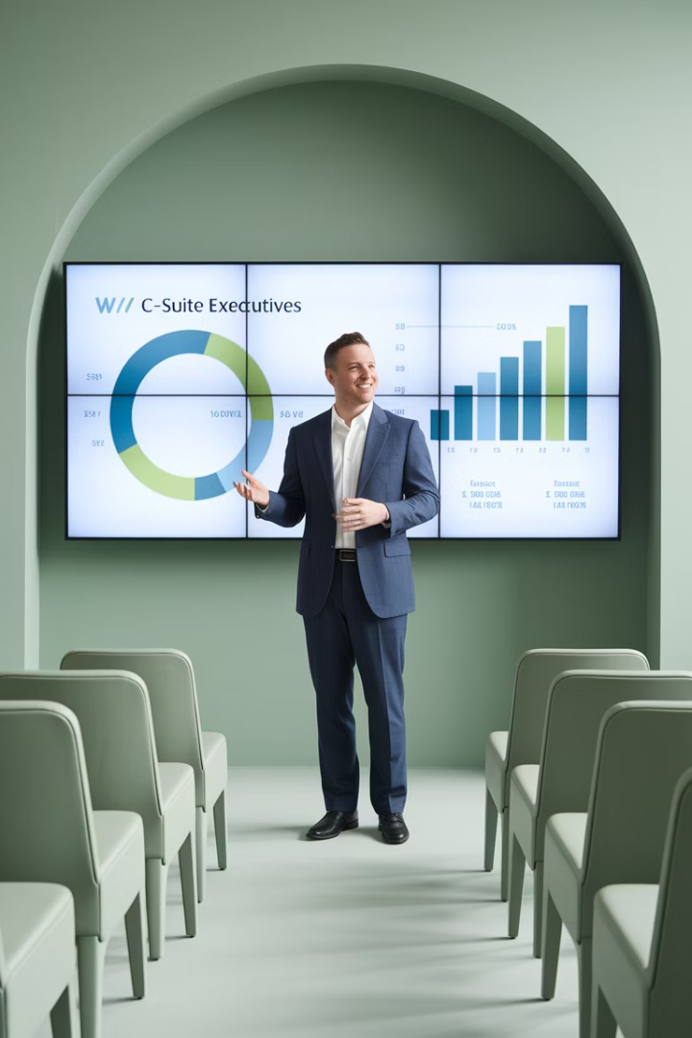
Final Thought
Project managers in hedge funds must be more than taskmasters—they must be communicators, translators, and strategic advisors. The C-suite and front office don't just want to know what's happening—they want to know why it matters and what's next. When you master the art of stakeholder communication, you elevate your role and unlock greater impact.

