Slide 1

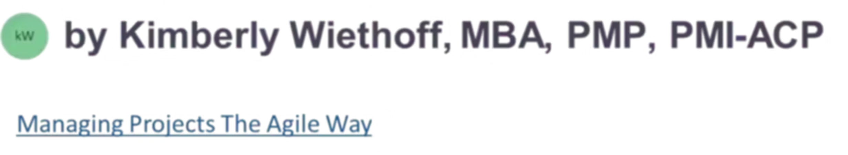
The Agile Waterfall Paradox
How to Deliver Predictability with Adaptability
Project managers today face a fundamental challenge: delivering predictable outcomes in an unpredictable world. Executives demand clarity and control, while markets demand flexibility and speed. This presentation explores how to master both.
#ManagingProjectsTheAgileWay #HybridProjectManagement #AgileLeadership #WaterfallToAgile #ProjectGovernance #BusinessAgility #PMO #ChangeManagement #ContinuousImprovement #ProjectLeadership

Slide 2
The Modern PM's Dilemma
What Leadership Expects
What Reality Demands
Fixed timelines and budgets
Shifting business priorities
Clear milestones and deliverables
Evolving technology landscapes
Predictable resource allocation
Changing regulatory requirements
Transparent reporting structures
Market disruptions
Stakeholder confidence
Continuous adaptation
Business priorities shift, technologies evolve, and regulatory expectations change midstream — but the project plan still needs to hold. The question isn't whether to adapt, but how to adapt without losing control.

Slide 3




The Solution: Embrace the Paradox
The answer lies in embracing the Agile Waterfall paradox — the art of blending predictability with adaptability so your project stays on course, even when the landscape shifts beneath it.
This isn't about compromising on either front. It's about engineering a delivery approach that leverages the strengths of both methodologies to create something more powerful than either alone.
Structure from Waterfall
Agility from Iterative
Combined Excellence
Continuous feedback, rapid adjustment, and value validation
Clear planning, defined phases, and governance frameworks
Predictable delivery of adaptive solutions that stay relevant

Slide 4

Principle #1: Predictability and Adaptability Are Complementary
In traditional project management, predictability is achieved through detailed upfront planning. In Agile, adaptability comes from continuous learning and iteration. But in reality, the two are complementary forces, not conflicting ones.
Predictability Provides
Adaptability Ensures
Structure and framework
Market relevance
Stakeholder confidence
Business alignment
Resource planning clarity
Resilience to change
Risk management foundation
Continuous improvement
Projects that master both don't just stay on track — they stay aligned with business value. The key is understanding that these forces work together to create sustainable success.

Slide 5

Principle #2: Build Predictability Through Strong Governance
Even Agile-inspired projects need guardrails. Establishing clear governance helps create the predictable backbone your stakeholders expect. When governance is transparent and consistent, it builds trust — freeing teams to innovate within the boundaries of control.
Define Roles & Responsibilities
Establish Approval Gates
Crystal-clear ownership and decision rights at every level
Clear thresholds for escalation and risk management
Standardize Reporting
Create Transparency
Dashboards, burnup charts, and consistent metrics
Visible workflows and decision-making processes

Slide 6

Principle #3: Enable Adaptability Through Empowered Teams
True adaptability doesn't come from process tweaks — it comes from people who are empowered to act. Give your teams decision-making authority within their domain. Encourage them to identify and address risks early. Create an environment where they can propose alternate paths without waiting for escalation.
Empowerment fuels agility — and makes change a source of momentum, not disruption. When teams feel trusted to make decisions, they respond faster, innovate more boldly, and take ownership of outcomes.
Grant Decision Authority
Encourage Early Risk Identification
Support Alternative Solutions
Let teams own choices within their domain without constant approvals
Make it safe to surface problems before they become crises
Welcome creative approaches that achieve goals differently

Slide 7

Principle #4: Plan for Change, Don't React to It
Waterfall projects often assume a straight path from A to B. But what if you planned for change instead of planning against it? The goal isn't to eliminate change — it's to normalize it, so your project can pivot smoothly without panic.
1
Build in Buffer Time
Include capacity for rework, feedback cycles, and unexpected pivots
2
Fast Change Workflows
Define rapid, visible processes for evaluating and implementing changes
3
Contingency Planning
Prepare backup plans for high-risk assumptions before they materialize
4
Regular Validation
Check assumptions frequently to catch drift early

Slide 8
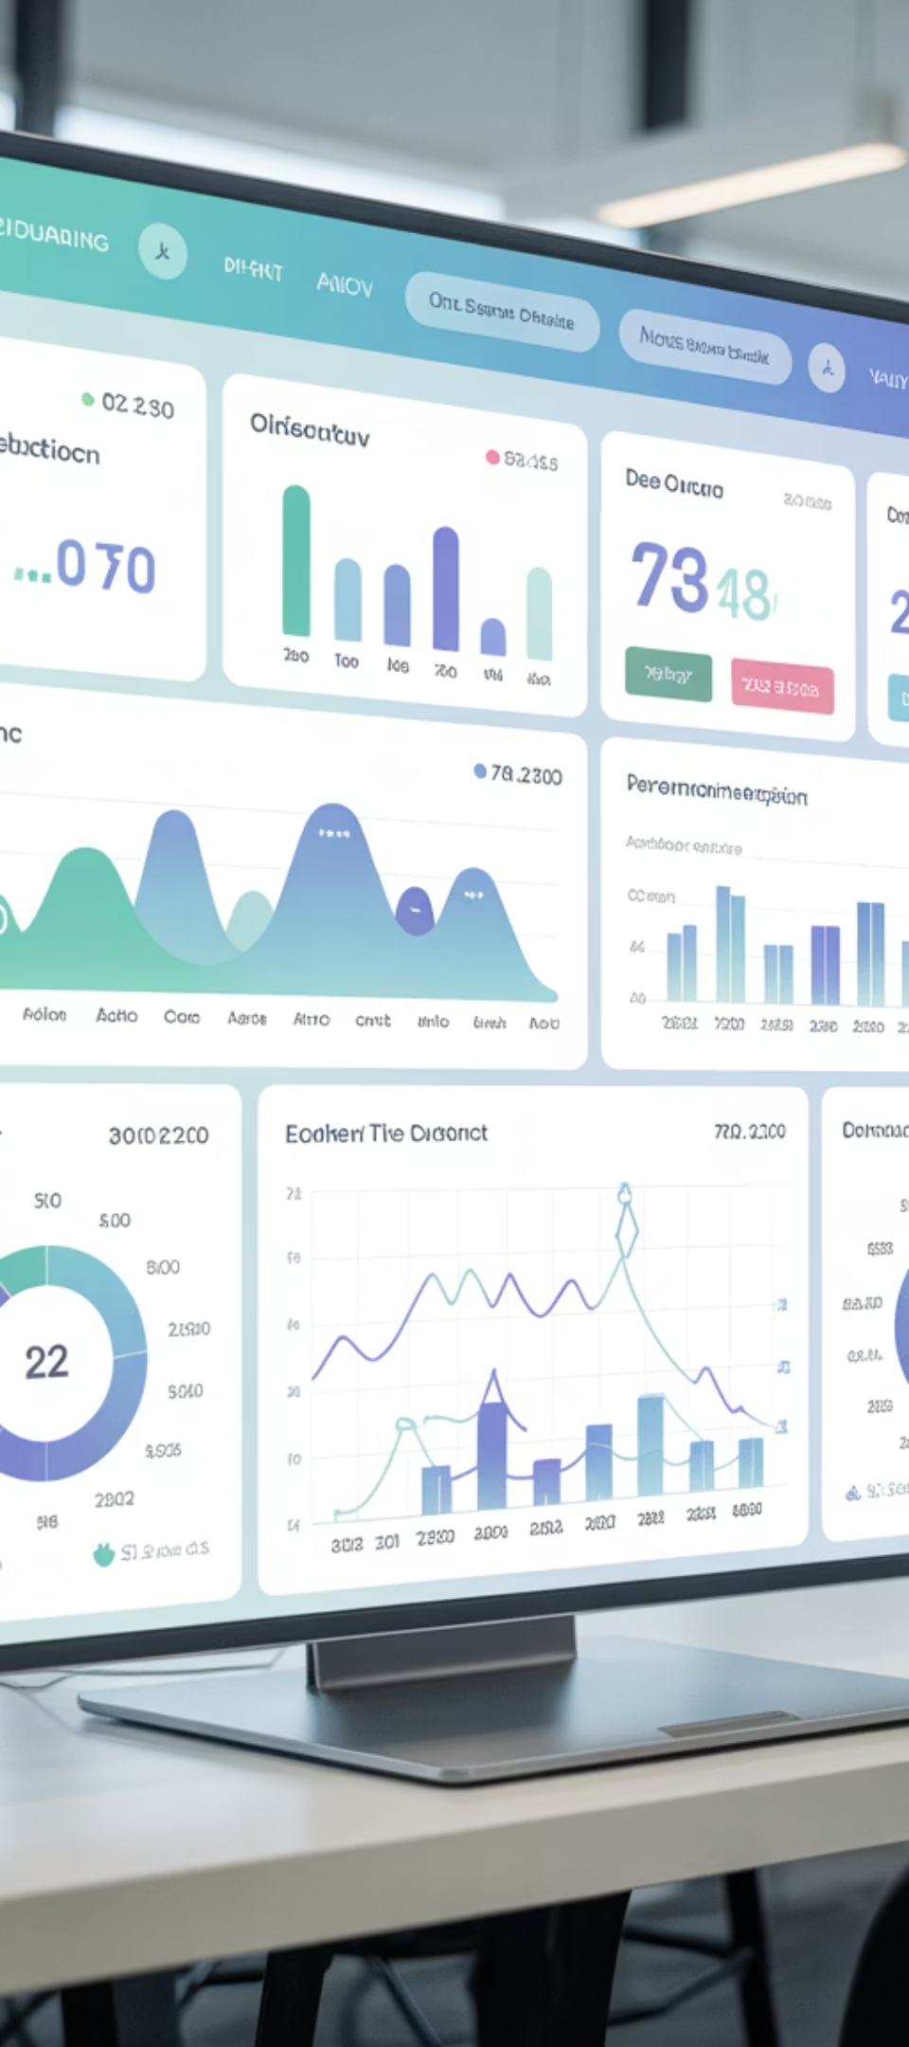
Principle #5: Measure Value, Not Just Progress
Traditional KPIs like percent complete or milestones achieved tell you how much work is done, not whether it's the right work. When you measure outcomes instead of activity, you balance predictability with purposeful progress.
Cycle Time
Customer Satisfaction
Value Per Iteration
How quickly the team delivers usable outputs from start to finish
How well deliverables meet real user needs and expectations
Business value delivered in each phase, not just work completed
These Agile-inspired metrics ensure your team isn't just busy — they're delivering outcomes that matter. They provide early warning signals when work isn't translating to value, allowing course corrections before major resources are wasted.

Slide 9
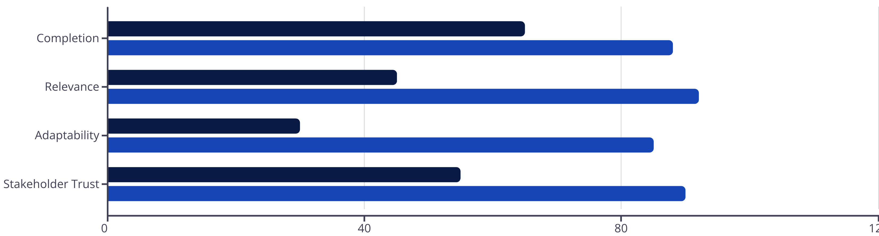
Traditional vs. Value-Based Metrics
Traditional Focus
Value-Based Focus
This comparison shows how value-based metrics consistently outperform traditional progress tracking across key dimensions. When you shift focus from "work done" to "value delivered," every aspect of project performance improves — from staying relevant to building stakeholder confidence.

Slide 10


Principle #6: Communicate the Balance to Stakeholders
Your stakeholders may equate adaptability with risk — so be transparent about how the hybrid approach protects predictability while embracing flexibility. This language builds confidence that agility isn't chaos — it's controlled responsiveness.
Frame It Positively
Emphasize Risk Reduction
Highlight Proactive Control
"We're maintaining milestone targets, but validating value earlier to ensure we're building the right thing."
"We're adjusting our approach based on real-time feedback to avoid costly rework down the line."
"We're managing change proactively through structured processes, not reacting to surprises."
The key is helping stakeholders understand that flexibility within a framework is actually more predictable than rigid adherence to outdated plans. You're not introducing chaos — you're preventing it.

Slide 11
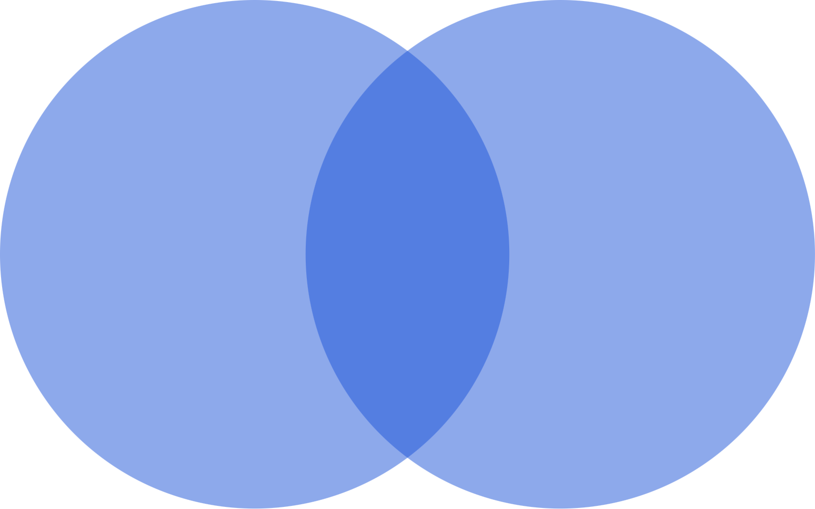
The Harmonized Delivery Model
The Agile Waterfall paradox isn't about mixing two methodologies — it's about harmonizing their strengths. Waterfall gives you discipline; Agile gives you resilience. Together, they form a delivery model that thrives amid uncertainty.
Waterfall Strengths
Harmonized Benefits
Agile Strengths
This harmonized approach creates a sustainable middle ground where structure enables rather than constrains, and flexibility operates within clear boundaries rather than creating chaos.

Slide 12
Key Takeaways for Project Leaders
1
2
3
Reframe the Relationship
Build the Foundation
Trust Your Teams
See predictability and adaptability as complementary forces, not opposing choices
Establish strong governance as the backbone that enables controlled flexibility
Empower people to make decisions and respond quickly within clear boundaries
4
5
6
Normalize Change
Measure What Matters
Communicate Clearly
Build flexibility into your baseline plan rather than treating change as failure
Track value delivered, not just work completed, to ensure meaningful progress
Help stakeholders understand that structured adaptability reduces risk

Slide 13
Great project leaders don't choose between predictability and adaptability
They engineer both
That's not a contradiction. That's evolution. In the end, mastering the Agile Waterfall paradox is about moving beyond false choices and embracing a more sophisticated approach to delivery — one that honors both the need for control and the imperative to adapt.
The future belongs to project leaders who can hold this paradox with confidence, creating delivery models that are both dependable and responsive. Start building yours today.

