Slide 1
AI-Augmented Agile: Revolutionizing Project Leadership
AI is becoming the ultimate Agile assistant, enhancing our ability to lead with clarity, precision, and speed.
As Agile project managers, we pride ourselves on adaptability, transparency, and delivering value early and often. But even the most seasoned Agile leaders can struggle with forecasting velocity, managing team dynamics, or catching risks before they derail delivery. Enter AI—our newest team member.
Far from replacing human insight, AI is becoming the ultimate Agile assistant, enhancing our ability to lead with clarity, precision, and speed.
kW
by Kimberly Wiethoff

Slide 2
The New Agile Teammate
Adapt
AI amplifies Agile adaptability with predictive insights and real-time analytics.
Enhance
Human intuition meets machine precision for better project outcomes.
Empower
Teams spend less time on admin, more time on high-value activities.
Partner
AI supports, not replaces, the essential human elements of Agile leadership.

Slide 3
Smarter Sprint Planning
Precision Estimates
Achieve greater accuracy in sprint commitments
Historical Analysis
Learn from past performance patterns
Complexity Assessment
Evaluate task difficulty objectively

Slide 4
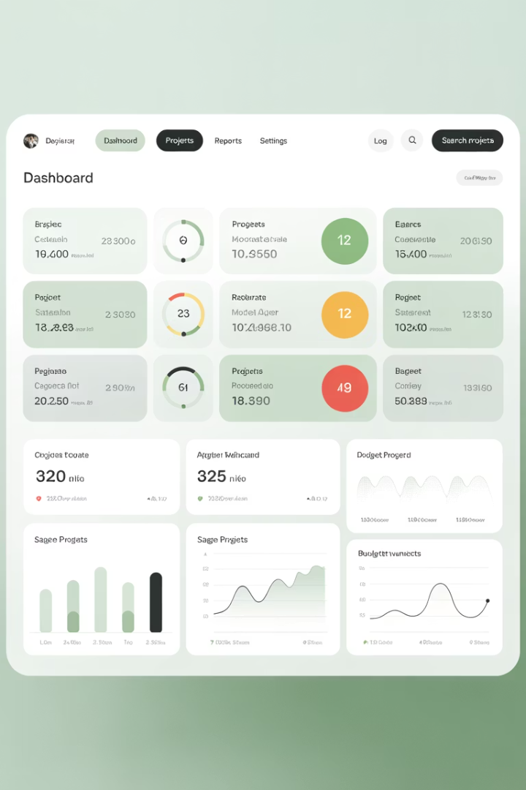
Real-Time Risk Detection
Dependency Analysis
Communication Patterns
AI scans task relationships to identify potential bottlenecks before they impact delivery timelines.
Algorithms detect when team discussions indicate confusion or misalignment on requirements.
Code Quality Metrics
Machine learning flags technical debt that could slow future sprints or cause defects.

Slide 5
Team Health Monitoring
Coaching Opportunities
Morale Indicators
Identify when and where leadership intervention would help most.
Communication Analysis
Track team energy and engagement across sprints.
Burnout Prevention
Review Slack messages and Jira comments for sentiment patterns.
Detect early warning signs of team exhaustion or frustration.

Slide 6
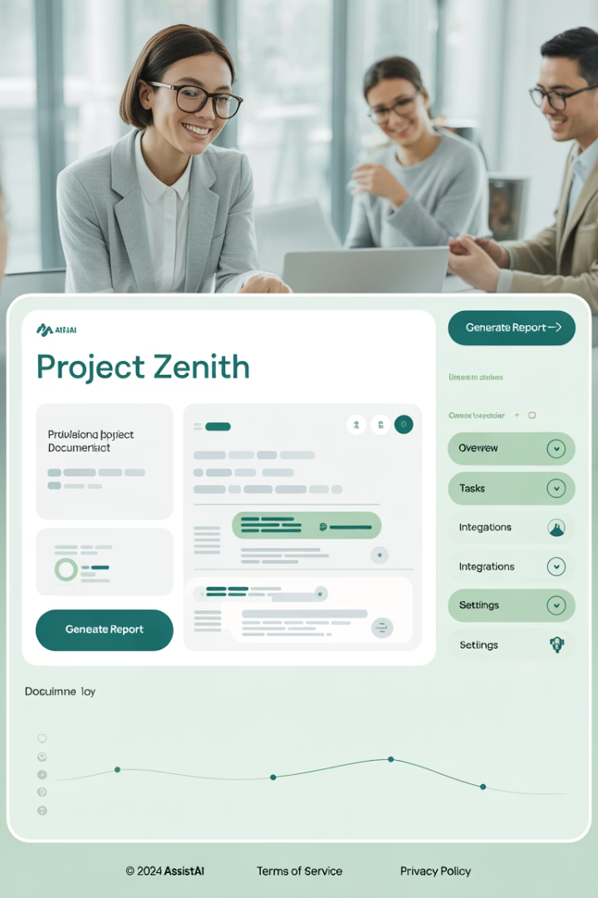
Workflow Automation
Admin Tasks
Automate backlog grooming suggestions and updates.
Documentation
Generate meeting notes and documentation drafts.
Reporting
Create burndown charts and status reports automatically.
Story Creation
Draft user stories from requirements discussions.

Slide 7
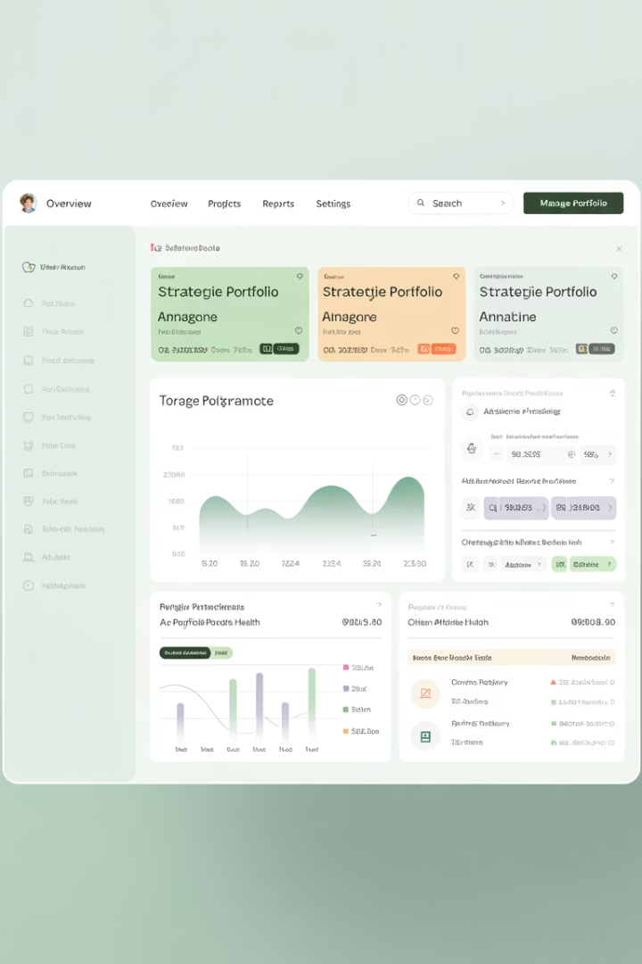
Strategic Portfolio Management
Trend Analysis
Budget Optimization
AI identifies patterns across multiple projects to inform portfolio decisions. Leaders gain visibility into systemic issues.
Simulate various budget allocation scenarios to maximize ROI. Find the optimal balance between constraints.
Resource utilization trends
Cost-benefit analysis
Cross-team dependencies
Resource optimization
Delivery consistency
Risk-adjusted forecasting

Slide 8
AI-Powered Sprint Retrospectives
Pattern Discovery
Identify recurring themes from past retrospectives
Improvement Tracking
Measure progress on action items over time
Suggested Actions
Get AI recommendations for process improvements

Slide 9
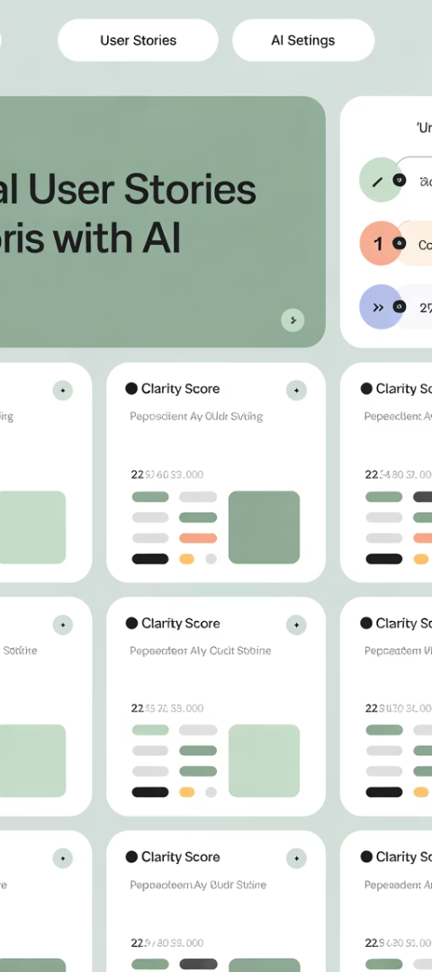
Enhanced Story Refinement
Requirement Clarity
Dependency Mapping
Effort Estimation
AI analyzes user stories for ambiguity and suggests clarifications. Vague requirements get flagged before they cause confusion.
Automatically identify relationships between stories. See the hidden connections that might impact sequencing.
Get AI-suggested story points based on historical data. Compare with team estimates for better accuracy.

Slide 10
Metrics That Matter
AI-enhanced agile practices dramatically outperform traditional approaches across key performance indicators. The metrics below demonstrate the quantifiable impact of AI integration in agile environments.
Traditional
AI-Enhanced
As shown above, AI implementation delivers substantial improvements in critical areas: 24% higher forecast accuracy for better planning, 44% stronger risk detection to prevent issues, 13% deeper team insights for improved collaboration, and 36% greater administrative efficiency to reduce overhead. These metrics translate directly to faster delivery, higher quality, and more sustainable team performance.

Slide 11
Implementing AI in Your Agile Practice
Start Small
Begin with one AI tool that addresses your team's biggest pain point. Measure results before expanding.
Build Trust
Be transparent about how AI tools work. Involve the team in selecting and implementing solutions.
Refine & Expand
Use retrospectives to evaluate AI effectiveness. Gradually introduce new capabilities as confidence grows.

Slide 12
Balancing AI and Human Leadership
AI Strengths
Human Strengths
Pattern recognition, data processing, prediction accuracy
Emotional intelligence, creativity, ethical judgment
Outcome
Integration
Enhanced agility, better decisions, happier teams
Tools and practices that combine the best of both

Slide 13
Key Takeaways: The Future of Agile Leadership
AI augments human judgment, not replaces it
The most effective Agile leaders will leverage AI as a powerful teammate.
Core Agile values remain the compass
Technology changes, but collaboration and customer focus stay essential.
Start your AI-Agile journey now
Early adopters will gain competitive advantage in delivery excellence.
The human element becomes more valuable
Emotional intelligence and servant leadership cannot be automated.

