Slide 1
10 Essential Project Management Tools
These tools will streamline your workflow and boost team productivity. Each offers unique features for different project types and team sizes.
kW
by Kimberly Wiethoff

Slide 2
Visual Task Management with Trello
Visual Workflow
Perfect for Small Teams
Intuitive kanban boards help teams visualize task progress at a glance.
Simple interface makes adoption easy. No extensive training required.
Real-time Updates
Track progress instantly with drag-and-drop cards. See who's working on what.

Slide 3
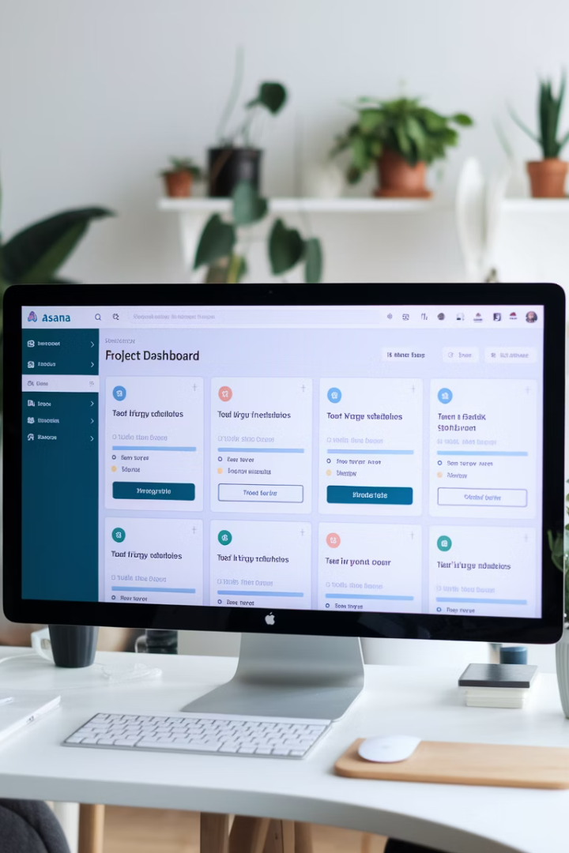
Asana for Complex Projects
Task Assignment
Easily assign work to team members with clear accountability.
Timeline View
Visualize project schedules and dependencies in an interactive Gantt chart.
Workload Management
Monitor team capacity to prevent burnout and optimize resources.
Project Tracking
Generate custom reports to measure progress against goals.

Slide 4
Microsoft Project for Enterprise Solutions
Advanced Reporting
Detailed insights for executive stakeholders
Resource Management
Optimize team allocation across complex projects
Gantt Charts
Visualize timelines and dependencies
Microsoft Integration
Seamless connection with Office 365

Slide 5
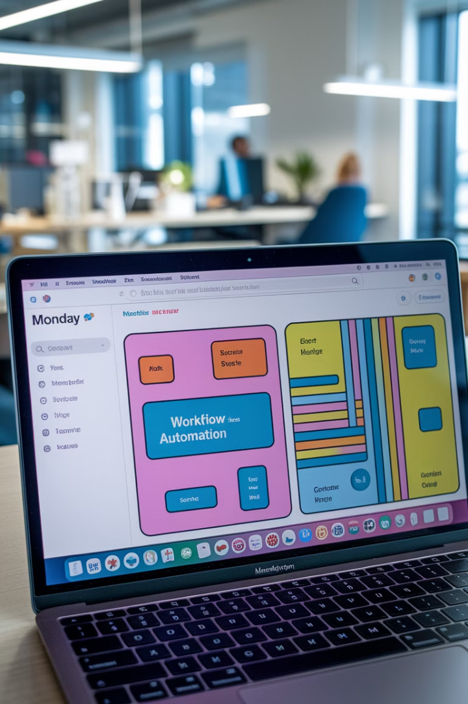
Customize Workflows with Monday.com
Visual Dashboards
Color-coded boards make progress tracking intuitive.
Automation Rules
Reduce manual work with custom triggers and actions.
Time Tracking
Monitor hours spent on tasks for accurate billing.
Integrations
Connect with your existing tools for seamless workflows.

Slide 6
Smartsheet: Spreadsheets Enhanced
Familiar Interface
PM Features
Spreadsheet format offers quick adoption for Excel users. No steep learning curve.
Goes beyond basic spreadsheets with built-in project management tools.
Formulas and cell references work just like traditional spreadsheets.
Gantt charts
Automation rules
Critical path analysis

Slide 7
Jira for Agile Teams
Backlog Management
Sprint Planning
Prioritize user stories and tasks for upcoming work
Organize work into time-boxed iterations
Reporting
Issue Tracking
Track velocity and burndown with built-in metrics
Record and assign bugs with detailed information

Slide 8
Basecamp: Streamlined Collaboration
To-Do Lists
Create, assign, and track tasks with simple checklists. Perfect for straightforward projects.
Message Boards
Keep discussions organized by topic. Reduce email overload with centralized communication.
File Sharing
Store and organize documents, images, and other assets. Find what you need quickly.
Automatic Check-ins
Get status updates without scheduling meetings. Maintain awareness with minimal disruption.

Slide 9
Wrike for Complex Portfolios
Project Organization
Hierarchical folders for multi-level project portfolios
Real-Time Collaboration
Live editing and commenting on project documents
Robust Reporting
Customizable dashboards for stakeholder updates
Workflow Customization
Tailored processes for different teams and projects

Slide 10
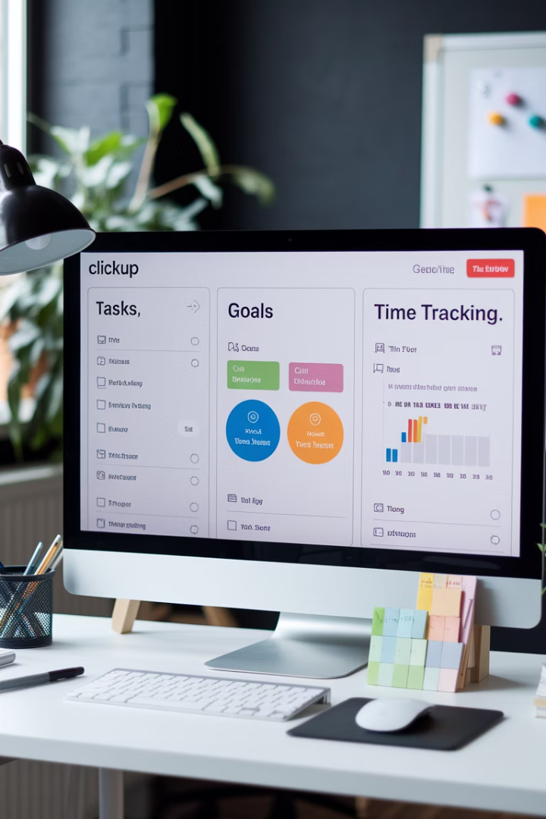
ClickUp: All-in-One Solution
1000+
15+
Customizations
View Options
Adapt the platform to fit any workflow or process.
See your work as lists, boards, calendars, or Gantt charts.
100+
50%
Integrations
Time Saved
Connect with your existing tools seamlessly.
Average efficiency gain reported by users.

Slide 11
Zoho Projects: Budget-Friendly Option
Cost-Effective
Gantt Charts
Time Tracking
Zoho Integration
Lower price point than competitors with comparable features. Ideal for small businesses.
Visual timeline planning with dependencies and milestones. Track critical paths easily.
Built-in timers for tracking billable hours. Generate accurate client invoices.
Seamless connection with other Zoho apps. Create a complete business ecosystem.

Slide 12
Comparing Tool Features
Ease of Use
Feature Richness
Price Value

Slide 13
Choosing the Right Tool
Assess Your Needs
Consider team size, project complexity, and budget constraints. Different tools excel in different environments.
Trial Period
Take advantage of free trials. Get team feedback on usability and feature relevance.
Evaluate Integration
Ensure the tool connects with your existing systems. Avoid creating information silos.
Implement Gradually
Start with core features. Add complexity as your team adapts to the new workflow.

