Slide 1
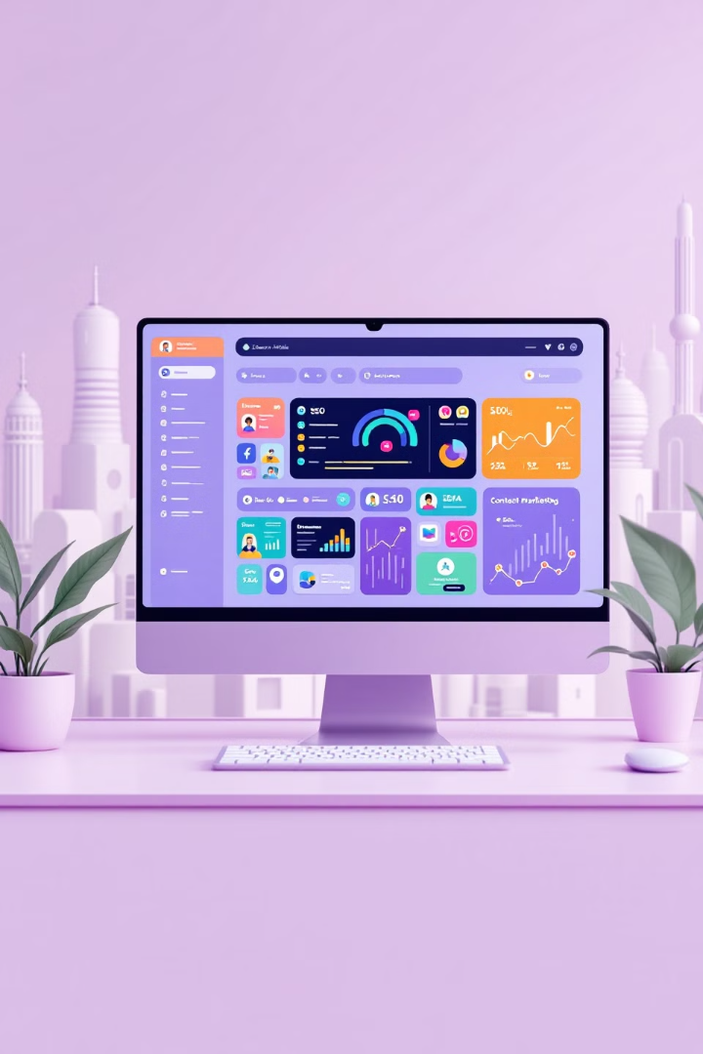
Mastering the Art of Digital Marketing
Welcome to the future of marketing! With ever-evolving technology, digital marketing offers endless opportunities to connect with your audience and grow your business.
kW
by Kimberly Wiethoff

Slide 2
Define Your Objectives
Goal Setting
What do you want to achieve? Increase brand awareness? Drive website traffic? Boost sales? Clearly defined goals will guide your efforts and make it easier to track progress.

Slide 3
Know Your Audience
Understanding Your Target
Market Research
Use data and analytics to gather insights about your target audience. Explore their online behavior, interests, and buying patterns.
Who are you trying to reach? Dive deep into your audience's demographics, preferences, and pain points to tailor your message and content for maximum impact.
Persona Development
Create detailed profiles of your ideal customers. This helps you understand their needs and develop strategies to address them.

Slide 4
Content is King
Blog Posts
Videos
Share valuable insights, industry trends, and practical tips to educate and engage your audience. Optimize posts with relevant keywords for better SEO.
Create engaging video content to showcase products, services, or tutorials. Leverage popular platforms like YouTube and TikTok to reach wider audiences.
Infographics
Transform data and complex information into visually appealing graphics to increase understanding and engagement. Share these on social media and your website.

Slide 5
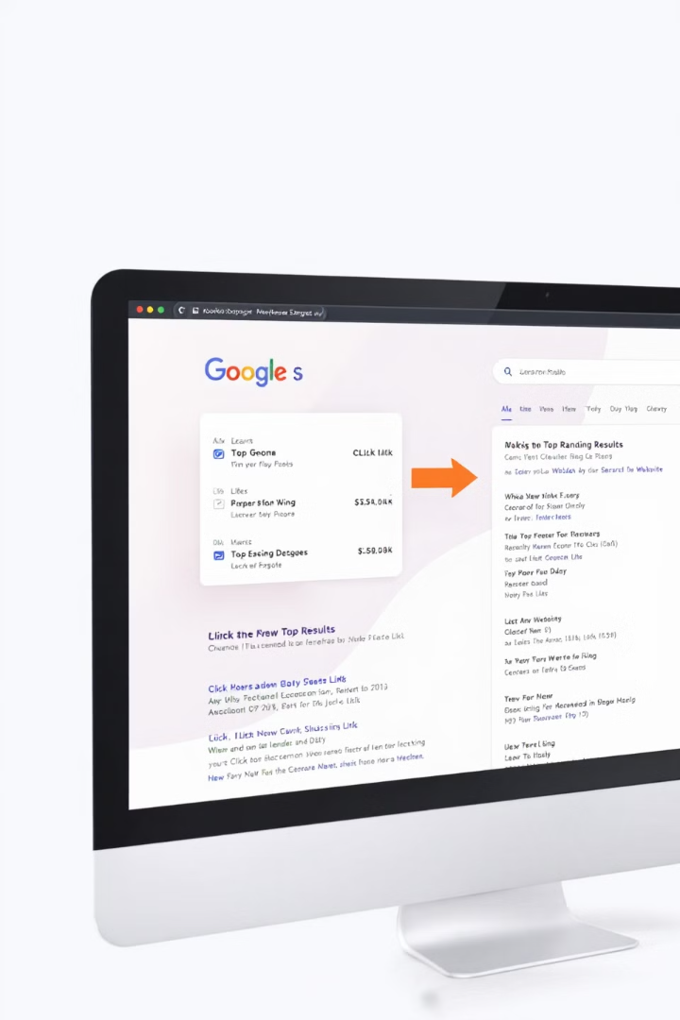
SEO Optimization
1
Keyword Research
Identify the terms and phrases your target audience uses when searching for products or services. Utilize tools like Google Keyword Planner to find the most relevant keywords.
2
On-Page Optimization
Optimize your website's content, meta descriptions, and titles with targeted keywords to improve your search engine rankings.
3
Off-Page Optimization
Focus on building high-quality backlinks from reputable websites to enhance your site's authority and improve your search ranking.
4
Mobile Optimization
Ensure your website is fully responsive and optimized for mobile devices. Google prioritizes mobile-friendly sites in search results.

Slide 6
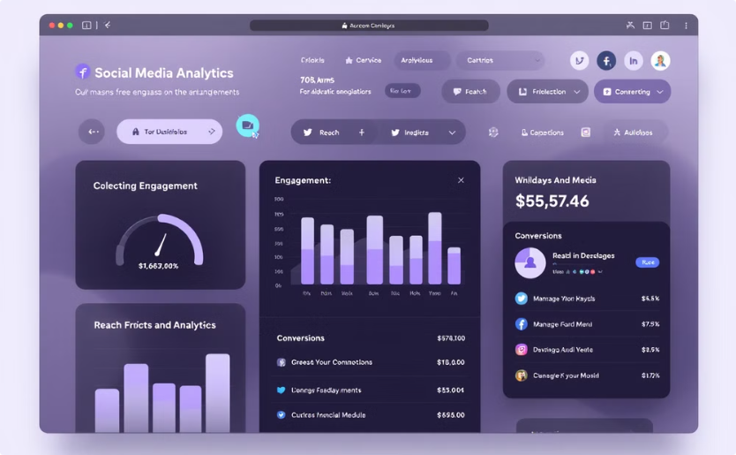
Harness the Power of Social Media
Data-Driven Strategy
Influencer Marketing
Monitor key metrics like engagement, reach, and conversions to understand what resonates with your audience. Use this data to refine your strategy.
Partner with influencers in your industry to reach new audiences and build brand awareness. Select influencers who align with your brand values and target audience.

Slide 7
Email Marketing
List Building
1
Segmentation
2
Categorize your email list based on demographics, preferences, or engagement to personalize your messaging and increase relevance.
Automated Campaigns
3
Set up automated email sequences based on user actions, such as welcome emails, abandoned cart reminders, or post-purchase follow-ups.
Personalization
4
Tailor email content to individual recipients based on their interests and behaviors. Use dynamic content to personalize subject lines, greetings, and offers.

Slide 8
Data-Driven Insights
100%
200%
Tracking
Analysis
Monitor key performance indicators (KPIs) to measure the success of your campaigns. Track metrics like website traffic, conversion rates, and social media engagement.
Analyze data to identify trends, patterns, and areas for improvement. Understand what resonates with your audience and adjust your strategies accordingly.
300%
Optimization
Use data-driven insights to optimize your campaigns and improve performance. Continuously test and refine your strategies to maximize results.

Slide 9
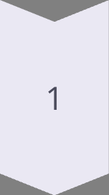
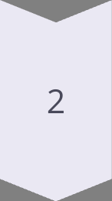
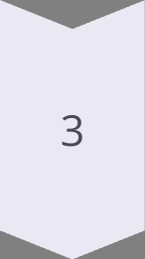
Be Fast and Adapt
Stay Informed
Continuously research the latest trends, algorithm updates, and customer preferences in the digital marketing world. Stay ahead of the curve.
Experiment
Don't be afraid to try new things and experiment with different strategies. Embrace innovation and embrace what works best for your audience.
Adapt
Be willing to adapt your strategies based on data-driven insights and changing market conditions. Stay nimble and flexible to thrive in the dynamic digital landscape.

Slide 10
Conclusion
Embrace the power of digital marketing to connect with your audience, build your brand, and achieve your business goals. Stay curious, experiment, and adapt to the ever-changing digital landscape.

