Slide 1
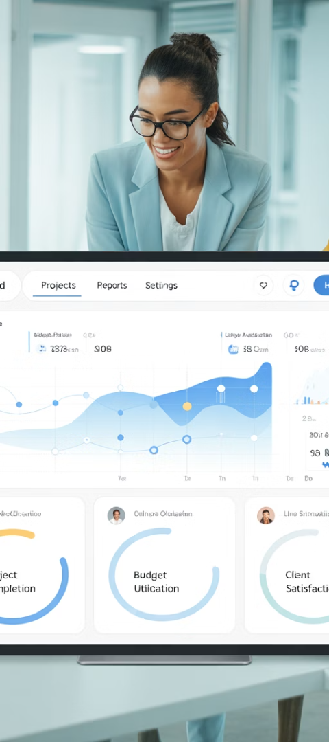
Applied Epic Customization: Stakeholder & Scope Management
Successfully implementing Applied Epic requires careful customization to match your agency's unique workflows, compliance requirements, and service models. While the system offers remarkable flexibility, this creates complexity for project managers balancing stakeholder expectations against technical constraints.
This presentation explores best practices for managing Applied Epic customization projects, with a focus on stakeholder alignment, scope control, and ensuring long-term scalability—key factors that determine whether your implementation succeeds or struggles.
kW
by kimberly Wiethoff

Slide 2
Identifying the Right Stakeholders
Map Stakeholders by Role
Include Power Users
Form a Steering Committee
Engage your "super users" who understand the system best and can advocate for practical solutions
Create a comprehensive map covering all roles and functions (CSRs, Accounting, Sales, IT Admins) to ensure all needs are represented
Establish a cross-functional working group to validate priorities and ensure customizations solve real business problems
Early stakeholder identification prevents the common pitfall of creating customizations that solve isolated problems while creating workflow issues elsewhere. This cross-functional approach ensures your Epic implementation delivers organization-wide value.

Slide 3
Documenting Custom Requests
What to Customize
What to Document
Custom forms and templates
Detailed request specifications
Unique workflows or activities
Business justification
User-defined fields (UDFs)
Priority classification
Automated reports/dashboards
Estimated implementation effort
Security roles and access levels
Dependencies and stakeholders
Using a centralized backlog tool like Jira, Excel, or SharePoint helps track all requests and prevents "hallway requirements" from derailing your project. Work with stakeholders to rank by business value rather than responding to whoever makes the loudest demands.

Slide 4
Aligning Scope with System Capabilities
Out-of-Box Configuration
Simple changes using existing system options
Admin-Level Customization
Changes requiring system admin privileges
Technical Customization
Requires development or vendor involvement
Not every request is feasible to implement—or wise to pursue. Work with Applied Epic administrators or consultants to determine what's configurable versus what requires custom development or vendor support. Validate if workarounds exist using workflows, dashboards, or activities before committing to complex customizations.
Create "guardrail" documentation defining acceptable customization types to prevent future upgrade complications. This proactive approach prevents technical debt that can hinder your agency's agility.

Slide 5
Defining and Protecting Project Scope
Baseline Requirements
Guard Against Creep
Document and approve initial scope after requirements gathering
Implement change control processes to manage new requests
Formalize Changes
Assess Impact
Document approvals and update project baseline
Evaluate schedule, budget and quality effects of changes
Scope creep represents a major risk in customization-heavy Epic projects. Establish your scope baseline after the requirements phase and use change request logs to track additions or adjustments. Communicate regularly with stakeholders about what's in versus out of scope to manage expectations effectively.

Slide 6
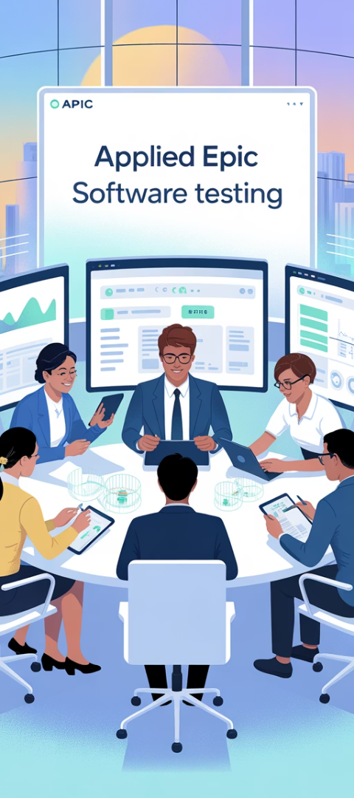
Testing Customizations for Value
Design Test Scenarios
Create real-world use cases that reflect actual daily operations
Engage End Users
Include representatives from every impacted department
Measure Improvements
Compare metrics against pre-customization baseline
Refine & Adjust
Implement feedback before full deployment
Don't just test for functionality—test for usability and business value. Using real-world scenarios during User Acceptance Testing (UAT) with end users from every impacted team ensures customizations truly improve workflows rather than simply automating old inefficient processes.

Slide 7
Maintaining a Customization Register
Customization Name
Purpose
Business Owner
Support Contact
Review Cycle
Producer Dashboard
Sales Pipeline Tracking
Sales Director
Epic Admin Team
Quarterly
Renewal Workflow
Streamline Renewals
Service Manager
Operations Analyst
Semi-Annual
Custom Client Fields
Regulatory Compliance
Compliance Officer
IT Support
Annual
After go-live, maintain a comprehensive record of all implemented customizations. Document their purpose, business owner, support contacts, dependencies, and review cycle. This register becomes invaluable for troubleshooting, employee onboarding, compliance audits, and planning future system upgrades.
A well-maintained register transforms tribal knowledge into organizational documentation, reducing risk when key personnel change roles or leave the organization.

Slide 8
Common Customization Pitfalls
Over-Customization
Digitizing Bad Processes
Modifying everything possible rather than accepting standard functionality where appropriate, creating unnecessary complexity and maintenance burden
Customizing Epic to match inefficient legacy workflows instead of taking the opportunity to improve and streamline operations
Ignoring Upgrade Impacts
Inadequate Documentation
Implementing customizations that create barriers to future system upgrades, effectively locking the agency into an outdated version
Failing to document the purpose, function, and maintenance procedures for customizations, creating knowledge silos dependent on specific individuals
Recognizing these common pitfalls helps project managers avoid them. Remember that the most successful Epic implementations balance customization with standardization, leveraging out-of-box functionality where possible while customizing strategically for genuine competitive advantage.

Slide 9
Building an Effective Governance Model
Executive Sponsorship
Decision Framework
Change Control Board
Standardized Processes
Established criteria for evaluating requests
Cross-functional team reviewing all changes
Senior leadership support and clear ownership
Consistent request and approval workflows
Effective governance provides the structure needed to manage customizations over time. Establish a cross-functional Change Control Board with representation from IT, operations, and business units to evaluate new customization requests against established criteria focused on business value, strategic alignment, and technical feasibility.
This governance model helps balance innovation with standardization, ensuring Epic remains both customized to your needs and sustainable over time.

Slide 10
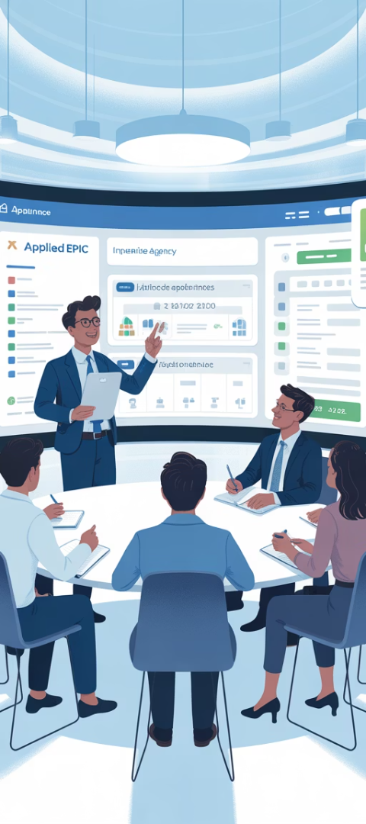
Training for Customized Environments
Role-Based Training
Custom Documentation
Create targeted training modules specific to each department's customizations rather than generic system overviews
Develop agency-specific user guides that reflect your customized workflows and screen layouts
Video Tutorials
Super User Network
Record screen captures demonstrating common tasks in your customized environment for just-in-time learning
Establish a network of advanced users who can provide peer support for customized features
Generic Applied Epic training often falls short when agencies implement significant customizations. Develop agency-specific training materials that address your unique workflows, custom fields, and specialized processes to ensure adoption and proper utilization of customized features.

Slide 11
Measuring Customization ROI
Before
After
Quantify the business impact of your customizations by tracking key performance indicators before and after implementation. Focus on metrics that matter to the business: processing times, error rates, customer satisfaction scores, and producer efficiency. This data helps justify the investment and builds support for future optimization efforts.
Don't limit measurement to technical metrics—the true value of customizations comes from business outcomes like improved client retention, increased sales, and enhanced compliance capabilities.

Slide 12
Key Takeaways for Project Success
1
Start with the Business, Not the Technology
2
Balance Flexibility with Standardization
3
Plan for the Full Lifecycle
Consider the long-term implications of customizations, including maintenance requirements, upgrade impacts, and staff training needs. Today's perfect solution can become tomorrow's technical debt if not properly managed.
Focus customization efforts on solving genuine business problems rather than implementing features simply because they're available. Every customization should tie directly to agency goals or client experience improvements.
Find the right mix between customizing for competitive advantage and leveraging standard functionality for stability and upgrade compatibility. Not everything needs to be—or should be—customized.
Applied Epic customizations can transform your agency operations when implemented strategically. By following these best practices for stakeholder management and scope control, you'll create an environment that balances unique agency needs with system stability and scalability.

Slide 13
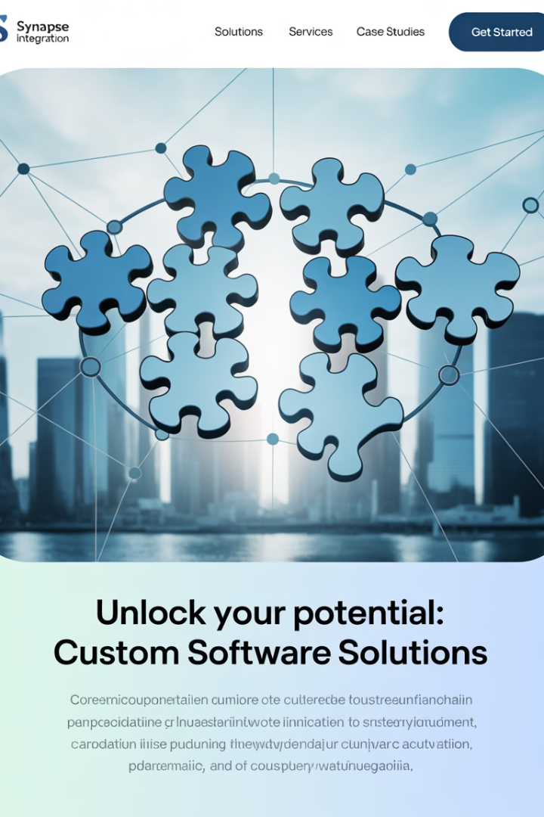
Final Thoughts
Customization can unlock powerful efficiencies in Applied Epic—but only if approached strategically. By involving the right stakeholders, prioritizing business value, setting clear scope boundaries, and planning for long-term maintainability, project managers can ensure their Epic environment truly supports the agency's goals.

