Slide 1
Cloud Migration Project Manager's Guide
Navigate the journey from legacy infrastructure to cloud-native services with confidence. This guide provides project managers with essential checkpoints, practical tips, and strategic frameworks.
kW
by Kimberly Wiethoff

Slide 2
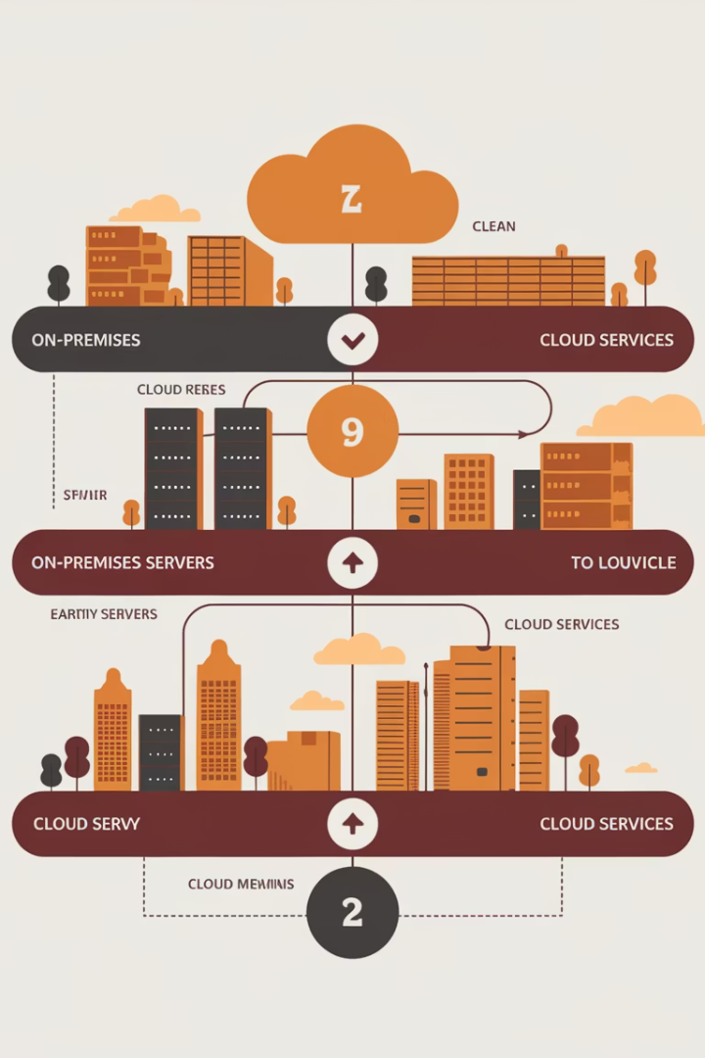
Migration Journey Overview
Discovery & Assessment
Inventory systems and align stakeholders on migration goals.
Planning & Design
Create migration blueprint and establish governance.
Migration Execution
Move workloads methodically in coordinated waves.
Optimization & Handover
Optimize resources and transition to operations teams.

Slide 3
Discovery & Assessment Essentials
Inventory Current Systems
Document all applications, servers, and dependencies. Identify integration points and data flows.
Identify Quick Wins
Prioritize file servers and non-production apps. They provide early momentum with lower risk.
Conduct Readiness Assessments
Evaluate network capacity, storage needs, and licensing requirements. Consider compliance implications.
Align On Strategic Goals
Build consensus around cost savings, agility, or scalability objectives. Set measurable targets.

Slide 4
Migration Strategy Selection
Rehost (Lift & Shift)
Refactor
Move applications without redesign. Fastest approach but limits cloud-native benefits.
Optimize applications for cloud without changing core architecture. Balances speed and value.
Rearchitect
Rebuild/Replace
Significantly modify applications to leverage cloud capabilities. Higher investment but better ROI.
Create new cloud-native applications or adopt SaaS alternatives. Most transformative approach.

Slide 5
Building Your Migration Plan
Define Scope & Timeline
Segment migration into logical waves. Prioritize by business impact and technical complexity.
Secure Budget & Contracts
Obtain funding approval. Finalize agreements with cloud providers and migration partners.
Establish Governance
Create RACI matrix. Define decision frameworks and escalation paths.
Set Up Landing Zones
Configure core infrastructure. Implement identity management, networks, and security controls.

Slide 6
Risk Management Approach
Identify Risks
Document technical, organizational, and compliance risks
Assess Impact
Evaluate likelihood and business impact
Develop Mitigation
Create contingency plans and rollback procedures
Monitor Continuously
Track risk indicators throughout migration

Slide 7
Migration Execution Framework
Prepare Environment
Migrate Workloads
Configure cloud infrastructure and testing environments.
Execute data transfer and application deployment in waves.
Cut Over
Validate & Test
Switch traffic to cloud environment and monitor closely.
Perform smoke testing and user acceptance testing.

Slide 8
Command Center Operations
Command Center Setup
Real-time Monitoring
Communication Protocols
Establish a dedicated physical or virtual space. Staff it with technical experts and decision-makers.
Deploy dashboards showing migration progress. Track key metrics and system health indicators.
Schedule regular status updates. Create templates for reporting progress to stakeholders.
Create clear escalation paths. Define roles for critical cutovers and high-visibility migrations.
Use tools like Jira or ServiceNow. Document issues and resolution steps as they emerge.
Maintain open channels with end users. Set up support hotlines during critical transitions.

Slide 9
Post-Migration Optimization
Security Hardening
Cost Optimization
Review access controls and security configurations. Conduct vulnerability assessments and penetration testing.
Performance Analysis
Identify and eliminate over-provisioned resources. Implement auto-scaling and reserved instances for predictable workloads.
Benchmark application performance against pre-migration baseline. Address any degradation issues immediately.

Slide 10
Operational Handover Checklist
Documentation
Training
Compile comprehensive runbooks and architecture diagrams. Update standard operating procedures.
Conduct knowledge transfer sessions. Provide access to cloud platform training resources.
Support Models
Review Cycles
Define escalation paths and SLAs. Establish monitoring and alerting responsibilities.
Schedule regular optimization reviews. Set up quarterly cost and performance evaluations.

Slide 11
Common Migration Challenges
Challenge
Mitigation Strategy
Dependency Gaps
Map all integrations pre-migration. Test thoroughly in staging environment.
Performance Issues
Benchmark before and after. Optimize cloud resources appropriately.
Security Concerns
Involve security team early. Implement least-privilege access model.
Budget Overruns
Set up cost alerts. Review spending weekly during migration.
User Resistance
Create change management plan. Engage users throughout process.

Slide 12
Measuring Migration Success
99.9%
30%
Availability
Cost Reduction
Target uptime for migrated applications
Average infrastructure savings after optimization
40%
25%
Deployment Speed
Operational Efficiency
Improvement in time-to-market for new features
Reduction in maintenance overhead

Slide 13
Next Steps for Success
Prepare assessment templates
Customize inventory and readiness worksheets
Assemble your dream team
Identify technical leads and key stakeholders
Develop cloud governance
Define security standards and operating procedures
Create success metrics
Establish KPIs to measure migration impact

Slide 14
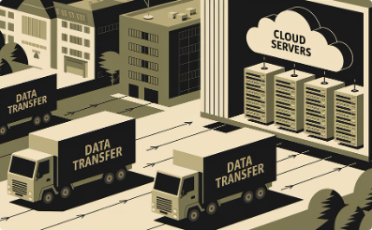
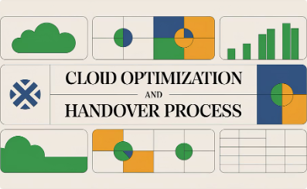
Cloud Migration PM Checklist
🧭 Phase 1: Discovery & Assessment
🛠️ Phase 2: Planning & Design
🚚 Phase 3: Migration Execution
📈 Phase 4: Optimization & Handover
Define project scope, migration waves, and schedule
Provision infrastructure and configure cloud services
Inventory existing systems, applications, and dependencies
Conduct post-migration cost analysis and resource rightsizing
Secure cloud vendor contracts and budget approvals
Migrate workloads in prioritized waves
Conduct a cloud readiness assessment
Enable monitoring, auto-scaling, and alerting tools
Design landing zones and core cloud architecture
Perform smoke testing and user acceptance testing
Identify and prioritize migration candidates
Transition management to Ops or DevSecOps teams
Develop rollback and risk mitigation strategies
Monitor system performance and security during migration
Define migration goals
Document lessons learned and update procedures
Choose migration strategies
Establish governance and RACI matrix
Maintain a real-time issues log and escalation plan
Schedule performance and cost optimization reviews

Slide 15
Final Thoughts
Cloud migration is more than a tech initiative—it's a business transformation. As a project manager, your role is to guide the organization through ambiguity, technical hurdles, and shifting priorities—while ensuring clarity, communication, and control.
Use this checklist to make your next cloud migration efficient, secure, and aligned with your strategic goals.

