Slide 1

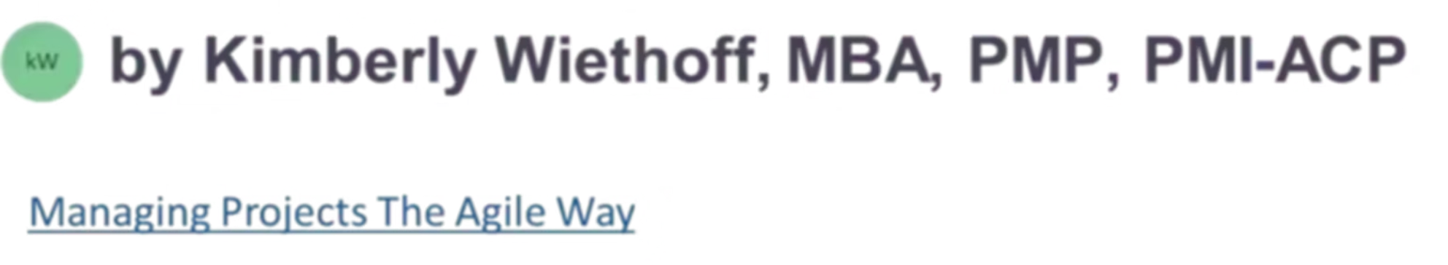
Building Lightweight AI Assistants to Surface Delivery Risks During Sprints
Modern Agile teams move fast—sometimes too fast for traditional risk management to keep up. Discover how AI-driven assistants can automatically detect silent risks and proactively notify teams before problems escalate.
#AgileDelivery #AIDrivenScrum #AIProjectManagement #AzureDevOps #DigitalTransformation #ScrumMasterLife #ManagingProjectsTheAgileWay #AgileLeadership #AIForPMOs #SprintPlanning #AgileRiskManagement

Slide 2

The Challenge of Moving Too Fast
Modern Agile teams operate at unprecedented velocity, but this speed creates blind spots. By the time a stalled user story or dependency issue is discovered, the sprint has already drifted off course. Morale dips, the release train suffers, and teams scramble to recover.
Traditional risk management practices simply can't keep pace with today's delivery tempo. Manual inspection of every user story, commit, blocker, and dependency chain becomes impossible at scale.

Slide 3




What If Risks Could Surface Themselves?
Continuous Scanning
Intelligent Detection
Proactive Alerts
AI monitors sprint activity 24/7, never missing a signal
Pattern recognition identifies risks before they escalate
Real-time notifications deliver insights when teams need them
Lightweight AI assistants make this vision possible today—even without heavy engineering investment. The result is cleaner flow, fewer surprises, and measurably improved team predictability.

Slide 4
Silent Risks That Form Quietly
Stalled Work
Dependency Chains
Clarity Gaps
User stories sit untouched for three days while everyone assumes someone else is handling them
Blocked items create cascading delays that ripple through downstream work
Missing or unclear acceptance criteria leave developers guessing at requirements
Rising Cycle Time
Contributor Overload
Work takes unexpectedly longer to complete, but the trend goes unnoticed until too late
Developers juggle too many WIP items simultaneously, reducing throughput and quality

Slide 5
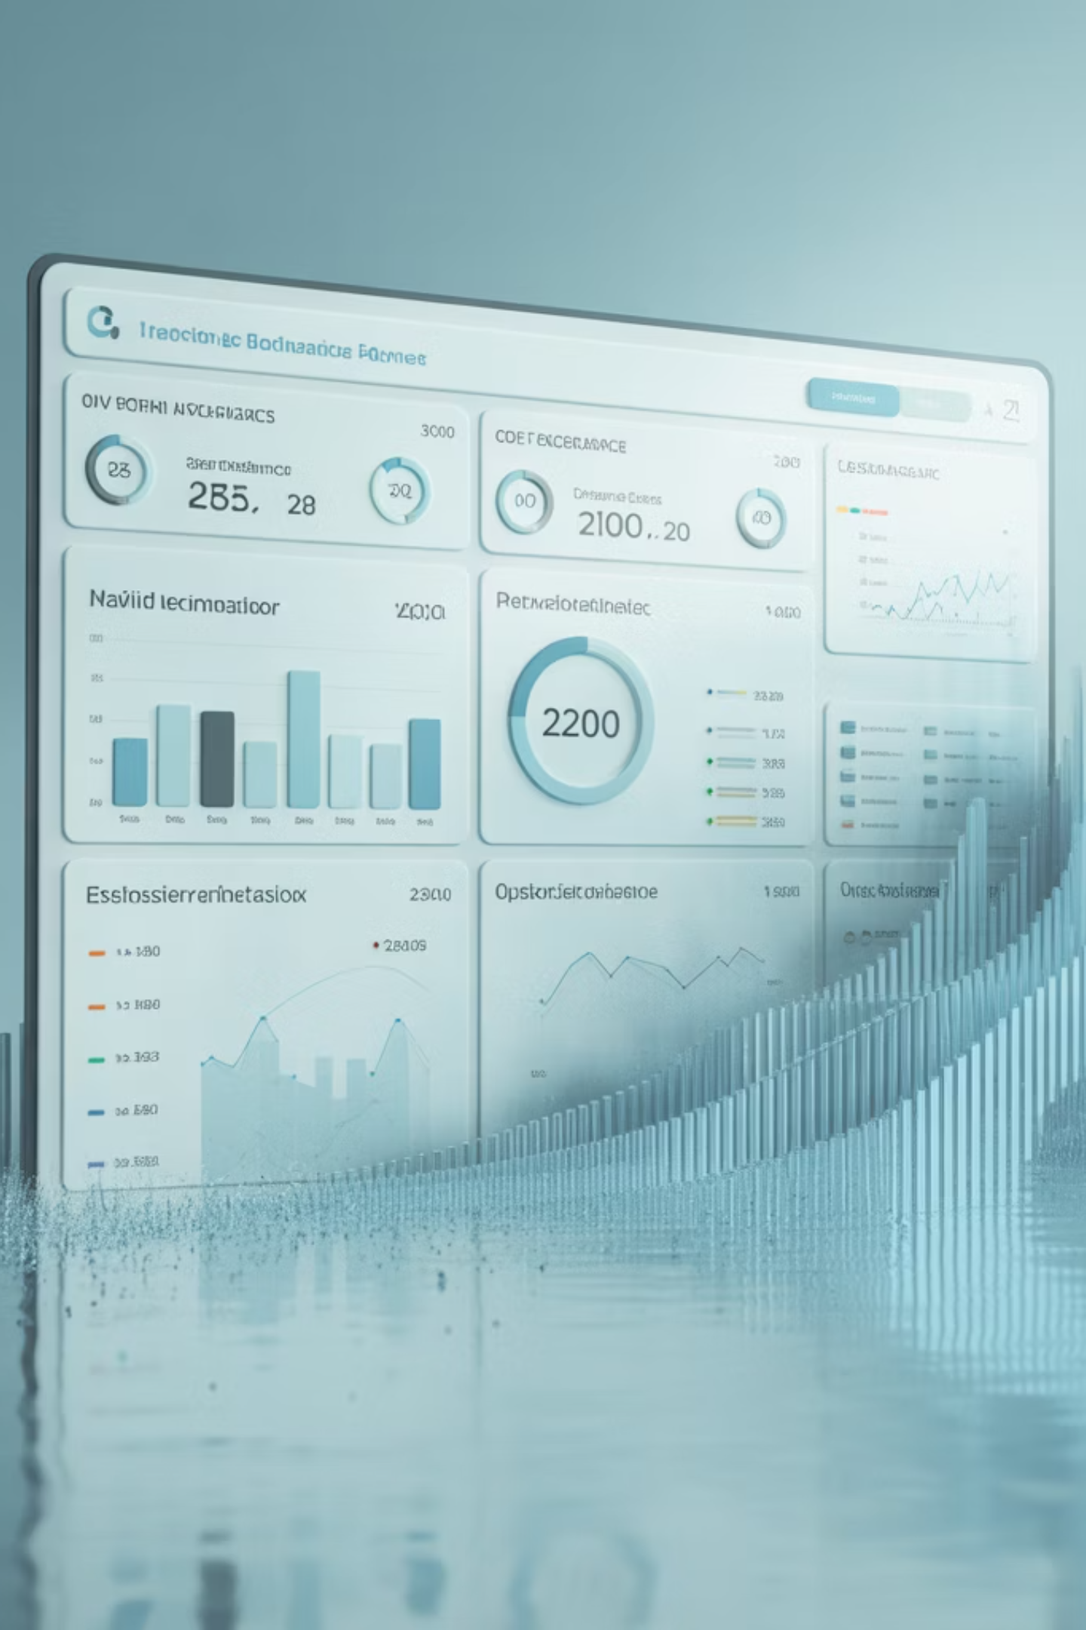
AI Bridges the Gap at Scale
Scrum Masters simply cannot manually inspect every detail across multiple teams and sprints. The volume of information overwhelms even the most dedicated practitioners.
AI assistants continuously listen for signals, analyze patterns across vast datasets, and push insights at precisely the moment teams need them. Instead of looking backward during retrospectives, teams can now course-correct mid-sprint—transforming reactive problem-solving into proactive risk management.

Slide 6





Step 1: Define Your Risk Watchpoints
Begin by identifying exactly which delivery issues demand detection. These become the "watchpoints" your AI assistant continuously monitors throughout every sprint.
Stalled Work
Dependency Conflicts
Clarity Gaps
No status updates or activity for a defined threshold period
Blocked work items or long dependency chains that threaten flow
Missing acceptance criteria or undefined task descriptions
Delivery Drift
WIP Overload
Cycle time trending above historical norms for similar work
Excessive work-in-progress items per team member

Slide 7




Step 2: Connect to Your Delivery Data
AI assistants derive their power from the data they can access. Your assistant needs visibility into the actual work streams, not just status reports.
Azure DevOps Boards
Commit History
Work item states, assignments, and updates
Development activity and code changes from repos
Sprint Analytics
Team Context
Cycle time, throughput, and WIP aging metrics
Backlog refinement fields and availability data
Tools like Power Automate, Azure DevOps REST API, and Copilot Studio make these connections straightforward without requiring heavy custom code development.

Slide 8
Step 3: Build AI Reasoning Logic
Hard Rules
Soft Reasoning
Clear, deterministic triggers that fire when specific conditions are met:
LLM-powered interpretation for nuanced analysis:
"Analyze these user stories and identify clarity gaps"
No update in 3 days = stalled
"What items risk not completing based on current throughput?"
Blocked status >24 hours = dependency risk
Cycle time >2x average = drift warning
"Detect hidden dependencies in this backlog"
WIP count >3 items = overload alert
"Assess requirement completeness"
This hybrid approach keeps risk detection both mathematically accurate and contextually intelligent—combining the precision of automation with human-centered reasoning.

Slide 9
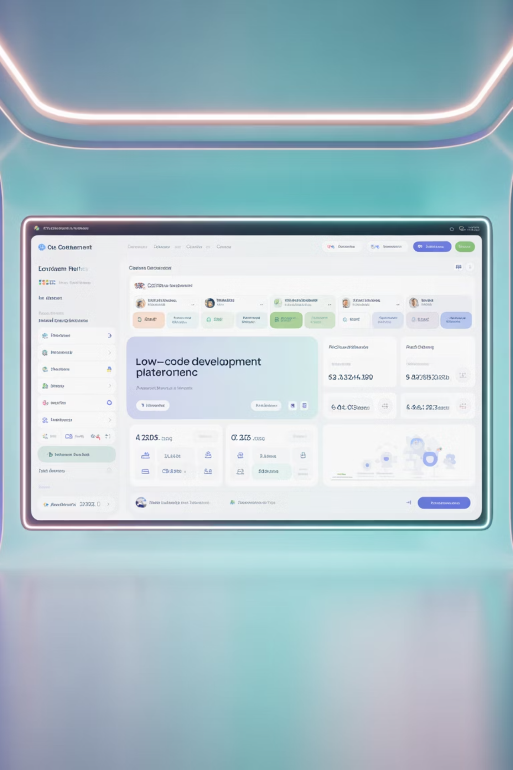
Step 4: Build Your Assistant
Option A: Microsoft Copilot Studio
Option B: Power Automate Flow
Create a conversational bot that team members can query directly: "What are today's sprint risks?" It fetches live data, analyzes with AI, and responds instantly in natural language.
Schedule automated checks that run daily or hourly: Pull ADO items, feed to AI model, generate risk summary, and post results directly in Teams channels.
Option C: Azure Function
Deploy a lightweight Python or JavaScript script that runs on-demand or scheduled, posting intelligent updates to your collaboration tools with minimal infrastructure.
You don't need enterprise-scale engineering resources to unlock transformational value from AI-enhanced risk detection.

Slide 10
Step 5: Apply Risk Scoring
Rather than overwhelming teams with noise, intelligently rank risks based on their potential impact to sprint delivery.
Risk Type
Trigger Condition
Score
Priority
Stalled Work
>3 days no movement
3
Critical
Dependency Conflict
Blocked + dependency chain
2
High
Lack of Clarity
Missing acceptance criteria
1
Medium
Delivery Drift
Cycle time out of range
2
High
WIP Overload
>3 concurrent items
2
High
Your assistant highlights the top 3 critical risks, explains why they matter, suggests specific actions, and identifies who should own the resolution.

Slide 11

Steps 6-7: Deliver Insights & Integrate with Ceremonies
Proactive Notifications
Scrum Ceremony Integration
Push insights directly where teams work:
Daily Standups: AI posts "🛑 2 items stalled more than 3 days"
Daily risk reports at 8 AM in Microsoft Teams
Backlog Refinement: AI reviews stories for clarity and dependency visibility
Instant alerts when blockers exceed 24 hours
Sprint Planning: AI estimates workload vs. capacity and flags overload risks
Pre-planning backlog quality scans
Email summaries for Product Owners
Retrospectives: AI summarizes cycle time trends, blocker frequency, and WIP aging patterns
DevOps dashboard widgets
This closes the feedback loop before issues compound into major problems.

Slide 12




Step 8: Continuously Evolve Your Assistant
Expand Signal Coverage
Tune Thresholds
Add new data sources like test coverage, PR aging, and alert severity as your understanding matures
Adjust sensitivity based on team feedback and false positive rates to maintain signal quality
Enhance Analysis
Scale Capabilities
Deepen AI reasoning capabilities with lessons learned and team-specific context
Extend to multiple teams, portfolios, and increasingly sophisticated risk patterns
Like Agile itself, continuous improvement is the real differentiator. Your AI assistant should grow alongside your team's maturity and evolving needs.

Slide 13

The Measurable Value AI Assistants Deliver
47%
35%
Fewer Mid-Sprint Surprises
Reduced Cycle Times
Teams catch issues early before they derail delivery commitments
Faster identification and resolution of blockers accelerates flow
62%
89%
Improved Predictability
Higher Team Satisfaction
Better visibility enables more accurate sprint forecasting and planning
Reduced stress and firefighting leads to improved morale and retention
AI doesn't replace the Scrum Master—it augments them with superpowers to monitor flow, optimize delivery, and improve team health with unprecedented visibility into delivery dynamics.

Slide 14


The Future of Agile Is Smarter
The future of Agile delivery isn't just about moving faster—it's about moving smarter. AI assistants help teams catch risks in real time, make informed decisions with data-backed insights, and focus energy on the work that truly drives value.
This transformation isn't reserved for organizations with massive budgets or advanced AI expertise. Any team can start building lightweight AI assistants today using M365, Azure DevOps, and a few well-crafted AI prompts.
Agile is ultimately about maintaining sustainable flow. AI has become one of the most powerful tools we have to protect that flow, surface hidden risks, and unlock team potential at unprecedented scale.

