Slide 1
Why Program & Project Managers Need CompTIA Security+
In today's digital landscape, cybersecurity is a business-critical function affecting project execution, risk management, and organizational success. For Program and Project Managers (PMs), the CompTIA Security+ certification can be a game-changer.
kW
by kimberly Wiethoff

Slide 2
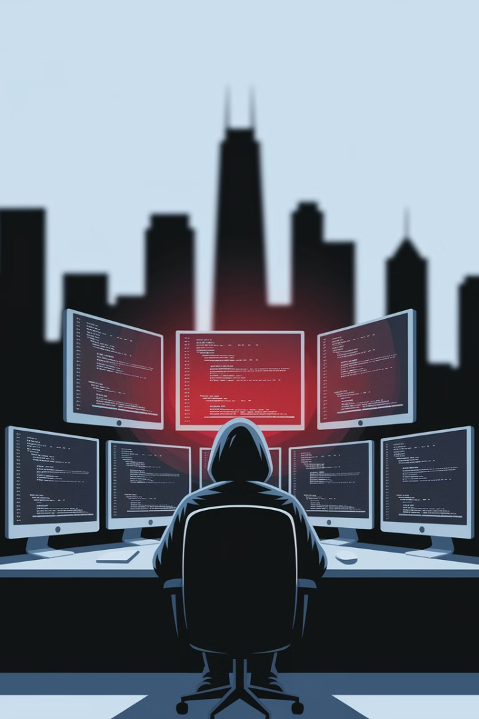
Cybersecurity: A Core Business Risk
1
Data, Technology, and Security Risks
2
Potential Threats
Data breaches, ransomware attacks, and compliance failures can derail projects, increase costs, and damage reputations.
Every project involves these risks, whether deploying software, migrating systems, or managing vendor contracts.
3
PM Responsibility
Security is no longer just IT's job. PMs must factor cybersecurity into planning, risk assessments, and execution.

Slide 3
Security+ Benefits for PMs
Fundamental Understanding
Ask Right Questions
Bridge the Gap
Effectively communicate between IT teams and business stakeholders.
Gain knowledge of security best practices to incorporate into projects from day one.
Proactively address vulnerabilities before they become major issues.

Slide 4
Bridging IT and Business
Communication
Understanding
Compliance
Decision-Making
Effectively communicate cybersecurity requirements to non-technical stakeholders.
Grasp security controls impacting system design, development, and implementation.
Ensure adherence to industry standards like NIST, ISO 27001, GDPR, and HIPAA.
Facilitate risk-based decisions balancing security, cost, and business objectives.

Slide 5
Enhancing Risk Management Expertise
Threat Identification
Risk Assessment
Understand different attack types like phishing, malware, and insider threats.
1
2
Apply structured approaches to mitigate risks.
Compliance
4
Incident Response
Ensure projects adhere to security regulations and industry standards.
3
Know how to react when security incidents impact project timelines.

Slide 6
Competitive Advantage in Career
Differentiation
Stand out from other PMs competing for IT and digital transformation roles.
New Opportunities
Qualify for cybersecurity-related PM roles like Cybersecurity Project Manager.
Higher Earnings
PMs with security expertise often command higher salaries.

Slide 7
Industries Valuing Security Expertise
Finance
Protect sensitive financial data and transactions.
Healthcare
Ensure patient data privacy and regulatory compliance.
Government
Safeguard national security and citizen information.
Cloud Computing
Secure distributed systems and data in the cloud.

Slide 8
Security+ as a Stepping Stone
CISSP
1
For senior-level security leadership roles.
CISM
2
Focuses on risk management and governance.
CRISC
3
Ideal for managing IT and security risks.
PMI-RMP
4
Covers broader enterprise risk, including cybersecurity.
Security+
5
Foundation for advanced certifications.

Slide 9
Who Should Get Security+?
IT Project Managers
1
Enhance expertise in managing technology-driven projects.
2
Cloud Migration Managers
Understand security implications of moving to the cloud.
Application Development PMs
3
Incorporate security into the software development lifecycle.
4
Digital Transformation Leaders
Ensure security is part of organizational change initiatives.

Slide 10
Benefits of Security+ for PMs
Improved Risk Management
Enhanced Expertise
Stronger Leadership
Apply cybersecurity lens to project risks.
Understand and communicate security concepts effectively.
Lead secure, compliant, and successful projects.

Slide 11
Cybersecurity in Project Management
Integration
1
Incorporate security into every phase of project management.
Communication
2
Bridge the gap between technical and non-technical stakeholders.
Risk Mitigation
3
Identify and address security risks proactively.
Compliance
4
Ensure projects meet regulatory and industry standards.

Slide 12
Security+ Exam Overview
1
Attacks, Threats, and Vulnerabilities
Understand various types of cybersecurity threats.
2
Architecture and Design
Learn about secure network and system design principles.
3
Implementation
Explore how to implement security controls.
4
Operations and Incident Response
Understand how to respond to security incidents.

Slide 13
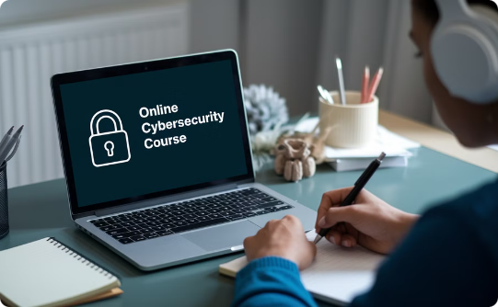
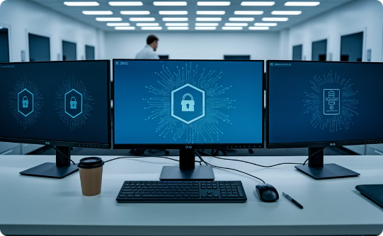
Preparing for Security+
Self-Study
Online Courses
Hands-On Practice
Use CompTIA-approved study materials and practice exams.
Enroll in instructor-led or self-paced online training.
Gain practical experience through labs and simulations.

Slide 14
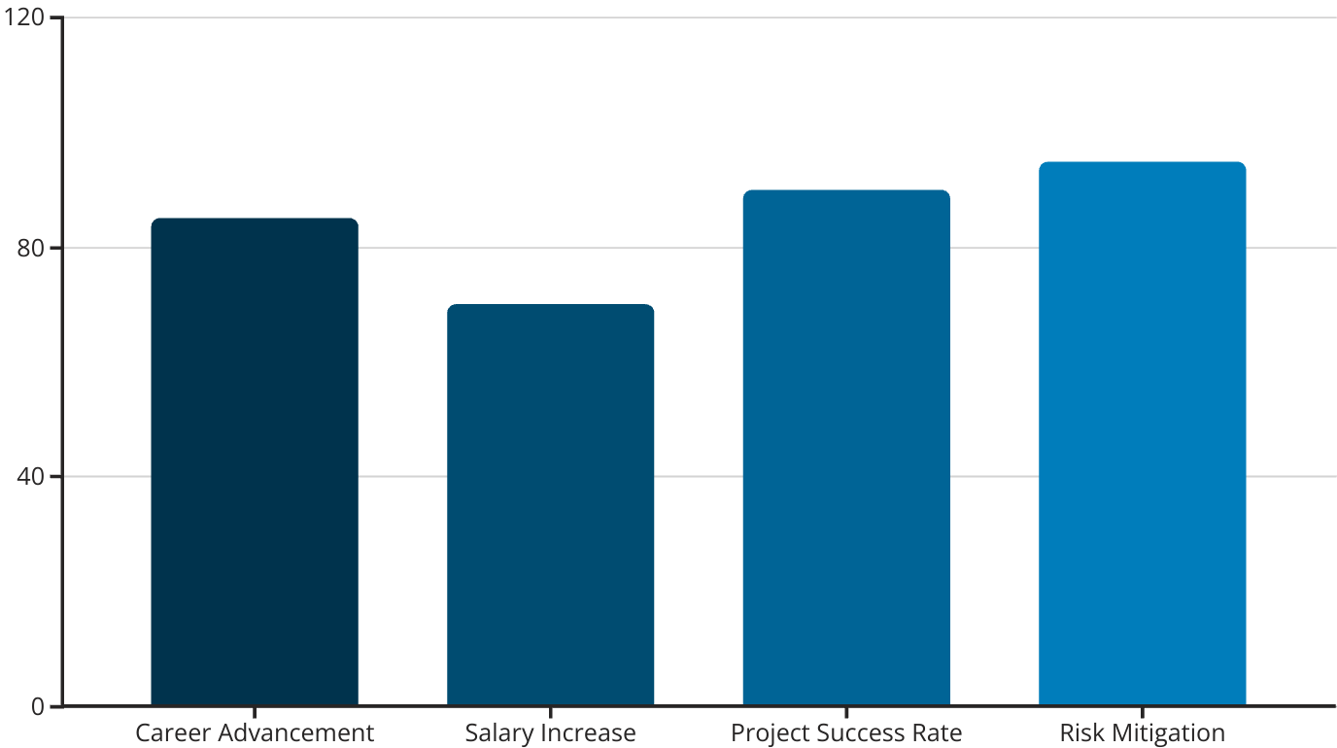
ROI of Security+ for PMs
Security+ certification offers significant benefits for PMs, with the highest impact on risk mitigation and project success rates.

Slide 15
Take Action: Get Security+ Certified
Research
Explore the Security+ exam objectives and requirements.
Plan
Create a study schedule and choose your preparation methods.
Prepare
Study, practice, and gain hands-on experience.
Certify
Schedule and take the Security+ exam.

