Slide 1

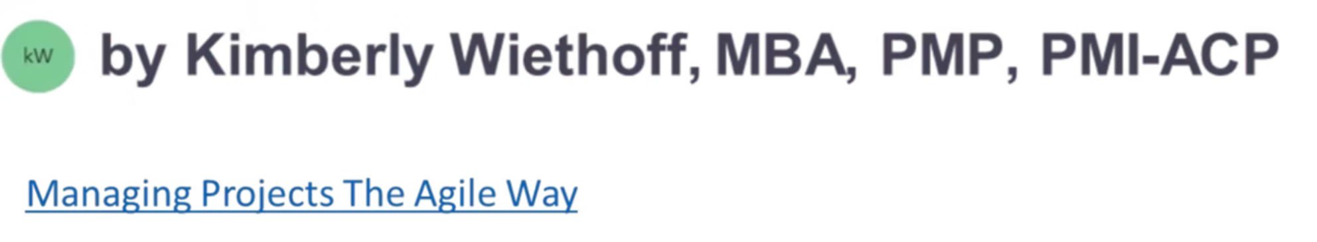
Building Excellence: Managing High-Performing Tech Teams
In today's rapidly evolving technology landscape, leading high-performing application development and infrastructure teams requires a unique blend of technical expertise and leadership skills. This presentation explores proven strategies for IT managers and team leads to build, nurture, and sustain exceptional teams that deliver consistent results.
We'll examine approaches for establishing clear expectations, fostering collaboration, implementing best practices, and developing talent while preventing burnout. These strategies apply across development and infrastructure domains, helping you create an environment where innovation and excellence can flourish.
#HighPerformingTeams #TechLeadership #ITLeadership #AgileLeadership #DevOps #EngineeringLeadership #TeamManagement #DigitalTransformation #LeadershipStrategy #ContinuousImprovement #TeamCulture #EmployeeEngagement #InnovationLeadership #FutureOfWork #PeopleLeadership #ManagingProjectsTheAgileWay

Slide 2

Establishing a Strong Foundation
1
Align with Business Objectives
2
Set Clear Performance Expectations
Connect team goals directly to broader organizational success metrics. When team members understand how their work impacts business outcomes, they develop a stronger sense of purpose and direction.
Define specific project timelines, deliverables, and quality standards. Ambiguity breeds confusion, while clarity creates confidence and accountability within the team.
3
Define Roles and Responsibilities
Establish who owns what within the team structure. Clear role definition prevents overlap, eliminates blind spots, and helps team members understand their unique contribution.

Slide 3
Building a Collaborative Culture
Regular Touchpoints
Collaboration Tools
Knowledge Sharing
Implement daily stand-ups, sprint retrospectives, and team meetings to maintain alignment and surface issues early. These structured interactions create rhythm and ensure no team member works in isolation.
Leverage platforms like Jira for tracking, Confluence for documentation, and Slack or Teams for communication. The right toolset eliminates friction and creates a single source of truth for team information.
Establish processes for documentation, peer reviews, and technical presentations. Creating systems for knowledge transfer prevents information silos and builds collective team expertise.

Slide 4




Empowering Through Autonomy
Decision Authority
Intelligent Risk-Taking
Flexible Execution
Provide team members with defined decision-making power within their domain of expertise. When professionals own decisions, they invest more deeply in outcomes and develop stronger problem-solving skills.
Set clear objectives but allow teams latitude in how they achieve them. This balance between structure and flexibility optimizes for both accountability and innovation.
Create safe spaces for experimentation with a fail-fast, learn-fast mentality. Teams that can try new approaches without fear of punishment innovate more effectively and solve problems more creatively.

Slide 5





Agile Methodologies for Development Teams
Daily Stand-ups
Sprint Planning
Coordinate team activities and address blockers
2
Define clear work increments and prioritize backlog items
1
Development & Testing
Build features and ensure quality through automated testing
3
Retrospective
5
Reflect on process and identify improvements
Sprint Review
4
Demonstrate completed work and gather stakeholder feedback
Agile methodologies provide structure while maintaining flexibility. For application development teams, frameworks like Scrum or Kanban create predictable delivery rhythms while allowing for adaptation as requirements evolve. The iterative nature of these approaches enables faster feedback loops and continuous improvement.

Slide 6




DevOps Practices for Infrastructure Teams
Infrastructure as Code
Implement tools like Terraform or Ansible to define infrastructure through code rather than manual configuration. This approach ensures consistency, enables version control, and facilitates automated provisioning.
CI/CD Automation
Create robust pipelines that automate testing, validation, and deployment of infrastructure changes. Automation reduces human error and accelerates the delivery of stable infrastructure updates.
Monitoring & Observability
Deploy comprehensive monitoring solutions to proactively identify and address issues before they impact users. Modern observability practices provide deep insights into system behavior and performance.

Slide 7





Developing Talent Through Continuous Learning
Innovation & Leadership
1
Leading initiatives and mentoring others
Specialization
2
Deep expertise in key technologies
Certifications & Training
3
Formal education in relevant skills
Cross-Training
4
Understanding adjacent domains
Core Technical Skills
5
Fundamental competencies
A learning culture drives both individual growth and team capability. Support team members in pursuing AWS, Azure, or Kubernetes certifications that align with your technology stack. Establish mentorship programs that pair junior and senior staff for knowledge transfer. Allocate time for exploration of new technologies that could benefit your organization.

Slide 8

Effective Feedback and Recognition Systems
Structured Feedback Cycles
Achievement Recognition
Implement 360-degree feedback processes that gather insights from peers, direct reports, and leadership. Comprehensive feedback provides a more complete picture of performance and identifies blind spots that individuals might miss in self-assessment.
Create formal and informal channels to celebrate team and individual accomplishments. Recognition reinforces desired behaviors and creates positive momentum, especially when tied directly to business impact or team values.
Regular One-on-Ones
Conduct consistent individual meetings focused on career development, performance coaching, and addressing concerns. These dedicated touchpoints build trust and provide space for deeper conversations than team settings allow.

Slide 9

Preventing Burnout and Managing Workload
85%
Developer Stress
Percentage of developers reporting work-related stress in 2022
42%
Task Switching
Productivity loss from constant context switching
20%
Capacity Buffer
Recommended sprint capacity reserve for unexpected work
33%
Burnout Risk
IT professionals at high risk of burnout
Sustainable performance requires deliberate workload management. Monitor team capacity during sprint planning and maintain buffer for unexpected issues. Implement mental health initiatives like no-meeting days or flexible scheduling. Address process bottlenecks quickly to prevent resource overload on specific team members.

Slide 10
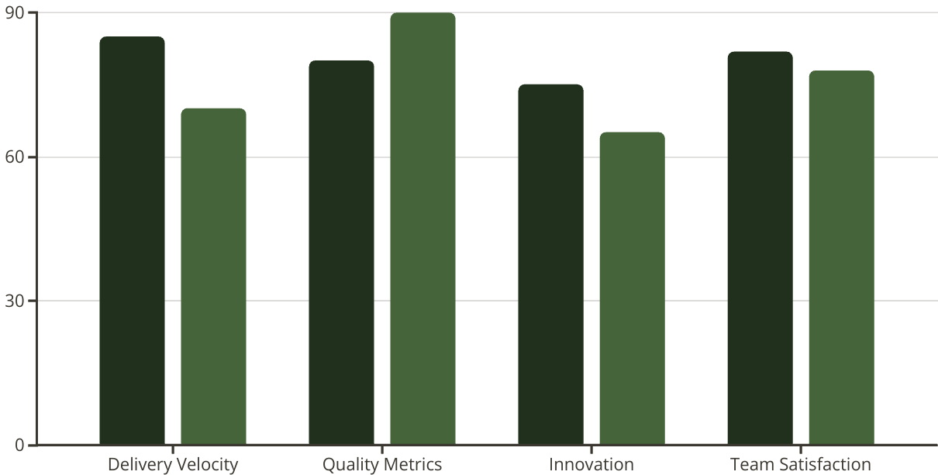
Measuring Team Performance
Dev Teams
Infra Teams
High-performing teams require balanced measurement across multiple dimensions. Track delivery velocity through metrics like story points completed or deployment frequency. Monitor quality through defect rates, uptime, or mean time to recovery. Measure team health through engagement surveys and retention rates.
Different team types may excel in different areas – development teams often show higher velocity and innovation metrics, while infrastructure teams typically lead in stability and quality indicators.

Slide 11

Handling Challenges and Conflicts
1
Early Identification
Watch for warning signs like communication breakdowns, missed deadlines, or quality issues. Creating systems that surface problems early allows for intervention before conflicts escalate or performance deteriorates significantly.
2
Direct Conversation
Address issues promptly through honest, fact-based discussions. Frame conversations around specific behaviors and impact rather than personalities. Maintain privacy and show respect throughout difficult conversations.
3
Collaborative Resolution
Work together to develop action plans with clear ownership and timelines. Document agreements and establish follow-up mechanisms to ensure accountability and track progress toward resolution.
4
Reflection and Learning
After resolving conflicts, examine root causes and implement preventive measures. Create systems that reduce the likelihood of similar issues occurring in the future.

Slide 12
Key Takeaways for Technical Team Leaders
Measure What Matters Most
Evolve Your Approach as Teams Mature
Create Systems, Not Just Solutions
Select metrics that align with business goals and incentivize desired behaviors. Avoid metrics that drive unintended consequences or optimize for the wrong outcomes.
Balance Technical Leadership with People Management
Different team maturity levels require different leadership styles. New teams need more structure and guidance, while established teams benefit from greater autonomy and strategic direction.
Focus on establishing processes and frameworks that enable consistent performance. Individual solutions solve immediate problems, but systems and culture drive long-term excellence.
Your role requires both deep technical understanding and strong interpersonal skills. Technical expertise establishes credibility, while leadership ability unlocks team potential. Neither is sufficient alone.

