Slide 1

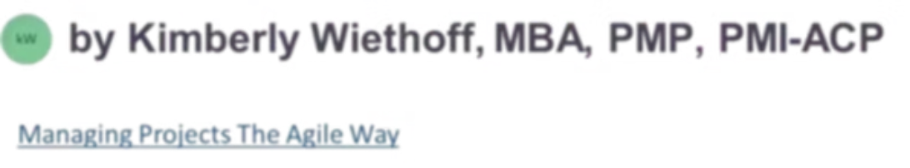
RAG vs. Fine-Tuning: What Business Leaders Need to Know About Enterprise AI
As organizations accelerate their AI transformation initiatives, one critical question is dominating executive discussions, architecture reviews, and digital strategy meetings: Should we use Retrieval-Augmented Generation (RAG) or Fine-Tuning? Understanding the difference is not just a technical exercise — it is a strategic imperative that shapes cost, speed, governance, and the ultimate success of your enterprise AI program.
#AI #GenerativeAI #RAG #FineTuning #EnterpriseAI #ArtificialIntelligence #MachineLearning #DigitalTransformation #AITransformation #KnowledgeManagement #LLM #ResponsibleAI #ProjectManagement #PMO #TechnologyLeadership #OperationalExcellence #FutureOfWork #Innovation #CloudComputing #BusinessTransformation #AIOps #Leadership #DataStrategy #AIGovernance
ENTERPRISE AI STRATEGY
DECISION GUIDE

Slide 2

The Stakes of Choosing the Wrong Approach
For many business leaders, RAG and fine-tuning sound interchangeable. In reality, they solve very different problems — and choosing the wrong one carries real consequences for your organization.
💸 Unnecessary Costs
🐢 Slower Implementation
⚙️ Operational Complexity
Expensive model retraining cycles that could have been avoided with the right architecture from the start.
Delayed deployment timelines as teams struggle to adapt mismatched AI approaches to enterprise requirements.
Increased infrastructure overhead and technical debt that compounds over time and slows future innovation.
🔒 Governance Challenges
📉 Poor AI Adoption
Reduced auditability and traceability, creating compliance risk especially in regulated industries.
Low workforce confidence in AI outputs when systems lack access to current, trusted organizational knowledge.
The good news: organizations do not have to choose exclusively. But knowing when each approach delivers value is essential for scalable, trustworthy enterprise AI.

Slide 3
The Enterprise AI Challenge
Generic AI systems were not built for the complexity of enterprise environments. Organizations need AI that goes far beyond answering general questions — they need systems that understand their business, protect their data, and earn the trust of their workforce.
What Enterprises Are Trying to Solve
What Enterprise AI Must Deliver
Improve productivity and reduce manual work
Enhance decision-making with real-time insight
Scale organizational knowledge across teams
Automate operational workflows efficiently
Accelerate project delivery and execution
Access to current, accurate information
Deep understanding of business context
Governance and auditability built in
Dramatically reduced hallucinations
Protection of sensitive and proprietary data
Explainable, traceable responses
This is precisely where RAG and fine-tuning enter the strategic conversation — each addressing a distinct dimension of enterprise AI readiness.

Slide 4

What Is RAG?
Retrieval-Augmented Generation (RAG) is an architecture that combines information retrieval with generative AI. Instead of relying solely on what the model learned during training, a RAG system dynamically retrieves relevant information from enterprise data sources before generating a response.
Retrieve
Generate
This architecture allows AI systems to tap into internal documentation, policies, regulatory guidance, project artifacts, and operational procedures — all in real time, without any model retraining. Traditional AI answers from memory. RAG-enabled AI answers after reviewing trusted enterprise information.

Slide 5





What Is Fine-Tuning?
Fine-tuning is the process of retraining or adapting a pre-trained AI model using specialized datasets. Rather than adding external retrieval capabilities, fine-tuning changes the model's internal behavior — how it thinks, writes, and responds.
Domain Terminology
Formatting Consistency
Teach the model specialized vocabulary, acronyms, and domain-specific language unique to your industry or organization.
Enforce consistent output structures — reports, summaries, classifications — that align with organizational standards.
Tone & Style
Task Optimization
Calibrate the model's voice — formal, empathetic, concise — to match brand guidelines or professional expectations.
Sharpen performance on specific high-value tasks like contract drafting, coding, or medical summarization.
Fine-tuning modifies the model's internal behavior rather than retrieving live enterprise knowledge. It changes how the model responds — not what it knows.

Slide 6
The Simplest Way to Understand the Difference
RAG = The Informed Employee
Fine-Tuning = The Trained Expert
RAG is like giving an employee access to a fully stocked library before answering questions. They can research, verify facts, reference current documents, and retrieve the latest organizational knowledge before responding. Their answers are grounded, traceable, and current.
Fine-tuning is like putting an employee through specialized training so they think and communicate differently. They develop industry expertise, follow preferred formats, and handle specialized tasks with precision — but they rely on learned behavior rather than live retrieval.
Both are valuable. But the employee with library access will always have the latest information. The trained expert may be highly skilled — but working from potentially outdated knowledge.

Slide 7
RAG vs. Fine-Tuning: Side-by-Side Comparison
Understanding these capability differences is foundational to making the right architectural decision for your enterprise AI investments.
Capability
RAG
Fine-Tuning
Access current information
Excellent
Poor
Uses enterprise documents
Excellent
Limited
Supports source citations
Excellent
Weak
Reduces hallucinations
Strong
Moderate
Easy to update
Very Easy
Difficult
Requires model retraining
No
Yes
Improves formatting & style
Limited
Excellent
Governance & traceability
Strong
Limited
Best for knowledge retrieval
Excellent
Weak
Best for specialized behavior
Moderate
Excellent

Slide 8

Why Many Enterprises Start with RAG
One of the most persistent misconceptions in AI transformation is that fine-tuning is required to make AI enterprise-ready. In reality, most enterprise challenges are knowledge problems — not model behavior problems.
The Real Enterprise Challenge
Enterprise Knowledge Is Dynamic
Organizations need AI systems that can surface current policies, retrieve operational procedures, search project documentation, and reference regulatory guidance. These are retrieval problems — and RAG solves them extremely well, without the cost or complexity of retraining.
Policies evolve and regulations update frequently
Procedures change as operations scale
Projects shift direction and produce new artifacts
Operational data grows daily across systems
If this knowledge were embedded in a fine-tuned model, organizations would face expensive, time-consuming, operationally difficult retraining cycles just to keep AI current. RAG eliminates this entirely by retrieving information in real time.
RAG delivers faster business value, lower operational risk, and easier governance than fine-tuning alone — making it the preferred starting point for most enterprise AI programs.

Slide 9
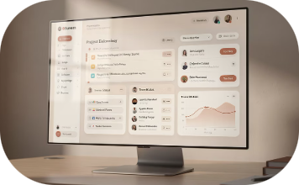



The Business Case for RAG
For most enterprises, RAG delivers faster ROI because it directly solves immediate operational problems — without requiring large-scale model retraining or significant data science investment.
PMO Copilots
Regulatory Guidance
Enterprise Search
Operational Assistants
Instant access to lessons learned, risk registers, governance policies, and portfolio reporting — all grounded in current project documentation.
AI assistants that surface the latest FDA guidance, compliance frameworks, and regulatory procedures in real time without manual research.
Intelligent search copilots that retrieve accurate, cited answers from across SharePoint repositories, knowledge bases, and internal documentation.
AI-powered support systems that access current troubleshooting guides, policy documents, and operational procedures to resolve issues faster.

Slide 10

The Business Case for Fine-Tuning
Fine-tuning becomes strategically valuable when organizations need AI systems that go beyond knowledge retrieval — requiring highly specialized outputs, consistent formatting, or deeply optimized task performance.
Legal & Contract Drafting
Healthcare & Medical Coding
Train models to follow precise contract formatting conventions, apply jurisdiction-specific language patterns, and maintain consistent legal drafting styles across high-stakes documents.
Optimize models for clinical summarization patterns, ICD coding workflows, and medical transcription accuracy — where specialized terminology and format matter enormously.
Insurance & Financial Analysis
Customer Experience
Fine-tune for claim categorization, financial analysis formatting, and industry-specific reasoning patterns that require consistent, structured outputs at scale.
Calibrate AI tone, empathy levels, and escalation classification to match brand voice standards and deliver optimized customer interaction outcomes consistently.
Fine-tuning is often most effective when layered on top of strong retrieval architectures — after RAG has been established as the knowledge foundation.

Slide 11

The Rise of Hybrid AI Architectures
The future is not RAG versus fine-tuning.
As enterprise AI programs mature, leading organizations are discovering that the most powerful systems combine both approaches. Fine-tuning optimizes how the model behaves; RAG ensures it always has access to the most current, trusted organizational knowledge.
RAG Layer
Fine-Tuning Layer
Real-time retrieval from enterprise knowledge sources — policies, procedures, documentation — ensuring responses are always grounded in current, authoritative information.
Domain-specific behavioral optimization — specialized terminology, output formatting, and task-specific performance — layered on top of the retrieval foundation.
Hybrid Result
AI systems that are context-aware, behaviorally optimized, knowledge-driven, and enterprise-ready — capable of scaling across complex organizational environments.

Slide 12
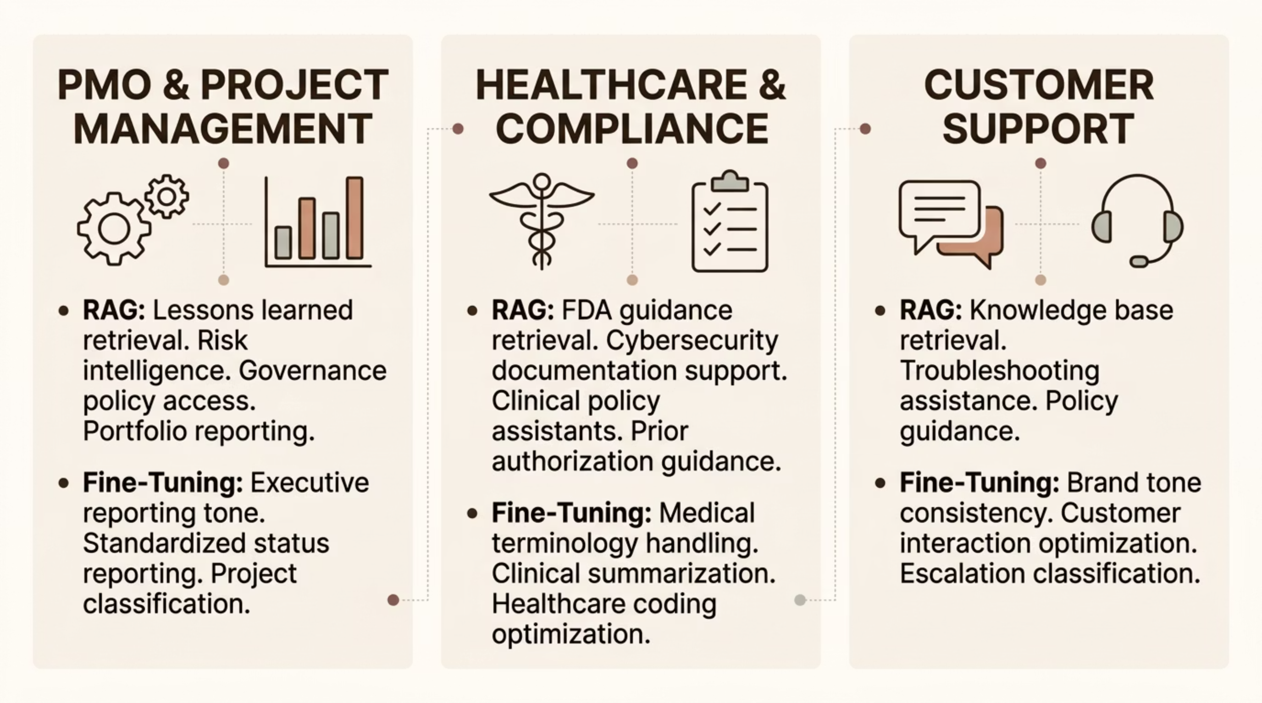

Enterprise Use Cases Across Industries
Both RAG and fine-tuning deliver measurable value across enterprise functions. Understanding which approach applies to your specific use cases accelerates deployment and reduces implementation risk.

Slide 13

Governance: A Critical Differentiator
As enterprise AI governance frameworks become mandatory — driven by regulatory requirements, board oversight, and workforce trust — the structural differences between RAG and fine-tuning take on significant strategic importance.
Why RAG Supports Stronger Governance
Fine-Tuning Governance Challenges
Source citations — every response links to the document it came from
Traceability — audit trails show exactly what information was retrieved
Access control — document-level permissions enforce data boundaries
Auditability — compliance teams can verify AI reasoning transparently
Updateability — remove outdated or sensitive content without retraining
When knowledge is embedded inside the model itself, it becomes difficult to:
Identify the source of a specific output
Remove outdated or incorrect information
Enforce data access boundaries
Satisfy regulatory audit requirements
For highly regulated industries — healthcare, financial services, government — this distinction can determine whether an AI system is deployable at all.

Slide 14
Common Enterprise AI Mistakes to Avoid
Organizations that struggle with AI transformation often share a common set of avoidable mistakes. Recognizing these patterns early can save significant time, budget, and organizational credibility.
Mistake #1: Fine-Tuning Too Early
Mistake #2: Ignoring Knowledge Governance
Mistake #3: Treating AI as a Technology Project Only
Many organizations attempt fine-tuning before solving foundational problems in data quality, governance, retrieval architecture, and knowledge management. Fine-tuning amplifies what already exists — including gaps and errors. Establish your knowledge foundation first.
AI systems are only as trustworthy as the organizational knowledge they access. Poor documentation, outdated content, and ungoverned knowledge bases lead directly to poor AI outputs — regardless of how sophisticated the model is. Invest in your knowledge layer.
Successful AI transformation requires far more than engineering. Change management, executive alignment, workforce readiness, governance frameworks, and operational integration are equally critical to sustainable AI adoption at scale.

Slide 15
The Future of Enterprise AI
The enterprise AI landscape is shifting decisively away from generic chatbots toward purpose-built, knowledge-driven systems that operate within trusted organizational boundaries.
Generic Chatbots
1
Broad language models with no enterprise context, poor governance, and high hallucination risk
2
RAG-Powered Assistants
Context-aware copilots grounded in current enterprise knowledge with strong traceability and governance
Hybrid AI Systems
3
Fine-tuned behavioral models layered on robust RAG architectures — optimized for both knowledge and performance
4
Autonomous Enterprise AI
Fully integrated, governance-compliant AI agents driving knowledge-based automation across the enterprise
RAG is becoming foundational because it solves the core enterprise challenge: giving AI secure, real-time access to trusted organizational knowledge. Fine-tuning remains powerful — but most effective when layered on top of strong retrieval architectures.

Slide 16
Final Thoughts: Choosing the Right Strategy
The conversation around enterprise AI is evolving quickly — but one thing is becoming increasingly clear: RAG and fine-tuning solve fundamentally different problems. The smartest enterprise AI strategy is not choosing one over the other — it is knowing precisely when each capability creates the greatest business value.
RAG Helps AI Systems…
Fine-Tuning Helps AI Systems…
Access current, authoritative knowledge
Retrieve trusted enterprise information in real time
Reduce hallucinations through grounded responses
Improve explainability and auditability
Enable governance at scale
Improve specialized behavioral performance
Optimize formatting and output consistency
Learn domain-specific patterns and terminology
Deliver precise task-specific outputs
Align with industry and brand standards
Organizations that successfully combine governance, retrieval, behavioral optimization, and trusted organizational knowledge will be best positioned to scale AI transformation — and win the enterprise AI race.

