Slide 1
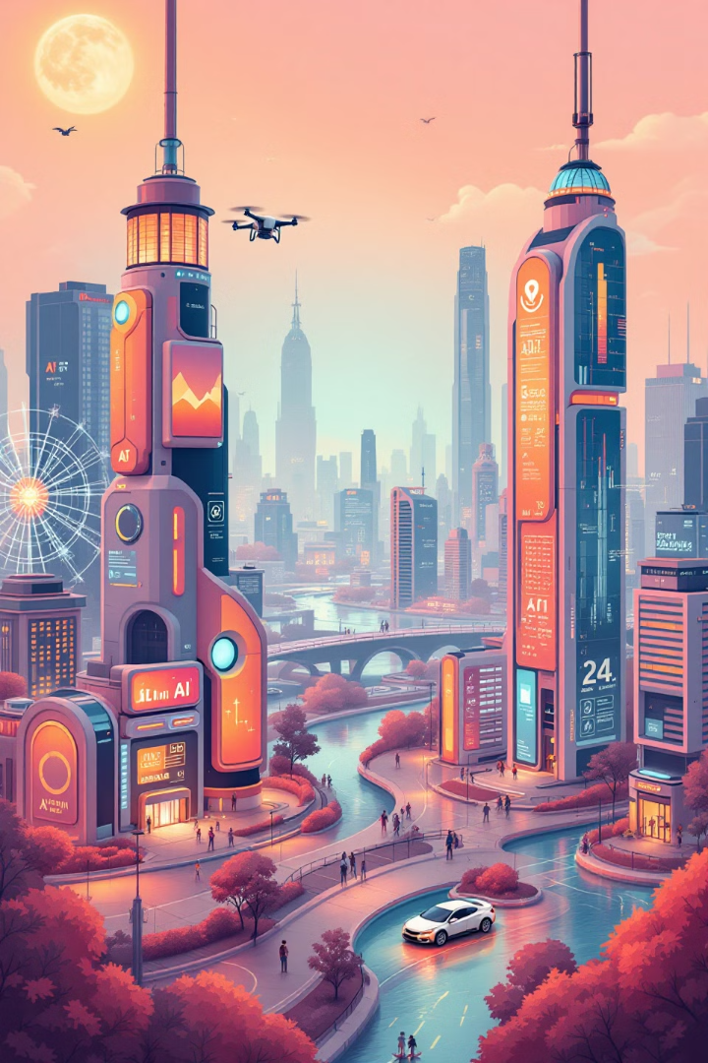
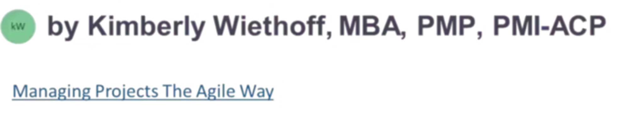
Harnessing the Power of AI in Project Management
In today's fast-paced world, artificial intelligence (AI) has moved beyond a buzzword into a driving force reshaping industries. For project managers, AI offers a toolkit that improves decision-making, boosts productivity, and enhances the overall success of projects. Leveraging AI in project management allows organizations to stay ahead in an increasingly competitive landscape. This presentation will explore how AI is transforming project management and how it can help professionals deliver projects with greater efficiency and precision.
#AIinProjectManagement #DigitalTransformation #FutureOfWork #ProjectManagement #AgileLeadership #PMI #PMP #PMIACP #PredictiveAnalytics #RiskManagement #Automation #AIDrivenPM #EnterpriseTransformation #Leadership #Innovation #TechLeadership #ManagingProjectsTheAgileWay

Slide 2
Automating Routine Tasks
Saving Time and Resources
Freeing Up Valuable Time
Project management involves several repetitive tasks such as scheduling, sending reminders, and updating status reports. AI-powered tools can automate these routine functions, allowing project managers to focus on more strategic activities. For instance, AI can automatically update project schedules based on real-time data, generate status reports from various systems without human intervention, and send automatic reminders for upcoming deadlines. By automating these time-consuming tasks, project managers can spend more time on problem-solving, decision-making, and team leadership.
Imagine a scenario where AI handles the mundane tasks, while project managers concentrate on high-level strategy and collaboration. This shift can significantly impact project efficiency and team morale. It also allows project managers to dedicate more time to fostering innovation and creativity, leading to more impactful project outcomes.

Slide 3
Improved Risk Management
1
Proactive Risk Mitigation
2
Data-Driven Insights
3
Minimizing Potential Setbacks
Risk management is an essential component of any project. Identifying potential risks early can save time and resources. AI tools use historical project data and predictive analytics to forecast potential risks, helping project managers proactively mitigate them.
AI empowers project managers to predict project delays based on current progress and historical trends, identify potential resource shortages or budget overruns, and analyze large datasets to detect patterns that may indicate upcoming issues. These AI-driven insights allow managers to take preventative measures before small problems turn into major setbacks.
By anticipating and addressing potential risks before they materialize, AI helps project managers stay ahead of the curve. It allows for a more proactive approach, reducing the chances of unexpected delays, budget overruns, and other project disruptions.

Slide 4



Enhanced Decision-Making with Predictive Analytics
Informed Decision-Making
Optimal Project Planning
Reduced Uncertainty
One of the most significant contributions of AI in project management is predictive analytics. AI tools analyze historical project data, team performance, market trends, and other relevant factors to provide insights that aid decision-making.
For example, AI can recommend optimal project timelines by analyzing previous similar projects. It can identify the most suitable team members based on past performance and skills, improving resource allocation. Predictive analytics can also help with cost estimation, improving budget accuracy and avoiding overruns.
These data-driven insights lead to more informed decisions, enabling project managers to plan better and reduce uncertainties. AI becomes a valuable tool for making more accurate and effective decisions, leading to greater project success.

Slide 5
Smarter Resource Allocation
Maximizing Efficiency
Effective resource management is critical for project success. AI can analyze resource availability, skills, and project requirements to recommend optimal resource allocation. AI tools take into account factors like team member workloads, deadlines, and skills to suggest the best fit for tasks.
Streamlined Resource Management
By automating resource allocation, AI removes the manual effort involved in assigning tasks and managing workloads. It empowers project managers to focus on more strategic activities while ensuring optimal resource utilization, which leads to better project outcomes.
1
2
3
AI-Powered Optimization
AI can also monitor team performance and suggest adjustments to improve efficiency, ensuring that the right resources are working on the right tasks at the right time. This intelligent approach allows project managers to allocate resources strategically, ensuring that the right people are assigned to the most impactful tasks.

Slide 6



Real-Time Data and Insights
Data-Driven Decisions
Improved Communication
Proactive Problem-Solving
AI-powered dashboards provide real-time updates and insights, allowing project managers to monitor progress and make data-driven decisions quickly. These dashboards pull data from multiple sources and display critical metrics such as project health, resource utilization, and progress against deadlines.
With real-time data at their fingertips, project managers can spot potential issues before they escalate, adjust project plans on the fly to keep things on track, and improve communication and transparency across teams. AI provides a unified view of project progress and helps ensure that everyone is aligned on the latest information.
AI dashboards help project managers identify and address potential problems early, minimizing delays and ensuring project success. They provide a comprehensive picture of the project status, enabling managers to make timely interventions and keep things on track.

Slide 7
AI-Driven Communication and Collaboration
Enhanced Team Interaction
Improved Team Dynamics
Boosting Collaboration
In large or remote teams, effective communication is a common challenge. AI tools can streamline communication and collaboration by providing intelligent chatbots, virtual assistants, and collaboration platforms that improve team interaction.
AI-powered tools can answer common project-related questions, schedule meetings based on team availability, and facilitate cross-functional collaboration by suggesting relevant documents or previous projects based on the topic of discussion. By streamlining communication, AI enables teams to collaborate more effectively, ultimately improving project outcomes.
AI-powered collaboration platforms can break down communication barriers, fostering seamless collaboration between teams, regardless of their location. This can enhance team dynamics, lead to more efficient problem-solving, and ultimately contribute to a more cohesive and productive project environment.

Slide 8

Conclusion
AI is not a replacement for project managers but a powerful ally that can enhance their capabilities. By automating routine tasks, predicting risks, improving decision-making, and optimizing resource allocation, AI empowers project managers to focus on what they do best—leading teams and delivering successful projects. As AI continues to evolve, project managers who embrace its potential will be better equipped to navigate the complexities of modern projects, driving innovation and achieving greater success.

