Slide 1
PgMP® vs. PfMP®: Choose Your Strategic Path
Elevate your project management career with PMI's advanced certifications. Discover which path aligns with your leadership goals and organizational impact.
kW
by Kimberly Wiethoff

Slide 2
Advanced PMI Certifications Overview
Program Management Professional (PgMP®)
Portfolio Management Professional (PfMP®)
Validates expertise in managing multiple related projects as coordinated programs.
Certifies ability to manage collections of programs and projects.
Focuses on execution with strategic alignment.
Emphasizes enterprise-level strategy and investment decisions.

Slide 3
Core Certification Purposes
PgMP® Purpose
PfMP® Purpose
For professionals managing multiple related projects to achieve specific business outcomes.
For executives overseeing collections of programs and operations.
Ensures strategic investments deliver maximum business value at enterprise scale.
Bridges the gap between project execution and organizational strategy.
Career Impact
Both certifications validate strategic leadership beyond project execution.
They demonstrate ability to drive broader business impact in complex environments.

Slide 4
Tactical vs. Strategic Leadership
Focus Area
PgMP®
PfMP®
Primary Scope
Program execution and benefit realization
Strategic investment decisions
Ideal Candidate
Senior program managers
Executive leaders, portfolio directors
Decision Level
Program integration
Enterprise-level alignment

Slide 5
PgMP® Core Domains
Benefits Management
Strategy Alignment
Ensuring programs deliver measurable business value.
Connecting program outcomes with organizational objectives.
Governance
Establishing decision frameworks and oversight processes.
Stakeholder Engagement
Managing relationships across program boundaries.
Life Cycle Management
Guiding programs through initiation to closure phases.

Slide 6
PfMP® Core Domains
Governance
Strategic Alignment
Optimizing resource allocation across investments
Ensuring investments support organizational strategy
Portfolio Performance
Measuring value delivery against strategic objectives
Communications
Risk Management
Engaging stakeholders at enterprise level
Balancing risk-return across the investment mix

Slide 7
Exam Structure Comparison
170
4
Questions
Hours
Both exams have the same number of multiple-choice questions.
Both allow four hours for completion.
60
$800
PDUs
Member Cost
Required every three years for renewal of either certification.
Same price for PMI members ($1,000 for non-members).

Slide 8
PgMP® Eligibility Requirements
Education Background
Four-year degree or secondary degree (high school diploma, associate's)
Project Experience
4 years of project management experience required
Program Experience
4 years with degree, 7 years with secondary education

Slide 9
PfMP® Eligibility Requirements
Business Experience
8 years of professional business experience regardless of education level.
Demonstrates broad understanding of organizational operations and strategy.
Portfolio Management Experience
4 years with four-year degree, 7 years with secondary education.
Must show direct responsibility for portfolio decisions and outcomes.
Panel Review
Experience verification by PMI panel before exam eligibility.
Thorough assessment of portfolio management capabilities and impact.

Slide 10
Certification Renewal Process
Earn Certification
Pursue Development
Pass examination and complete experience verification
Participate in ongoing professional learning
Renew Every 3 Years
Track PDUs
Submit renewal application with PDU documentation
Document 60 Professional Development Units

Slide 11
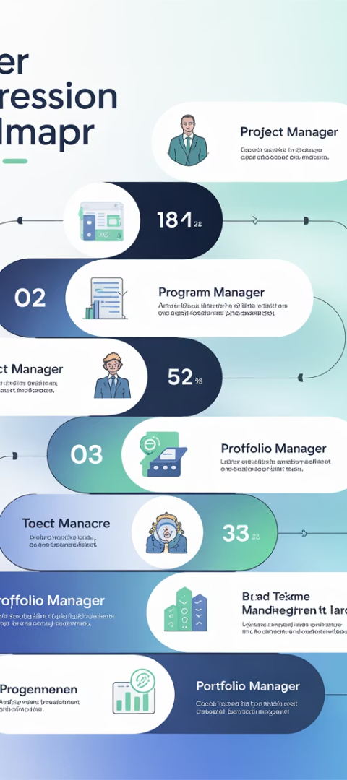
Career Path Alignment
Project Manager
Focus on delivering individual projects successfully.
Starting point for advanced certification paths.
Program Manager (PgMP®)
Coordinate multiple related projects toward specific outcomes.
Bridge between execution and organizational strategy.
Portfolio Manager (PfMP®)
Oversee collection of programs and projects.
Ensure strategic alignment of all investments.
Executive Leadership
Drive organizational strategy and enterprise decisions.
Leverage portfolio management expertise at highest levels.

Slide 12
Which Certification Fits Your Goals?
Choose PgMP® if...
Choose PfMP® if...
Consider Both if...
You manage multiple related projects as coordinated programs.
You oversee enterprise investments across multiple programs.
You're in a PMO leadership role with diverse responsibilities.
You focus on execution and program governance.
You make strategic resource allocation decisions.
Your organization needs both program and portfolio expertise.
You drive benefit realization through integrated project delivery.
You're moving from execution to executive leadership.
You want maximum flexibility in your career progression.

Slide 13
Industry Recognition & Value
PgMP®
PfMP®
Both certifications deliver strong professional benefits. PfMP® typically yields higher salary premiums and executive recognition, while PgMP® offers more numerous job opportunities.

Slide 14
Next Steps in Your Certification Journey
Assess Your Experience
Review your qualifications against PMI requirements for both certifications.
Align With Career Goals
Determine whether program or portfolio management better matches your path.
Prepare For Success
Invest in study materials and training specific to your chosen certification.
Apply And Achieve
Submit your application, complete the panel review, and pass the exam.

Slide 15
Final Thoughts
Both PgMP® and PfMP® are prestigious credentials that demonstrate your ability to lead beyond the project level. If your career is shifting toward strategic decision-making and investment oversight, PfMP® may be the better fit. If your focus is still on execution through coordinated programs, then PgMP® is the logical next step.
Either way, earning one of these certifications will distinguish you as a leader who can drive organizational success—not just complete projects.

