Slide 1

Mastering Daily Stand-Ups Across Time Zones
Synchronizing Agile practices when your team spans continents presents unique challenges. This guide offers practical solutions for maintaining effective daily stand-ups regardless of geographic distribution.
kW
by Kimberly Wiethoff

Slide 2

The Global Team Challenge
Time Zone Gaps
Communication Barriers
Team members may be separated by 8+ hours, making simultaneous meetings difficult.
Different working hours can delay critical information sharing and problem solving.
Team Cohesion
Distance makes building relationships and maintaining team spirit challenging.

Slide 3
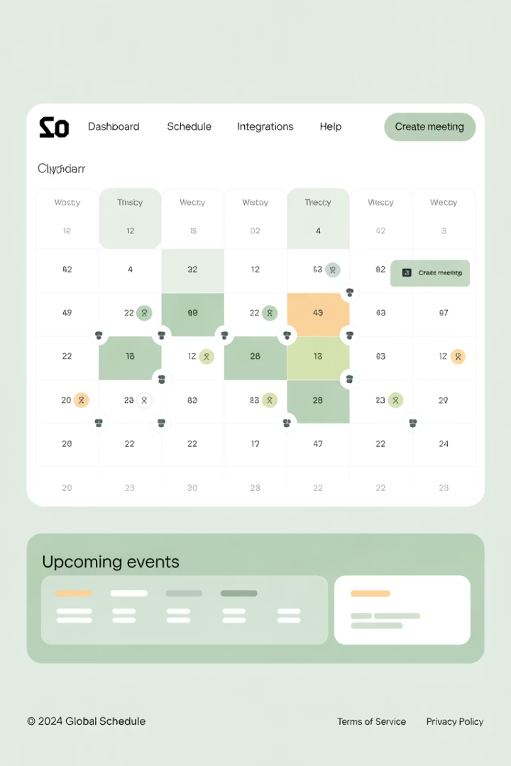
Rotating Schedule Strategy
Share the Burden
Rotate meeting times weekly or bi-weekly. This prevents one region from always working outside normal hours.
Create Rotation Calendar
Establish a predictable pattern: Week 1 – 8 AM PST, Week 2 – 8 AM GMT, Week 3 – 8 AM IST.
Communicate Schedule Clearly
Use team calendars with time zone conversion to avoid confusion about meeting times.

Slide 4



Asynchronous Stand-Ups
Post Updates
Review Others
Follow Up
Team members share daily progress in dedicated channels at their convenience.
Everyone reads updates from teammates when they start their day.
Address questions or blockers via thread comments or direct messages.

Slide 5




Technology Solutions
Stand-Up Bots
Dedicated Slack Channels
Geekbot, Standuply, and similar tools automate the collection of stand-up updates.
Create threads specifically for daily updates that persist for review.
Wiki Pages
Video Snippets
Use Confluence or similar tools to document daily progress for team visibility.
Allow team members to record short video updates for more personal connection.

Slide 6
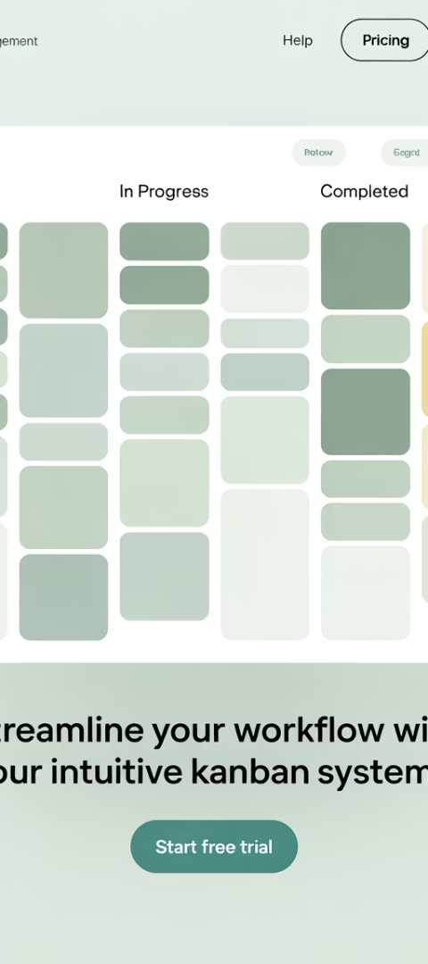
Standardized Format
Question
Purpose
Example
What did you do yesterday?
Tracks progress
Completed user login feature
What will you do today?
Sets expectations
Starting password reset function
Any blockers?
Identifies issues
Waiting for API credentials

Slide 7
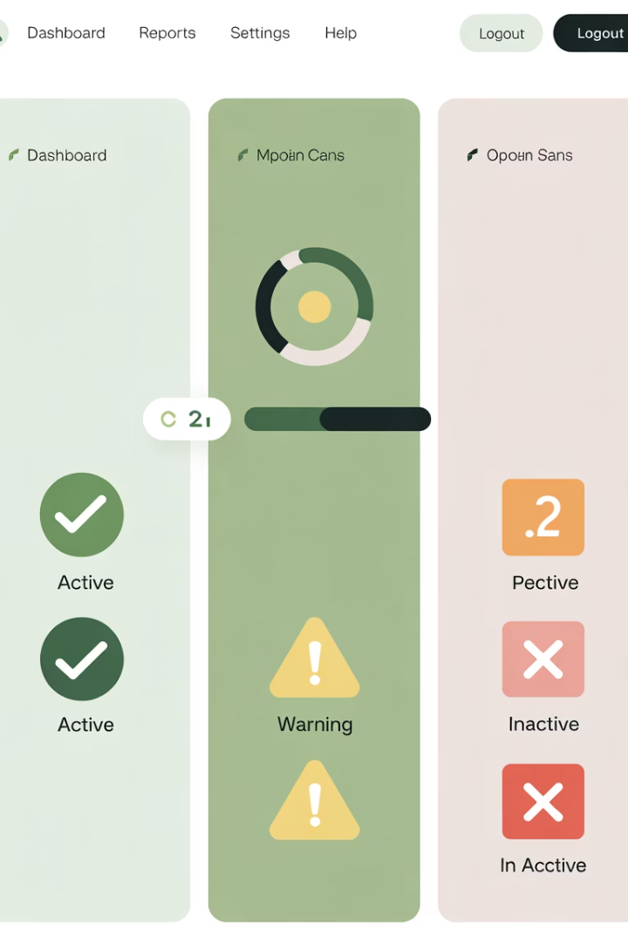




Visual Status Indicators
✅ On Track
⚠️ At Risk
Use green indicators or checkmark emojis for tasks progressing normally.
Use yellow indicators for tasks that may face delays or complications.
🛑 Blocked
❓ Need Help
Use red indicators for tasks that cannot proceed without intervention.
Indicate when a team member requires assistance to proceed.

Slide 8








The Summary Role
Daily Collection
Distill Key Points
Gather all stand-up updates from synchronous and asynchronous sources
Identify the essential information and actionable insights
Distribute Insights
Create Summary
Share with the team and relevant stakeholders
Document the team's progress, blockers, and next steps

Slide 9






Maintaining Daily Momentum
Team Alignment
Everyone understands the daily goals and progress
Consistent Rhythm
Updates happen within each 24-hour cycle
Dedicated Time Blocks
Team members reserve time specifically for stand-up activities

Slide 10



Addressing Common Challenges
Meeting Fatigue
Limit stand-ups to 15 minutes max
Too Much Detail
Create guidelines for concise updates
Inconsistent Participation
Implement gentle accountability measures

Slide 11
Measuring Effectiveness
92%
11min
Update Completion
Average Duration
Percentage of team members providing daily updates
For synchronous stand-up meetings
86%
3.5
Issue Resolution
Team Satisfaction
Blockers addressed within 24 hours of reporting
Average rating (out of 4) for stand-up effectiveness

Slide 12
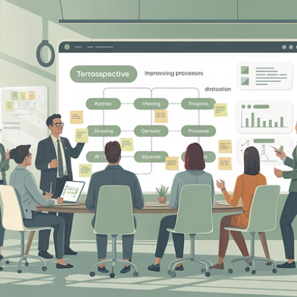
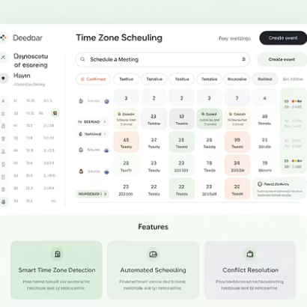


Keys to Long-Term Success
Regular retrospectives help refine your approach. Remain flexible as team composition changes. Remember that connection matters as much as information exchange.

